Slide 1


SMART INDIA HACKATHON 2025
AI-Based Crop Recommendation for Farmers
🌱 Empowering farmers with AI-driven solutions for better yield and sustainability.
Problem Statement –
Problem Statement ID –
SIH25030
Theme: Agriculture, Food Tech & Rural Development
PS Category: Software
Team Name : AGRI INNOVATORS
Team Leader : S. Vidhya
Teammates : R. Zynab Shalima,
A. SriVarshini,
S. Yuvaraj,
M. Vishnu,
P. Sanjai Kumar.

Slide 2

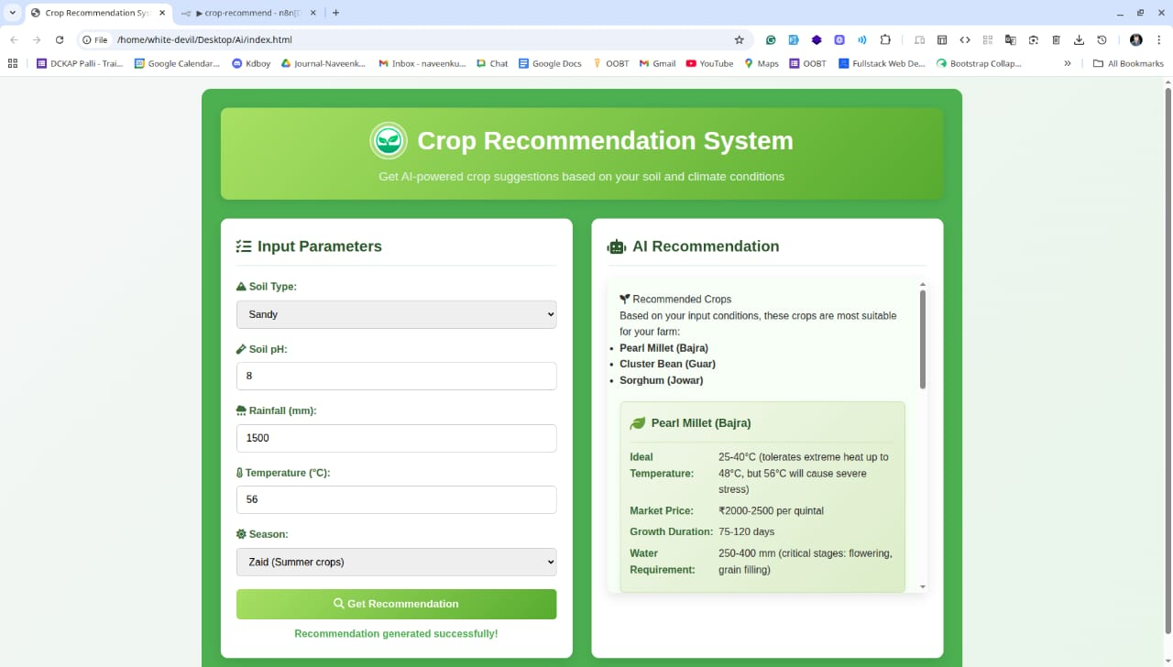


PROPOSED SOLUTION
A Farmer-friendly WEB-APP that takes inputs like: Soil type, Soil pH, Rainfall, Temperature, Season.
Our Web Application that:
Collects farm input data
Uses AI & workflow automation (n8n) for decision-making
Suggests most suitable crops with details (growth duration, market price, water requirement, etc.)
Already Existing Apps:
https://plantix.net/en/
https://www.google.com/?olud
Cropify Web App: https://shalima17.github.io/Cropify/

Slide 3
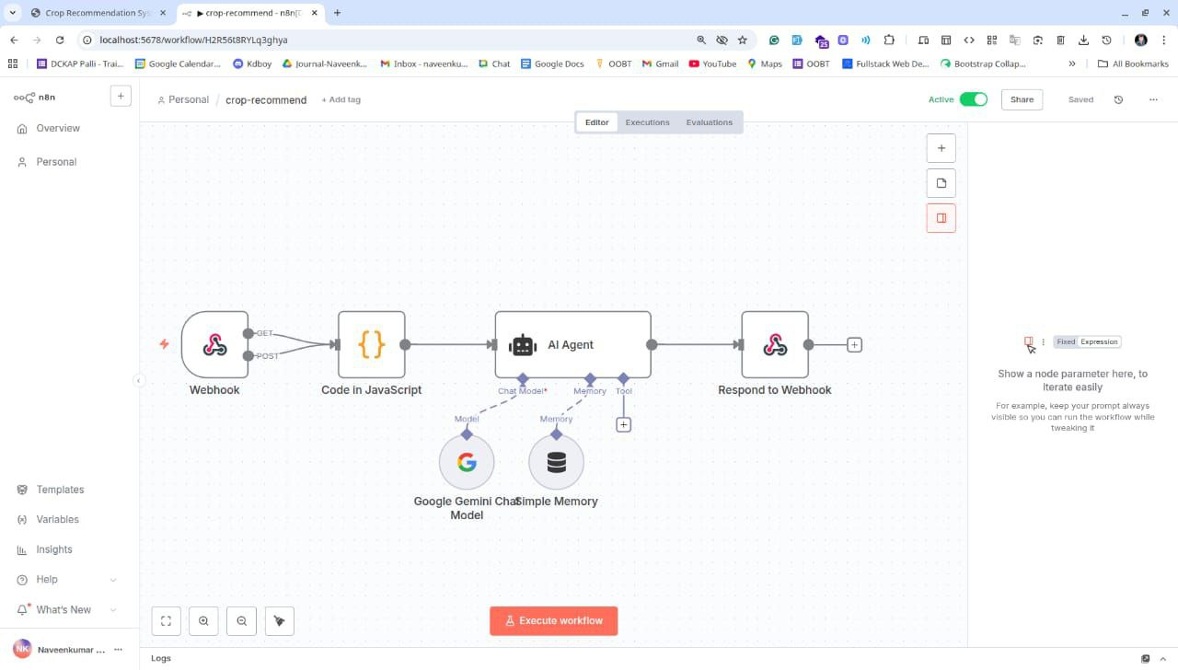
TECHNICAL APPROACH
Technologies Used:
Frontend: HTML, CSS, JavaScript
Workflow: n8n
AI Model: Google Gemini
Database/Memory: Webhooks &
Simple memory
Methodology:
Collect inputs
Process via n8n + JavaScript
AI (Gemini) generates recommendations
Results sent back to web app

Slide 4






FEASIBILITY AND VIABILITY
Feasibility :
Uses lightweight tech → easy to implement
AI model (Gemini) ensures accurate crop recommendations
Scalable workflow → can integrate with sensors & weather APIs
Viability :
Addresses real farmer challenges (crop selection, climate risk)
Improves productivity & income
Low-cost solution, accessible via web/mobile
High potential for government/NGO adoption in rural areas

Slide 5
IMPACT AND BENEFITS
✅ Better Crop Yield – data-driven decisions boost productivity
✅ Reduced Risk – avoid wrong crop choices
✅ Farmer-Friendly – simple and easy-to-use web app
✅ Sustainable Farming – aligns with soil & climate conditions
✅ Scalable Solution – can expand to multiple regions & languages

Slide 6
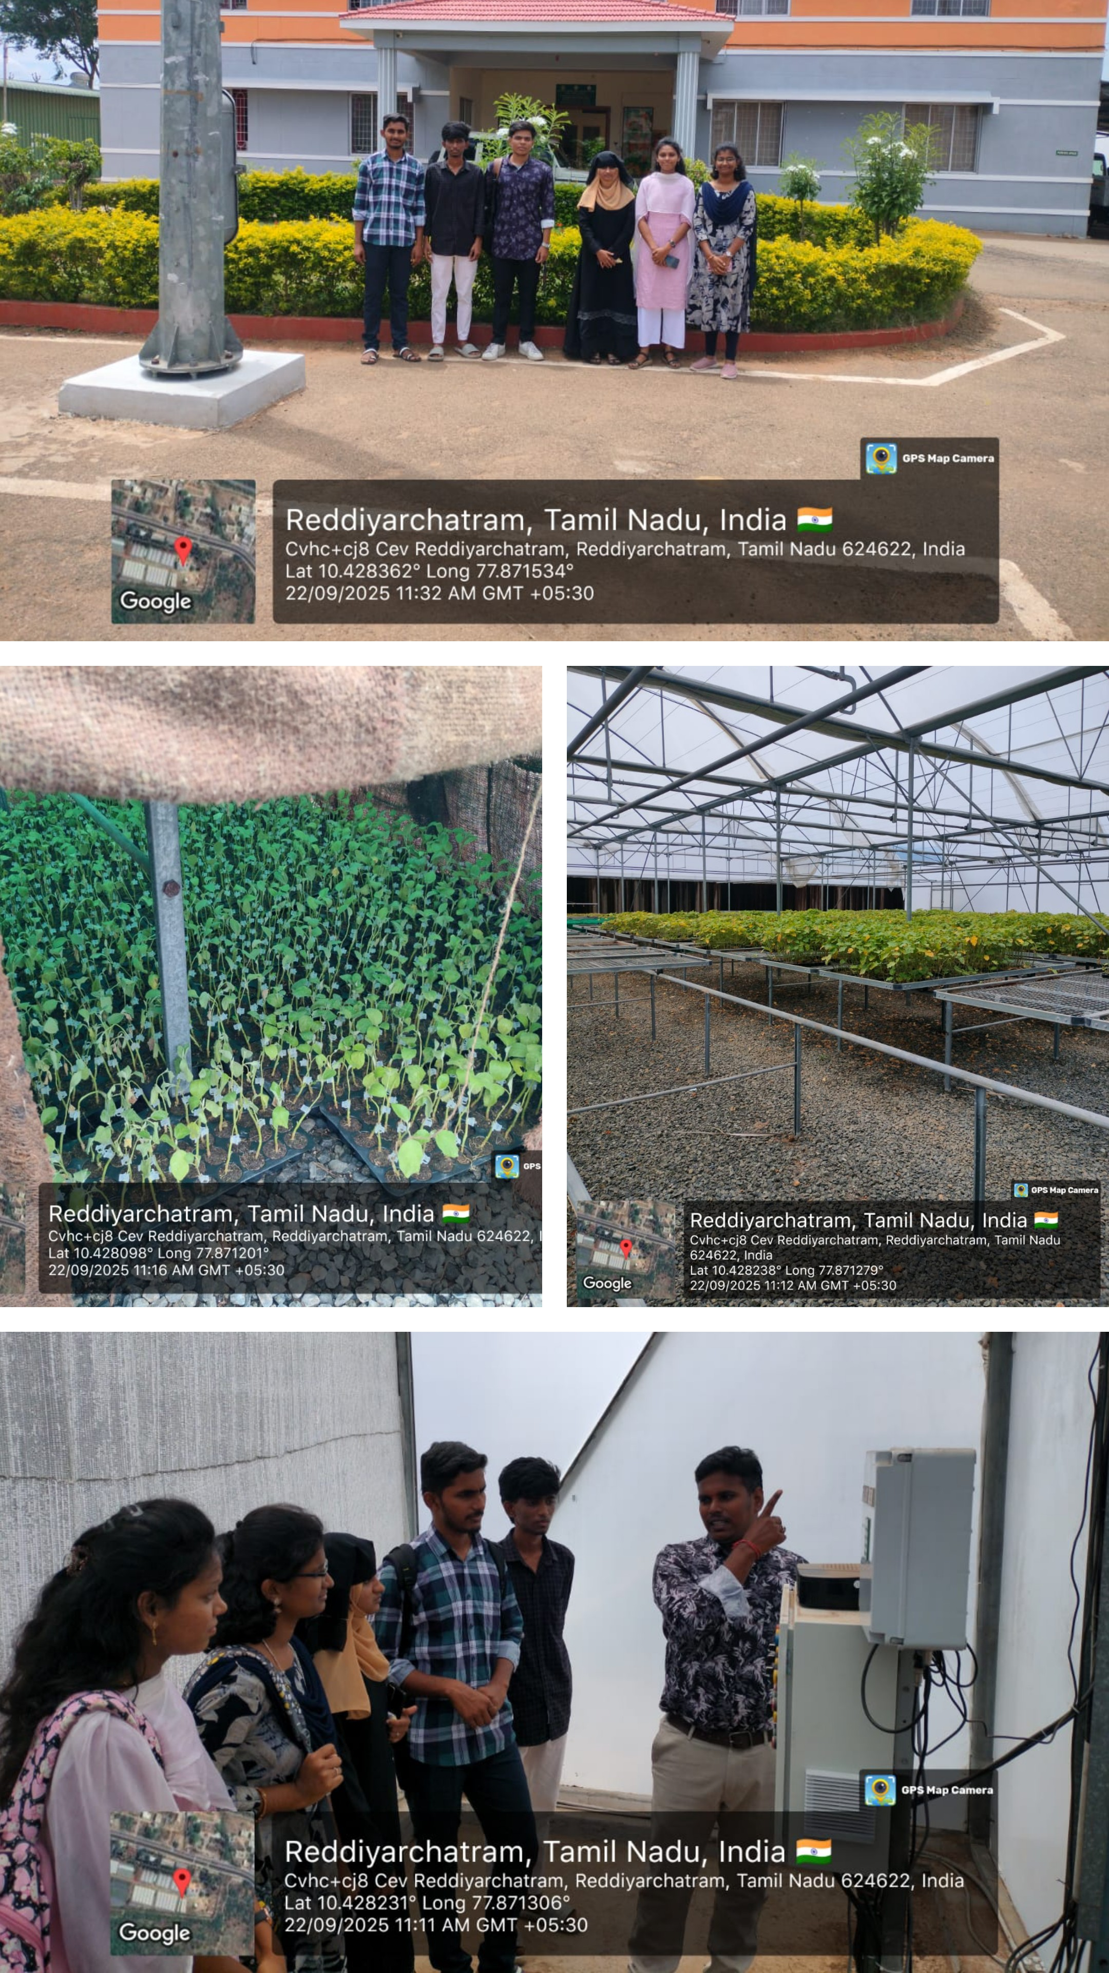
RESEARCH AND REFERENCES
M. S. Ali, B. Rohit, R. Roshith, V. Biradar and M. A. Jabbar, "Crop Prediction & Fertilizer Recommendation using AODE Algorithm," 2024 IEEE 9th International Conference for Convergence in Technology (I2CT), Pune, India, 2024, pp. 1-5, doi: 10.1109/I2CT61223.2024.10543894.
M. Ravindra Kumar, C. Mohan Babu, S. Likhitha, N. Pruthvi, N. Nayana and R. M. Meghana, "An AI-Based Guiding System That Recommends the Optimal Crop Based On the Environment and Soil Type," 2025 International Conference on Knowledge Engineering and Communication Systems (ICKECS), Chickballapur, India, 2025, pp. 1-5, doi: 10.1109/ICKECS65700.2025.11034869.
A. Sharma, M. Bhargava and A. V. Khanna, "AI-Farm: A crop recommendation system," 2021 International Conference on Advances in Computing and Communications (ICACC), Kochi, Kakkanad, India, 2021, pp. 1-7, doi: 10.1109/ICACC-202152719.2021.9708104.
OUR PROTOTYPE:
👉
Visit Cropify Web App

