Slide 1
Amazon Bedrock – What & Why
Fully managed service to access FMs via a single API (Anthropic, Meta, Mistral, Amazon Nova, etc.)
Key capabilities:
Serverless
Guardrails (safety/content filters)
Provisioned & on‑demand throughput
Easy integration with other AWS services

Slide 2
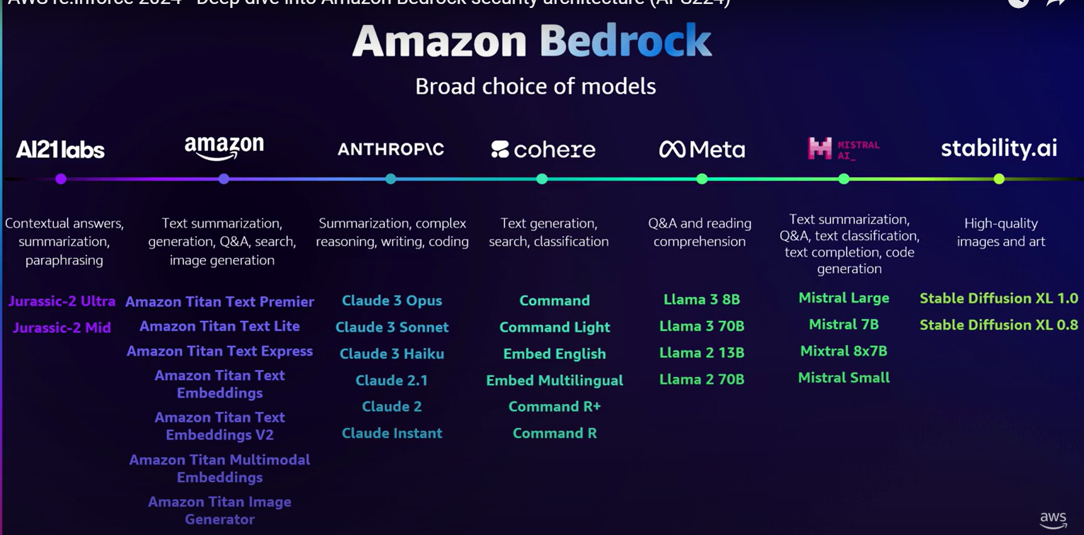
Amazon Bedrock – What & Why

Slide 3
Amazon Bedrock – Sample API
import boto3
client = boto3.client("bedrock-runtime", region_name="us-east-1")
response = client.invoke_model(
modelId="meta.llama2-13b-chat-v1", # Bedrock’s managed LLaMA
body='{"prompt": “Give me the capital of India"}',
contentType="application/json",
accept="application/json"
)
print(response['body'].read().decode("utf-8"))

Slide 4
Amazon Bedrock – What & Why

Slide 5
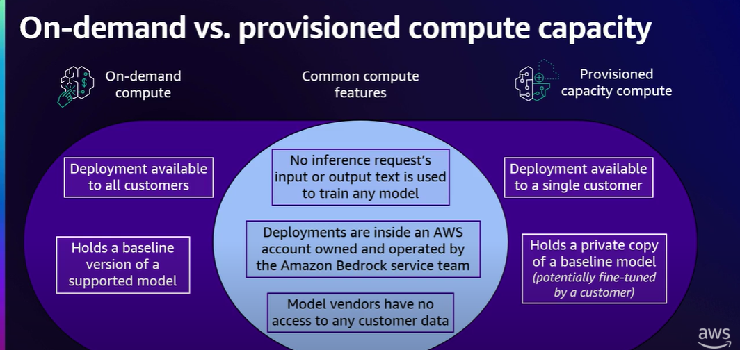
Amazon Bedrock – What & Why

Slide 6
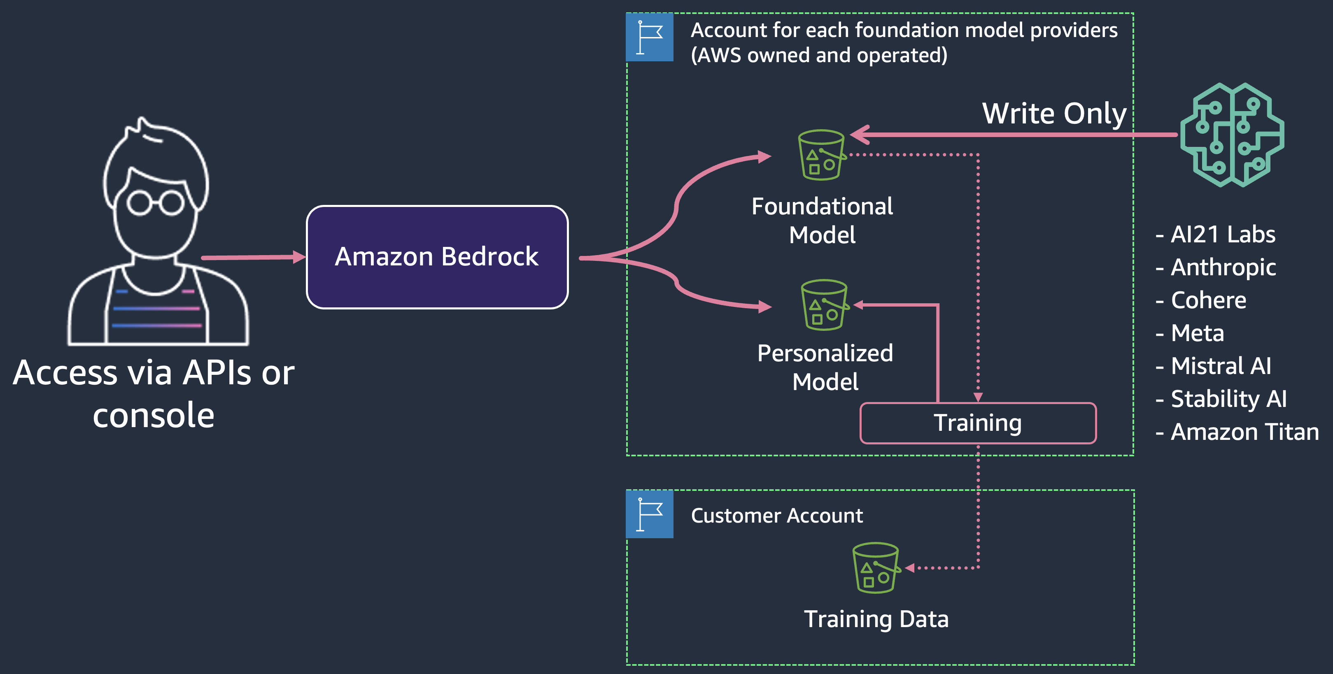
Amazon Bedrock – What & Why
None of the customer's data is used to train the underlying foundation models
All data is encrypted at rest using AWS KMS and encrypted in transit with TLS 1.2 (minimum);
Support for data privacy standards, including GDPR, HIPAA, and PCI

Slide 7
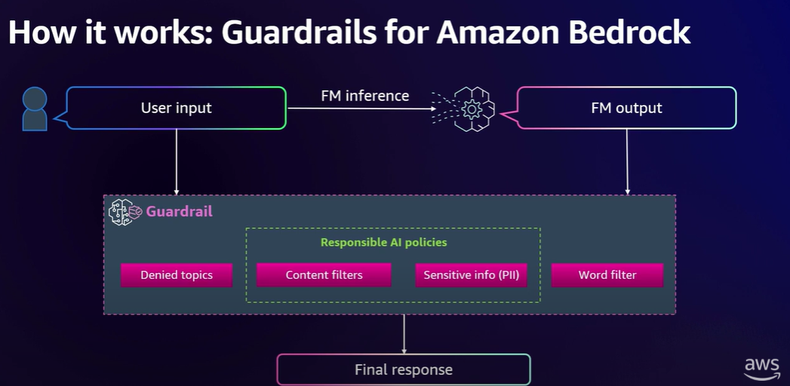
Amazon Bedrock – Guardrails
Denied topics
Content filters
Sensitive info
Word filter

Slide 8
Amazon SageMaker – What & Why
Fully managed ML platform for building, training, and deploying custom models
DevOps-relevant features:
Pay as you use, scalable infrastructure
Model Registry, CI/CD with CodePipeline
CloudWatch metrics/logs; Model Monitor

Slide 9
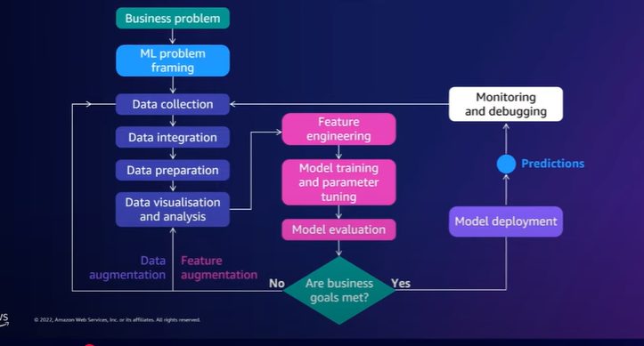
Amazon SageMaker – What & Why
https://github.com/aws/amazon-sagemaker-examples/blob/default/%20%20%20%20%20%20%20%20end_to_end_ml_lifecycle/sm-autopilot_linear_regression_california_housing.ipynb

Slide 10
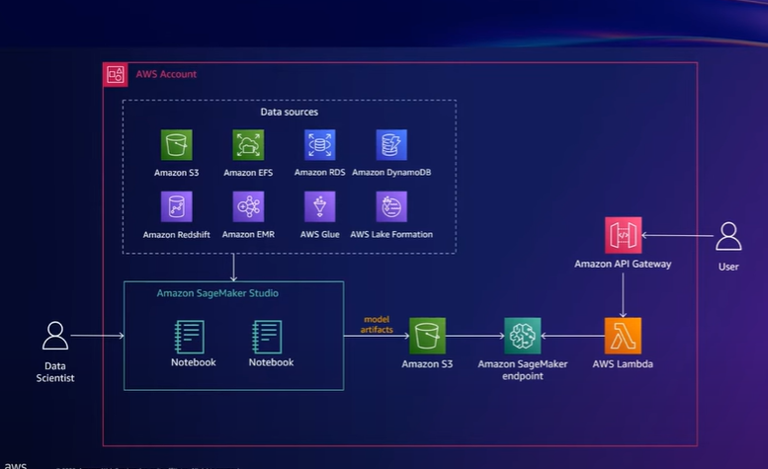
Amazon SageMaker – What & Why

Slide 11
When to choose what?
Bedrock:
Fastest path to GenAI, managed safety, RAG, agents, and multi‑FM access
Great for app teams that don’t want to host/operate models
SageMaker:
Own training/fine‑tuning stack or host OSS/proprietary models
Tight MLOps integration, custom inference graphs, data network locality

