Slide 1

CONTENT BASED IMAGE RETRIEVAL SYSTEM (CBIR)
B S Akash
16311AO5Q5

Slide 2
PRESENTATION OUTLINE
Introduction
Challenges
CBIR Techniques
Advantages of CBIR
Applications of CBIR
Limitations of CBIR
Conclusion

Slide 3
INTRODUCTION
CBIR (Content-Based Image Retrieval) also known as query by image content.
CBIR is the retrieval of images based on visual features such as colour, texture. The aim of CBIR is to avoid the use of textual descriptions.

Slide 4
LIMITATIONS OF TEXT-BASED APPROACH
Problem of image annotation
Large volumes of databases
Problem of human perception
Too much responsibility on the end-user
Problem of Queries that cannot be described at all, but tap into the visual features of images.

Slide 5
CHALLENGES
Semantic gap
The semantic gap is the lack of coincidence between the information that one can extract from the visual data .
User seeks semantic similarity, but the database can only provide similarity by data processing.
Huge amount of objects to search among.

Slide 6
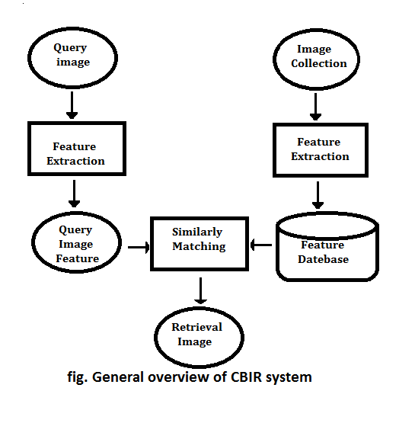
General CBIR system works according to the following schema :

Slide 7
FEATURE EXTRACTION
Color
Local Shape
Texture

Slide 8
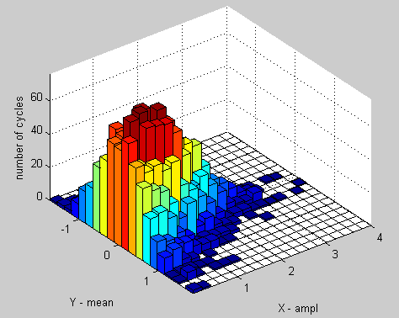
COLOR
Color similarity is achieved by computing a color histogram for each image that identifies the proportion of pixels within an image holding specific values.
It is one of the most widely used techniques because it does not depend on image size or orientation.
Color searches will usually involve comparing color histograms, though this is not the only technique in practice.

Slide 9
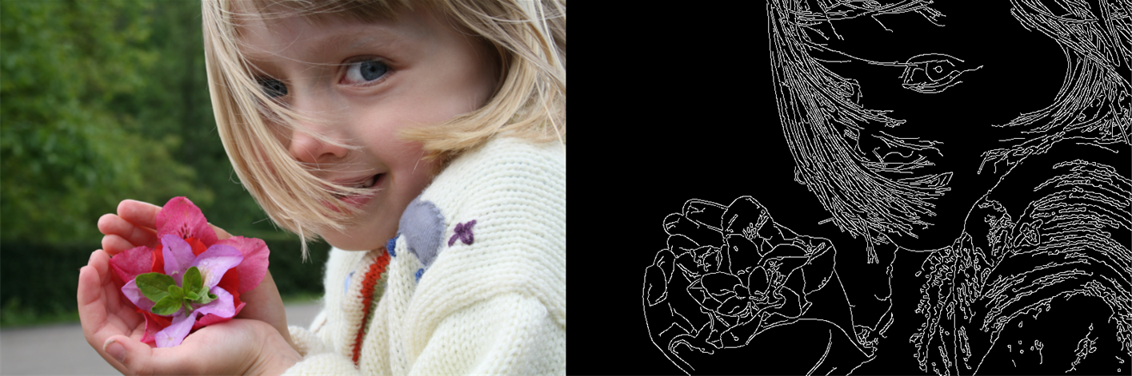
SHAPE
Shape does not refer to the shape of an image but to the shape of a particular region that is being sought out.
Shapes will often be determined first applying segmentation or edge detection to an image.
Other methods like use shape filters to identify given shapes of an image.

Slide 10
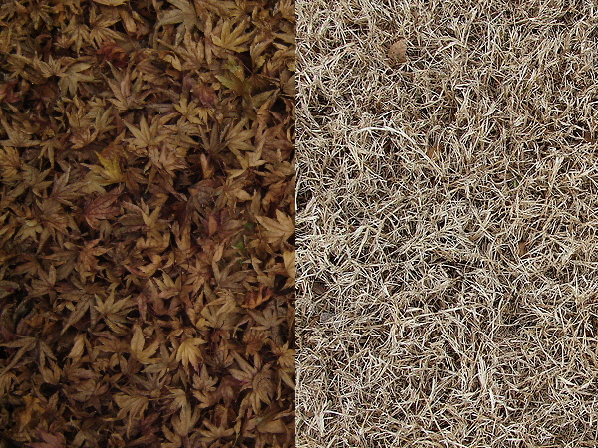
TEXTURE
Texture measures look for visual patterns in images and how they are spatially defined.
These sets not only define the texture, but also where in the image the texture is located.
Texture is a difficult concept to represent.

Slide 11
ADVANTAGES
It avoid the annotation of name with each image.
Visual features of images are extracted automatically.
Similarities of images are based on the distances between features.
It is more efficient than previous technique.

Slide 12
APPLICATIONS OF CBIR
Crime prevention: Automatic face recognition systems, used by police forces.
Security Check: Finger print or retina scanning for access privileges.
Medical Diagnosis: Using CBIR in a medical database of medical images to aid diagnosis by identifying similar past cases.

Slide 13
LIMITATIONS
We do not yet have a universally acceptable algorithmic means of characterizing human vision, more specifically in the context of image understanding.
Hence it is not surprising to see continuing efforts towards it, either building up on prior work or exploring novel directions.

Slide 14
CONCLUSION
CBIR is used to search a specific image from a large database.
CBIR makes interactive search of images from the database.
Until now CBIR is not the most accurate technique for finding desired outcomes.
This technique is still in research state for finding better and accurate output.
At present this technique is implemented by Google.

Slide 15
😉
THANK YOU

