Slide 1
Design Seminar on CONTENT BASED IMAGE RETRIEVAL USING RELEVANT FEEDBACK APPROACH
TEAM
Y.Varshini-16311A05W1
C.Venkatesh Kumar-17315A0549
V.Harsha Vardhan Reddy-16311A05W7
PROJECT COORDINATORS INTERNAL GUIDE
Mr.V.Sateesh Kumar/Ms.J.Neha Mrs.Preethi Jeevan
Assistant Professor Assistant Professor
Department Of CSE Department Of CSE

Slide 2
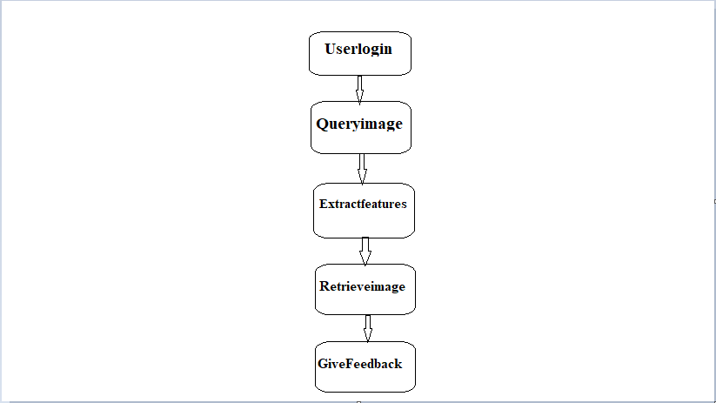
DATAFLOW DIAGRAM

Slide 3
DESCRIPTION
Dataflow diagram is often used as a preliminary step to create an overview of the system without going into great detail, which can later be elaborated.
Here the userlogins through the id and gives the queryimage.
Imagefeatures are extracted and relevant images are displayed.
The feedback is given by the user.

Slide 4
USECASE DIAGRAM

Slide 5
DESCRIPTION OF USECASE
A use case is a list of actions or event steps typically defining the interactions between a role (known in the Unified Modeling Language as an actor) and a system to achieve a goal.
The actor can be a human or other external system.

Slide 6
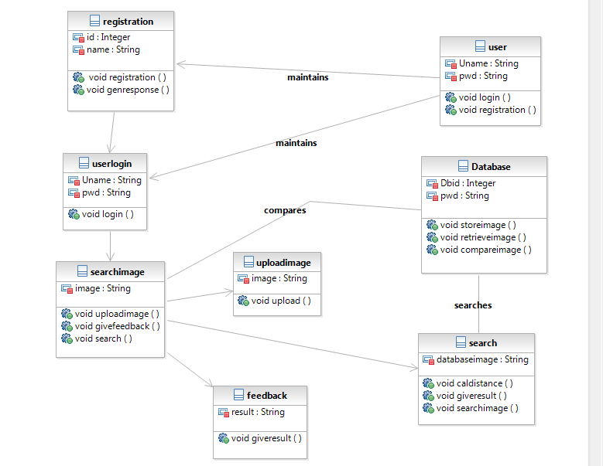
CLASS DIAGRAM

Slide 7
DESCRIPTION OF CLASS DIAGRAM
This class diagram contains the following classes namely:
Registration for the purpose of registering details.
Userlogin for the purpose of login of user.
Database for storing and retriveing images.
Uploadimage to upload the source image.
Searchimage for searching relevant image.
Feedback for the user to give feedback.

Slide 8
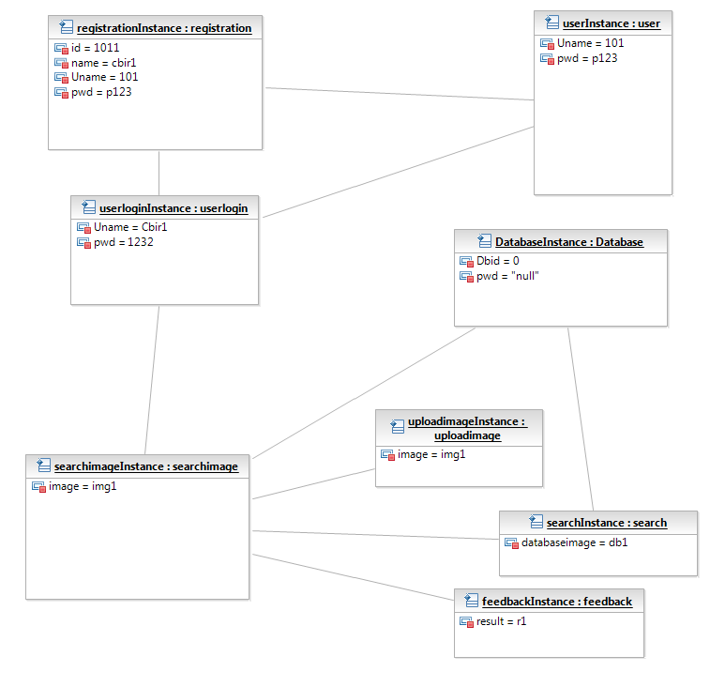
OBJECT DIAGRAM

Slide 9
DESCRIPTION OF OBJECT DIAGRAM
A UML object diagram represents a specific instance of a class diagram at a certain moment in time.
This object diagram contains registrationinstance which contains the values of id,name,uname,pwd.
Userlogininstance which contains details of user like name and password.
Searchimageinstance for displaying the result image.
Uploadimageinstance which contains source image.
Feedbackinstance displays the result.

Slide 10
FUTURESCOPE
This technology has a significant scope for future research.
This technology improves the understanding of various techniques for feature extraction and similarity measurement which aids image retrieval
This advances the state of the art through its contributions.

Slide 11
CONCLUSION
Rapid expansion of digital images in various fields requires an efficient content based image retrieval system for retrieving images that are visually similar to query image.
CBIR in general at present is a research topic.
The technology is exciting but yet to achieve a good degree of maturity.

Slide 12


