Slide 1
Secure data hiding in image using stenography
CAPSTONE PROJECT
Presented By: varshini yeligati
Student Name : varshini yeligeti
College Name & Department : chaitanya institute of technology and science

Slide 2
OUTLINE
Problem Statement
Technology used
Wow factor
End users
Result
Conclusion
Git-hub Link
Future scope

Slide 3
Problem Statement
Design and develop a secure encryption and decryption system that allows users to securely send confidential information over potentially insecure communication channels. The system will implement an encryption algorithm that converts plaintext into ciphertext and a decryption algorithm that restores ciphertext back to its original plaintext.

Slide 4
Technology used
1. Hardware Requirements:
Processor: A multi-core processor (i5 or above for better performance).
RAM: At least 4 GB (8 GB recommended for handling larger encryption tasks).
Storage: Minimal space required (10–20 MB), but enough disk space to store data files or logs (depending on the size of the data being processed).
Network: A stable internet connection if you're using cloud services or external libraries.
2. Software Requirements:
Operating System:
Windows 10 or above, Linux, or macOS.
Programming Environment:
Python: Python 3.x version (recommended to use a virtual environment for managing dependencies).
Python libraries:
Opencv, with python IDE

Slide 5
Wow factors
End-to-End Encryption (E2EE): Ensure that data is encrypted at the sender's end and only decrypted at the receiver's end, making it unreadable to any intermediaries.
Hybrid Encryption Model: Combine symmetric (AES) and asymmetric (RSA) encryption to optimize both security and performance, with RSA handling secure key exchange and AES encrypting the data.
Real-Time Secure Messaging: Create a secure messaging platform where all messages are encrypted in real-time, with integrity checks (e.g., digital signatures) to ensure no tampering.
Zero-Knowledge Proof Authentication: Implement Zero-Knowledge Proofs for user authentication, allowing users to verify their identity without revealing sensitive information like passwords.
Quantum-Resistant Encryption: Future-proof your system by integrating encryption methods that are resistant to quantum computing attacks, ensuring long-term security.

Slide 6
End users
Individuals seeking secure communication for personal data and private messages.
Businesses handling sensitive customer data, requiring robust encryption for transactions and internal communications.
Financial institutions that need to protect sensitive financial transactions and records.
Government agencies that need to secure confidential documents and classified communications.
Developers who integrate encryption into applications or systems to ensure secure user data handling.

Slide 7
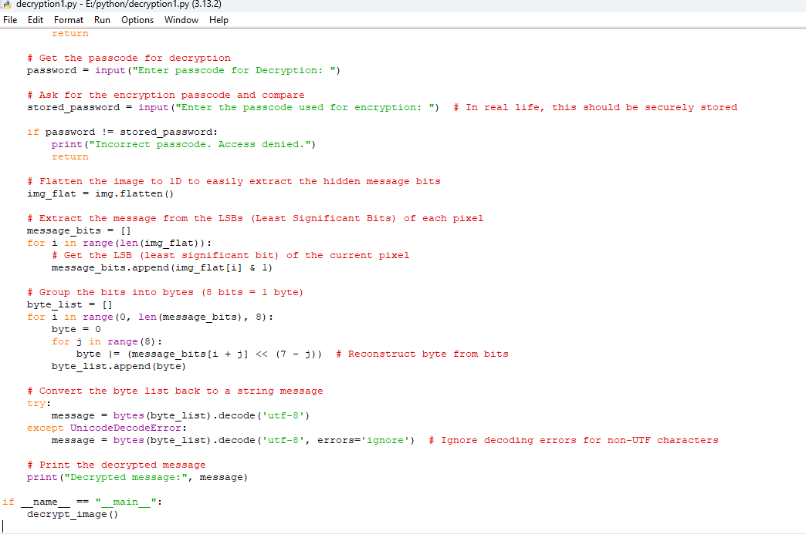
Results

Slide 8
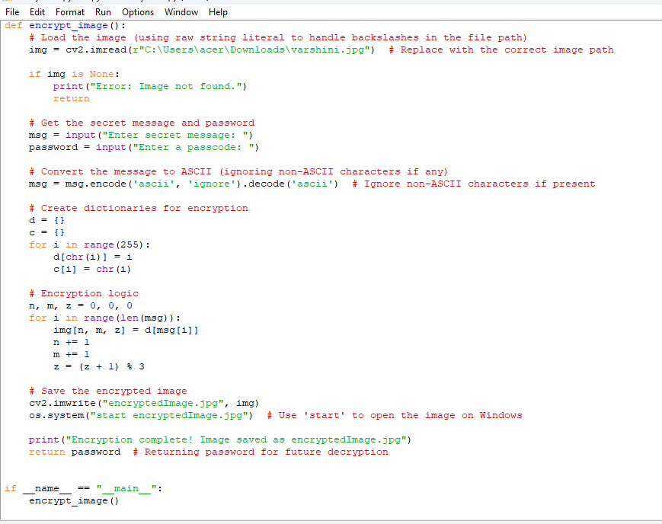
ENCRYPTION CODE

Slide 9
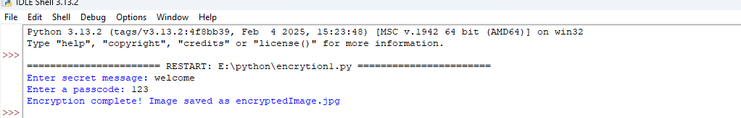
OUTPUT

Slide 10
Conclusion
The encryption and decryption system ensures secure data exchange by combining AES and RSA algorithms for efficient and robust protection. With features like end-to-end encryption and message integrity checks, it guarantees privacy and prevents unauthorized access.
Future-proofed with quantum-resistant encryption, the system is adaptable for individuals, businesses, and government agencies, providing scalable and user-friendly security for modern communication and data storage needs.

Slide 11
GitHub Link
https://github.com/varshiniyeligeti/encryption.git

Slide 12
Future scope(optional)
The future scope of encryption and decryption projects is vast, driven by emerging technologies and the need for stronger data security. One key area is quantum cryptography, where the focus is on developing quantum-resistant algorithms to protect against the threats posed by quantum computing. Additionally, blockchain integration is gaining traction, as it combines encryption with decentralized ledger technology to enhance data integrity and privacy. The use of artificial intelligence and machine learning in encryption systems is also on the rise, aiding in advanced key management and anomaly detection. Moreover, homomorphic encryption allows for computations on encrypted data without needing decryption, which is particularly beneficial for cloud-based services. Lastly, the development of post-quantum cryptography aims to create encryption methods that remain secure even in the age of quantum computers. These advancements will shape the future of secure digital communication and data protection.

Slide 13
THANK YOU

