Slide 1

CSA15 | Cloud Computing and Big Data Analytics
CSA15 Cloud Computing and Big Data Analytics
Presenter Details
Student Name:K.Varshini
Register Number:192472358
Class / Section / Slot:B
Capstone Title:SkillHire: AI Resume Screening and Job-Fit Android App
Selected SDG Goal(s):SDG 8 – Decent Work and Economic Growth
SDG 9 – Industry, Innovation and Infrastructure
Cloud Platform / Tools:Firebase,Google Cloud,PythonFlask API,
Android Studio
Capstone Cloud Technical Presentation
Individual Student Presentation Deck
Presentation Focus
Present your capstone as a cloud-backed product. Explain the problem, architecture, service choices, evidence, and CO1 learning clearly.
Individual student submission template | Department of Computer Science and Engineering
CO1 AT3 | 01
Notes:
Open by naming the capstone problem and the cloud product objective. Keep the title slide uncluttered and clearly identify the individual presenter.

Slide 2
CSA15 | Cloud Computing and Big Data Analytics
Problem Context and Stakeholder Mapping
Our capstone begins with a real problem to solve
Problem Statement
Target Users
Students
Freshers
Recruiters
HR Managers
Many job seekers submit resumes that do not match job requirements, while recruiters spend significant time manually reviewing resumes.
SDG Fit
Product Boundary
Supports SDG 8 by improving employment opportunities through AI.
Version 1 includes:
Resume upload
AI resume analysis
Job matching
Recruiter dashboard
Individual student submission template | Department of Computer Science and Engineering
CO1 AT3 | 02
Notes:
Do not start with technology. First make the need clear, then connect it to cloud-enabled scale, reach, or reliability.

Slide 3
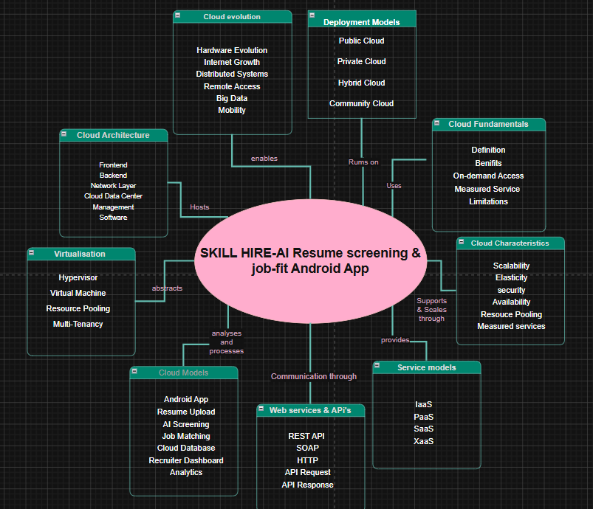
CSA15 | Cloud Computing and Big Data Analytics
Cloud Adoption Rationale and Concept Map
The problem needs cloud support to become a usable product
Cloud Definition
Cloud Concept Map
Cloud computing allows SkillHire to store resumes, process AI predictions, and deliver services online without maintaining physical servers.
Cloud Characteristics
Elasticity, scalability, measured service, resource pooling,On-Demand Access.
Individual student submission template | Department of Computer Science and Engineering
CO1 AT3 | 03
Notes:
Students should explain the concept map as a reasoning artifact, not as decoration.

Slide 4
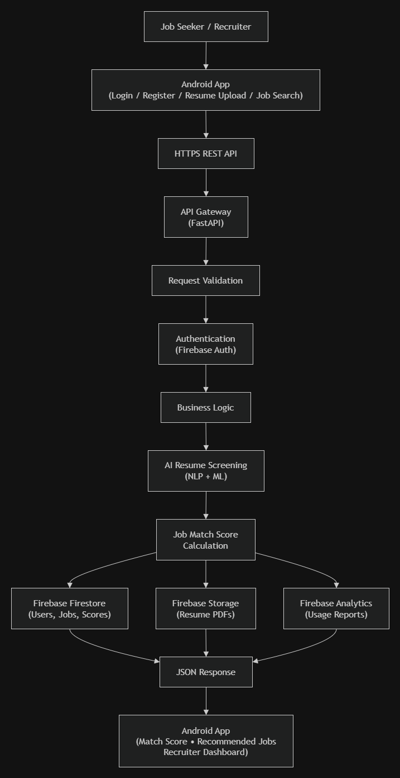
CSA15 | Cloud Computing and Big Data Analytics
Capstone Cloud Architecture
Our cloud architecture connects the user action to services
Presentation Points
API handles communication
Python predicts job match
Firebase stores resumes
Cloud Storage stores PDF files
Monitoring tracks system usage
Individual student submission template | Department of Computer Science and Engineering
CO1 AT3 | 04
Notes:
Walk from user request to API, compute, data, storage, analytics, monitoring, and security boundary.

Slide 5
CSA15 | Cloud Computing and Big Data Analytics
Cloud Service Model Responsibility Matrix
Each service model defines what we control and what cloud manages
Service area
Model
Provider manages
Student team manages
Why this fits
PaaS
Hosting
UI Design
Easy deployment
Frontend hosting
PaaS
Runtime
Flask Code
Less maintenance
Backend/API
DBaaS
Backup
Data Structure
Reliable storage
Secure access
Database
SaaS
Files
Upload Logic
Secure documents
Storage
SaaS
Logs
Performance
Detect issues
Monitoring / logs
IAM
Authentication
User Roles
Secure Access
Security / IAM
Individual student submission template | Department of Computer Science and Engineering
CO1 AT3 | 05
Notes:
Ask the student to defend provider responsibility and student responsibility for the selected service models.

Slide 6
CSA15 | Cloud Computing and Big Data Analytics
Data Flow and Analytics Pipeline
The product data moves from user activity to useful insight
Resume Analysis
Job Matching Result
Dashboard
User Uploads Resume
Resume PDF
Cloud Storage
Python AI
Database
Data Requirements
Analytics Requirement
Proof Required
User data, events, logs, files, Resume PDF
User Profile,Job Description.
Dashboard,Match Score,Skill Gap
Recommended Jobs .
Input:
Resume
Output:
85% Match Score
Insight:
Python recommended Data Analyst role.
Individual student submission template | Department of Computer Science and Engineering
CO1 AT3 | 06
Notes:
Big data analytics is optional, but a thoughtful data path is expected.

Slide 7
CSA15 | Cloud Computing and Big Data Analytics
Python / AI Module Integration
Python or AI adds intelligence where the product needs it
Python Role
Input and Output
Uses NLP and Machine Learning to compare resumes with job descriptions.
Input:
Resume PDF
Skills
Experience
Output:
Match Score
Recommended Jobs
Execution Point
Product Value
API endpoint, serverless function, container, notebook, or scheduled job,Flask REST API.
Faster screening
Better accuracy
Reduced HR workload
Individual student submission template | Department of Computer Science and Engineering
CO1 AT3 | 07
Notes:
If AI is not required, students can present a Python automation or analytics module instead.

Slide 8
CSA15 | Cloud Computing and Big Data Analytics
Security, Scalability, Privacy and Cost Design
Security, scale, privacy and cost shape the final design
Security
Privacy
Firebase Authentication, Login roles,Input validation,Role-based Access, audit trail.
Encrypted Resume Storage,Restricted Access
User Consent
Scalability
Cost Awareness
Cloud automatically supports increasing users.
Uses Firebase Free Tier., managed services, storage/API usage limits.
Individual student submission template | Department of Computer Science and Engineering
CO1 AT3 | 08
Notes:
This slide is where students show engineering judgment instead of simply listing services.

Slide 9
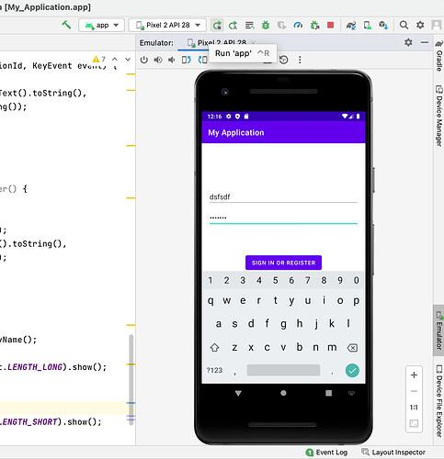
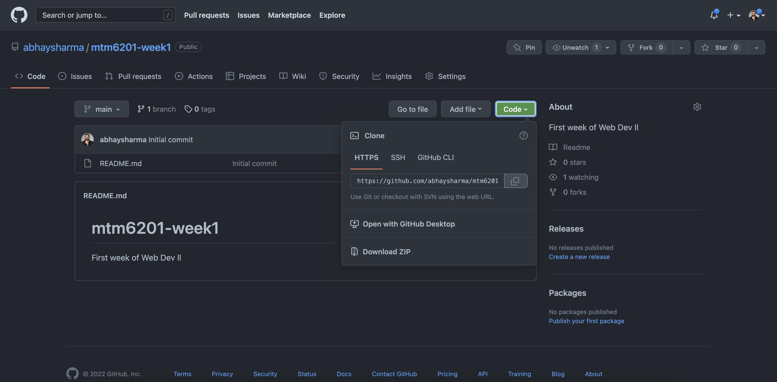
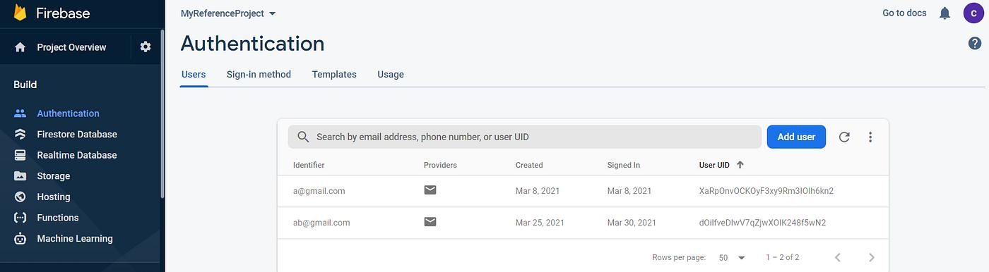
CSA15 | Cloud Computing and Big Data Analytics
Implementation Stack and Deployment Evidence
Our implementation stack shows how the design will be built
Mobile / Web Layer
Cloud Services
Android, iOS, Flutter, React, or web frontend.
Firebase Authentication
Firestore
Cloud Storage
Flask API
Evidence
Version Control
Repository structure, commits, branches, and README clarity.
Individual student submission template | Department of Computer Science and Engineering
CO1 AT3 | 09
Notes:
Evidence should be specific and inspectable, not a generic list of tools.

Slide 10
CSA15 | Cloud Computing and Big Data Analytics
Demo Storyboard and User Journey
A complete user journey proves the product flow
Scene 1
Scene 2
Scene 3
The user (student or recruiter) opens the SkillHire app and logs in using Firebase Authentication.
After login, the user reaches the dashboard and selects Upload Resume.
The user uploads a PDF resume. The file is securely stored in Firebase Cloud Storage.
Scene 4
Scene 5
Scene 6
The Flask API sends the resume to the Python AI model, which extracts skills, education, and experience and compares them with job requirements.
The AI generates a job match score (e.g., 85%) and recommends suitable job roles along with missing skills.
Recruiters can view candidate profiles, match scores, and shortlisted applicants for further recruitment.
Individual student submission template | Department of Computer Science and Engineering
CO1 AT3 | 10
Notes:
A storyboard helps the faculty see whether the cloud architecture is connected to actual use.

Slide 11
CSA15 | Cloud Computing and Big Data Analytics
Evaluation Readiness Checklist
Our evidence confirms that the presentation is ready
✅
Cloud ecosystem and service model explained
✅
Elasticity and scalability decisions are visible
✅
REST/SOAP/API role connected to capstone
✅
GitHub and cloud evidence are inspectable
✅
Architecture has compute, data, storage, security, monitoring
✅
References and integrity statement are included
Evaluator Focus
CO1 is verified through cloud design reasoning, service choices, evidence, and individual explanation.
Individual student submission template | Department of Computer Science and Engineering
CO1 AT3 | 11
Notes:
Students can use this as the self-check slide before presenting the conclusion.

Slide 12
CSA15 | Cloud Computing and Big Data Analytics
Conclusion, Limitations and Future Scope
We close with learning, limitations and next steps
Learning Outcome
Limitations
Learned Cloud Computing concepts
Used Firebase
Built REST API
Integrated AI with cloud
Limited dataset
Supports only PDF resumes
Basic recommendation engine
Future Improvement
Integrity Statement
Interview scheduling
Multiple languages
Advanced AI recommendations
Company dashboard
Project developed for academic purposes using Python, Firebase, Android Studio, GitHub, and AI-assisted documentation where acknowledged
Individual student submission template | Department of Computer Science and Engineering
CO1 AT3 | 12
Notes:
The ending should synthesize learning, not just say thank you.

