Slide 1


SMART INDIA HACKATHON 2025
Problem Statement ID – 25034
Problem Statement Title - AI-Based Internship Recommendation Engine for PM Internship Scheme
Theme - Open Innovation
PS Category- Software
Team ID-
Team Name (Registered on portal)

Slide 2
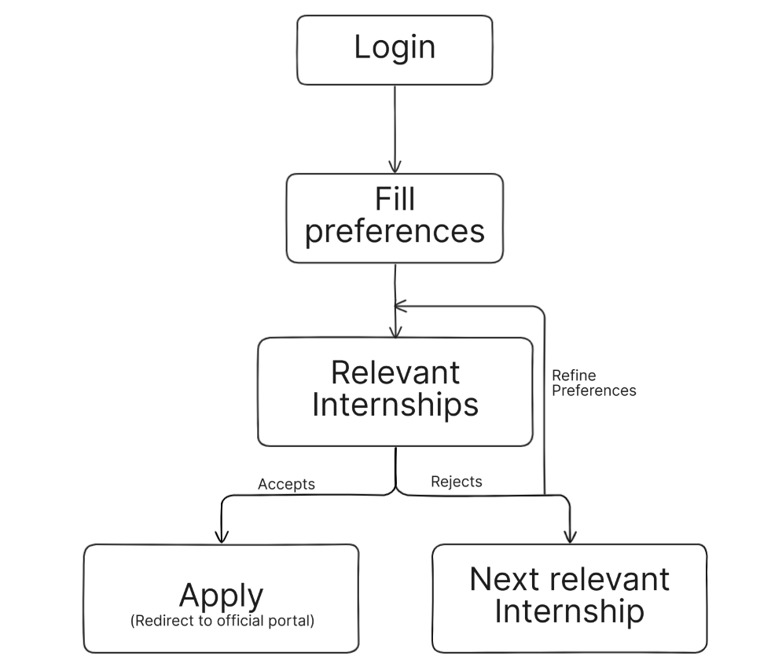
IDEA TITLE
Your Team Name
Proposed Solution
A web application that provides instant, personalized internship recommendations using rule-based approach to youth even with low digital literacy
How it addresses the problem:
Replaces overwhelming lists with 3-5 highly relevant suggestions.
A simple, visual UI
Multi-language support
Innovation and Uniqueness:
Hyper-Simplicity
Empathy-Driven Design
Pre-qualification

Slide 3




TECHNICAL APPROACH
Your Team Name

Slide 4
FEASIBILITY AND VIABILITY
Your Team Name
Analysis of the feasibility of the idea
Built on the popular and well-documented MERN stack
Component-based nature of React allows for efficient parallel teamwork
Rule-based AI is computationally lightweight
Requires no specialized hardware
Potential challenges | Strategies
Low Digital Literacy of Users | Use visual-first design (icons, step-by-step flow)
Limited Technical Infrastructure | Build a lightweight web app
Overwhelming or Irrelevant Recommendations | Limit to 8-10 curated suggestions per user.
Language and Cultural Barriers | Support multilingual UI

Slide 5
IMPACT AND BENEFITS
Your Team Name
Potential impact on the target audience
Easily operable for digital-illiterates
Empowers youth from rural communities
Saves significant time and effort for candidates
Increases the quality and relevance of applications submitted
Directly reduces the urban-rural employment opportunity gap.
Benefits of the solution (social, economic, environmental, etc.)
Social : Promotes digital inclusivity and provides equitable access for first-generation learners.
Economic : Creates a clear pathway from education to employment, contributing to rural economic development
Administrative : Helps the portal by guiding users to the most suitable internships, improving match quality

Slide 6
RESEARCH AND REFERENCES
Your Team Name
Details / Links of the reference and research work
PM Internship Scheme - Official Portal (pminternship.mca.gov.in)

