Slide 1
AI EXCEL ANALYTICS REPORT
Executive Dashboard
14 July 2026
Generated using AI Excel Analytics & Report Generator

Slide 2
Executive Dashboard
ROWS
298
COLUMNS
6
MISSING
0
DUPLICATES
0
SCORE
100.0/100
Executive Summary
• Dataset contains 298 records.
• Dataset has 6 columns.
• Missing Values : 0
• Duplicate Rows : 0
• Overall Dataset Score : 100.0/100
Recommendations
✓ Dataset quality is good.

Slide 3
Dataset Overview
Metric | Value
Rows | 298
Columns | 6
Missing Values | 0
Duplicate Rows | 0
Numeric Columns | 1
Categorical Columns | 5
Column Names | 6
Columns
• Sl no
• Name
• USN Number
• Mail ID
• Branch
• Company applied for
Data Quality
Overall Quality : Excellent

Slide 4
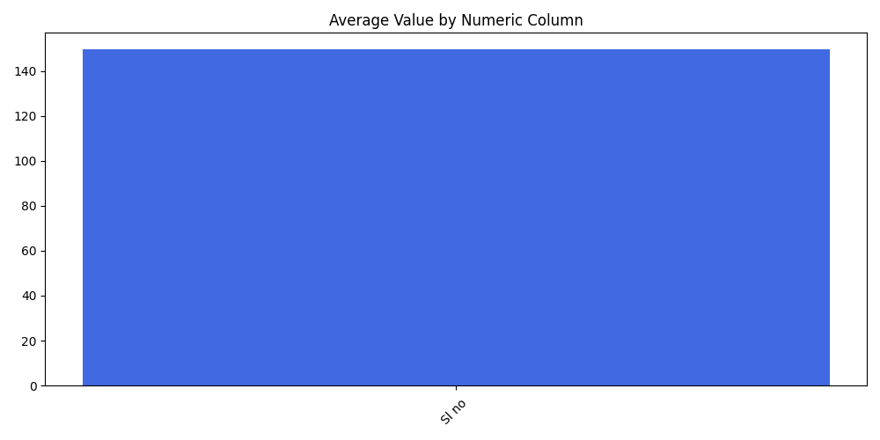
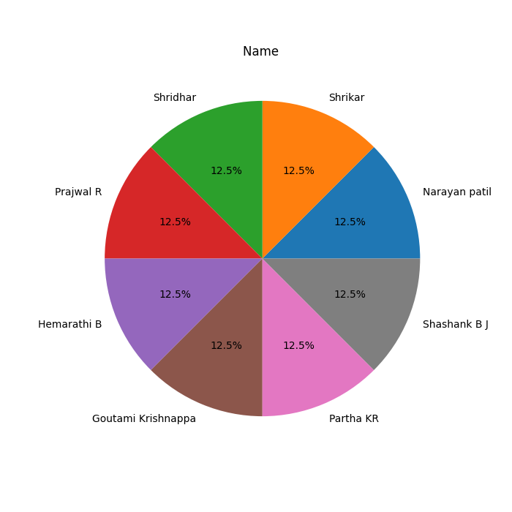
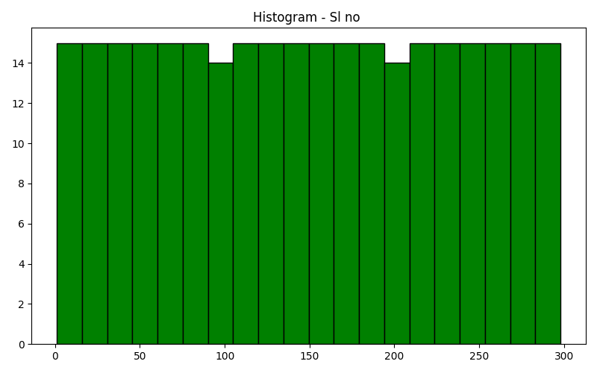
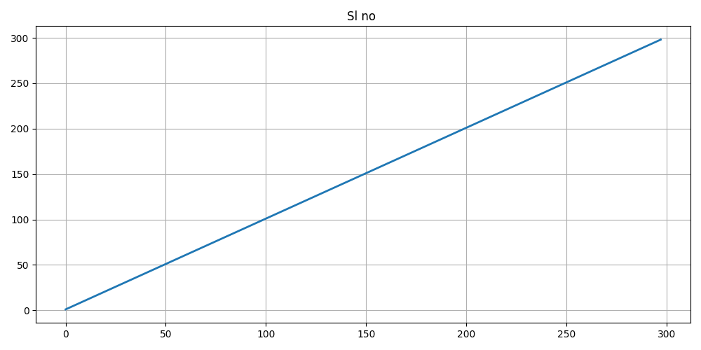
Data Visualization
Bar Chart
Pie Chart
Histogram Chart
Line Chart

Slide 5
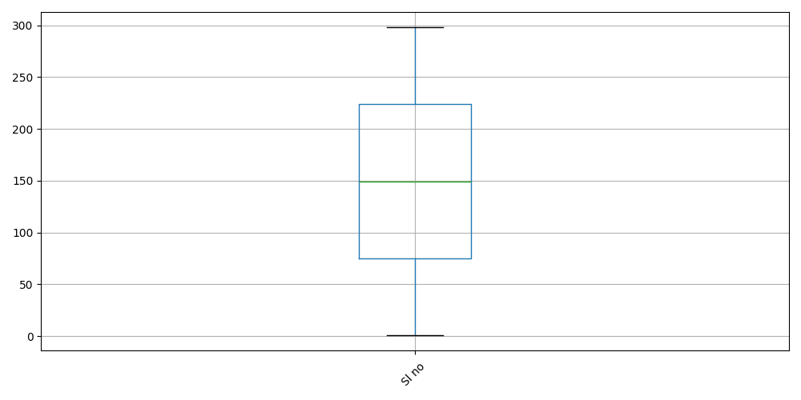
Box Plot Analysis
The box plot highlights the spread, median and potential outliers within the numeric columns.

Slide 6
AI Executive Insights
AI Insights
• The dataset contains 298 records.
• A total of 6 columns were detected.
• There are 1 numeric columns.
• There are 5 categorical columns.
• No missing values were detected.
• No duplicate records were detected.
DATA SCORE
100.0/100
Risk Analysis
⚠ No major risks detected.
Recommendations
✓ Dataset quality is good.
AI-generated insights based on dataset quality, missing values, duplicate records and statistical analysis.

Slide 7
Executive Recommendations
Recommended Actions
✓ Dataset quality is good.
Best Practices
• Validate data before analysis.
• Handle missing values carefully.
• Remove duplicate records.
• Maintain consistent column names.
• Review data quality regularly.
• Generate dashboards for business users.
Following these recommendations will improve data quality and analytics accuracy.

Slide 8
THANK YOU
AI Excel Analytics & Report Generator
Generated Automatically using Python
Generated on 14 July 2026

