Slide 1
Predicting Stock Price Direction
Minor project second progress Report.
-Veeramaneni Varshith
159103095
CCE-6B

Slide 2
Introduction
The outline
Project Description
Work Status
Problems Encountered
Conclusion

Slide 3
Project Description
Stock Market or Share Market is a place where the companies sell their shares to gather financial assistance.
There are millions of people who are investing the billions of rupees expecting for the profits.
the highly volatile and time varying nature makes it complicated to take right decisions at right time.
To overcome this issue many of the researchers coming up the models that could predict the direction of the stock market.

Slide 4
Project Scope
Stock market prediction makes it easy for the investors to make the right decisions at right time.
The economy of the country directly depends upon the Stock Market.
If there is a model that could predict the direction of the stock market could prevent the economic crisis from happening like the 2008 which effects economy till today.

Slide 5
Work phases
The work phases of this project is
Literature review
Collection of data
Building the model
Training the model
Making the trained algorithm into working model

Slide 6
Work status before first presentation
Acquiring required knowledge
Literature review
Collecting data

Slide 7
Work Status
Predicting in any field is a tedious task. The highly volatile and time varying nature of the stock market makes it more complicated.
Stock market is analyzed in two basic methods
Fundamental Analysis
Technical Analysis
Fundamental analysis of the stock is analyzing the financial statement, valuation and the qualitative factors.
Fundamental analysis deals with the news and the sentiment of the stock.

Slide 8
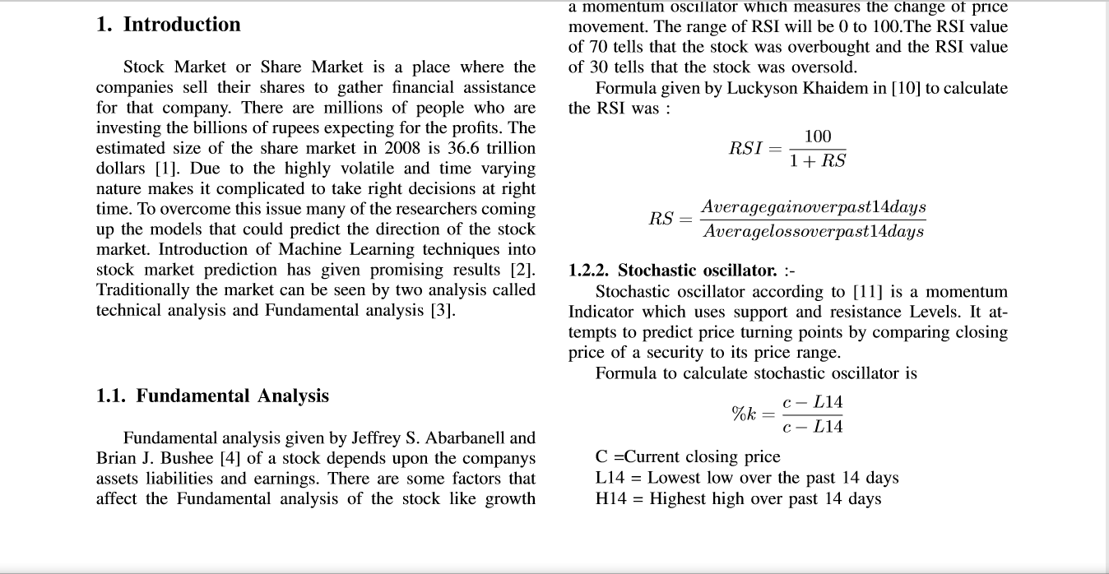
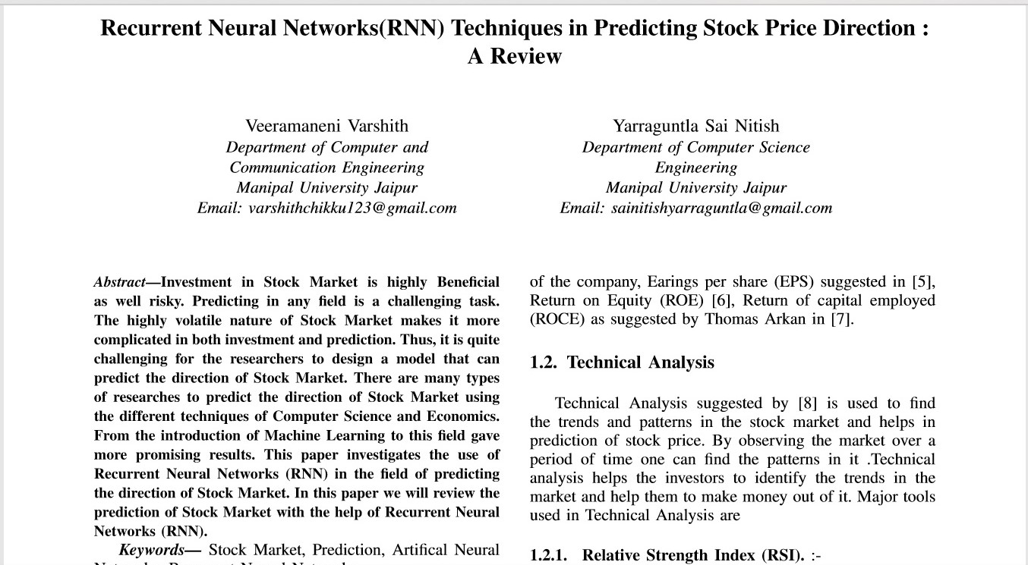
Snapshot of my paper

Slide 9
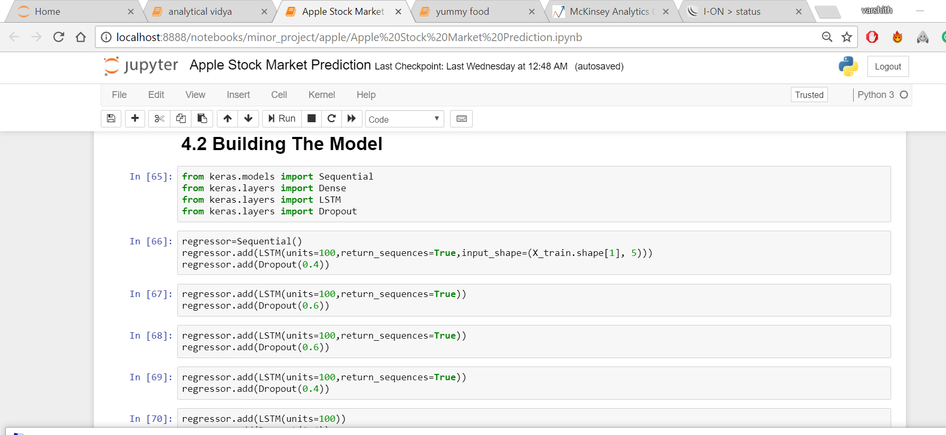
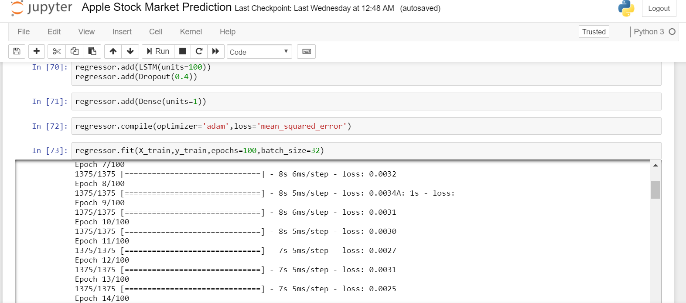
Snapshot of built rnn lstm model

Slide 10
Work status
the concepts of Machine learning and Deep learning will be used to predict the direction of the stock market
Research's suggest that the use of the deep learning concepts like Recurrent Neural Networks (RNN) combined with the Long Short Term memory cell (LSTM) gives the better results.
The unique nature of the LSTM cell produces the better results compared any other ML or DL algorithms

Slide 11
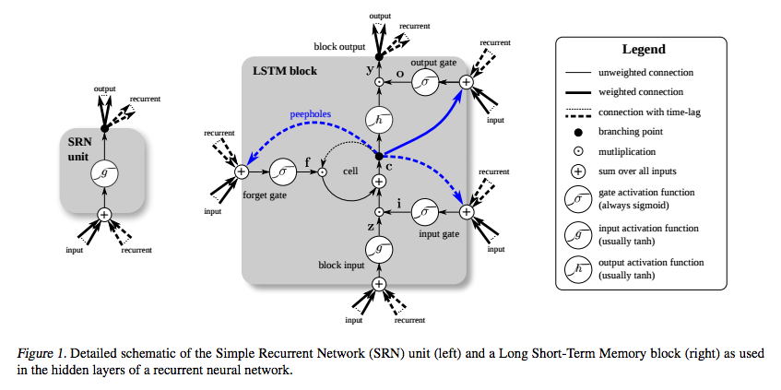
LSTM

Slide 12
Work Progress
The RNN and LSTM will be trained with All the factors that effects the stock market.
There are more than the technical analysis and the fundamental analysis to be considered like the
Stability of the government
Analyst opinion
Sentiment of the market
Performance of the Substitutes
Statements of the higher officials of the government

Slide 13
Work Progress
All the above mentioned factors effects the stock market directly or indirectly.
Along with the technical and fundamental analysis all the above mentioned factors are trained with the model.
Using the Principle Components Analysis all the useless and comparatively less useful factors are removed from the model.
The final goal is to get the good accuracy irrespective of the factors we have used.

Slide 14
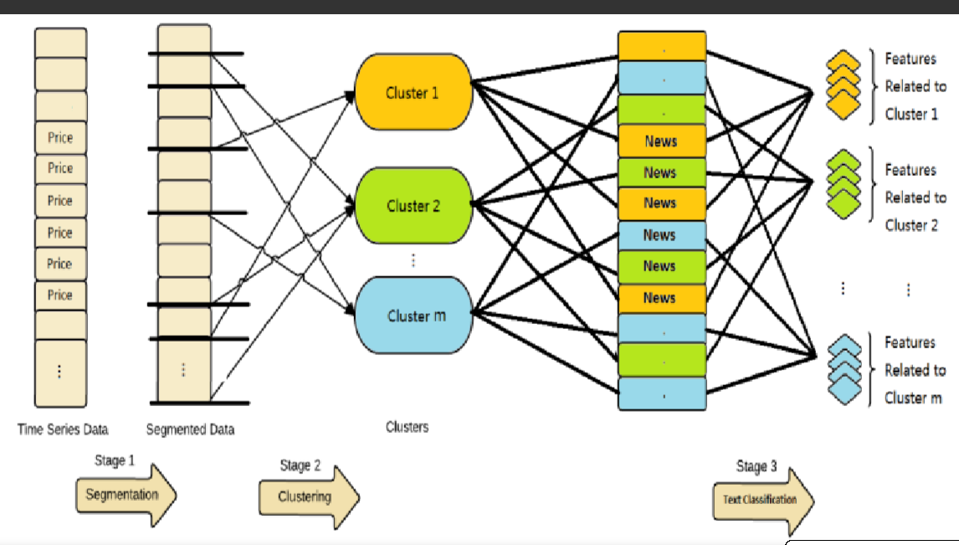
Proposed Model

Slide 15
Tools used
Programming Language: Python
Machine learning: Scikit learn
Deep learning: Keras and tensor flow
Natural language processing: nltk toolkit

Slide 16
Problems Encountered
The main problem is the availability of the data for the Indian Stock Market.
Clustering the Fundamental and the Technical analysis along with all the useful factors of the stock (which may cause the overfitting).

Slide 17
Conclusion
The accuracy of the stock market prediction depends upon clustering the factors that it depends on.
Combining both Technical and fundamental analysis gives the better results.
RNN along with the LSTM gives the better results and the accuracy increases on increase in the time lapse.

Slide 18
references
World Equity Market Declines: -$25.9 Trillion, http://seekingalpha.com/article/99256-world-equity-market-declines-259trillion
Inage: https://deeplearning4j.org/lstm.html
Screen-short: Identifying and Predicting Market Reactions to Information Shocks in Commodity Markets, CS229 Project Report, Fall 2014
References of the literature review were not added here (review paper).

Slide 19
Thank you
.

