Slide 1
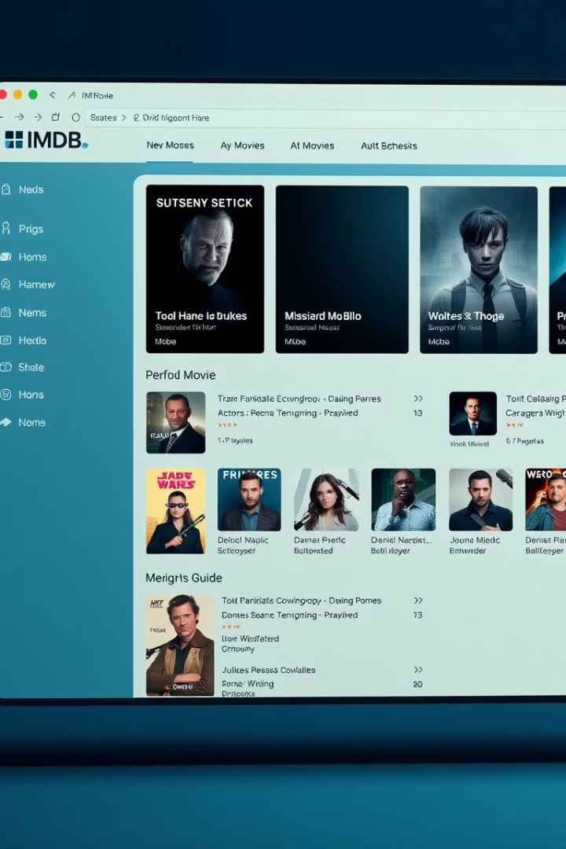
Advanced SQL Project: Analyzing the IMDB Dataset
PATNAMSHETTY VARSHITH
MARCH DADS ONLINE

Slide 2
Introduction to the IMDB Dataset
Dataset Overview
Use Cases
Includes movies, actors, directors, and ratings.
Supports data analysis, trend identification, recommendation engines.
Example Query
Find top-rated movies within a specific genre, Top 10 movies ,different genre movies

Slide 3
Data Exploration and Schema:
Tables:
Data Types & Integrity
Movies
VARCHAR, INTEGER, DATE, BOOLEAN
Genres
Primary and foreign keys ensure table linkage
Names
NULL handling and data cleaning strategies
Role Mapping
Director Mapping

Slide 4
SQL Concepts:
JOINS : It is used to combine rows from two or more tables
WITH CLAUSE: Used when you need to create one or more temporary tables that can be referenced throughout a query.
UNION ALL: Used to combine the result-set of two or more SELECT statements.
SUB QUERIES: To create more complex queries by using the results of one query within another.
LIMIT: It is used to specify the number of records to return.

Slide 5
HIGHLIGHTS:
Movies which contains highest ratings are tend to perform good in the market
The total movies produced in the year of 2019 in USA and INDIA is 1059
The highest genre movie containing in the dataset consists of 3289 movies
The total number of highest produced genre is "Drama"-4285 movies
Mammootty and Mohanlal are the only two actors contains median rating

Slide 6
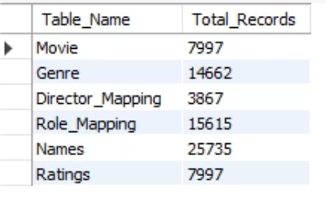
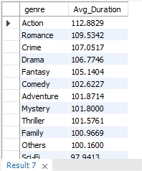
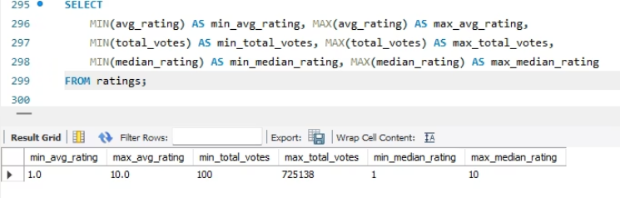
screenshots:
Q1:Count the total number of records in each table of the database.
Q7:Calculate the average movie duration for each genre.
Q9:Find the minimum and maximum values for each column in the ratings table, excluding the movie_id column.

Slide 7








Data Analysis: Trends and Insights
Top Genres
Directors
Analyze genre popularity shifting over decades.
Identify those with consistent high ratings.
Time Trends
Actors
Detect movie release patterns over time.
Find those with highest box office revenues.

Slide 8
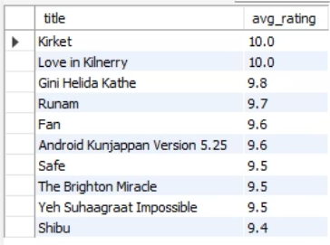
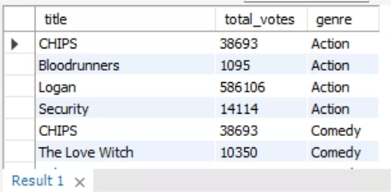
SCREENSHOTS:
Q12.How many movies, released in March 2017 in the USA within a specific genre, had more than 1,000 votes?
Q10.Which are the top 10 movies based on their average rating

Slide 9
Conclusion :
Learned advanced SQL queries, performance tuning, and analysis techniques.
In this we have analysed imdb movie data set by advanced SQL queries.
By this we got to know the how the real-world dataset to be analysed and get insights from it.
Learned to Join, aggregate, filter, grouping, etc..
Advanced SQL Queries is used to find the insights efficiently without data loss.

Slide 10
THANK YOU
ANY QUESTIONS?

