Slide 1
Sales Dataset Analysis – Advanced Excel
PATNAMSHETTY VARSHITH
23-4-2025
DADS-MARCH EVENING

Slide 2
Project Overview & Objectives
Objective:
Key Goals:
To analyze sales performance, customer behavior, and product profitability using the Super Sales dataset. The project aims to uncover key insights that support data-driven decisions in marketing, inventory, and customer targeting strategies.
Analyze sales trends over time
Identify top products and customers
Evaluate regional sales performance

Slide 3
Data Source & Preparation
DATASET OVERVIEW:
The Superstore Dataset is a sample dataset that simulates retail sales data for a fictional chain of stores across various regions. It includes detailed transactional records that provide insights into sales performance, customer graphics, product trends, and graphical patterns.
DATA CLEANING PROCESS:
In the Data cleaning process i have used some of the formatting and cleaning techniques to clean the data.
Here are the steps
*By adjusting the TOP ROW and COLUMNS i have used FREEZE PANES to freeze the top row
*By using remove duplicates function i have removed the duplicates from the dataset
*Using data validation removed the negative data from dataset

Slide 4
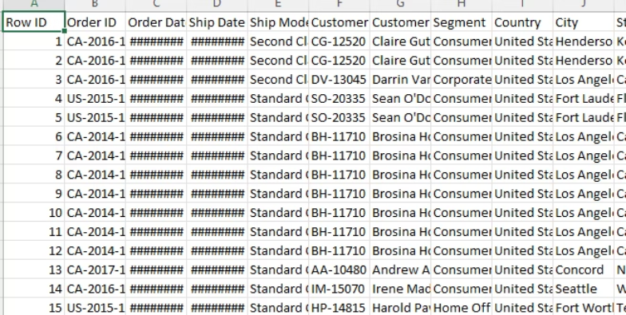
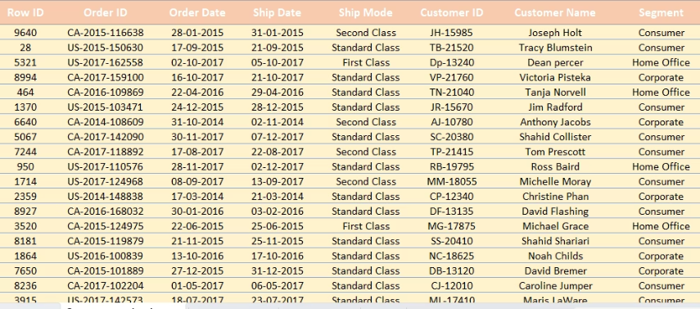
VISUALS:
BEFORE CLEANING: AFTER CLEANING:

Slide 5
KEY METRICS CALCULATION:
TOTAL SALES: 2297201
AVERAGE SALES PER ORDER: 197.58
TOTAL DISCOUNTS: 1561.09
COUNT OF CATEGORY:
FURNITURE: 2121
OFFICE SUPPLIES:6026
TECHNOLOGY:1847

Slide 6
PIVOT TABLE:
A Pivot Table in Excel is a powerful tool used to summarize, analyze, explore, and present data. It allows you to quickly transform raw data into meaningful insights without using complex formulas.
*Here i have prepared the pivot tables to aggregate data by different dimensions such as product category, customer segment, ship mode.
PIVOT CHART:
Pivot charts are used to visualize the data like sales trends and compare performance across different categories(e.g. bar charts for sales ,pie charts, line graphs etc..

Slide 7
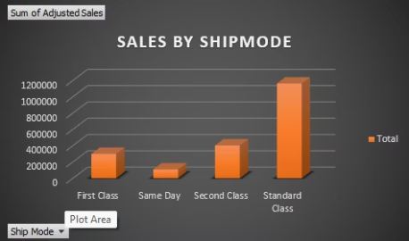
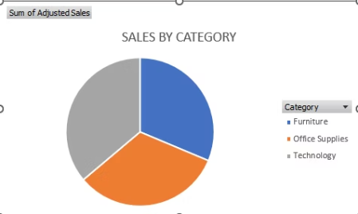
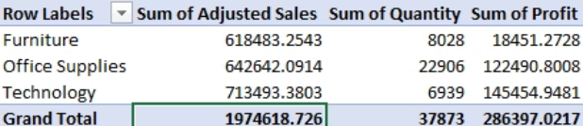
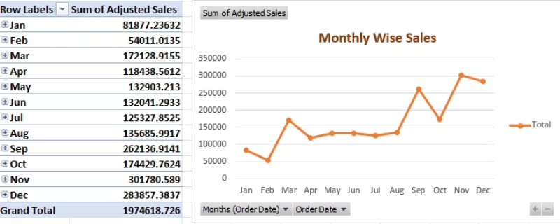
visuals:

Slide 8
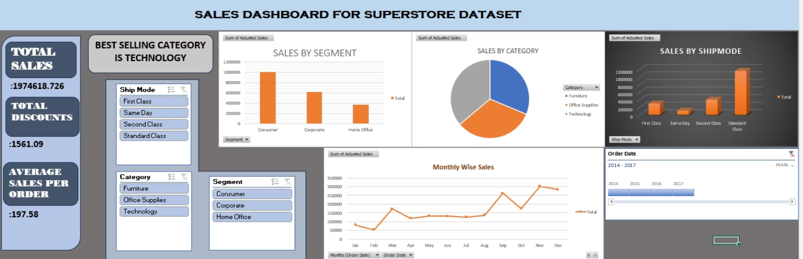
DASHBOARD:

Slide 9
MACROS:
A Macro in Excel is a recorded sequence of actions that you can replay to automate repetitive tasks. Macros are written in VBA (Visual Basic for Applications), but you don’t need to be a programmer to use them—Excel can record your actions and create
I have used macros to format the raw data to clean data
I have automated the formatting data using this macros
It saves the time by automating the data formatting

Slide 10
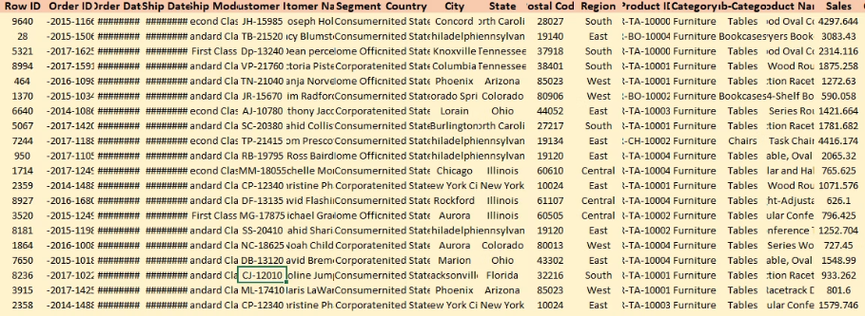
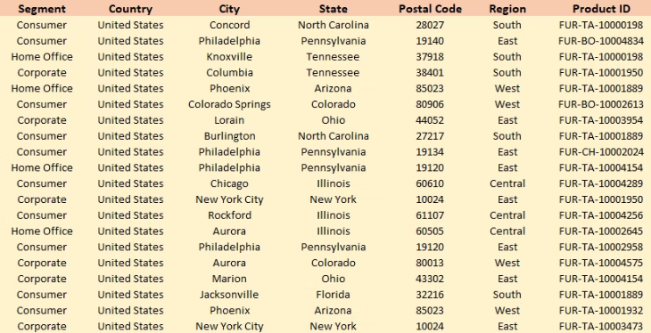
visuals:
BEFORE MACROS
AFTER MACROS

Slide 11
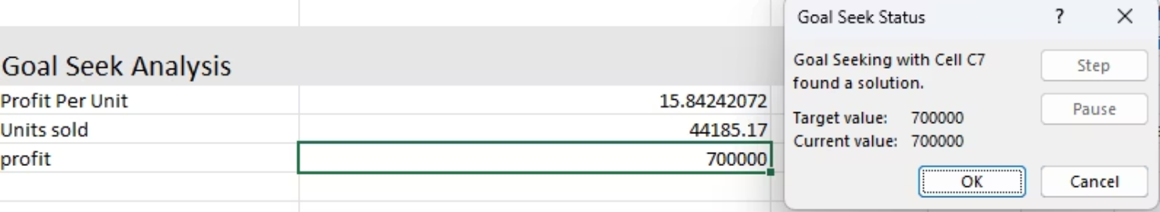
what if Analysis:
What-If Analysis in Excel is a powerful feature that helps you explore different scenarios and outcomes based on changes to your data. It's especially useful in financial modeling, forecasting, budgeting, or any situation where you want to see how changing one or more variables affects your results.
In this project i used Goal seek for to change the target value by changing cells of units sold.

Slide 12
Insights and Recommendation:
First as a seller we need do think from customers side and sell the products according to that so, the sales will be more.
Market the product in various different ways (e.g. Digital marketing, promoting, feedback,…)
We need to avail the discounts on our products for a particular day in regular bases so, that customers will be back for shopping.
No need to put the highest discounts and make loss through it.
we need to build the trust in customers by providing many options like money back guarantee, return policies and many more.

Slide 13
Conclusion:
Analyzing the super store sales data we got to know that
The high performing category in the market
Highest sales made by a segment etc..

Slide 14


