Slide 1
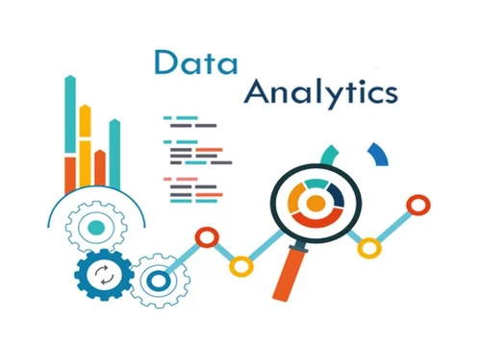
END SEM PROJECT
DAV (22ADE01)
Team Members:
ANISH PULLURU (1601-22-737-055)
VARSHITH REDDY (1601-22-737-064)
MOKSHITH BALIDI (1601-22-737-032)

Slide 2

Problem Statement
Problem Statement
Analysing the "World University Rankings“
dataset to understand factors influencing
university rankings and trends over time.
IMPORTANCE:
Insight into Education Quality
Benchmarking and Comparison
Resource Allocation
Policy Formulation
Student Decision-making

Slide 3

ABSTRACT
The "World University Rankings" dataset is a rich source of information encompassing a wide array of metrics and attributes related to universities worldwide. This project aims to conduct a comprehensive analysis of this dataset to extract valuable insights that can inform stakeholders in the education sector and beyond. The analysis will involve a multi-faceted approach, including exploratory data analysis (EDA), statistical analysis, and data visualization techniques. Through EDA, we will delve into the structure of the dataset, identify trends, outliers, and patterns, and gain a deeper understanding of the underlying data. Statistical analysis will allow us to quantify relationships between variables and identify key factors influencing university rankings.
Moreover, the project will utilize advanced data visualization techniques to present the analysis findings in an intuitive and visually appealing manner. Visualizations such as charts, graphs, and interactive dashboards will be employed to effectively communicate complex information and facilitate easier interpretation of the results.
The ultimate goal of this project is to provide actionable insights and recommendations to stakeholders in the education sector. These insights can help universities enhance their performance, policymakers formulate informed decisions, and students make more informed choices about their education. By leveraging the power of data analysis, this project seeks to contribute to the advancement of education quality and excellence on a global scale.

Slide 4

Development Process
DEVELOPMENT PHASES
TECH-STACK
Planning: Define the objectives and scope of the analysis, including data sources and desired outcomes.
Data Collection: Gather the relevant dataset(s) for analysis.
Data Preprocessing: Clean the data, handle missing values, and perform feature engineering if needed.
Exploratory Data Analysis (EDA): Explore the data using statistical techniques and visualizations to gain insights.
Model Development: Implement logistic regression or other models for analysis.
Model Evaluation: Assess the performance of the model using appropriate metrics.
Results Interpretation: Interpret the results of the analysis and derive actionable insights.
Reporting: Present the findings in a clear and understandable manner, often using visualizations and summaries.
Programming Language: Python
Data Analysis Libraries: NumPy, Pandas, Matplotlib/Seaborn (for data manipulation, analysis, and visualization)
Machine Learning Library: Scikit-learn (for implementing machine learning models like logistic regression)
Integrated Development Environment (IDE): Google-Colab, GITHUB.
Data Visualization Libraries: Matplotlib, Seaborn, Plotly.
Code Editor: Visual Studio Code, Sublime Text, or Atom (for editing code)

Slide 5
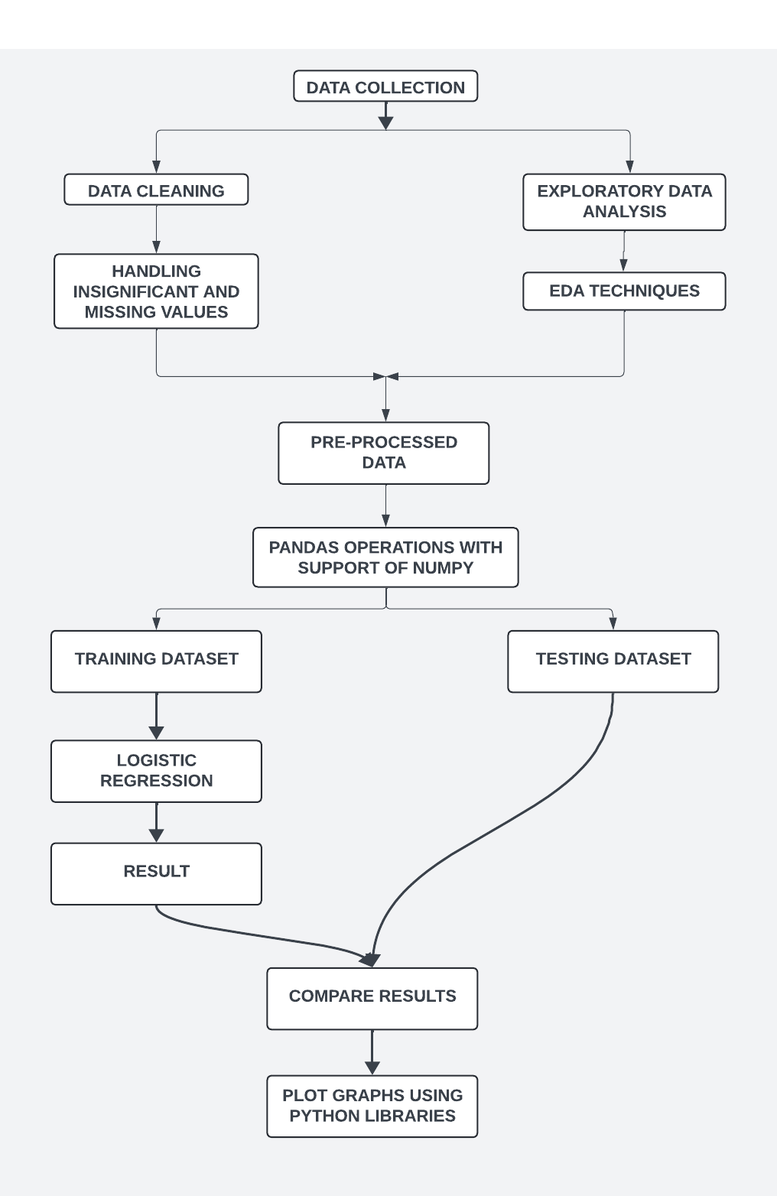
Solution Model
Data Collection:
We collected data from foreign websites to build a comprehensive dataset for our dropout prediction model.
Data Preprocessing:
Before training our model, we rigorously preprocessed the dataset, addressing missing values and ensuring data quality.
Exploratory Data Analysis:
Exploratory Data Analysis (EDA) includes data cleaning, summarization, visualization, and hypothesis generation to understand the dataset's structure, identify patterns, and inform further analysis.
Libraries for Graphs:
Matplotlib, Seaborn, Pandas, Plotly, Bokeh, Altair
LOGISTIC REGRESSION:
MLogistic regression is a statistical model used for binary classification tasks, estimating the probability of an event occurring based on input features, often used in machine learning for its simplicity and interpretability.

Slide 6

Our Goals
Data Exploration
Insight Generation
Gain a deep understanding of the dataset through exploratory data analysis (EDA) to uncover patterns, trends, and anomalies.
Generate meaningful insights and
Actionable recommendations based on the analysis to support decision-making.
Reproducibility
Performance Evaluation
Ensure that the analysis can be easily reproduced by documenting the code, methodologies, and assumptions used in the analysis.
Assess the performance of the models using appropriate metrics to ensure they meet the project's objectives.

Slide 7
THANK YOU
“If you look at history, innovation doesn’t come just from giving people incentives; it comes from creating environments where their ideas can connect.”
—Steven Johnson

