Slide 1


Order Book System

Slide 2

INTRODUCTION
Order-Book Management system refers to an online web application where a customer can purchase stocks online.
HTML, CSS and JavaScript are used to create customer view and admin view.

Slide 3
WORKFLOW
First, a homepage will be created.
Based on login credentials, the user will be classified as customer or admin.
If the user is a customer, he can check whether the market is open or close, based on which he can place the order.
If the user is an admin, he can close the market and execute the queries which are present and he can get the result whether a particular order is accepted or rejected.
The customer can place the order when the market is open and admin can execute the queries when the market is closed.

Slide 4
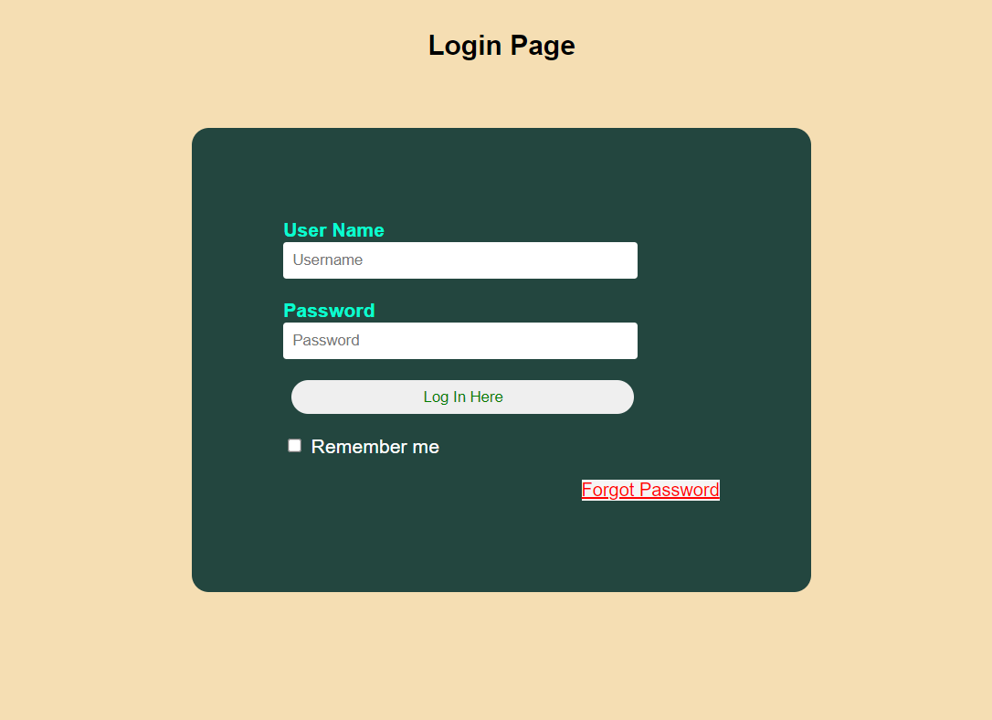
Login Page

Slide 5
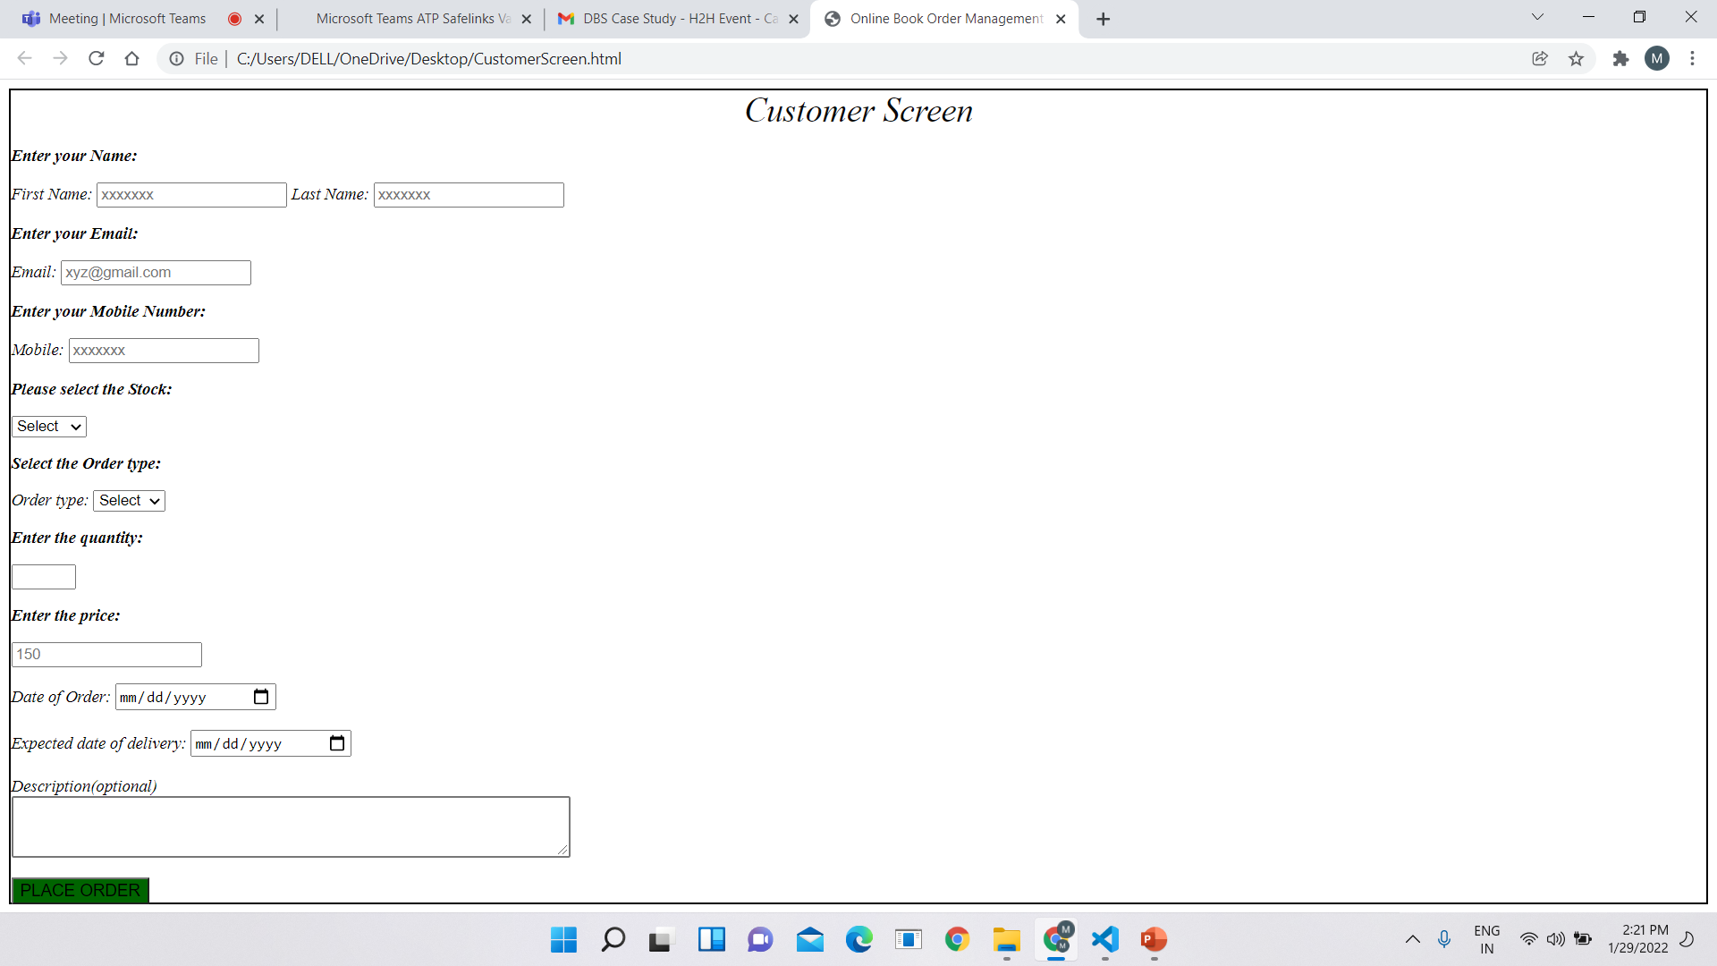
Customer View

Slide 6
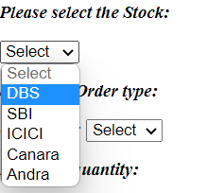
Selection of Stocks

Slide 7
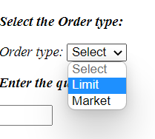
Selection of Order-type

Slide 8
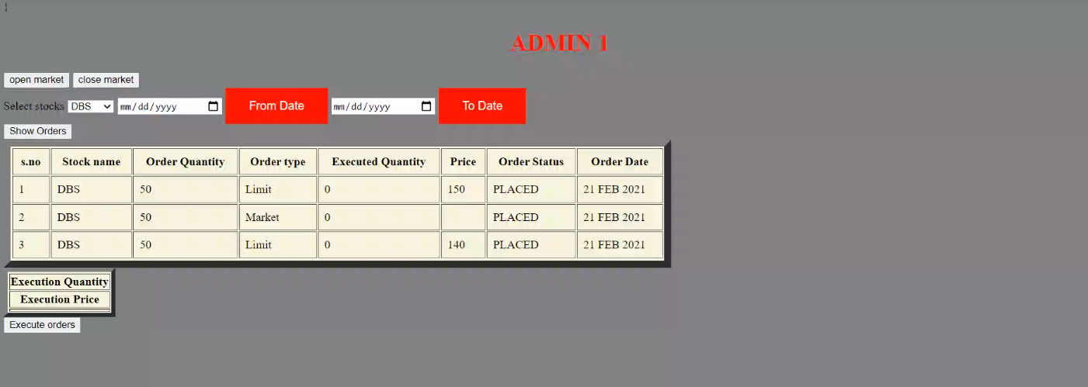
Admin View

