Slide 1
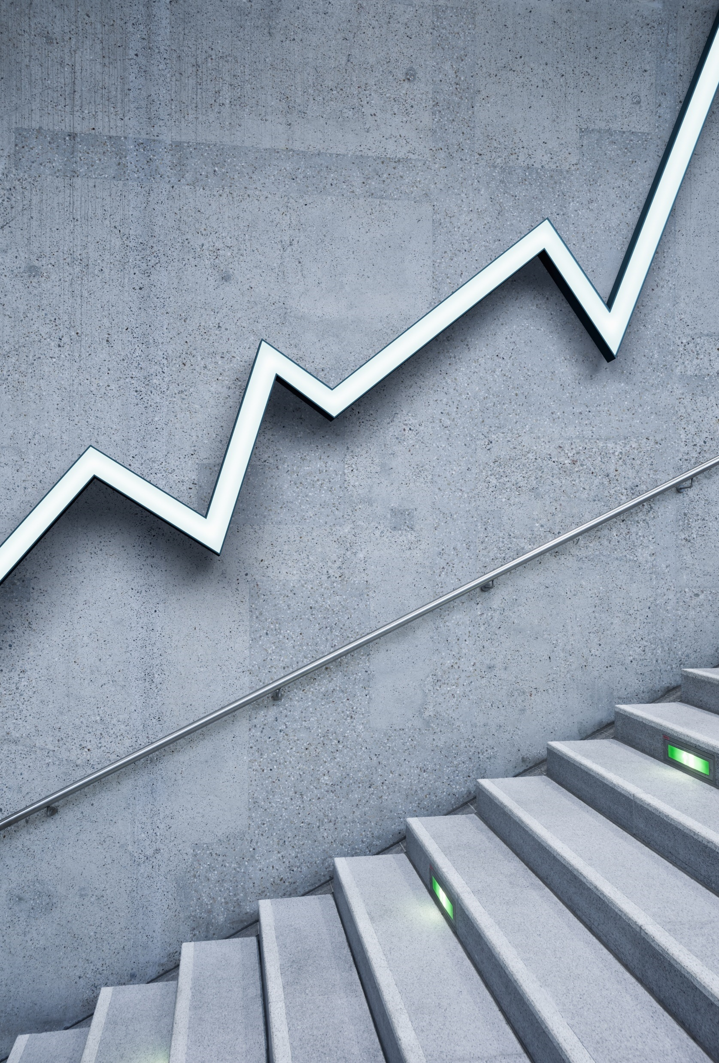
Clothing Image Generator Using Stable Diffusion Pipeline
Team:53
sYnthestyle

Slide 2
Introduction:
In the modern fashion industry, consumers and designers often struggle with visualizing custom clothing before making a purchase or finalizing a design. Online shopping platforms typically offer static product images, which limit personalization and creativity.
Additionally, fashion designers and brands face high costs and long production times when developing prototypes.
This project addresses these challenges by utilizing AI-powered image generation, allowing users to create realistic clothing visuals based on simple text descriptions. With this approach, the fashion industry can experience a more efficient, creative, and personalized design process.

Slide 3
Key Features:
The AI-powered clothing image generator offers several key features. Users can generate realistic clothing images simply by entering a text-based description of their desired outfit.
The system also provides customization options, enabling users to modify elements such as color, pattern, and fabric texture. The project features a user-friendly web interface, built using Streamlit, making it accessible even to non-technical users.
Additionally, the platform allows users to save and share their AI-generated designs, providing flexibility for designers, brands, and fashion enthusiasts.

Slide 4
Technologies Used:
This project is built using state-of-the-art AI and web technologies. At its core, it utilizes Stable Diffusion, a powerful deep learning model capable of generating high-quality images from text prompts. The frontend is developed using Streamlit, a lightweight and interactive Python-based framework for web applications.
The backend is powered by Python with FastAPI or Flask, ensuring smooth communication between the user interface and the AI model. Additionally, an optional database (MySQL or MongoDB) can be integrated to store generated designs for future use.

Slide 5
System Architecture:
The workflow of this project follows a structured process. First, the user provides a text input, describing a clothing item, such as "A red satin evening gown with golden embroidery." The AI model then processes the input and generates a corresponding clothing image.
Users can then refine and customize the generated design, adjusting details like color and texture. Finally, the output image can be saved, shared, or even used as a reference for clothing production. This seamless pipeline enhances the creative process in fashion design.

Slide 6
Future Scope:
There is significant potential for expanding this project with future developments. Integration with AR/VR technology could allow users to virtually try on AI-generated outfits, improving online shopping experiences.
Adding real-time AI refinements would enhance the quality and accuracy of generated clothing images. The project could also be expanded into an API service, enabling fashion brands and e-commerce platforms to integrate AI-generated fashion design into their websites and apps.
Another future enhancement is the introduction of 3D modeling, where AI-generated 2D images can be converted into 3D prototypes, making fashion design even more interactive and immersive.

Slide 7
Conclusion:
AI-powered fashion visualization is set to revolutionize the industry by making design creation faster, more accessible, and more personalized.
By combining Stable Diffusion with an interactive web interface, this project enables designers, brands, and consumers to generate and refine unique clothing ideas effortlessly. With further advancements, AI-generated clothing images can transform fashion prototyping, e-commerce, and digital styling, ultimately reshaping the way people interact with fashion.
The future of AI-driven fashion is here, offering limitless possibilities for creativity and innovation.

Slide 8
Thank You!

