Slide 1

A Project Report On
“BIKE E-CATALOGUE MOBILE APP FOR YAMAHA MOTORS PVT LTD
Batch Details
Sl. No. | Roll Number | Student Name
1 | 20201CEI0111 | HARDIK YADAV
2 | 20201CEI0082 | VARSHITHA
3 | 20201CEI0138 | SHAIK MAHEER
4 | 20201CEI0131 | SAHITH K
School of Computer Science, Presidency University, Bengaluru.
Under the guidance of,
Ms.Merlin Xavier (Assistant Professor)
Presidency University

Slide 2
ACKNOWLEDGEMENT
We hereby declare that we have completed review 1 presented in this report titled BIKE E-CATALOGUE MOBILE APP FOR YAMAHA MOTORS PVT LTD under the guidance of Dr. MERLIN XAVIER. The findings mentioned in this report are based on our collective research and analysis.
Ms.Merlin Xavier | Ms.Shilpa C N
Supervisor | Reviewer 1
Date: 15/11/23
0

Slide 3
CONTENTS
1. Introduction to Project | 2
2. Literature Review | 3
3. Problem Statement | 7
4. Objectives | 8
5. Methodology | 9
6. Expected Outcomes | 12
7. Timeline for Execution of Project | 13
8. Conclusion | 14
9. References | 15
1

Slide 4
INTRODUCTION
“E-CATALOGUE”
In the era of digital commerce, our e-catalogue revolutionizes the way you explore and engage with our products. Presented in a dynamic digital format, our catalogue embraces interactive elements, allowing you deeper into product details through clickable links, zoomable images, and even multimedia content. The inclusion of search functionality ensures that you can swiftly locate specific items, making your browsing experience efficient and tailored to your needs. With real-time updates, our catalogue keeps you informed about the latest products, prices,events and promotions.Navigating the nearby stores of specified yamaha motors.
E-catalogue, is a digital version of a traditional printed catalogue that can be viewed online. It typically contains information about products or services, including images, descriptions, prices, and other relevant details.It serves the same purpose as a physical catalogue, presenting information about products or services in a structured and organized manner. E-catalogues are commonly used in e-commerce and business-to-business (B2B) transactions, providing a convenient way for customers and clients to browse, explore, and make informed decisions about the products or services offered.
In a world where mobility is more essential than ever, we stands at the forefront of innovation,offering cutting-edge solutions that redefine the way we experience two-wheeled adventures. With a rich legacy of crafting iconic motorcycles that blend performance, style, and technology, we have taken a bold step forward by introducing the Yamaha Motor Bike E-Catalogue Mobile App.
The Yamaha Motor Bike E-Catalogue Mobile App is more than just a collection of product descriptions and images. It's a gateway to a dynamic and immersive journey through Yamaha's two-wheeled wonders. This app is designed to cater to the diverse needs and preferences of every motorcycling enthusiast, making it an indispensable companion for riders and Yamaha fans worldwide.
2

Slide 5
LITERATURE REVIEW
Swapnil S. Jagtap[1], have used a The android app that is going to be developed have its website built in PrestaShop eCommerce Shopping Cart software using PHP PL and is used with the MySQL DB to store the data. The objective of this project is to develop the online shopping android app and integrate the App with the PrestaShop eCommerce Shopping Cart software running on XAMPP Server and connect it to the MySQL database and design the GUI of the App for different devices like phones and tablets, so that the customers can easily use the App for online shopping on their android devices. The theme of the app should be attractive and easy to modify by the user so that the
customers get attracted to use this app for online shopping.
Dr. Urvashi Sharma[2]One of the major growth factor in India is the breadth of internet penetration in a country. India has an internet user base of about 354 million as of June 2015 and is expected that it will cross to 500 million in 2016,which is the world’s second largest user base only behind china. At the same time changing consumer lifestyle, supported by younger population base of India, where more than half of total 1.3 billion Population falls under “below 25 years of age” brackets would aid the future of e-commerce, driven by rising disposable income. According to joint ASSOCHAMForester study paper (2016), India’s e-commerce revenue is expected to grow from USD 30 billion in 2016 to USD 120 billion in 2020 growing at an annual rate of 51%, highest in the world.
Davide Di Fattaa,[3] Web retailers invest significant resources to improve the proportion of website visitors that make a purchase, also known as the conversion rate. Improving this rate is particularly important to SMEs that have traditionally lagged behind larger firms as they have found it difficult to justify the significant investment involved in website development against the historical low returns associated with an online sales channel. Identifying methods that increase conversion rates reduces these perceived barriers and increases effective SME participation in the growing e-commerce sector. This paper uses 1184 observations from 6 SME websites to identify and analyse the factors, or combination of factors, that improve conversion rates. This is achieved through a process of exploratory regression analysis to select the most relevant determinants and Qualitative Comparative Analysis (QCA) to offer more ‘fine-grained’ detail on the conditions where conversion rates improve. Our findings suggest that a key factor that improves the conversion rate is a strategy that focuses upon either quality or promotion and avoids mixing such attributes within the web site offer.

Slide 6
Amarpreet Singh Johal Baljit Singh[4]An increasing number of firms in the retail sector have developed digital channels to support sales and marketing strategies (Kaufmann etal., 2012) and online retailers have become gradually more successful in increasing traffic to their websites. As a consequence, projections show that retail ecommerce sales will increase from $1548 trillion in 2015 to $4.058 trillion in 2020, making up 14.6% of total retail spending (Smart Insights, 2017). To manage this evolution, web retailers need to invest significant resources, to enhance functionality, increase visitor numbers and convert more such visits into purchases (Ayanso and Yoogalingam, 2009). However in the SME sector where resources and expertise are limited, this activity must be accomplished with considerable efficiency and cost effectiveness (Grandon et al., 2011; Cronin-Gilmore, 2012). In the past, concerns about costs and the strategic relevance of online sales has limited SME engagement in e-commerce activity (Bharadwaj and Soni, 2007), but, as on-line retail sales have grown, such concerns are no longer valid and internet/web-based technologies are widely recognized as an important element of effective sales and marketing (Bell and Loane 2010; Jeansson et al., 2017). In Italy the fashion industry provides a good example of this change
Roy Thomas Fielding[5]:At the heart of software architecture is the principle of abstraction: hiding some of the details of a system through encapsulation in order to better identify and sustain its properties [117]. A complex system will contain many levels of abstraction, each with its own architecture. An architecture represents an abstraction of system behavior at that level, such that architectural elements are delineated by the abstract interfaces they provide to other elements at that level [9]. Within each element may be found another architecture, defining the system of sub-elements that implement the behavior represented by the parent element's abstract interface. This recursion of architectures continues down to the most basic system elements: those that cannot be decomposed into less abstract elements.

Slide 7
LITERATURE REVIEW TABLE
SL. NO. | TITLE | AUTHOR | YEAR | SOURCE | ALGORITHM | FINDINGS | DRAWBACKS
1 | Survey and development of Android based mobile app for e-commerce | Swapnil S. Jagtap Dr. Dinesh B. Hanchate | 2017 | Survey on Development of Android Based Mobile App for Prestashop eCommerce Shopping Cart (ALC)Swapnil S. Jagtap Department of Computer Engineering VPKBIET, Baramati | Sorting,real upadating | shopping cart for groceries for home | Electronic Commerce (eCommerce) refers to the online exchange of information, allowing users to electronically trade goods and services without constraints of time or distance. It facilitates seamless transactions over the internet. Meanwhile, Mobile Commerce (mCommerce) involves the buying and selling of goods and services through wireless handheld devices like mobiles and tablets, representing the next generation of eCommerce. Online shopping, a subset of eCommerce, enables customers to directly purchase items from a merchant through a web browser, with two primary processes: Business-to-Consumer (B2C) and Business-to-Business (B2B). The shopping cart system is integral, allowing customers to create a list of items, and at checkout, the total is calculated, including shipping, handling charges, and applicable taxes.
2 | Future of E-commerce in India | Dr. Urvashi Sharma* | 2018 | Dr.Urva Sharma, Bhawna Rajput, Future ofE-commere in India, IEEE 2021 | Market Analysis for upcomming ecommerce apps | Future Ecommerce website and applications | According to a joint ASSOCHAM-Forester study paper (2016), India's e-commerce revenue is projected to grow from USD 30 billion in 2016 to USD 120 billion in 2020, with an annual growth rate of 51%, the highest in the world. The future of e-commerce in India appears promising, attracting new players across various sectors. Government initiatives are also being taken to support traders in expanding their horizons and addressing challenges within this evolving landscape.
3 | The determinants of conversion rates in SME e-commerce websites | Davide Di Fattaa, Dean Pattonb, Giampaolo Vigliac,⁎ | 2017 | IEEE | Analysis of ecommerce websites,web retailing; SMEs | Prediction of retail prices of ecommerce market | the generalization that concerns about costs and strategic relevance are no longer valid might oversimplify the diverse challenges faced by SMEs in various sectors. It's crucial to acknowledge that while digital transformation offers opportunities, it also demands adaptation, and the pace of this adaptation may vary across industries and businesses. Overall, recognizing and addressing the drawbacks and challenges inherent in the digital evolution of the retail sector, especially for SMEs, is crucial for developing effective andsustainable strategies in this rapidly changing
5

Slide 8
4 | Performance Analysis of Web Services for Android based Devices | Amarpreet Singh Johal Baljit Singh | 2014 | of Computer Application s · September 2018 | Computer- aided webservices | Web services Android SOAP REST. | the implication that organizations or developers heavily invested in SOAP-based architectures may face challenges or need to reconsider their strategies in the face of the observed performance differences. Moreover, the paper doesn't delve into the specific scenarios or use cases where SOAP might still offer advantages despite the performance gap. Acknowledging such drawbacks and providing a more nuanced exploration of the trade-offs between SOAP and RESTful Web services would enrich the content and offer a more comprehensive understanding for readers in the field.
5 | Architectural Styles and the Design of Network-based Software Architectures | Roy Thomas Fielding[ | 2000 |  | Architectural elements and components | Complexity of Software development arcitecture | The detailed abstraction hierarchy, while facilitating the identification and sustenance of system properties, might introduce a level of opacity. Navigating through multiple layers of abstraction can potentially complicate the process of understanding the interconnections and dependencies within the system. This could pose difficulties for developers, especially those new to the project or maintaining the software, in deciphering the intricate relationships between various architectural elements.

Slide 9
PROBLEM STATEMENT
In the rapidly evolving landscape of online retail, the traditional bike purchasing experience is hindered by a lack of accessible and comprehensive information. Potential buyers often face challenges in navigating through a fragmented online market, encountering difficulties in comparing products, and struggling with limited visual representations. Additionally, the absence of interactive features and real-time updates further impedes the user's ability to make informed decisions.
The current state of online bike shopping lacks a centralized, user-friendly platform that seamlessly integrates detailed vehicle information, interactive elements, and a smooth purchasing process. Recognizing these challenges, there is a pressing need for a bike e-catalogue mobile application that not only addresses these pain points but also provides a modern, engaging, and efficient solution for both novice riders and seasoned bike enthusiasts. This application aims to revolutionize the way users explore, evaluate, and purchase bikes by offering a comprehensive, interactive, and user-centric platform that redefines the online bike shopping experience.

Slide 10
OBJECTIVES
Real-Time Updates
Ensure the application offers real-time updates on product availability, new arrivals, and promotions to keep users informed about the latest offerings.
Interactive Features:
Incorporate interactive elements such as zoomable images, 360-degree views, and virtual test rides to give users a more engaging and immersive experience.
User Engagement and Education
Provide educational content about different bike types, features, and maintenance tips to engage users and enhance their knowledge.
Feedback Mechanism
Include a feedback mechanism to collect user opinions, suggestions, and reviews to continuously improve the application based on user input.

Slide 11
METHODOLOGY
Creating a mobile application involves a structured methodology that encompasses the entire development lifecycle
Idea and Conceptualization: Start with brainstorming to generate a unique app idea, followed by a feasibility study to assess technical and market viability.
Research and Analysis: Conduct market research and user analysis to refine the app concept and choose the appropriate technology stack.
Planning: Define the app's scope, create a detailed project roadmap, and establish a budget.
Design: Focus on UI/UX design and plan the app's technical architecture.
Development: Set up the development environment, start coding using Agile methodologies, and manage source code with version control.
Testing: Perform various tests, including unit, integration, user acceptance, and performance testing, to ensure the app's functionality and efficiency.
Deployment: Plan the app's launch, submit it to app stores, and monitor its performance post-launch.
Maintenance and Updates: Collect user feedback, regularly update the app, and provide user support.
Marketing and Promotion: Engage in pre-launch, launch, and post-launch marketing strategies to attract and retain users.
Scaling Up: Optimize performance, expand features, and consider market expansion.
Analytics and Improvement: Use analytics tools for tracking user engagement and iterate improvements based on insights.
Market Research: Study competitors, target audience, and market trends to refine your app idea.
This methodology emphasizes a user-centric approach, flexibility, quality assurance, and compliance with legal standards, covering all aspects from ideation to scaling and improvement.

Slide 12
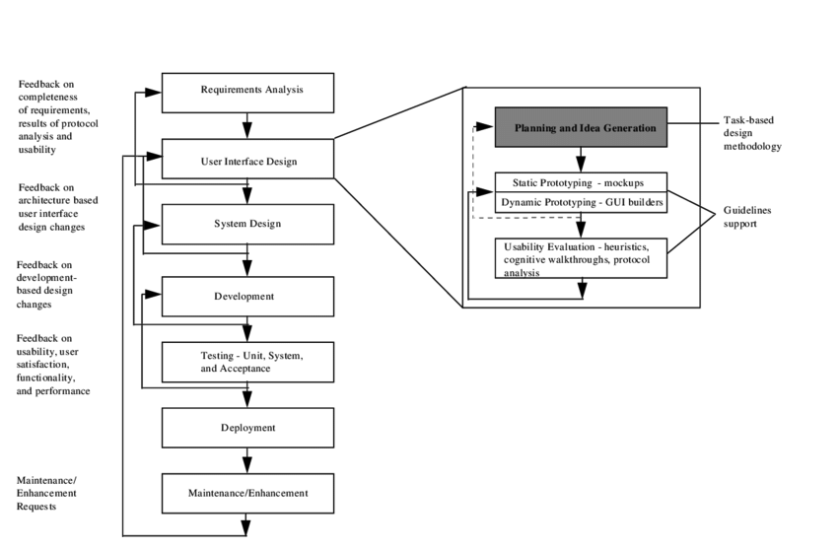
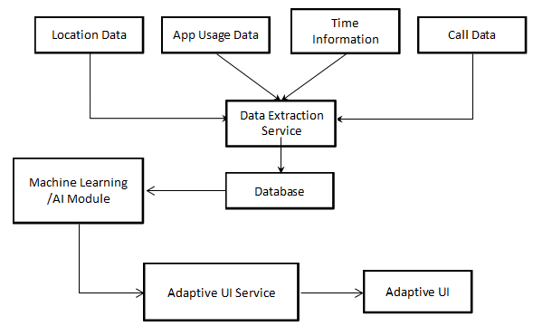
figure:User Interface
10

Slide 13
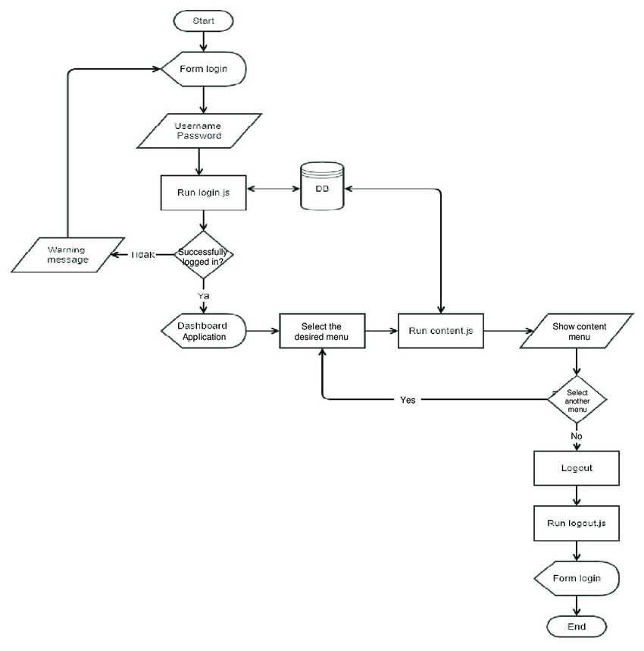
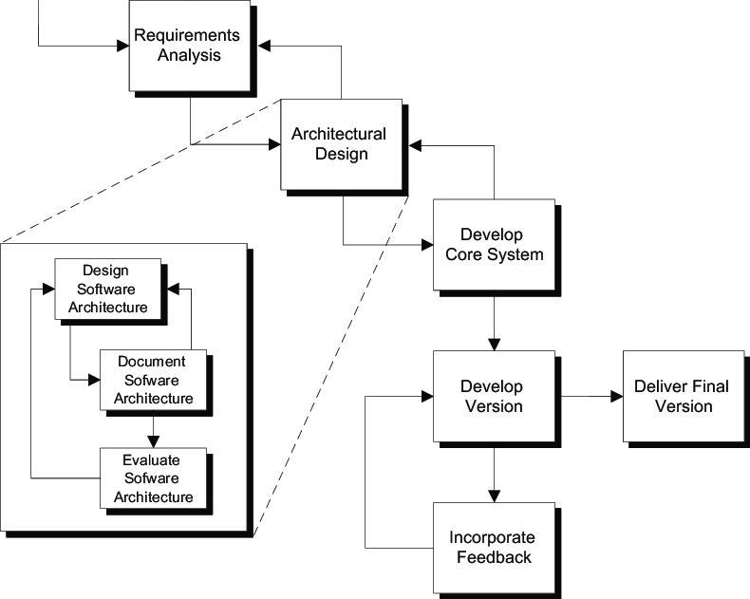
Design
figure:Architecture of design of application
11

Slide 14
EXPECTED OUTCOMES
Effortless Exploration: Navigate through our diverse offerings effortlessly. Explore detailed product/service descriptions, vivid images, and specifications with just a click.
Interactive Experience: Immerse yourself in an interactive experience that goes beyond static images. Zoom in, rotate, and explore our offerings from every angle for a comprehensive understanding and reviews of latest releases from yamaha with high quality youtube videos.
Real-Time Updates: Stay informed about the latest events,promotions, and updates. Our e-catalogue ensures you are always in the loop with real-time information.
User-Friendly Interface: Our e-catalogue is designed with you in mind. Enjoy a seamless browsing experience with an intuitive interface that makes finding what you need a breeze.

Slide 15
PROJECT EXECUTION PLAN
Name | Start Date | End Date | Duration
Project Planning | 25/09/23 | 07/10/23 | 12
Requirement Collection | 11/10/23 | 20/10/23 | 9
Research & Analysis | 23/10/23 | 04/11//23 | 12
Designing Project | 06/11/23 | 10/11/23 | 4
Development | 11/11/23 | 16/12/23 | 35
Beta Testing | 17/12/23 | 25/12/23 | 8
Implementation | 26/12/23 | 07/01/24 | 12

Slide 16
CONCLUSION
We conclude that our e-catalogue mobile application stands as a gateway to a seamless and enriched virtual experience. By combining intuitive design with user-friendly features, we have crafted a digital space that effortlessly guides users into the diverse world of our product offerings.
The interactive elements, such as clickable links and engaging visuals, beckon users to explore further, ensuring a dynamic and enjoyable interaction with the application. The inclusion of robust search functionality empowers users to swiftly find what they need, while real-time updates keep them abreast of the latest additions and promotions.

Slide 17
References
[1] Dr. Urvashi Sharma, Bhawna Rajput, Future of E-commerce in India, IEEE 2021.
[2] Group, Network Working. Hypertext Transfer Protocol -HTTP/1. 1. 061999. Available:. Accessed on 10 March 2014
[3] Apache. About Apache. Available at: <http://httpd. apache. org/ABOUT_APACHE. html>. Accessed on 11 March 2014.
[4] Android, Android Emulator. Android. com. Available at Accessed on 11 March 2014.
[5] Survey on Development of Android Based Mobile App for Prestashop eCommerce Shopping Cart (ALC)Swapnil S. Jagtap Department of Computer Engineering VPKBIET, Baramati,
[6] Matey, Shweta & Prajapati, D.R. & Shinde, Kunjan & Mhaske, A. & Prabhu, A.. (2017). Design and fabrication of electric bike. International Journal of Mechanical Engineering and Technology. 8. 245-253.
[7]Fielding, R. T. , 2000. Architectural Styles and the Design of Network-based Software Architectures. Doctor of Philosophy, University of California, Irvine. Retrieved from:.
[10]

