Slide 1


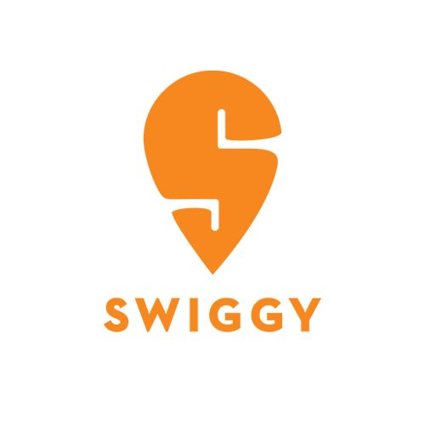






S
Swiggy SQL Analytics
Cooking up insights with sophisticated SQL joins 🍲
A Data Analysis Case Study | Customers · Orders · Restaurants · Delivery Partners
By Varshitha k

Slide 2

What's Cooking in This Deck 🍳
A quick appetizer before the main SQL course
🛵 About Swiggy
📊 About This Analysis
Swiggy is one of India's leading on-demand delivery platforms, connecting millions of customers with restaurants and delivery partners across the country. Every order placed generates rich data — customers, restaurants, ratings, orders and deliveries — that, when queried well, tells a powerful business story.
This case study uses sophisticated SQL — joins, aggregations, GROUP BY, HAVING— across Swiggy's Customers, Orders, Restaurants and Delivery datasets to answer 13 real business questions, from spotting top-rated restaurants to finding delivery partners with the widest reach to customer.
Customer behaviour & loyalty
Restaurant performance & ratings
Delivery partner reliability
City-level trends (Delhi, Mumbai)
2

Slide 3


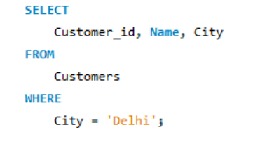
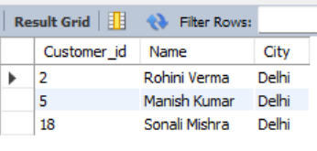
🍛 Delhi Diners: Who's Ordering from the Capital?
1
Q1: Display all customers who live in 'Delhi'.
Why this analysis: Understand the Delhi customer base to plan region-specific marketing and fleet capacity.
QUERY
RESULT
3

Slide 4
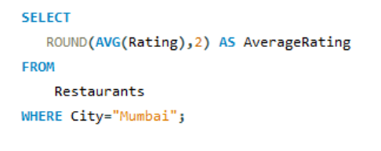
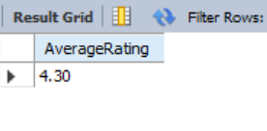
🍟
⭐ Mumbai's Foodie Verdict: Average Restaurant Ratings
2
Q2: Find the average rating of all restaurants in 'Mumbai'.
Why this analysis: Gauge overall restaurant quality in Mumbai to guide quality control and city-level promotions.
QUERY
RESULT
🍰
4

Slide 5

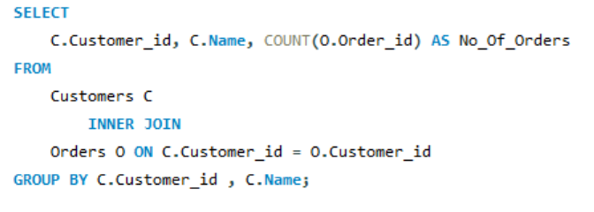
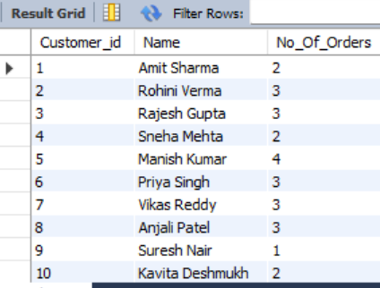

🥡
🛵 The Regulars: Customers Who've Placed at Least One Order
3
Q3: List all customers who have placed at least one order.
Why this analysis: Identify active, revenue-generating customers to prioritise for loyalty and retention programs.
QUERY
RESULT
5

Slide 6
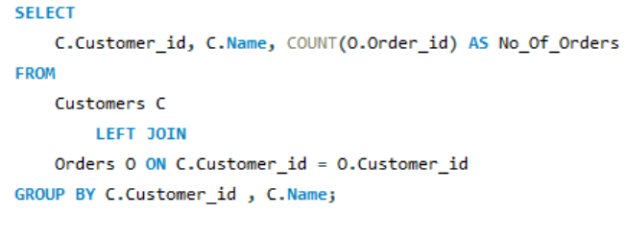
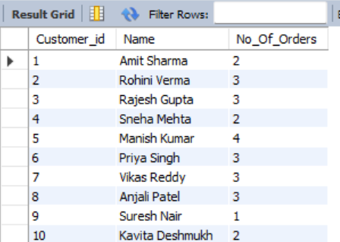
🍜
📦 Order Count Roll Call: Total Orders per Customer
4
Q4: Display the total number of orders placed by each customer.
Why this analysis: Segment every customer by order frequency to personalise offers and re-engagement campaigns.
QUERY
RESULT
🍗
6

Slide 7

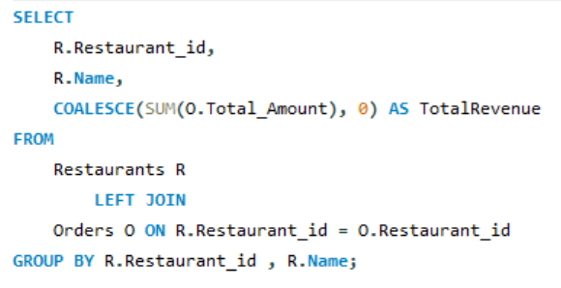
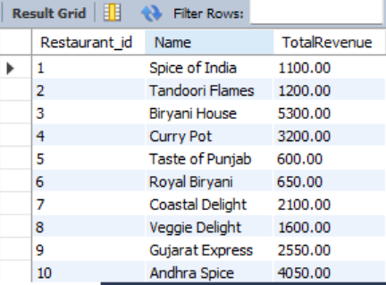

💰 Show Me the Money: Revenue Generated by Each Restaurant
5
Q5: Find the total revenue generated by each restaurant.
Why this analysis: Rank restaurant partners by revenue contribution to guide commission strategy and key-partner focus.
QUERY
RESULT
📸 Screenshot space —
result to be added
7

Slide 8
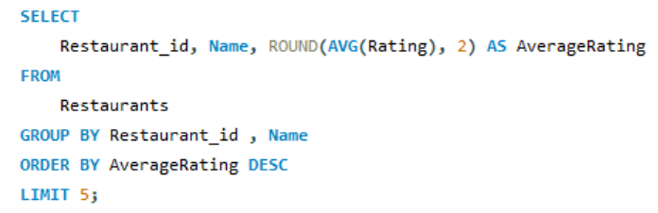
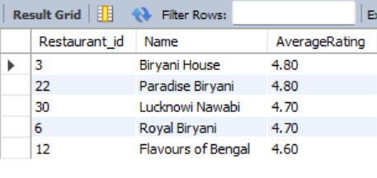
🏆 Top 5 Crowd Favorites: Highest-Rated Restaurants
6
Q6: Find the top 5 restaurants with the highest average rating.
Why this analysis: Spotlight the best-loved restaurants to feature them and build customer trust in the app.
QUERY
RESULT
8

Slide 9

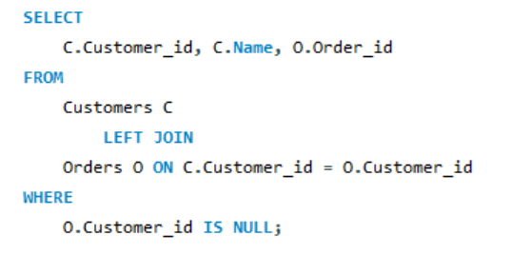
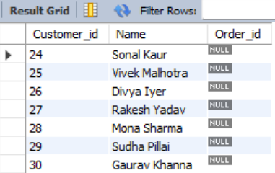
🍰
👻 Ghost Customers: Who Has Never Placed an Order?
7
Q7: Display all customers who have never placed an order.
Why this analysis: Flag dormant sign-ups so marketing can target them with reactivation offers.
QUERY
RESULT
🍪
9

Slide 10
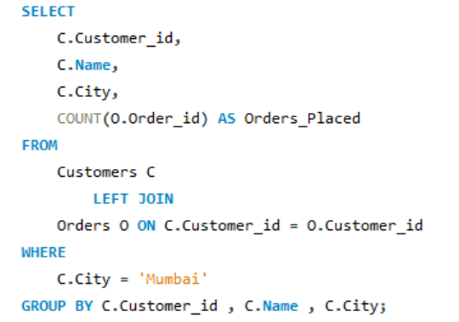
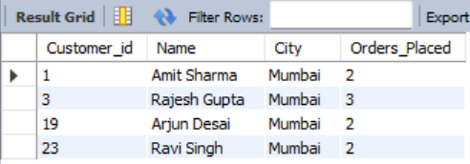
🌮
🌆 Mumbai Munchies: Orders Placed per Customer
8
Q8: Find the number of orders placed by each customer in 'Mumbai'.
Why this analysis: Measure customer engagement within Mumbai specifically to fine-tune the local growth strategy.
QUERY
RESULT
🥟
10

Slide 11

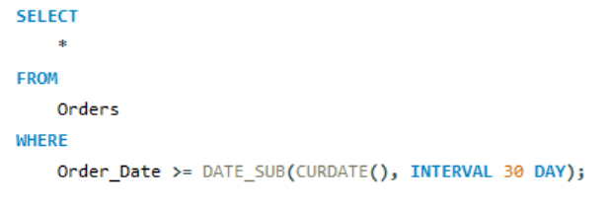


🍗
🕐 Fresh Off the Stove: Orders in the Last 30 Days
9
Q9: Display all orders placed in the last 30 days.
Why this analysis: Track recent order volume to monitor short-term demand and catch emerging trends early.
QUERY
RESULT
🍕
11

Slide 12
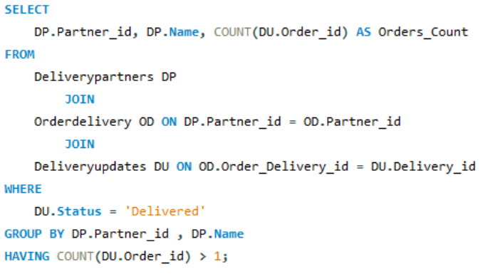
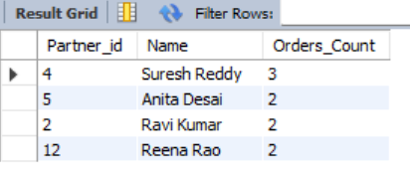
🍣
🚴 Delivery Heroes: Partners With More Than One Delivery
10
Q10: List all delivery partners who have completed more than 1 delivery.
Why this analysis: Recognise consistently reliable delivery partners for incentive and rewards programs.
QUERY
RESULT
🍔
12

Slide 13
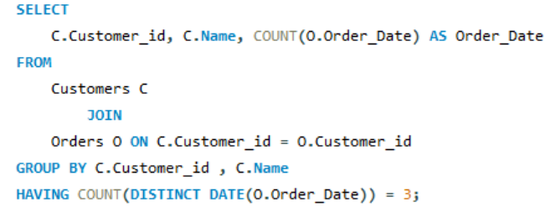
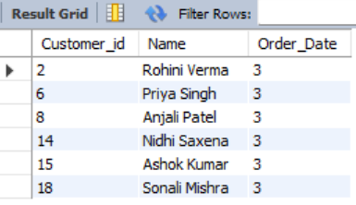
🧋
📅 The Three-Day Loyalists: Orders on Exactly 3 Different Days
11
Q11: Find the customers who have placed orders on exactly three different days.
Why this analysis: Detect a loyal, habit-forming customer cohort worth targeted, personalised engagement.
QUERY
RESULT
🍟
13

Slide 14
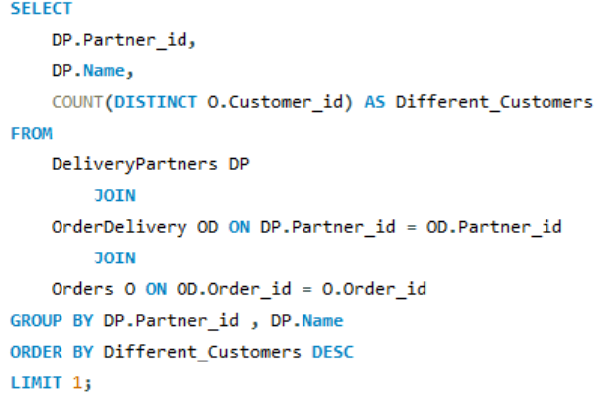
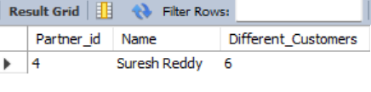
🍪
🗺️ Most-Traveled Partner: Widest Customer Reach
12
Q12: Find the delivery partner who has worked with the most different customers.
Why this analysis: Find the delivery partner serving the most distinct customers, useful for route and territory planning.
QUERY
RESULT
📸 Screenshot space —
result to be added
🥡
14

Slide 15

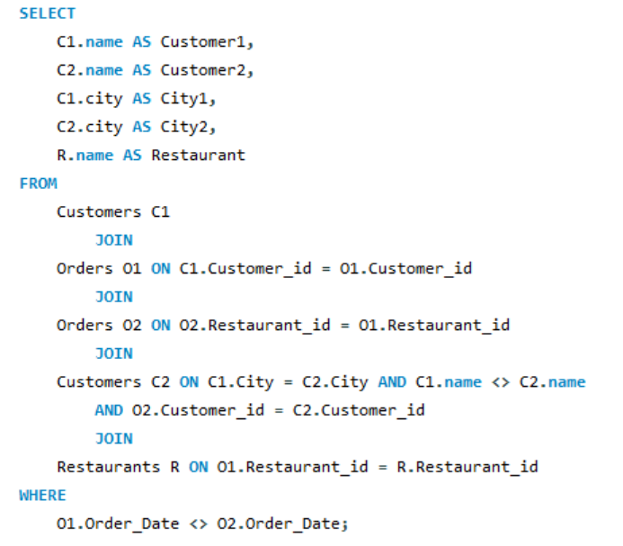
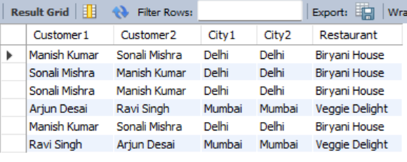

🔁 Déjà Food: Same City, Same Restaurant, Different Dates
13
Q13: Identify customers who have the same city and have placed orders at the same restaurants, but on different dates.
Why this analysis: Uncover repeat-visit patterns within a city to strengthen restaurant partnerships and predict demand.
QUERY
RESULT
📸 Screenshot space —
result to be added
15

Slide 16
TOOLS & CREDITS:
AI Assistance: Claude AI was used as a supporting tool for brainstorming, presentation design, and creating the chatbot visual concept.
Image Credits: Food-related images used in the presentation were sourced from Pinterest for visual representation.
My Contribution : I worked on the SQL queries and analysis, interpreted the results, and put together the final presentation based on my understanding of the case study.

Slide 17
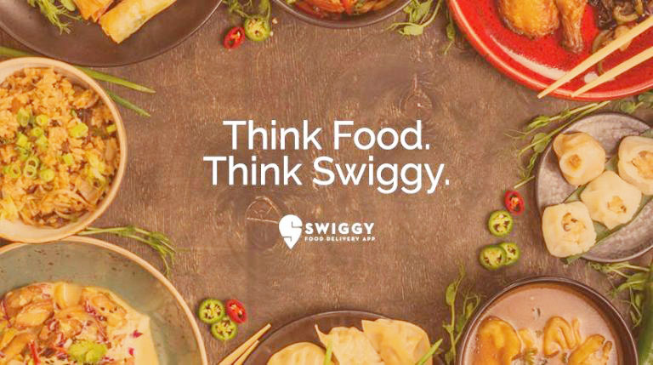
Thank You!
Bon appétit — may your queries always JOIN cleanly! 🍜✨
Swiggy SQL Analytics

