Slide 1
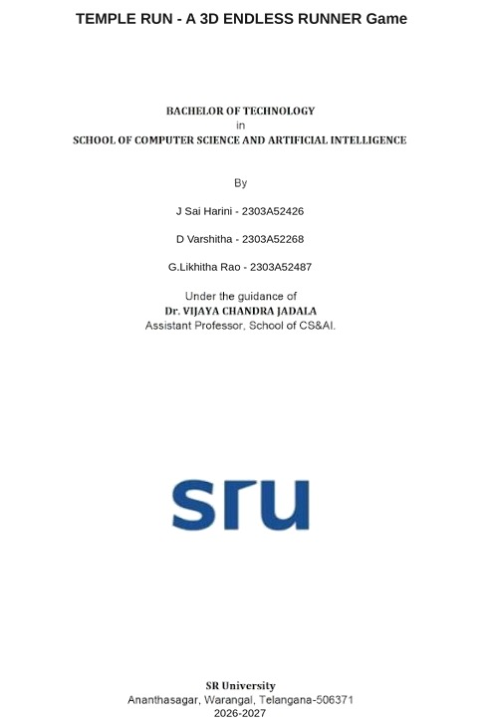

Slide 2
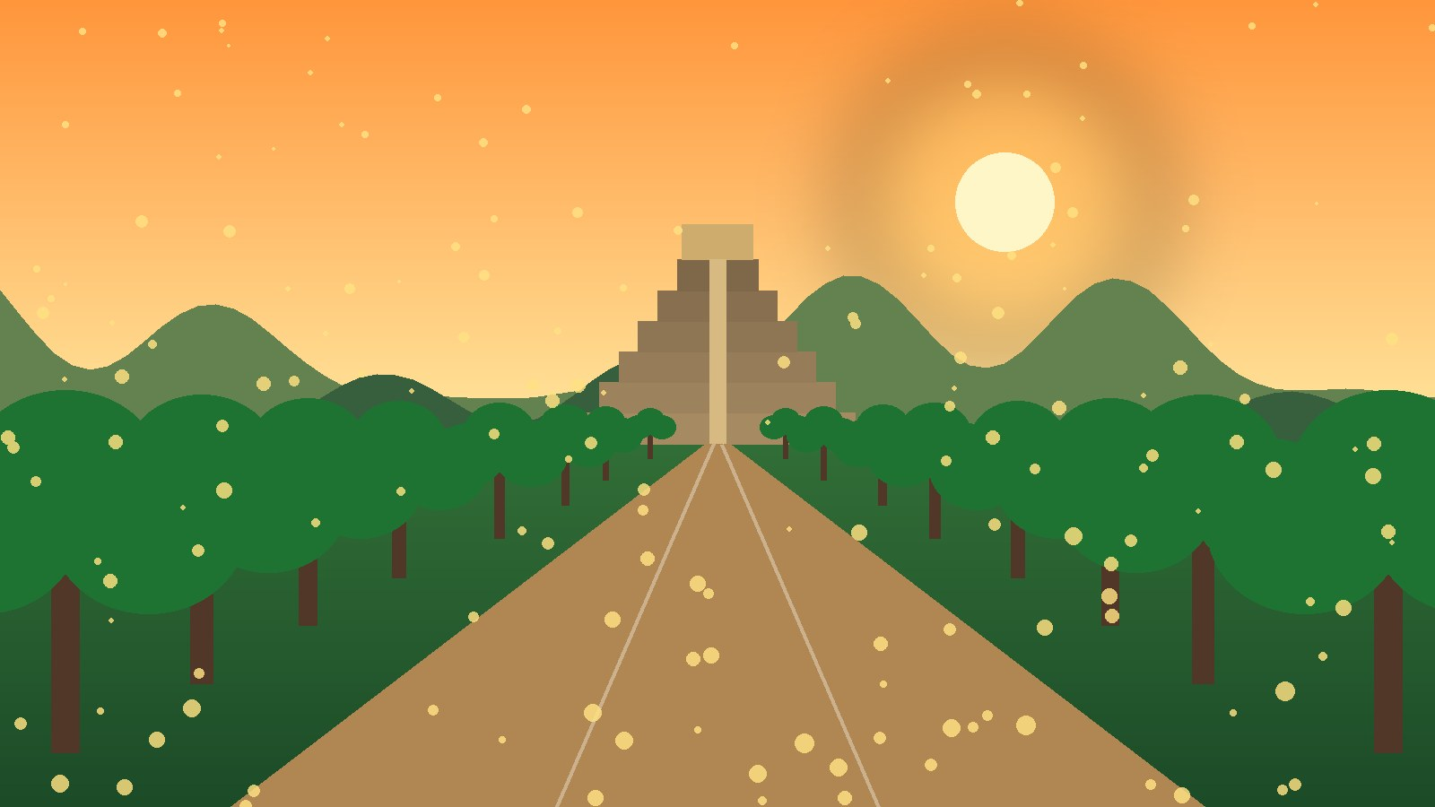
TEMPLE RUN
Endless runner built in Unity Hub
Themes: Cherry Blossom | Frozen Kingdom | Volcanic Island

Slide 3
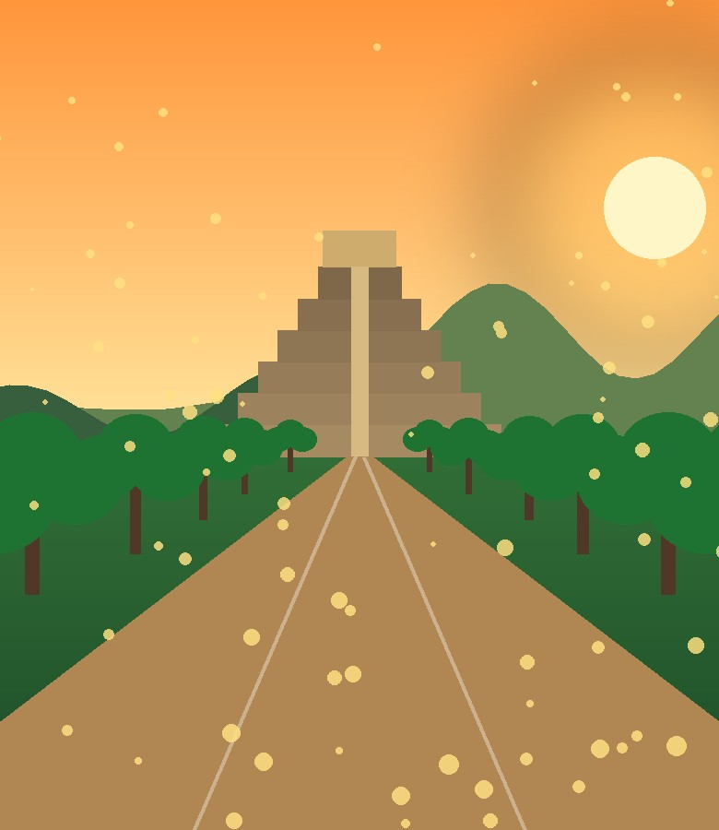
Game Overview
Genre: 3D endless runner, mobile/PC
Goal: run as far as possible, dodge obstacles, collect coins
Camera: third-person, behind the runner
Controls: swipe/arrow keys to turn, jump, slide, and lean
Difficulty: speed increases gradually with distance
Game over: hitting an obstacle, falling, or being caught
Three visual themes change the world, hazards and mood

Slide 4
Core Gameplay Mechanics
Movement
Obstacles
Auto-forward run
Left/right lane switch or 90° turns
Jump and slide
Gaps, barriers, low branches
Theme-specific hazards
Collision ends the run
Collectibles
Progression
Coins for score and shop
Power-ups: magnet, shield, boost
Distance multiplier
Speed ramps up over time
Missions and high score
Unlock characters/themes

Slide 5
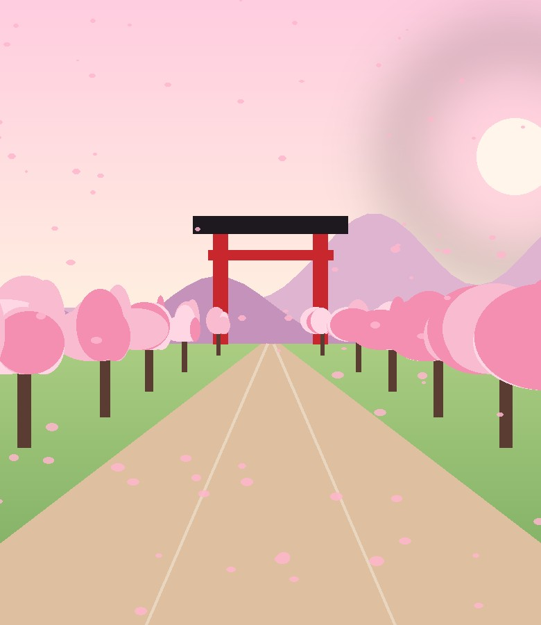
Unity Hub Project Setup
Unity Hub > New Project > 3D (URP) template
Install a Unity LTS editor version
Folders: Scripts, Prefabs, Materials, Scenes, Audio, UI, Themes
Scenes: MainMenu, Game, GameOver
Build target: Android / PC via Build Settings
Version control with Git (ignore Library folder)

Slide 6
Properties & Components Used
Component | Used for
Rigidbody / CharacterController | Player movement, gravity, jump
Box / Capsule Collider | Obstacle & coin detection (Is Trigger)
Animator | Run, jump, slide, death states
Transform | Position, rotation, lane offsets
Particle System | Dust, snow, petals, embers
Audio Source | Music, coin and crash sounds
Canvas / TextMeshPro | Score, coins, menus

Slide 7

Level Generation & Scripts
Procedural tiles: random path prefabs spawned ahead of the player
Object pooling: old tiles are disabled and reused for performance
PlayerController.cs: input, lanes, jump, slide
TileSpawner.cs: spawn, recycle, difficulty
GameManager.cs: state, score, speed
ThemeManager.cs: swaps skybox, materials, prefabs, lighting
Collectible.cs / Obstacle.cs: trigger events

Slide 8
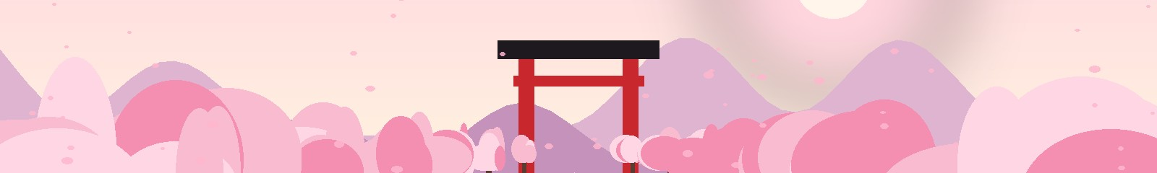
Theme 1: Cherry Blossom
A calm Japanese temple path under falling sakura petals
Environment
Hazards
Unity Effects
Torii gates, stone lanterns
Pink blossom trees
Soft dawn skybox
Fallen logs, stone walls
Broken wooden bridges
Rolling boulders
Petal Particle System
Warm directional light
Bloom in URP Volume
Palette:

Slide 9

Theme 2: Frozen Kingdom
An icy palace path through snow, glaciers and crystal bridges
Environment
Hazards
Unity Effects
Ice castle, frozen lake
Snowy pine trees
Blue-white skybox
Slippery ice (low friction)
Icicles, cracking ice floors
Snow walls
Snowfall Particle System
Cold fog and blue light
Physic Material: ice
Palette:

Slide 10
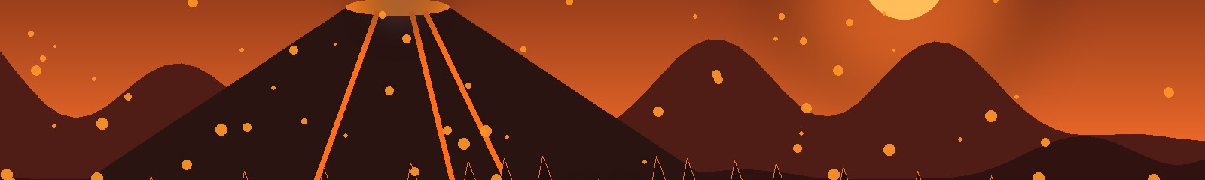
Theme 3: Volcanic Island
A dangerous run over lava, ash and burning rock bridges
Environment
Hazards
Unity Effects
Lava rivers, basalt rock
Smoking volcano backdrop
Red-orange skybox
Lava gaps, fire jets
Falling rocks
Collapsing bridges
Ember and smoke particles
Glowing emissive lava
Camera shake on eruption
Palette:

Slide 11
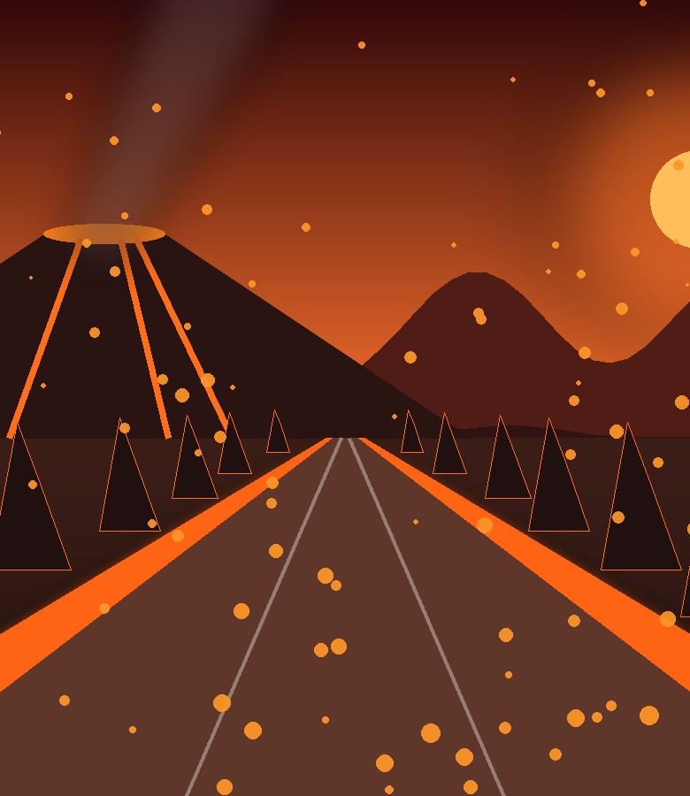
UI, Audio, Build & Summary
UI: score, coins, pause, game over, theme select
Audio: theme music, coin ping, crash sound
Optimization: object pooling, baked lighting, low-poly models
Build: Android APK/AAB or Windows from Unity Hub
Result: one endless runner with three switchable themes: Cherry Blossom, Frozen Kingdom, Volcanic Island
Next: more characters, daily missions, leaderboards

