Slide 1
E-COMMERCE SALES ANALYTICS
End-to-End Data Analytics Report
Dataset: realistic_e_commerce_sales_data.csv | 1,000 Transactions | Jan 2023 – Jan 2024
Key Highlights
Total Revenue: ₹1,378,791
Orders: 1,000 | Unique Customers: 292
Return Rate: 30.8% | Delivery Rate: 31.3%
Top Product: Laptop (₹715,314) | Top Region: West
Prepared by: Data Analytics Team
Python | pandas | Matplotlib | Seaborn | Streamlit

Slide 2
Table of Contents
Report Structure — 20 Slides
01
Cover & Highlights
11
Regional Analysis
Introduction and key metrics at a glance
Geographic performance breakdown
02
Table of Contents
12
Customer Analysis
Report structure overview
Loyalty, repeat rate, top spenders
03
Problem Statement
13
Gender Analysis
Objective and scope of the analysis
Male vs Female revenue and orders
04
Business Objectives
14
Age Group Analysis
Goals and deliverables defined
Life-stage spending patterns
05
Dataset Overview
15
Shipping Analysis
Structure, columns, data types, missing values
Delivered, In Transit, Returned breakdown
06
Data Cleaning Summary
16
Monthly Sales Trend
12-step preprocessing pipeline
Revenue and order trends across 12 months
07
Feature Engineering
17
Quarterly Performance
8 derived analytical columns
Q1–Q4 revenue and order comparison
08
Executive KPI Dashboard
18
Business Insights (1/2)
Headline metrics — revenue, orders, customers
Data-backed findings and recommendations
09
Product Analysis
19
Business Insights (2/2)
Revenue and quantity by product
Continued findings and recommendations
10
Category Analysis
20
Conclusions & Next Steps
Revenue concentration and contribution
Summary and action plan

Slide 3
Problem Statement
Objective & Scope of Analysis
Objective
Analyse 1,000 e-commerce transactions collected over 13 months (Jan 2023 – Jan 2024) to extract actionable insights that drive revenue growth, reduce returns, and improve customer experience.
Sales
Products
Total revenue, average order value, quantity trends
Best and worst-performing products by revenue & volume
Categories
Customers
Revenue concentration, contribution %, avg order value
Loyalty rate, repeat buyers, spending distribution
Regions
Gender
Geographic sales performance across North/South/East/West
Revenue, order count and avg spend split by gender
Shipping
Trends
Delivered vs In-Transit vs Returned order breakdown
Daily, monthly and quarterly revenue patterns
Age Groups
Returns
Life-stage spending segmentation (18-25 through 56+)
Return rate, affected revenue, and root-cause indicators

Slide 4
Business Objectives
Goals & Deliverables
01
Identify the highest-selling products by revenue and order frequency
02
Find the most profitable / high-revenue categories
03
Analyse regional sales performance across all four regions
04
Understand customer demographics — gender, age group, repeat rate
05
Identify the most popular products by volume (units sold)
06
Analyse shipping and delivery status distribution
07
Study monthly and quarterly sales trends
08
Measure quantity sold across all product and category dimensions
09
Calculate and benchmark the Average Order Value (AOV)
10
Identify returned orders and quantify their revenue impact
11
Generate data-driven business recommendations for each dimension

Slide 5
Dataset Overview
Structure, Columns, Data Types & Missing Values
Rows
Columns
Date Range
Missing Cells
Duplicates
File Size
1,000
12
Jan 2023 – Jan 2024
200 (6.7%)
0
~147 KB
#
Column Name
Data Type
Missing
Description
1
Customer ID
string
0
Unique customer identifier
2
Gender
string
0
Male / Female
3
Region
string
50
North / South / East / West
4
Age
float64
100
Customer age (years)
5
Product Name
string
0
Name of the ordered product
6
Category
string
0
Electronics / Wearables / Accessories
7
Unit Price
float64
0
Price per unit (₹)
8
Quantity
int64
0
Units ordered
9
Total Price
float64
0
Unit Price × Quantity
10
Shipping Fee
float64
0
Delivery charge (₹)
11
Shipping Status
string
50
Delivered / In Transit / Returned
12
Order Date
string→dt
0
Date of transaction (YYYY-MM-DD)

Slide 6
Data Cleaning Pipeline
12-Step Preprocessing — Original Data Preserved
1
Dataset Loaded
2
Missing Value Audit
1,000 rows × 12 columns from CSV
Region: 50 nulls | Age: 100 nulls | Shipping: 50 nulls
3
Fill Missing Age
4
Fill Missing Region
100 nulls replaced with median age (49.0)
50 nulls replaced with mode value 'West'
5
Fill Missing Shipping
6
Remove Duplicates
50 nulls replaced with 'Unknown'
0 exact duplicate rows found
7
Remove Invalid Numerics
8
Standardise Categories
0 rows with zero/negative prices or quantities
strip() + title-case on Gender, Region, Category, Status
9
Parse Order Date
10
Extract Date Parts
Converted string → datetime64 (range: Jan 2023 – Jan 2024)
Year, Month, Month Name, Day columns created
11
Verify Total Price
12
Feature Engineering
Result: 1,000 rows × 24 columns | All missing values handled | Original raw data untouched
20 mismatched rows corrected (Unit Price × Qty)
8 new analytical columns added

Slide 7
Feature Engineering
8 New Analytical Columns Derived from Raw Data
Revenue
Age Group
= Total Price (verified)
pd.cut(Age) → 18-25 / 26-35 / 36-45 / 46-55 / 56+
Core per-order income metric
Life-stage customer segmentation
Total Amount
Revenue per Qty
= Revenue + Shipping Fee
= Revenue / Quantity
Total paid by customer
Effective per-unit revenue
Quarter
Return Flag
dt.quarter → Q1 / Q2 / Q3 / Q4
1 if Shipped = 'Returned' else 0
Quarterly trend analysis
Binary return indicator for modelling
Order Day
Delivered Flag
dt.day_name() → Mon–Sun
1 if Shipped = 'Delivered' else 0
Day-of-week pattern analysis
Binary delivery indicator

Slide 8
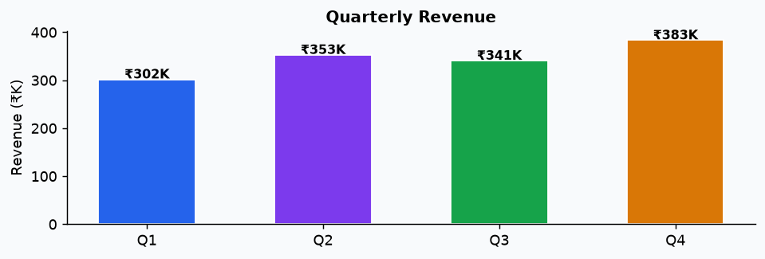
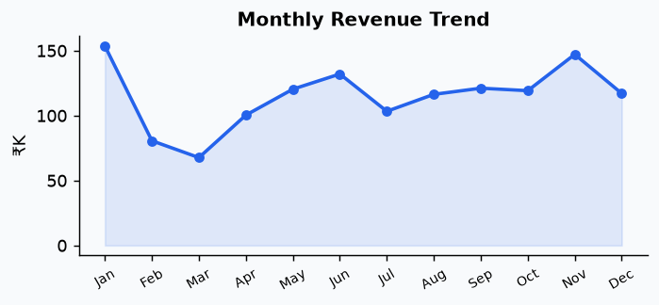
Executive KPI Dashboard
Overall Sales Summary — Full Dataset
Total Revenue
Total Orders
Units Sold
Unique Customers
₹1,378,791
1,000
3,008
292
Avg Order Value
Avg Unit Price
Avg Shipping Fee
Return Rate
₹1,379
₹458
₹12.42
30.8%
Delivery Rate
Repeat Customers
Total Amount Paid
Date Range
31.3%
251 / 292
₹1,391,208
2023-01-01 → 2024-01-03
Electronics dominates with 89.3% revenue share | West region leads with ₹405,964 | Peak month: January (₹153,523) | Top age segment: 46-55 (₹454,231)

Slide 9
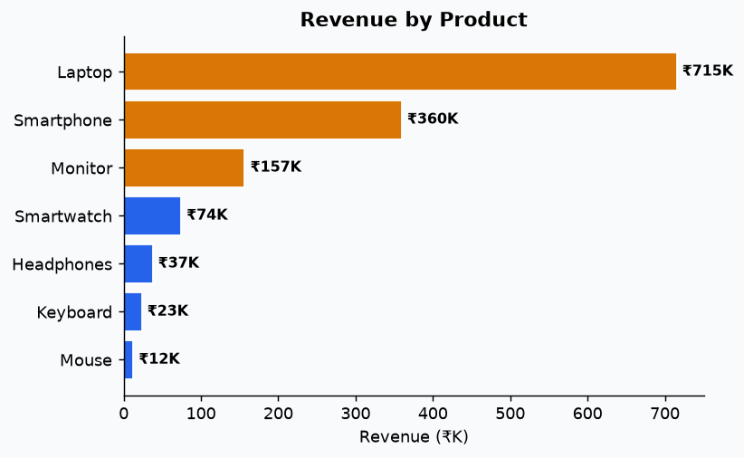
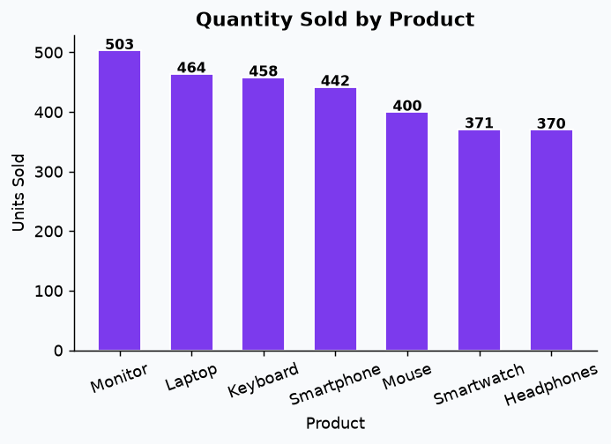
Product Analysis
Revenue, Quantity & Return Rate by Product
Product
Revenue
Quantity
Orders
Return %
Laptop
₹715,315
464
154
31.8%
Smartphone
₹359,609
442
142
29.6%
Monitor
₹156,694
503
181
28.7%
Smartwatch
₹74,200
371
122
31.1%
Headphones
₹37,322
370
120
33.3%
Keyboard
₹23,329
458
145
29.7%
Mouse
₹12,322
400
136
32.4%

Slide 10
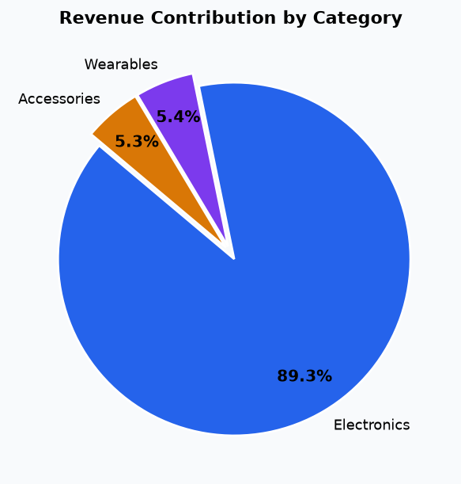
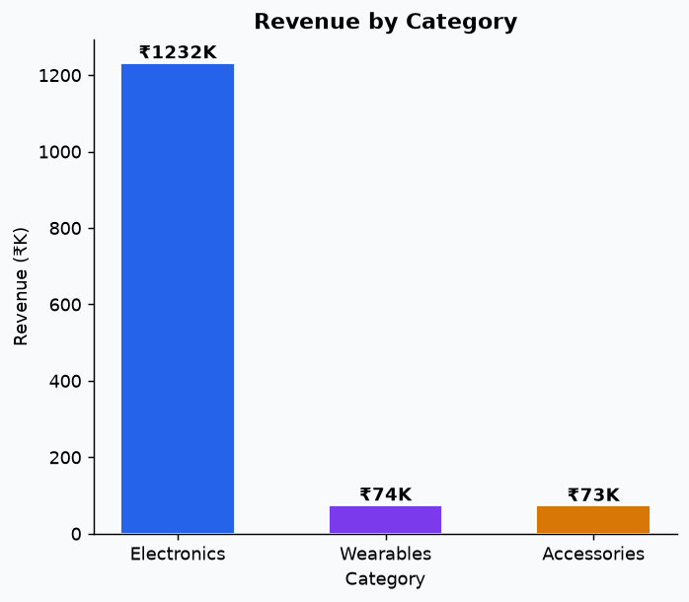
Category Analysis
Revenue Concentration & Contribution
Top Category
Electronics AOV
Accessories AOV
Wearables Contribution
Electronics (89.3%)
₹2,582
₹182
5.4%

Slide 11
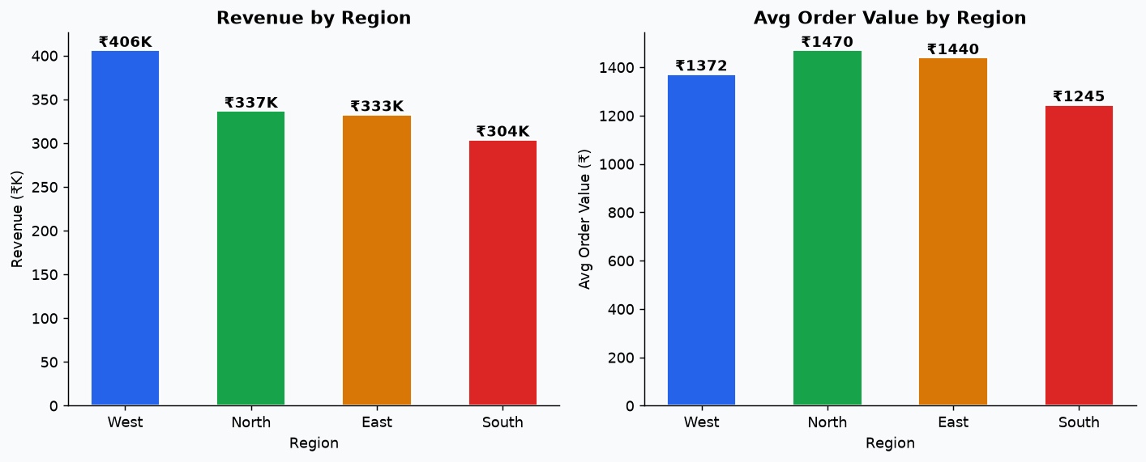
Regional Analysis
Geographic Sales Performance
West
North
East
South
Rev: ₹405,964 | AOV: ₹1,372
Rev: ₹336,579 | AOV: ₹1,470
Rev: ₹332,525 | AOV: ₹1,440
Rev: ₹303,723 | AOV: ₹1,245

Slide 12
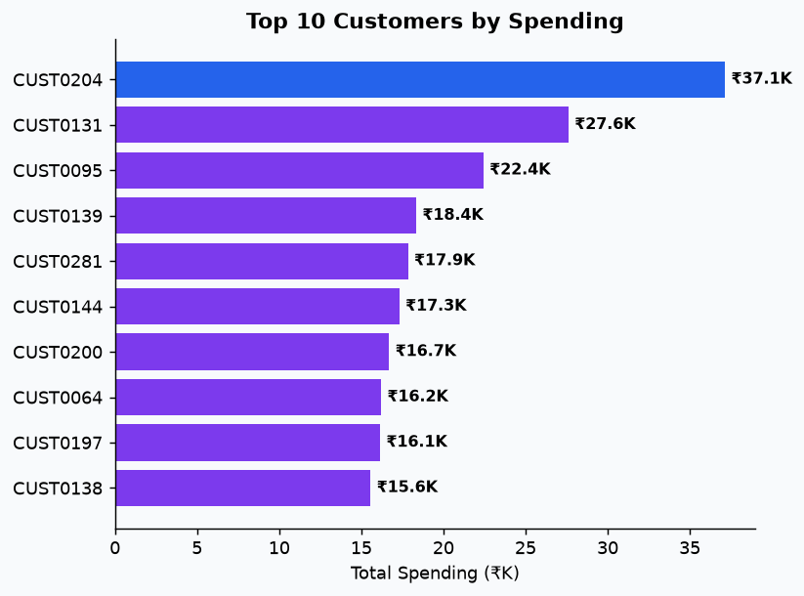
Customer Analysis
Loyalty, Repeat Rate & Top Spenders
Unique Customers
Repeat Customers
Repeat Rate
Avg Spend / Cust
292
251
86.0%
₹4,722
Rank
Customer ID
Total Spending
1
CUST0204
₹37,148
2
CUST0131
₹27,618
3
CUST0095
₹22,440
4
CUST0139
₹18,350
5
CUST0281
₹17,850
6
CUST0144
₹17,320
7
CUST0200
₹16,700
8
CUST0064
₹16,210
9
CUST0197
₹16,150
10
CUST0138
₹15,569

Slide 13
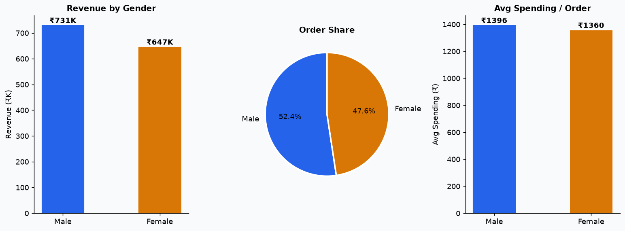
Gender Analysis
Revenue, Orders & Avg Spending by Gender
Male
Female
Revenue: ₹731,482 | Orders: 524 | Qty: 1,586 | AOV: ₹1,396
Revenue: ₹647,309 | Orders: 476 | Qty: 1,422 | AOV: ₹1,360

Slide 14
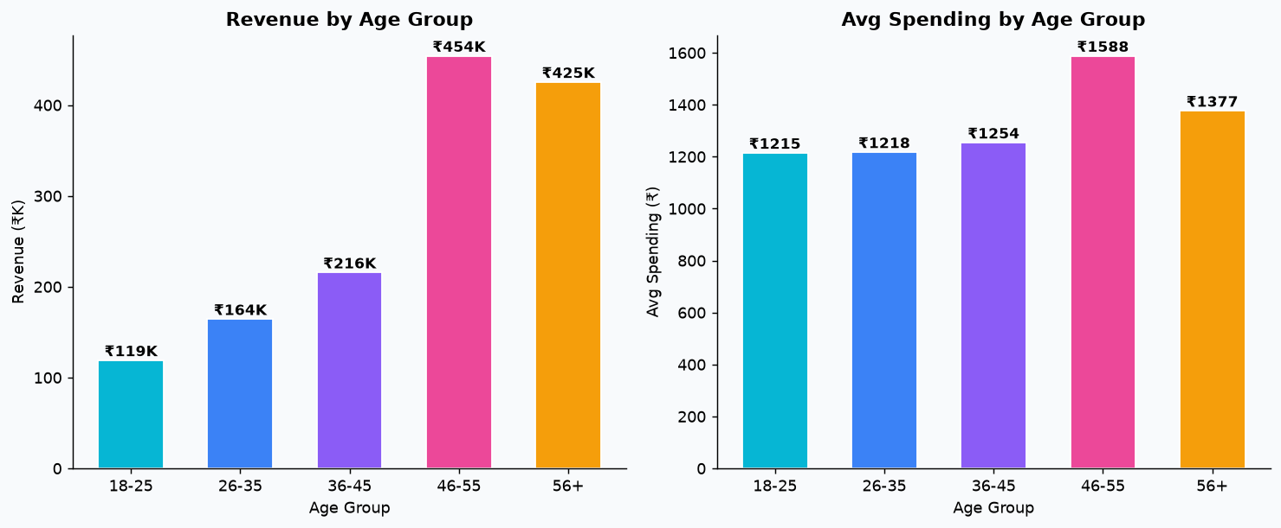
Age Group Analysis
Life-Stage Spending & Revenue Segmentation
18-25
26-35
36-45
46-55
56+
₹119,044 | 98 orders
₹164,374 | 135 orders
₹215,730 | 172 orders
₹454,231 | 286 orders
₹425,412 | 309 orders

Slide 15
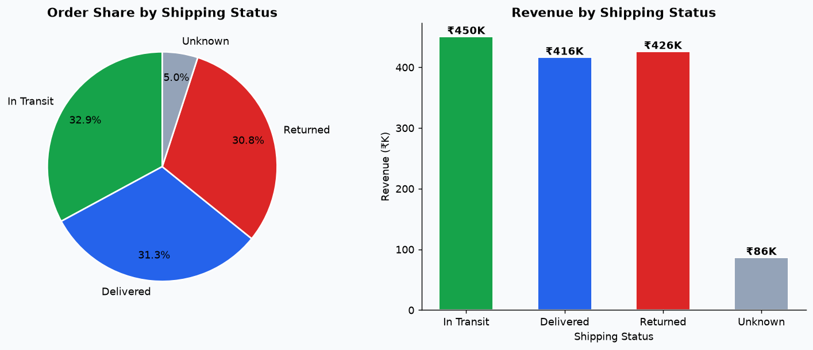
Shipping Analysis
Delivered / In Transit / Returned Breakdown
In Transit
Delivered
Returned
Unknown
329 orders (32.9%)
313 orders (31.3%)
308 orders (30.8%)
50 orders (5.0%)

Slide 16
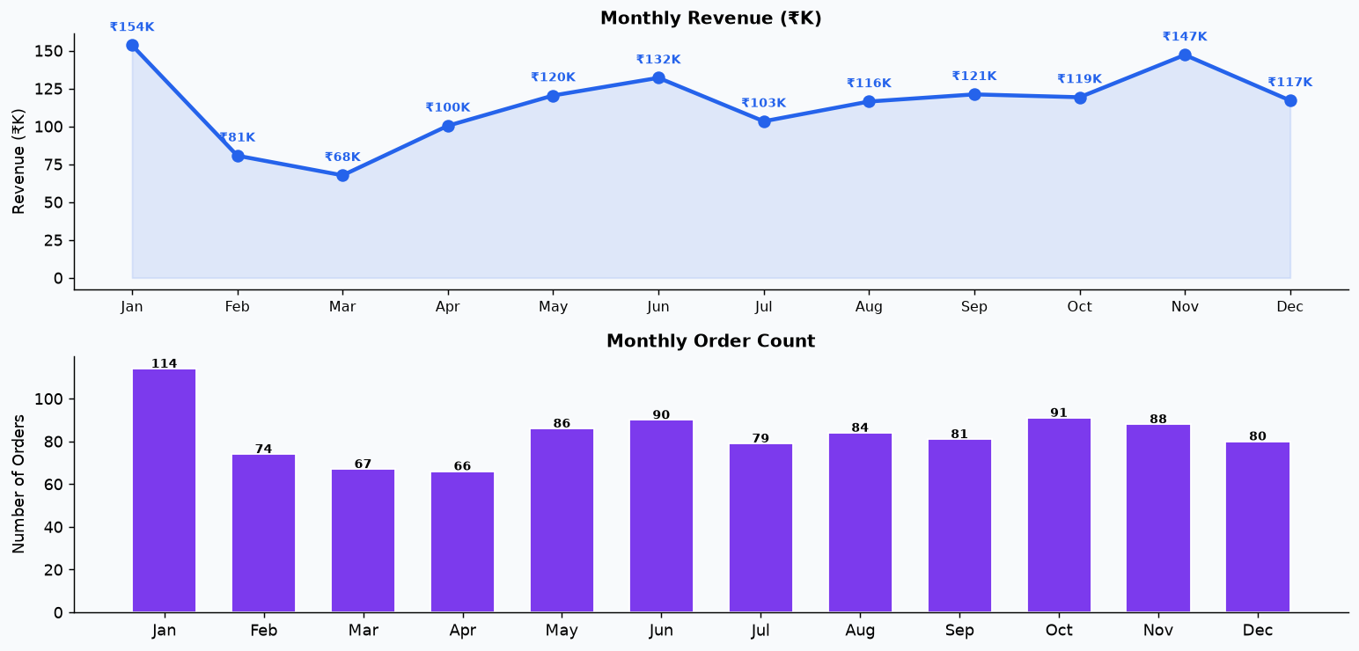
Monthly Sales Trend
Revenue & Order Count Across 12 Months

Slide 17
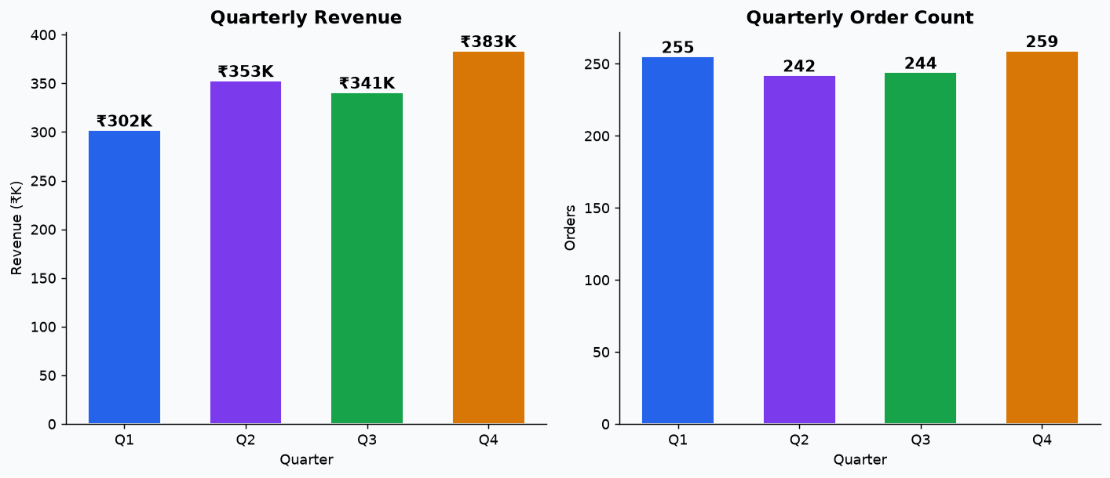
Quarterly Performance
Q1–Q4 Revenue & Order Comparison
Q1
Q2
Q3
Q4
₹301,810 (255 orders)
₹352,779 (242 orders)
₹340,797 (244 orders)
₹383,405 (259 orders)

Slide 18
Business Insights (1/2)
Data-Backed Findings & Recommendations
Top-Selling Product
🏆
Finding: Laptop drives the highest revenue (₹715,315). Mouse is the weakest performer.
Recommendation: Increase marketing spend and bundled promotions for Laptop. Review pricing or visibility strategy for Mouse.
Category Revenue Concentration
📦
Finding: Electronics contributes 89.3% of total revenue, indicating heavy reliance on a single category.
Recommendation: Diversify the product catalogue across under-performing categories to reduce revenue concentration risk.
Regional Performance Gap
🗺️
Finding: West leads all regions in revenue. South shows the lowest sales volume.
Recommendation: Audit logistics, pricing, and marketing in South. Replicate the successful playbook from West.
Return Rate Alert
↩️
Finding: 30.8% of orders are returned, representing ₹425,823 in reversed revenue.
Recommendation: Investigate top return reasons — incorrect size, quality issues, or misleading product descriptions — and implement targeted fixes.
Delivery Success Rate
🚚
Finding: 31.3% of orders are successfully delivered, generating ₹416,233 in confirmed revenue.
Recommendation: Offer real-time tracking and proactive delay notifications to further improve customer satisfaction and reduce in-transit losses.

Slide 19
Business Insights (2/2)
Continued Findings & Recommendations
Customer Loyalty Opportunity
👥
Finding: 251 of 292 customers (86.0%) have placed more than one order.
Recommendation: Launch a tiered loyalty programme — points, early access, and personalised discounts — to convert one-time buyers into repeat customers.
High-Value Age Segment: 46-55
🎂
Finding: The 46-55 age group generates the highest revenue (₹454,231).
Recommendation: Tailor email campaigns, push notifications, and product curation specifically for the 46-55 demographic.
Seasonal Sales Peaks
📅
Finding: Revenue peaks in Jan and dips in Mar.
Recommendation: Pre-load inventory and run promotional campaigns before Jan. Use clearance sales and discounts to lift Mar performance.
Average Order Value Optimisation
💰
Finding: The current average order value is ₹1,378.79.
Recommendation: Implement 'Frequently Bought Together', minimum-spend free-shipping thresholds, and volume-discount bundles to raise the average order value.

Slide 20
Conclusions & Next Steps
Summary of Findings & Recommended Actions
Revenue
Electronics
Total revenue of ₹1,378,791 across 1,000 orders with an AOV of ₹1,379.
Electronics dominates with 89.3% revenue share — diversification is a strategic priority.
Top Product
Region
Laptop drives 51.9% of total revenue; Mouse and Keyboard need promotion strategy review.
West leads revenue; South lags — regional campaigns and logistics review recommended.
Returns
Demographics
30.8% return rate representing ₹425,823 in reversed revenue needs immediate attention.
Age group 46-55 is the highest-spending segment; target with premium & loyalty offers.
Seasonality
Loyalty
January is the peak month; March is the weakest — plan inventory and campaigns accordingly.
251 of 292 customers (86%) are repeat buyers — a strong loyalty base.
Recommended Actions
Invest in Electronics diversification • Fix return pipeline • Launch 46-55 loyalty campaign • Boost South region marketing • Bundle Mouse & Keyboard with Laptop • Pre-stock for January peak

