Slide 1

BACHELOR OF TECHNOLOGY
IN
Artificial Intelligence and Machine Learning
Project Guide - Prof Bhavani
Batch Names & Roll Numbers
CH VARSHITH - 2111CS020620
H VARSHITH - 2111CS020621
D VARSHITHA - 2111CS020622
M VARSHITHA - 2111CS020623
T VARSHITHA - 2111CS020624
G VARUN - 2111CS020625
Batch Number : ZT14
Department of AIML, School of Engineering
Malla Reddy University Hyderabad.

Slide 2
CONTENTS
Introduction – (Number of Slides 1 or 2 Slides)
Project Title
Abstract
Limitations (OPTIONAL)
Existing System & Proposed System (1 Slide)
Modules (1 or 2 Slides)
Architecture of Project Diagram ( 1 Slide)
DFD’s/E-R Diagram/UML/Any project diagram (1 or 2) Slides

Slide 3
PROJECT TITLE - GYM ADMINISTRATION SYSTEM PROJECT(GASP)
ABSTRACT
Gyms are become the essential part of our lives, providing best exercise. Therefore, at the management end there are some necessary steps to maintain the records of every individual including trainer, trainees, and staff But maintaining the records on paper is very difficult So, it is necessary to have a computerized system that manages all these issues. Thus working on the administration system for Gym Industry are the basis of our project.

Slide 4
Introduction
Introduction
The fitness industry has witnessed tremendous growth in recent years, with more and more people becoming health conscious and interested in maintaining a healthy lifestyle. As a result, the demand for fitness centers and gyms has increased. The management of a gym can be a daunting task, with various activities such as membership management, scheduling of appointments, and billing. Gym administration systems created using Python are an important tool that can aid in managing these activities efficiently. Our project explores the benefits and importance of gym administration systems created using Python and identifies the features of effective gym administration systems.

Slide 5
Introduction
Limitations of our project
Limited Hardware support – Since we have no information on how many users are going to access it, we may find the hardware support which is available will not be sufficient.
Data Security – Since this project will have some personal data of users including financial data that creates potential risks and we will need to ensure protection to secure data.
Maintenance & Updates – Once the system is live we will be needed to ensure that it is maintained and updated regularly to keep it running smoothly.

Slide 6
Existing System
Proposed System
Existing system is a static website so you have to use file system to save record.
Time consuming system.
No proper system to make announcements.
Important information can be missed while writing on page
Inefficient and slow search.
New proposed system allow to user to save record is database.
Fast and easy to use
If we add some scripting and do some front end we can make proper system to make announcements.
Full fledge information system.
Efficient and proper availability of data.

Slide 7
Modules
The following are the modules that are part of our Gym Administration System:
Customer Management – To add customers and view customers.
Package Management- To add packages and remove packages.
Trainer Management- To add Trainers and remove Trainers.
Gym Manager- This is the main module in our management system since he/she will be the admin of the system.

Slide 8
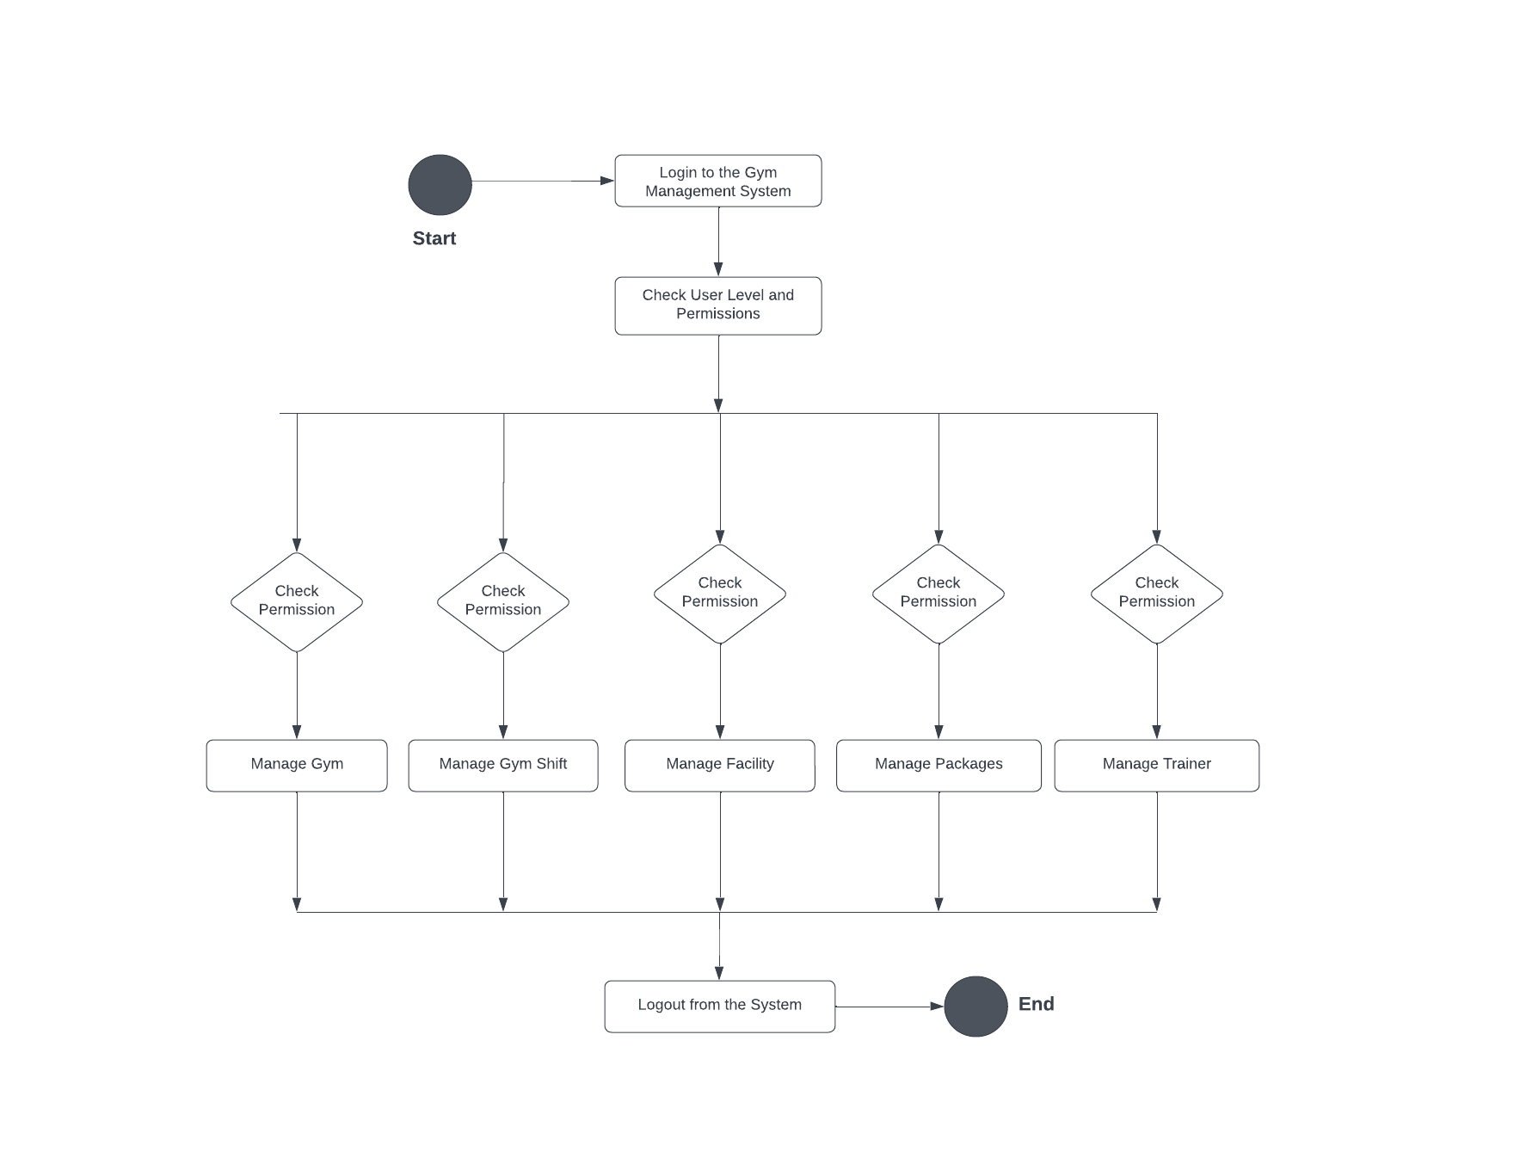
Flowchart of Project Diagram

Slide 9
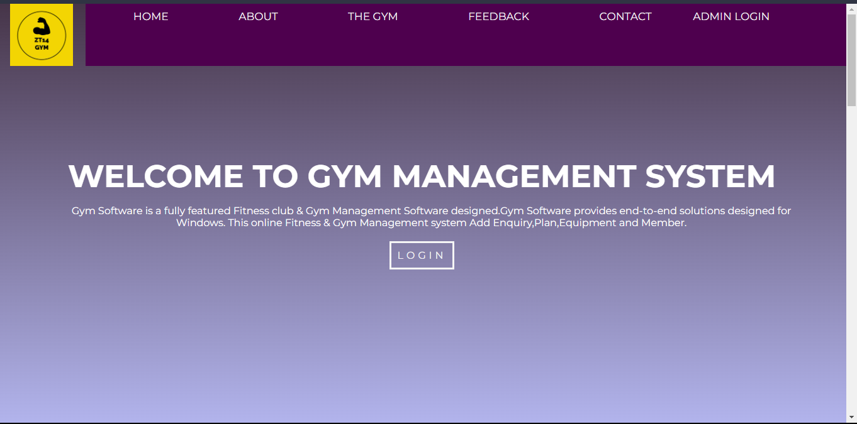
Home page for the users common for the customers and Admin (Gym Manager).

Slide 10
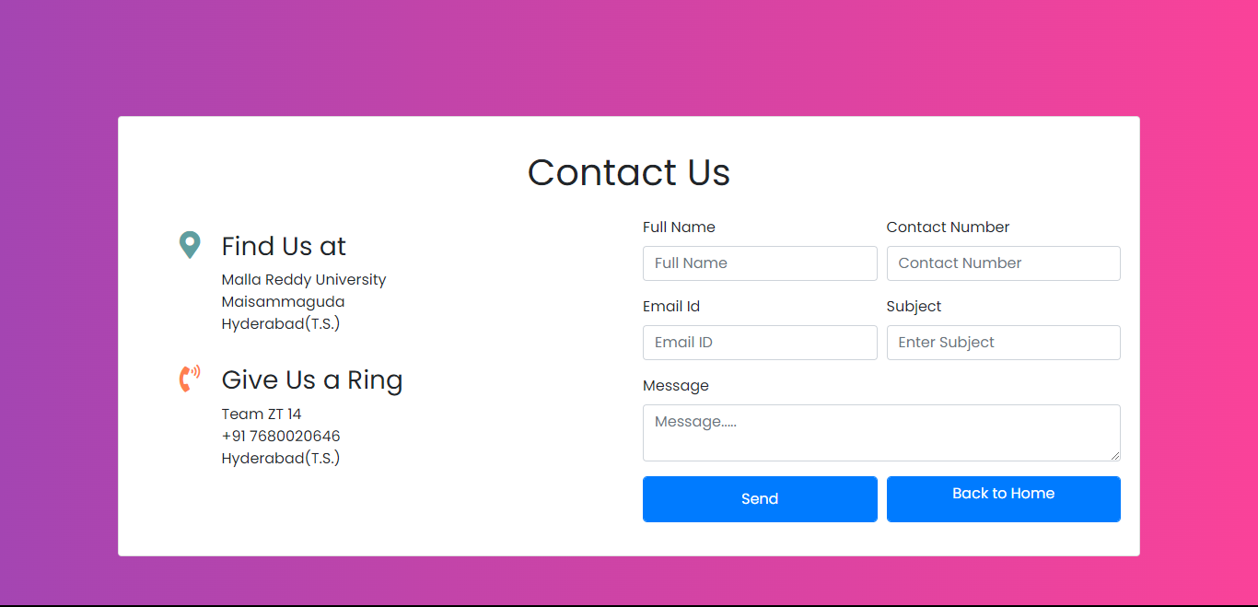
In Home webpage we have this Contact us Page which will be used to ask queries about Gym.

Slide 11
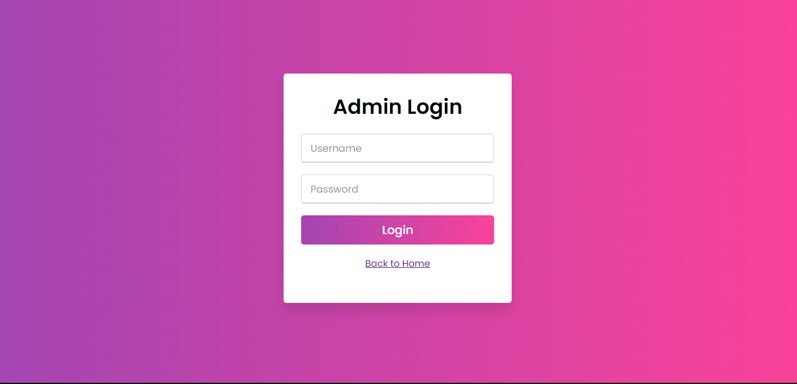
This is the Admin(Gym Manager) login page that will be used into ZT14Gym management system.

Slide 12
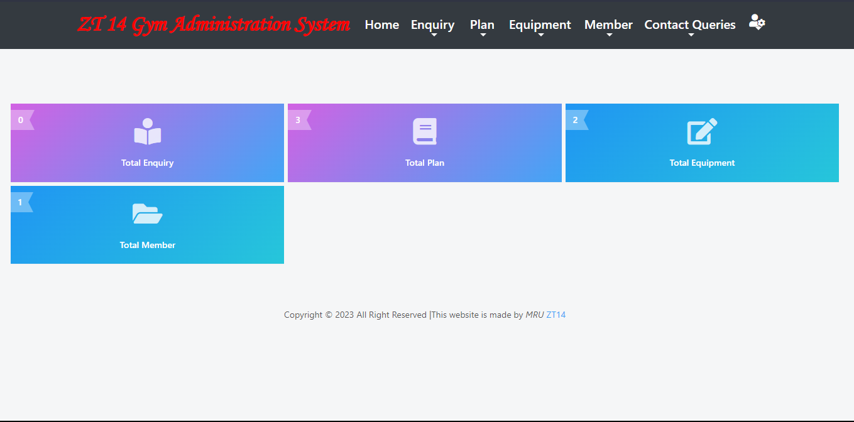
After logging in into the Gym Management System, the admin will enter into the Gym management system Home page.

Slide 13
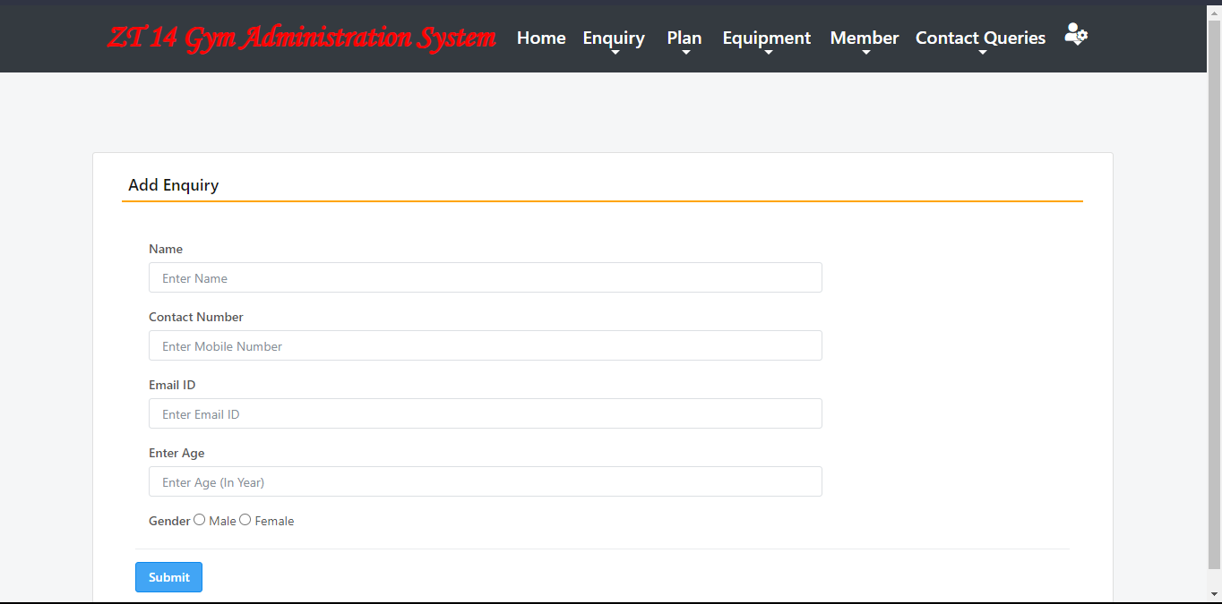
Add Enquiry page, This page is to enquire about someone, either it be trainer or customer of the Gym.

Slide 14
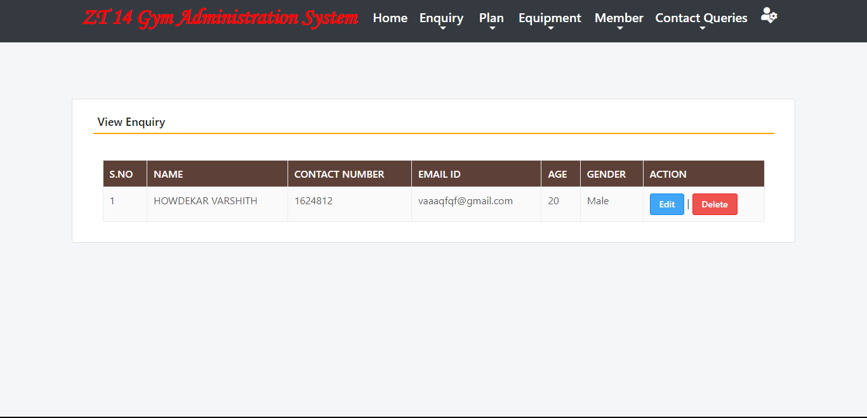
This is the view enquiry page, The details entered in the add enquiry page will be displayed here and saved in database.

Slide 15
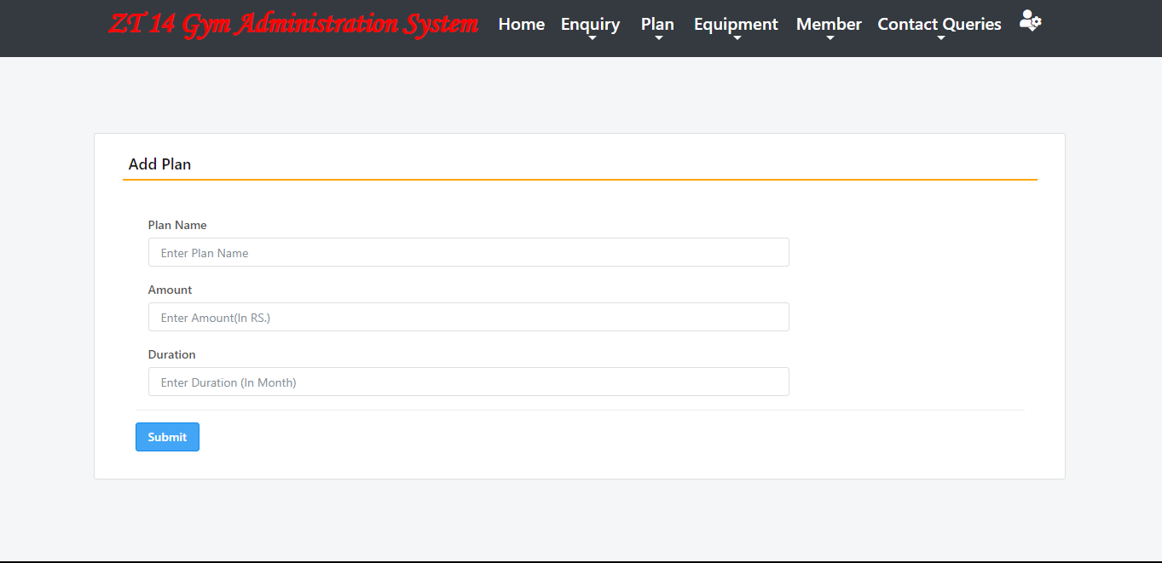
Add plan page is to add the plan or new package that needs to be introduced into Gym.

Slide 16
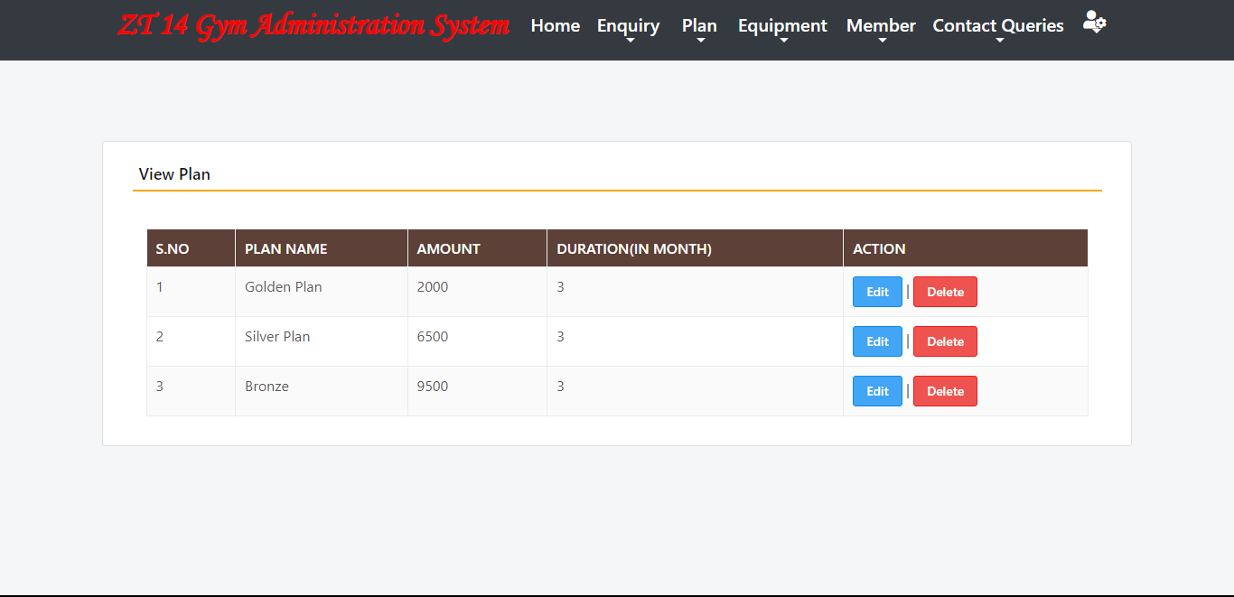
The plans/packages added into Gym will be shown here in the View plan page.

Slide 17
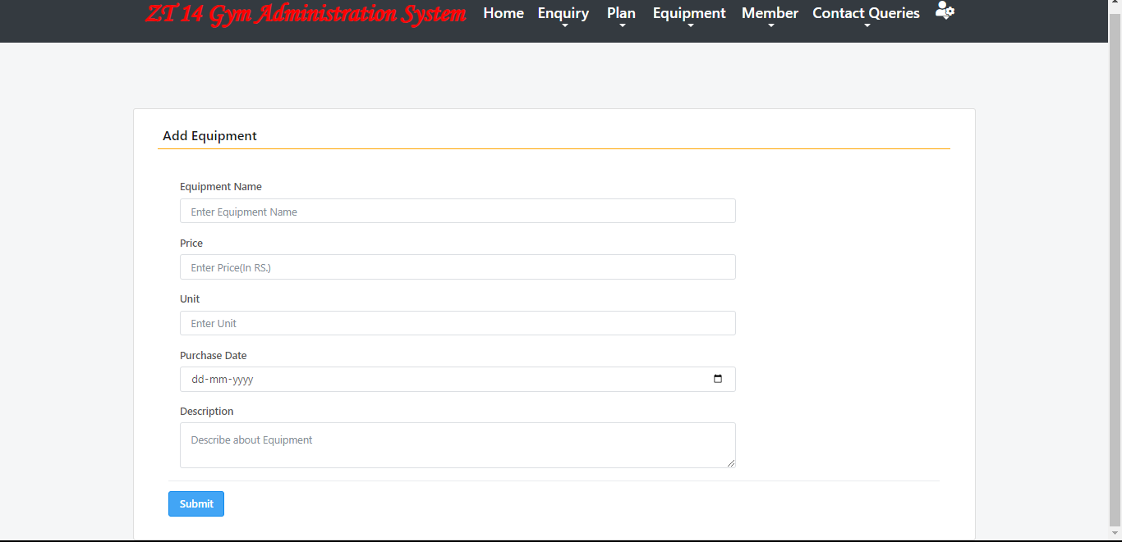
Add Equipment page, from this page the Gym manager can add the new equipment that is bought for the Gym.

Slide 18
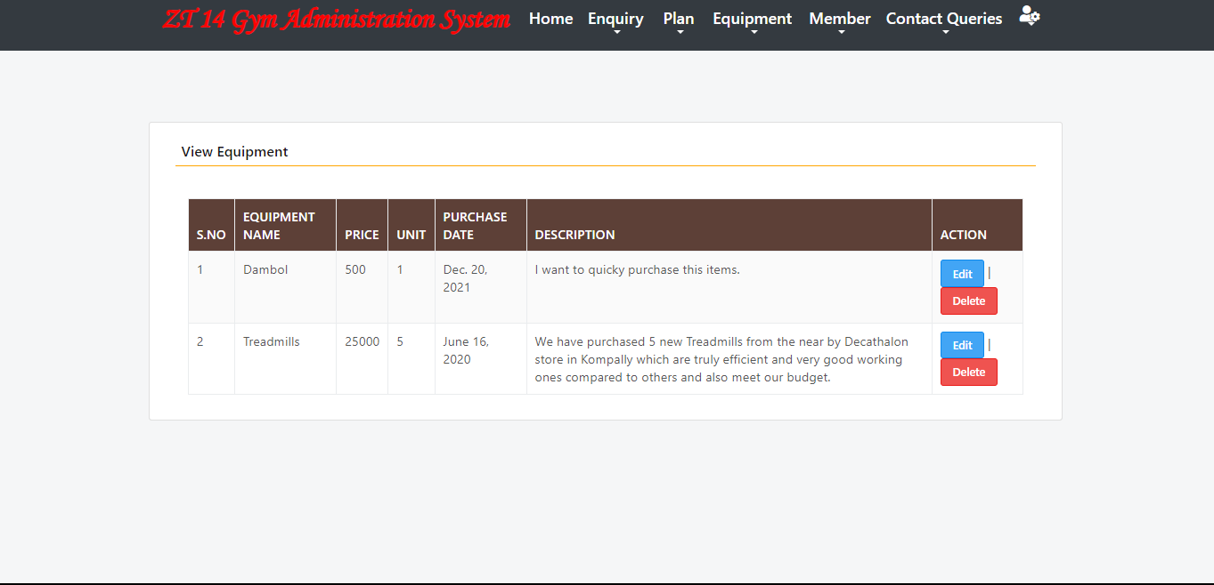
View Equipment page, from this page the Gym manager can view the new equipment that is present in the Gym.

Slide 19
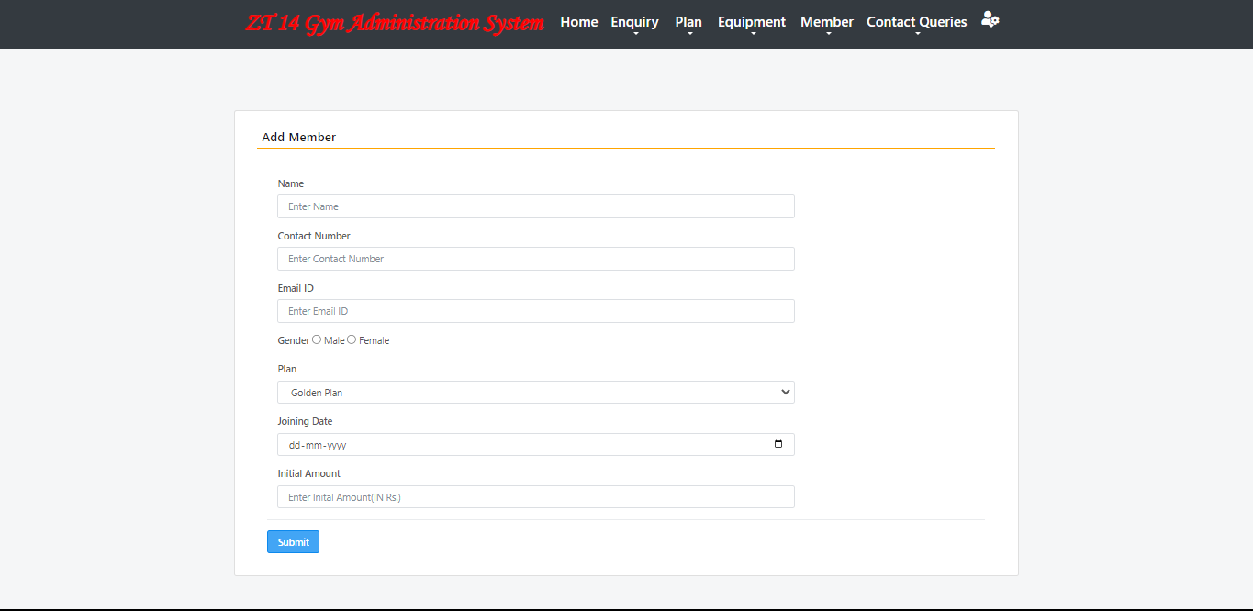
Add Member page, from this page the Gym manager can add the new customers that are joining the Gym.

Slide 20
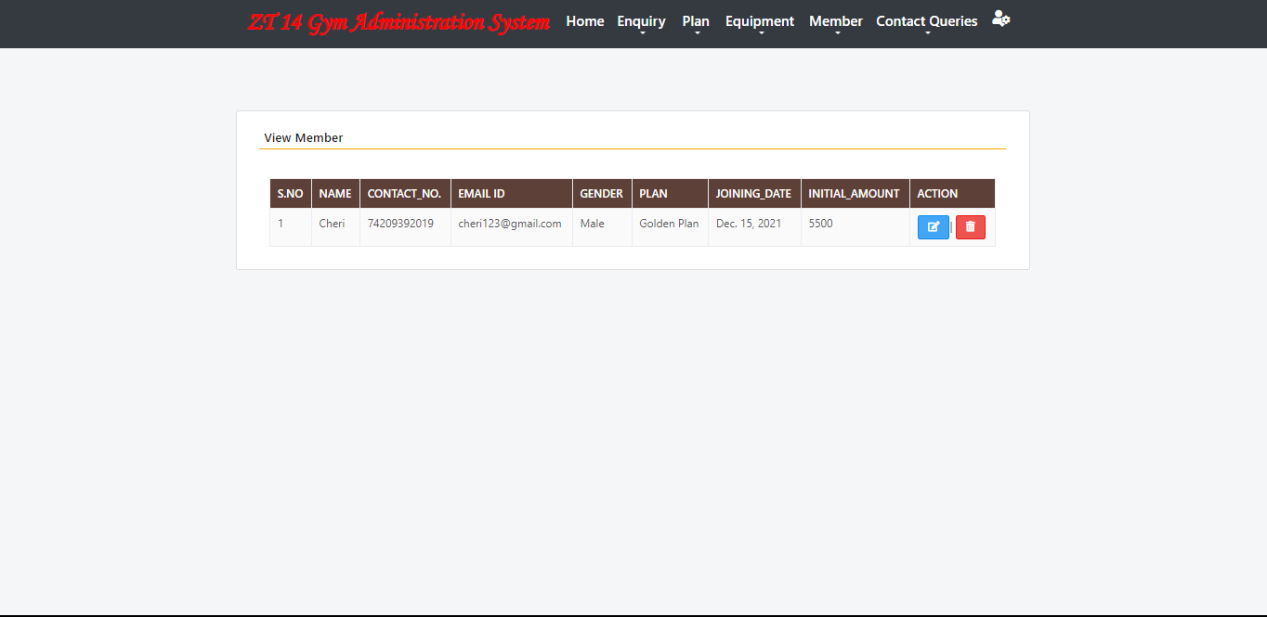
View Member page will be used to display the members that are already taken some plan/package from the Gym to get trained.

Slide 21
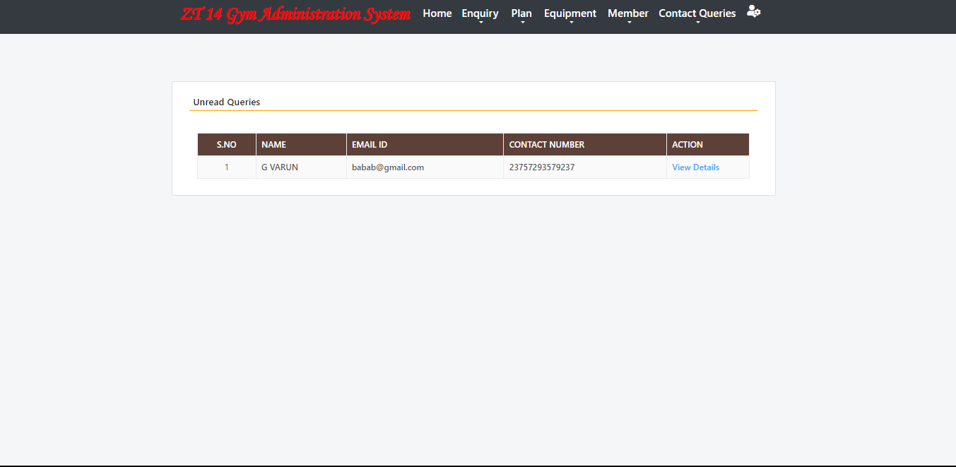
The Unread Queries page is the page, the query taken from query page(Contact Us) in the home page which is for the customers will be shown here.

Slide 22
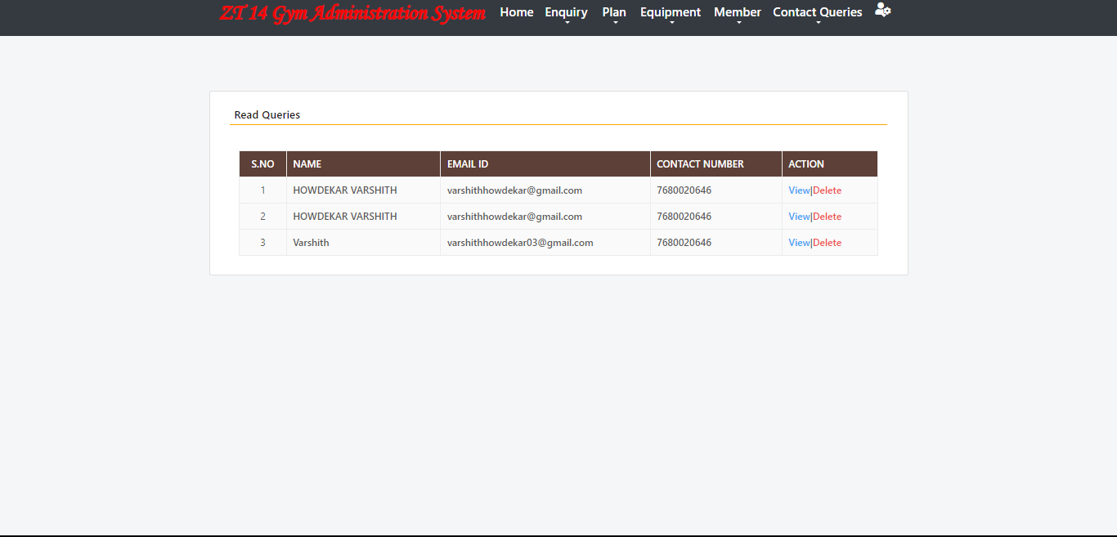
The read Queries page is the page, the query after reading that are taken from query page(Contact Us) in the home page which is for the customers will be shown here.

Slide 23
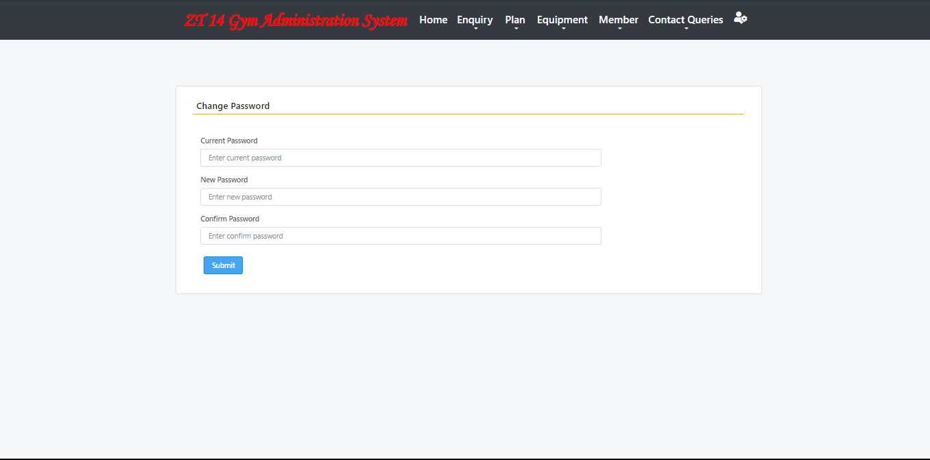
This is the navbar of the Gym Management System and in the profile icon we have links from changing password and Logging out from the management system back to the Home page that is common for Customers and Admin.

Slide 24
After logging out from the Gym Management system the admin will be redirected to Home page of Gym again.

Slide 25
C0NCLUSION
The gym administration system project has been successfully developed using Python programming language. The system provides various features that enable effective management of gym operations, including customer and package management, equipment inventory management, and reporting and analytics. The project has demonstrated the potential for data-driven decision-making in gym operations, providing valuable insights into customer attendance, membership trends, revenue, and other key performance indicators .The project has also showcased the importance of user-friendly interfaces and robust error handling to ensure seamless user experience.

Slide 26
BACHELOR OF TECHNOLOGY
IN
Artificial Intelligence and Machine Learning
THANK YOU
Batch Names & Roll Numbers
CH VARSHITH - 2111CS020620
H VARSHITH - 2111CS020621
D VARSHITHA - 2111CS020622
M VARSHITHA - 2111CS020623
T VARSHITHA - 2111CS020624
G VARUN - 2111CS020625
Batch Number : ZT14
Department of AIML, School of Engineering
Malla Reddy University Hyderabad.

