Slide 1

BACHELOR OF TECHNOLOGY
IN
Artificial Intelligence and Machine Learning
Project Guide – Prof K.Sathish
Batch Names & Roll Numbers
CH VARSHITH - 2111CS020620
H VARSHITH - 2111CS020621
D VARSHITHA - 2111CS020622
M VARSHITHA - 2111CS020623
T VARSHITHA - 2111CS020624
G VARUN - 2111CS020625
Batch Number : ZT14
Department of AIML, School of Engineering
Malla Reddy University Hyderabad.

Slide 2
PROJECT TITLE : HEART DISEASE PREDICTION
ABSTRACT:
Cardiovascular sickness is a major reason of dreariness and mortality in the present living style. Distinguishing proof of cardiovascular ailment is an imperative yet an intricate errand that should be performed minutely and proficiently and the right robotization would be exceptionally attractive. Each individual can't be equivalently skilled thus as specialists. All specialists can't be similarly talented in each sub claim to fame and at numerous spots we don't have gifted and authority specialists accessible effortlessly. A mechanized framework in therapeutic analysis would upgrade medicinal consideration and it can likewise lessen costs. In this exploration, we have planned a framework that can proficiently find the tenets to foresee the risk level of patients in view of the given parameter about their health.

Slide 3
Introduction
Heart disease is a leading cause of mortality worldwide, and early detection and accurate prediction of heart disease risk are crucial for effective prevention and treatment.
Machine learning and deep learning techniques have shown great promise in predicting heart disease based on patient data.
However, one common challenge in developing accurate predictive models for heart disease is dealing with imbalanced data.

Slide 4
Limitations
Incomplete data: The accuracy of heart disease prediction models relies heavily on the availability of comprehensive and high-quality data. Missing or inaccurate data can lead to flawed predictions.
Data quality: The quality of the data used for prediction is crucial. Inaccurate or outdated data can lead to incorrect predictions. Garbage in, garbage out (GIGO) is a common problem in predictive modeling.
Overfitting: Overfitting occurs when a model is too complex and fits the training data too closely. This can lead to poor generalization to new, unseen data, making predictions less reliable.

Slide 5
Data Sets Descriptions:
The "Effect of Imbalance Data Handling Techniques to Improve the Accuracy of Heart Disease Prediction using Machine Learning and Deep Learning" dataset encapsulates a comprehensive array of fields crucial for understanding and predicting heart health.
It includes demographic information such as age, gender, ethnicity, and socioeconomic status, alongside clinical metrics like blood pressure, cholesterol levels, BMI, and diabetes status. Lifestyle factors, including smoking habits, physical activity levels, and dietary patterns, contribute to a holistic representation of an individual's health profile.

Slide 6
Dataset includes the following specific fields:
Demographic Information:
Age (numerical)
Gender (categorical: male, female)
Ethnicity (categorical: various ethnic groups)
Clinical Metrics:
Systolic Blood Pressure (numerical)
Diastolic Blood Pressure (numerical)
Cholesterol Levels (numerical)
Presence of Diabetes (binary: yes, no)
Lifestyle Factors:
Smoking Habits (categorical: smoker, non-smoker, former smoker)
Physical Activity Levels (categorical: sedentary, moderate, active)
Dietary Patterns (categorical: healthy, balanced, unhealthy)
Medical History:
Family History of Heart Disease (binary: yes, no)
Previous Heart-Related Incidents (binary: yes, no)
Presence of Other Chronic Conditions (binary: yes, no)

Slide 7
Data Processing Techniques
Data Filtering: This technique involves selecting and extracting specific data from a larger dataset based on predefined criteria.
Data Aggregation: Aggregating data involves combining multiple data points into a single value or summary statistic, such as calculating the average or sum of a set of values.
Data Transformation: This technique involves converting data from one format or structure to another, such as changing the units of measurement or reformatting the data for compatibility with different systems.
Data Cleansing: Data cleansing refers to the process of identifying and correcting errors or inconsistencies in a dataset, such as removing duplicate entries or correcting misspelled data.

Slide 8
Data Processing Techniques
Data Integration: Data integration involves combining data from multiple sources or systems to create a unified view, allowing for more comprehensive analysis and decision-making.
Data Mining: Data mining is the process of extracting patterns, trends, and insights from large datasets using various statistical and machine learning techniques.

Slide 9
MODEL SELECTION:
The main goal of the entire project is to predict heart disease occurrence with the highest accuracy. In order to achieve this, we will test several classification algorithms. This section includes all results obtained from the study and introduces the best performer according to accuracy metric. We have chosen several algorithms typical for solving supervised learning problems throughout classification methods
Models:
Logistic Regression
Random Forest
Naïve Bayes
K-Nearest Neighbour
Decision Tree

Slide 10
Logistic Regression :
Logistic regression is a classification algorithm used to assign observations to a discrete set of classes. Unlike linear regression which outputs continuous number values, logistic regression transforms its output using the logistic sigmoid function to return a probability value which can then be mapped to two or more discrete classes.
Random Forest :
Random Forest is a supervised learning algorithm. Random forest can be used for both classification and regression problems, by using random forest regressor we can use random forest on regression problems. But we have used random forest on classification in this project so we will only consider the classification part
Naïve Bayes :
Naive Bayes is a classification algorithm for binary (two-class) and multi-class classification problems. The technique is easiest to understand when described using binary or categorical input values. It is called naive Bayes or idiot Bayes because the calculation of the probabilities for each hypothesis are simplified to make their calculation tractable.

Slide 11
K – Nearest neighbour :
We can implement a KNN model by following the below steps:
1. Load the data
2. Initialize the value of k
3. For getting the predicted class, iterate from 1 to total number of training data points
Decision Tree:
1. Place the best attribute of the dataset at the root of the tree.
2. Split the training set into subsets. Subsets should be made in such a way that each subset contains data with the same value for an attribute.
3. Repeat step 1 and step 2 on each subset until you find leaf nodes in all the branches of the tree.

Slide 12
Attribute selection method -
A dataset consists of “n” attributes then deciding which attribute to place at the root or at different levels of the tree as internal nodes is a complicated step. By just randomly selecting any node to be the root can’t solve the issue. If we follow a random approach, it may give us bad results with low accuracy.
Gini Index –
Gini Index is a metric to measure how often a randomly chosen element would be incorrectly identified. It means an attribute with lower Gini index should be preferred.

Slide 13
MODEL TESTING AND TRAINING -
The overall objective of our project is to predict accurately with less number of tests and attributes the presence of heart disease. In this project, fourteen attributes are considered which form the primary basis for tests and give accurate results more or less.
Many more input attributes can be taken but our goal is to predict with less number of attributes and faster efficiency to predict the risk of having heart disease at a particular age span. Five data mining classification techniques were applied namely K-Nearest Neighbor, Naive Bayes, Decision Tree, Random Forest & Logistic Regression.
It is shown that Random Forest has better accuracy than the other techniques. This project could answer complex queries, each with its own strength with respect to ease of model interpretation, access to detailed information and accuracy.

Slide 14
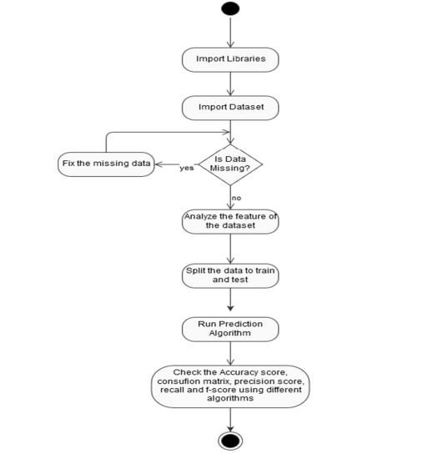
ACTIVITY DIAGRAM-

Slide 15
Model Evaluation Metrics-
The following are the model evaluation metrics which we used in our model testing:
Confusion Matrix
Precision Score
Recall
F-Score
Precision:
Precision is about being accurate when the model predicts something.
Example: In heart disease prediction, high precision means that when the model predicts someone has heart disease, it's likely to be accurate, minimizing false alarms.
Recall (Sensitivity):
Recall is about capturing as many relevant instances as possible.
Example: In heart disease prediction, high recall means the model is good at identifying most of the people who actually have heart disease, minimizing missed cases.
F1 Score:

Slide 16
F1 Score:
F1 Score is a balance between precision and recall.
Example: A high F1 score in heart disease prediction indicates a model that is both accurate and effective in identifying a significant portion of actual cases.
False Negatives:
False Negatives are cases where the model predicts negative, but the actual result is positive.
Example: In heart disease prediction, a false negative occurs when the model fails to identify someone with heart disease, which could delay necessary medical attention.
Confusion Matrix:
represents the prediction summary in matrix form. It shows how many prediction are correct and incorrect per class. It helps in understanding the classes that are being confused by model as other class

Slide 17
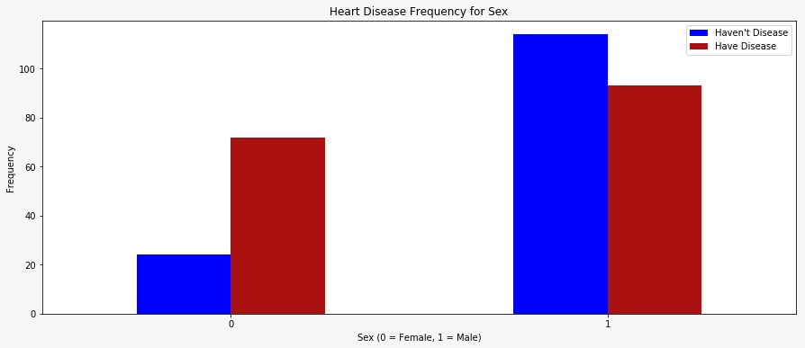
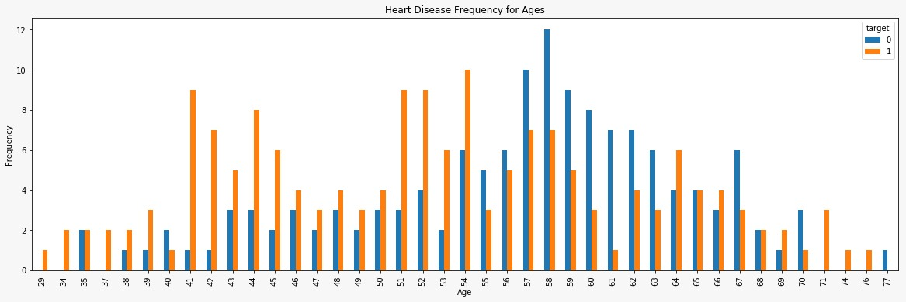
OUTPUTS:

Slide 18
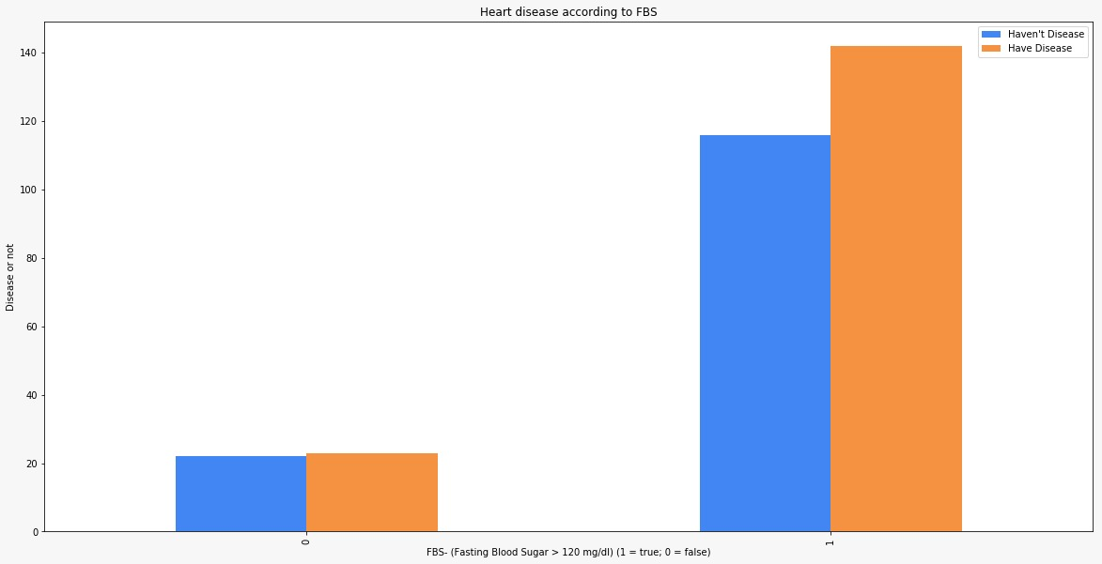
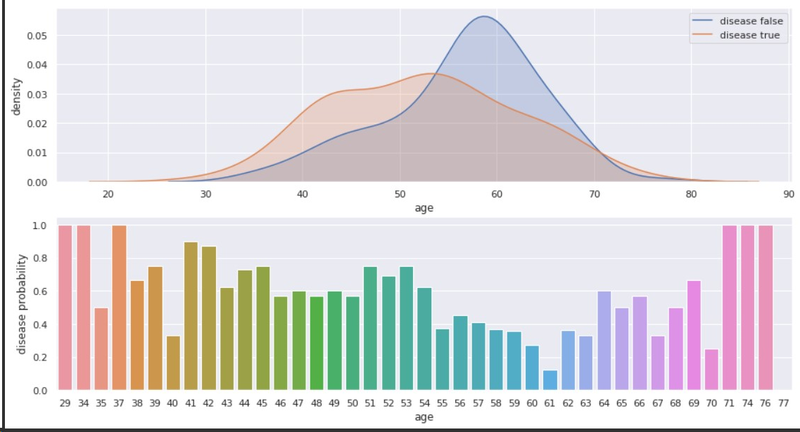

Slide 19
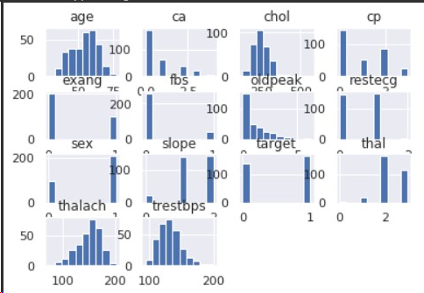
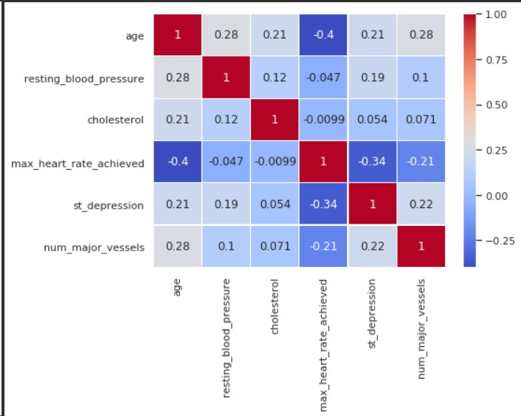

Slide 20
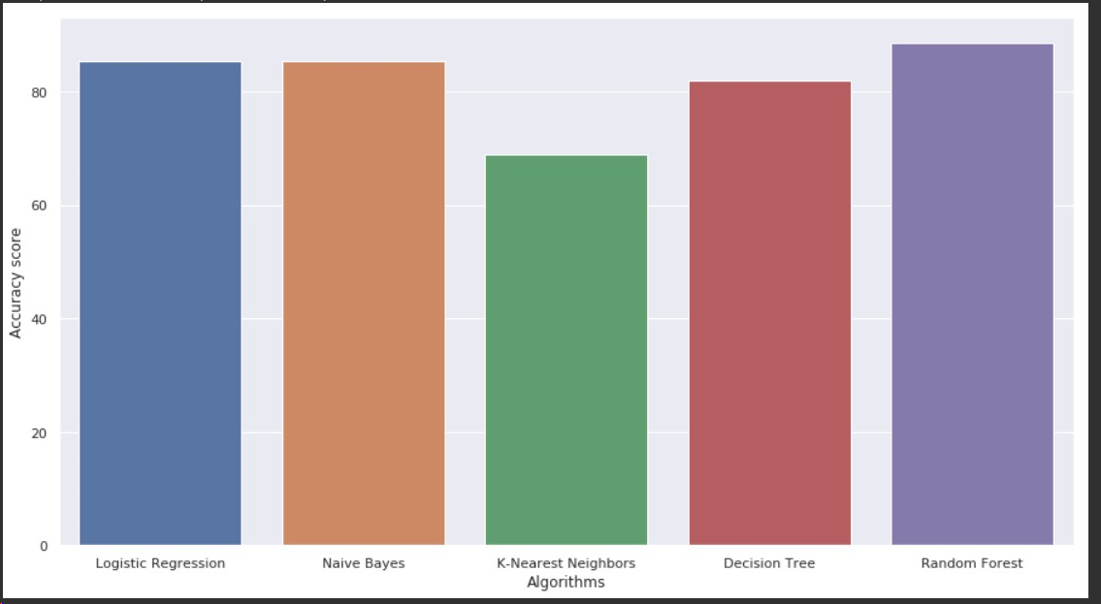
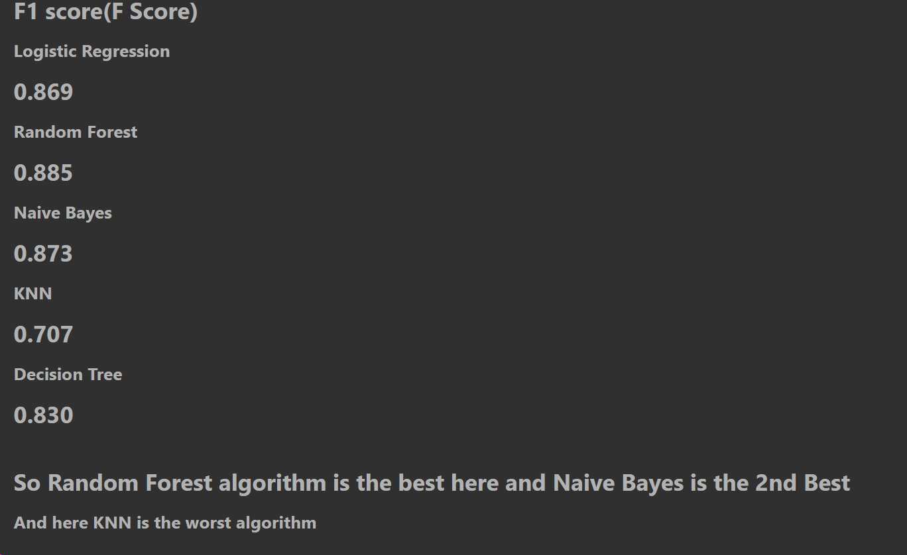
Final output:

Slide 21
BACHELOR OF TECHNOLOGY
IN
Artificial Intelligence and Machine Learning
THANK YOU
Batch Names & Roll Numbers
CH VARSHITH - 2111CS020620
H VARSHITH - 2111CS020621
D VARSHITHA - 2111CS020622
M VARSHITHA - 2111CS020623
T VARSHITHA - 2111CS020624
G VARUN - 2111CS020625
Batch Number : ZT14
Department of AIML, School of Engineering
Malla Reddy University Hyderabad.

