Slide 1


BACHELOR OF TECHNOLOGY
IN
Artificial Intelligence and Machine Learning
Image Caption Generator Using CNN & LSTM
Batch Number: ZT18
Batch Names & Roll Numbers:-
Sufiyan Ali Khan - 2111CS020573
G Swetha - 2111CS020584
G Thejashwini - 2111CS020589
H Varshith - 2111CS020621
M Varun Teja - 2111CS020626
Project Guide: A Siva Kumar
Professor
CSE-AI&ML
Malla Reddy University
Department of AIML, School of Engineering
Malla Reddy University

Slide 2
CONTENTS
Introduction
Literature Survey
Existing Methodology
Proposed Methodology
Block Diagram/Architecture
Algorithms/Flow Charts/ Modules
Development and training
Results
Conclusion / Future Enhancement
References

Slide 3
Abstract
Image Captioning is a task where each image must be understood properly and are able generate suitable caption with proper grammatical structure. Here it is a hybrid system which uses multilayer CNN (Convolutional Neural Network) for generating keywords which narrates given input images and Long Short Term Memory(LSTM) for precisely constructing the significant captions utilizing the obtained words .Convolution Neural Network (CNN) proven to be so effective that there is a way to get to any kind of estimating problem that includes image data as input. LSTM was developed to avoid the poor predictive problem which occurred while using traditional approaches. We used an encoder-decoder based model that is capable of generating grammatically correct captions for images. This model makes use of VGG16(Visual Geometry Group) as an encoder and LSTM as a decoder. The model will be trained like when an image is given model produces captions that almost describe the image. The efficiency is demonstrated for the given model using Flickr8K data sets which contains 8000 images and captions for each image but we use CNN and LSTM to capture dependencies and tell both the spatial relationships of images and contextual information of captions and generate contextually relevant captions.

Slide 4
Problem Statement
Image captioning presents a significant challenge in Artificial Intelligence, requiring systems to understand images and generate grammatically correct descriptions. The existing methods facing issues in accurately describing images with proper context. To address this, a hybrid system Convolutional Neural Networks (CNN) for feature extraction and Long Short-Term Memory (LSTM) networks for caption generation is proposed. However, the existing system struggling to capture suitable image differences and contextual nuances. Therefore, there is a need for an improved image captioning system that effectively integrates CNN and LSTM models to accurately describe images with contextual relevance. This research aims to develop such a system, utilizing the Flickr8K dataset for training and evaluation. The system efficiency will increased by generating suitable captions for given images.BLEU Score is used as a metric to evaluate the performance of the trained model.

Slide 5
Introduction
Image caption generator is a process of recognizing the context of an image and annotating it with relevant captions using deep learning and computer vision.
It includes labeling an image with English keywords with the help of datasets provided during model training.
The VGG-16 model, with 16 convolutional layers, has been employed for object recognition.
To build an image caption generator model we have to merge CNN with LSTM.
Image Caption Generator Model = CNN + LSTM
CNN – To extract features from the image.
LSTM – To generate a description from the extracted information of the image.
The dataset “Flickr8k” consists of 8k images and 5 captions for each image. The features are extracted from both the image and the text captions for input. The features will be concatenated to predict the next word of the caption. BLEU Score is used as a metric to evaluate the performance of the trained model.

Slide 6
Literature Survey
[1] One of the research study presents a model employing pre-trained deep learning, specifically the VGG model, for generating captions from images. By comparing the model's output with human-provided captions, it achieves an accuracy of around 75%, indicating a close resemblance between generated and human captions. This approach enhances the capability of automated caption generation, bridging the gap between machine-generated and human-provided descriptions of images.
[2] The image caption generator in few studies utilizes the Flickr_8k database, comprising 8000 diverse images, each with five captions. The dataset is divided into 6000 training, 1000 validation, and 1000 testing images. Through rigorous training and testing, the model effectively generates accurate captions. It employs a combination of Convolutional Neural Network (CNN) and Recurrent Neural Network (RNN), where CNN acts as the encoder and RNN as the decoder, ensuring grammatically correct captions with appropriate labels.
[3] In an image caption generator, the VGG16 model serves as a sophisticated filter for images, identifying crucial features such as shapes and objects. These features form a summary of the picture, which is then utilized by another component of the system to generate a descriptive sentence. VGG16 essentially aids in comprehending the content of the image, allowing the caption generator to translate this understanding into words.

Slide 7
Literature Survey
[4] Some studies presents a framework for generating descriptive captions from images, utilizing the Flickr8K dataset containing 8000 images, each paired with five descriptions. The model employs a neural network to automatically analyze images and generate English captions. The generated captions are categorized into error-free descriptions, descriptions with minimal errors, somewhat related descriptions, and unrelated descriptions, showcasing the system's ability to produce diverse outputs based on image content.
[5] The integration of VGG16, LSTM, and CNN in image caption generation is significant for enhanced performance. VGG16 acts as a robust feature extractor, capturing detailed information from images. LSTM complements VGG16 by generating coherent captions, leveraging its sequential data understanding. The synergy between CNN and LSTM addresses challenges in combining visual and linguistic information, leading to a comprehensive image understanding. Ongoing research may unveil novel approaches, refining the synergy between these components for improved image captioning.

Slide 8
Existing Methodology
The complete system is a combination of three models which optimizes the whole procedure of caption description from an image. The models are:
(a)Feature Extraction Model :
The model uses a VGG16 architecture to efficiently extract the features from the images using a combination of multiple 3*3 convolution layers. The output of a VGG16 network would be vectors of size 1*4096, which are used to represent the features of the images.
(b) Encoder Model :
The encoder model, is primarily responsible for processing the captions of each image fed while training. The output of the encoder model is again vectors of size 1*256 which would again be an input to the decoder sequences Initially the captions present with each images are tokenized ie the words in the sentences are converted to integers so that the neural network can process them efficiently.
(c)Decoder model:
The decoder model, is basically the model which concatenates both the feature extraction model and encoder model and produces the required output which is the predicted word given an image and the sentence generated till that point of time.

Slide 9
Proposed Methodology
Our model is not perfect and may generate incorrect captions sometimes. In the next phase, we will be developing models which will use Inceptionv3 instead of VGG as the feature extractor. Then we will be comparing the 4 models thus obtained i.e. VGG+GRU, VGG+LSTM, Inceptionv3+GRU, and Inceptionv3+LSTM . This will further help us analyze the influence of the CNN component over the entire network.
Our model is trained on the Flickr 8K dataset which is relatively small with less variety of images. We will be training our model on the Flickr30K and MSCOCO datasets which will help us to make better predictions. Other optimizations include tweaking the hyperparameters like batch size, number of epochs, learning rate etc and understanding the effect of each one of them on our model.
Evaluation metrics such as BLEU score validate the model's performance. Once validated, the system is tested on unseen data and can be deployed for real-time caption generation. Future directions include exploring advanced techniques like attention mechanisms for further improvement. Overall, the proposed system offers a robust solution for generating accurate and contextually rich captions for images

Slide 10
Block Diagram/Architecture
Input(images)
Features
Image features
Image features
CNN Layers
CNN Layer
CNN Layer
Feature Map
Encoder
Powerful CNN model
VGG 16
Decoder
LSTM
Output
Image Caption

Slide 11
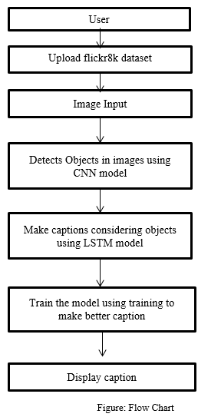
Flowchart

Slide 12
Development & Training
Model Implementation and Training :
Model implementation and training for the image caption generator using the Flickr8k dataset typically involves several steps, including data preparation, model construction, and training. Here's a high-level overview of the process:
Data Preparation
Model Construction
Training
During training, it's essential to iterate and experiment with different architectures, hyperparameters, and optimization strategies to improve model performance. Additionally, monitoring training progress through visualizations and logging can provide insights into the model's behavior and guide further refinement. Once training is complete, the trained model can be evaluated on the test set to assess its performance in generating accurate and contextually relevant captions for unseen images.

Slide 13
Development & Training
Model Evaluation Metrics:
BLEU-1 Score: 0.544 BLEU-2 Score: 0.319
In evaluating the image caption generator model trained on the Flickr8k dataset, BLEU (Bilingual Evaluation Understudy) scores play a pivotal role. The BLEU score is a standard metric used to measure the quality of machine-generated text by comparing it to human-generated reference texts. In this project, the BLEU-1 score of 0.544 and BLEU-2 score of 0.319 indicate the effectiveness of the model in generating captions that closely match the reference captions provided in the dataset. The BLEU-1 score measures the overlap of unigrams (individual words) between the generated and reference captions, while the BLEU-2 score considers the overlap of bigrams (pairs of adjacent words). A BLEU-1 score of 0.544 suggests that more than half of the individual words in the generated captions match those in the reference captions on average. Similarly, a BLEU-2 score of 0.319 indicates that about a third of the bigram sequences in the generated captions coincide with those in the reference captions. These scores provide quantitative insights into the model's ability to produce captions that are semantically and syntactically similar to human-written captions, thereby demonstrating its efficacy in generating descriptive and contextually relevant captions for a diverse range of images.

Slide 14
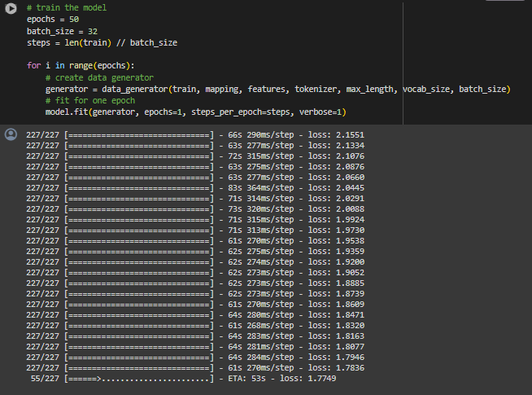
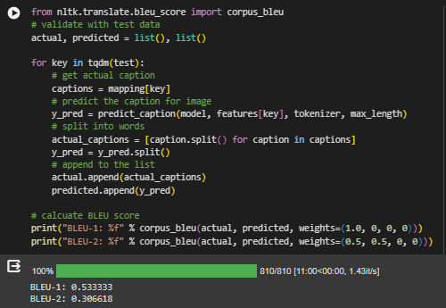
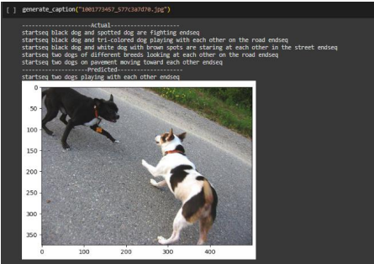
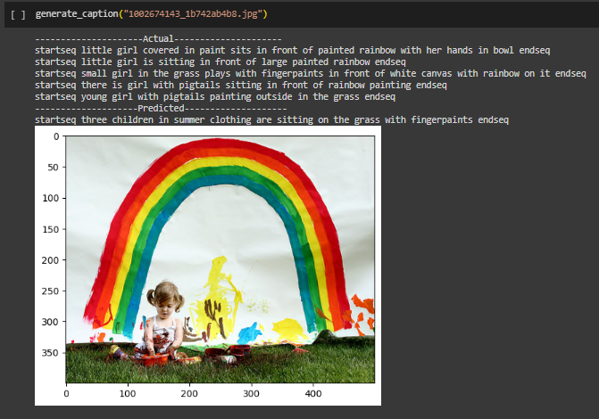
Results

Slide 15
Conclusion & Future Scope
CONCLUSION
We have successfully developed a deep-learning model using the Xception architecture to generate automatic captions. So far, most of the image captioning models have used inception (v3). We have famed our project in a web-based application using the Flask architecture. Some of the automatically generated captions based on our model are as shown below. Please note that generating captions is subjective and captions for the same image can differ from person to person. This is also the reason why the algorithm which is trained on human-typed captions can generate erratic results sometimes.
FUTURE SCOPE
The accuracy of the current project can be further increased by adding a weightage system to the vocabulary by assigning low weight to highly frequently occurring words. It can potentially create a better algorithm to generate captions.

Slide 16
References
[1]Dr.Jagadisha N ,Chaithra Rao(2022):Image Caption Generator Using Deep Learning
[2] Preksha Khant, Vishal Deshmukh, Aishwarya Kude, Prachi Kiraula (2021) : Image Caption Generator using CNN-LSTM.
[3] Ali Ashraf Mohamed (2020) : Image Caption Using CNN and LSTM.
[4] Chetan Amritkar, Vaishali Jabade (2018) : Image caption Generation Using Deep Learning Technique.
[5] Subrata Das, Lalit jain, Arup Das (2018) : Deep Learning for Military Image Captioning.
[6] Pranay Mathur , Aman Gill , Aayush Yadav , Anurag Mishra, Nand Kumar Bansode (2017): Camera2Caption :A Real-Time Caption Generator.
[7] Sreejith S P, Vijayakumar A (2021) : Image Captioning Generator using Deep Machine Learning.

