Slide 1
Fundamentals of Data
Visualization

Slide 2
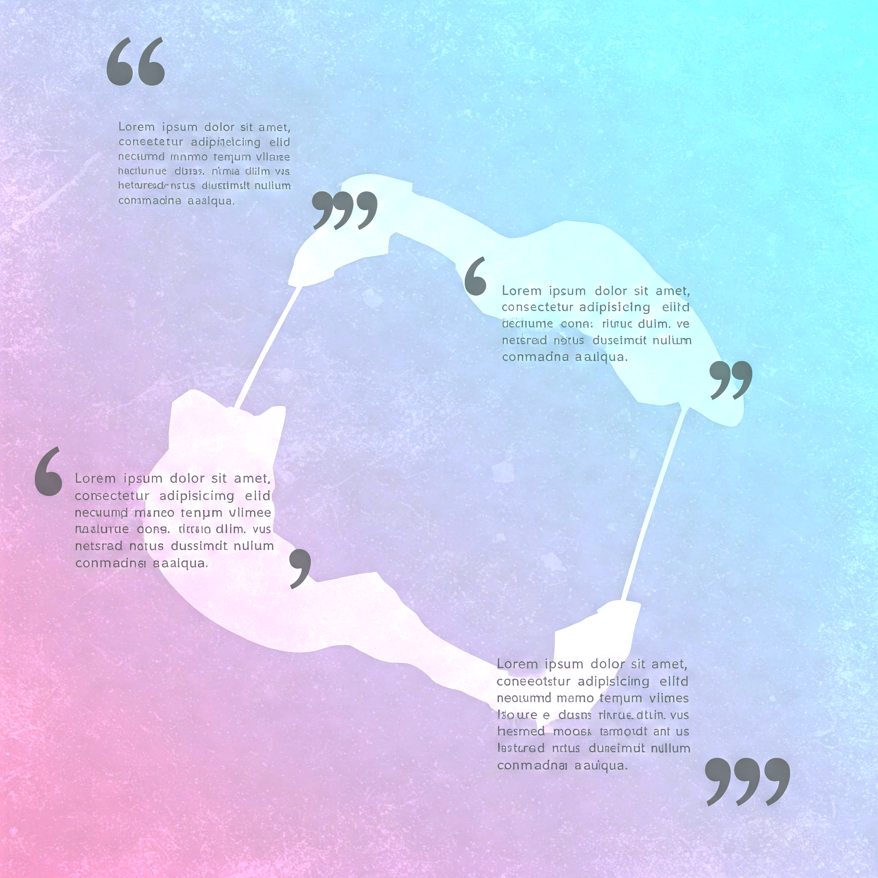
What is Data Visualization?
Data visualization refers to the graphical representation of information and data using visual elements like charts, graphs, maps, and infographics.
It transforms raw data into a visual format that is easier to understand and interpret.
Purpose: To simplify complex datasets, uncover insights, and communicate information effectively.
Examples: Bar charts for sales trends, heatmaps for website traffic, scatter plots for correlations between variables.
"The goal is to turn data into information and information into insight.” – Carly Fiorina
"Visualization gives you answers to questions you didn’t know you had." – Ben Shneiderman

Slide 3
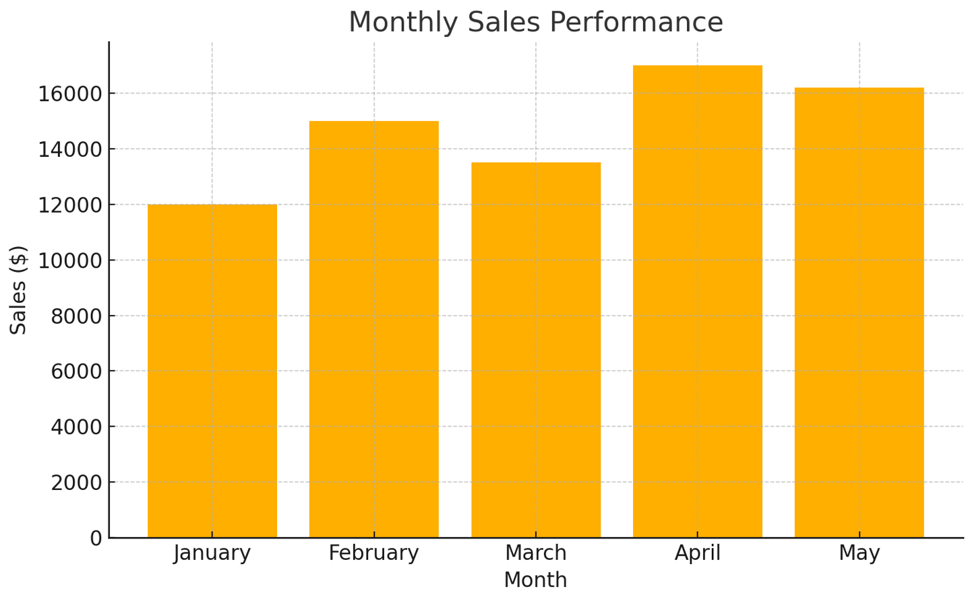
Examples
Month | Sales ($)
January | 12,000
February | 15,000
March | 13,500
April | 17,000
May | 16,200

Slide 4
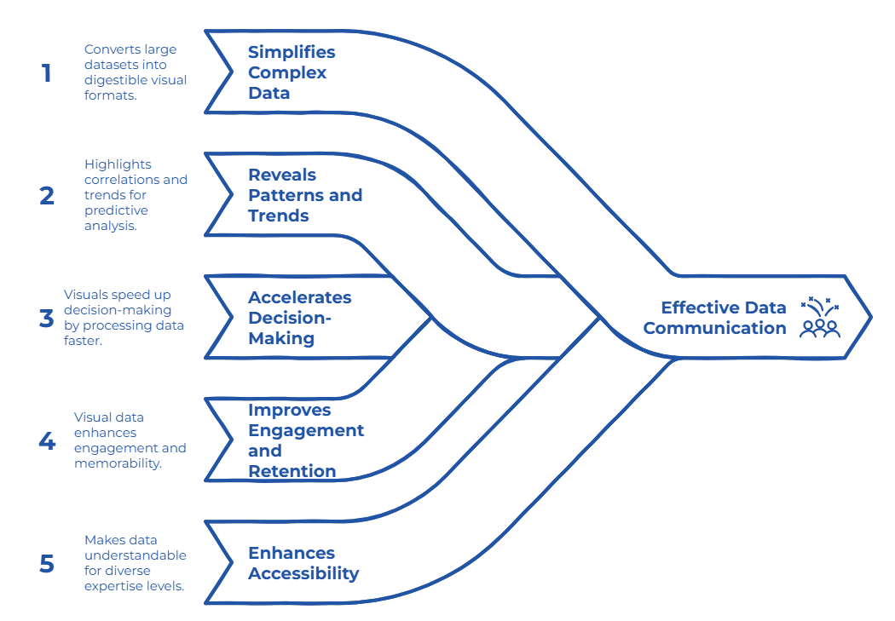
Why Data Visualization Matters?

Slide 5
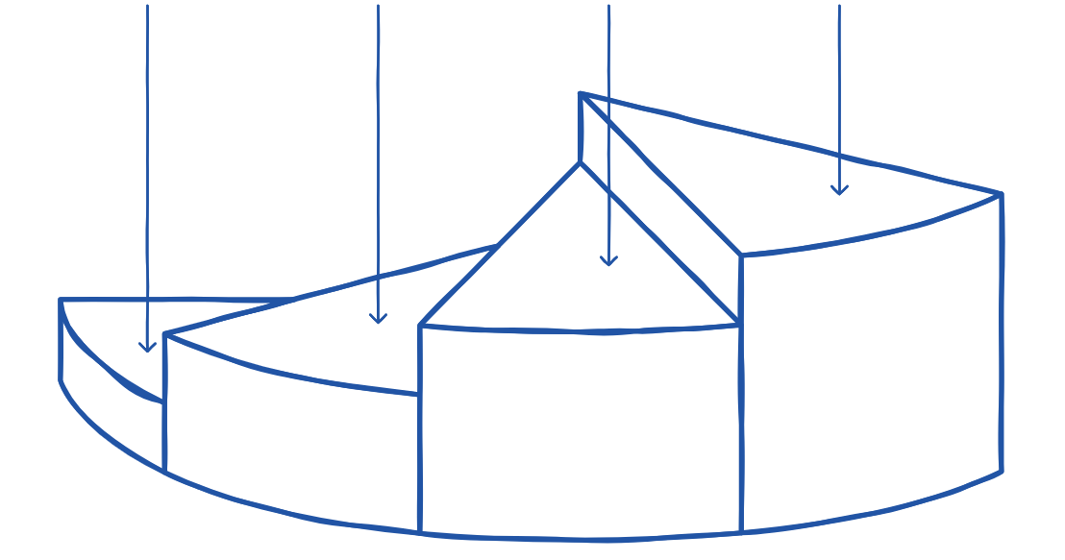
How Does Data Visualization Work?
Understand data Clean and analyze the dataset to identify key insights.
Design for clarity
Use labels, legends, consistent colors, and scales.
Choose right type visualization
Match the visual format (e.g., bar chart, pie chart) to the type of data.
Test effectiveness
Ensure the visualization communicates the intended message clearly.

Slide 6
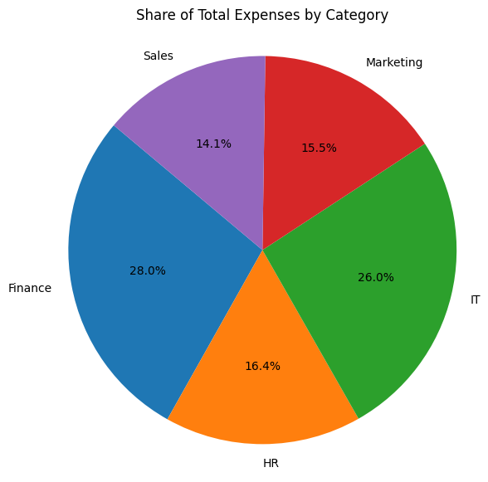
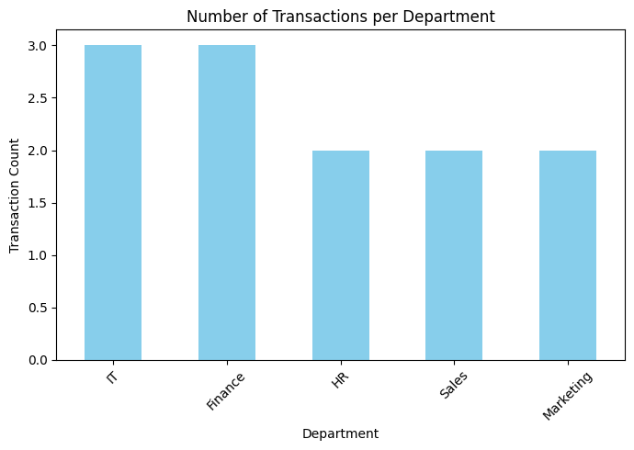
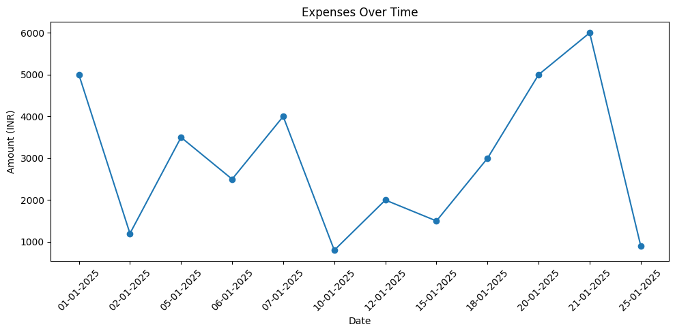
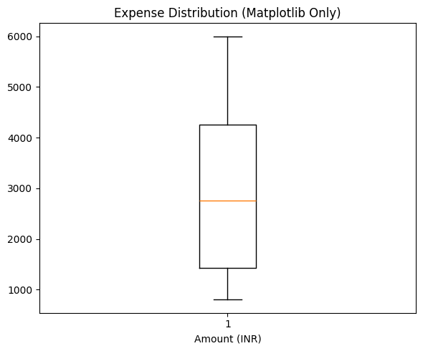
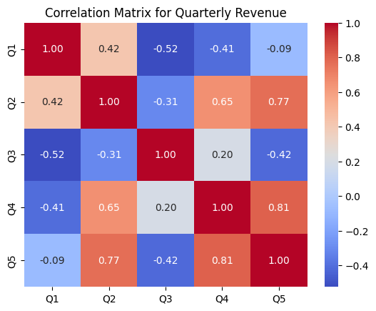
Types of Charts

Slide 7
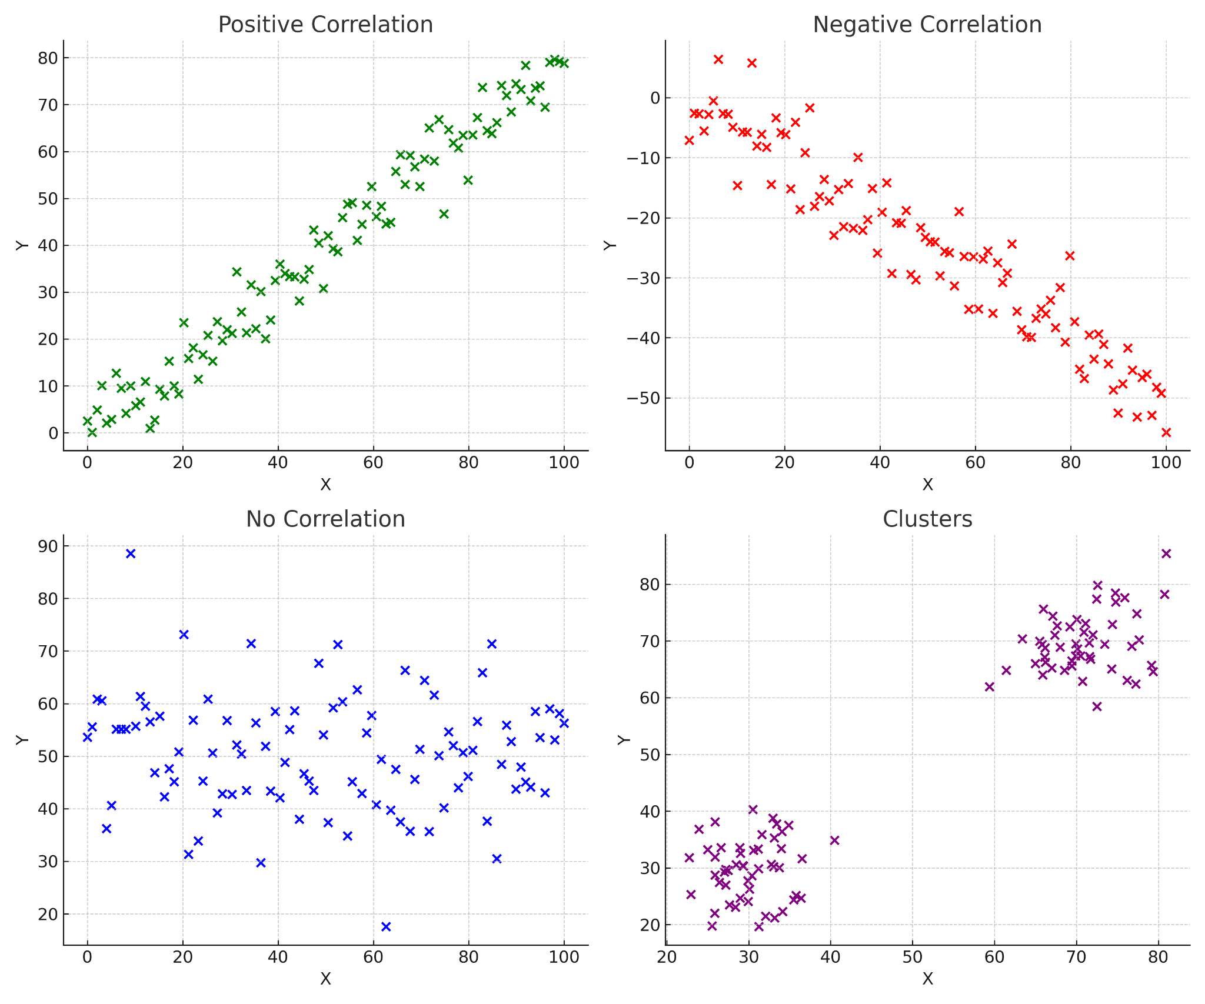
Scatter plot

Slide 8
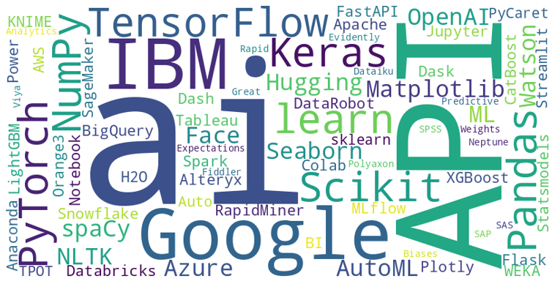
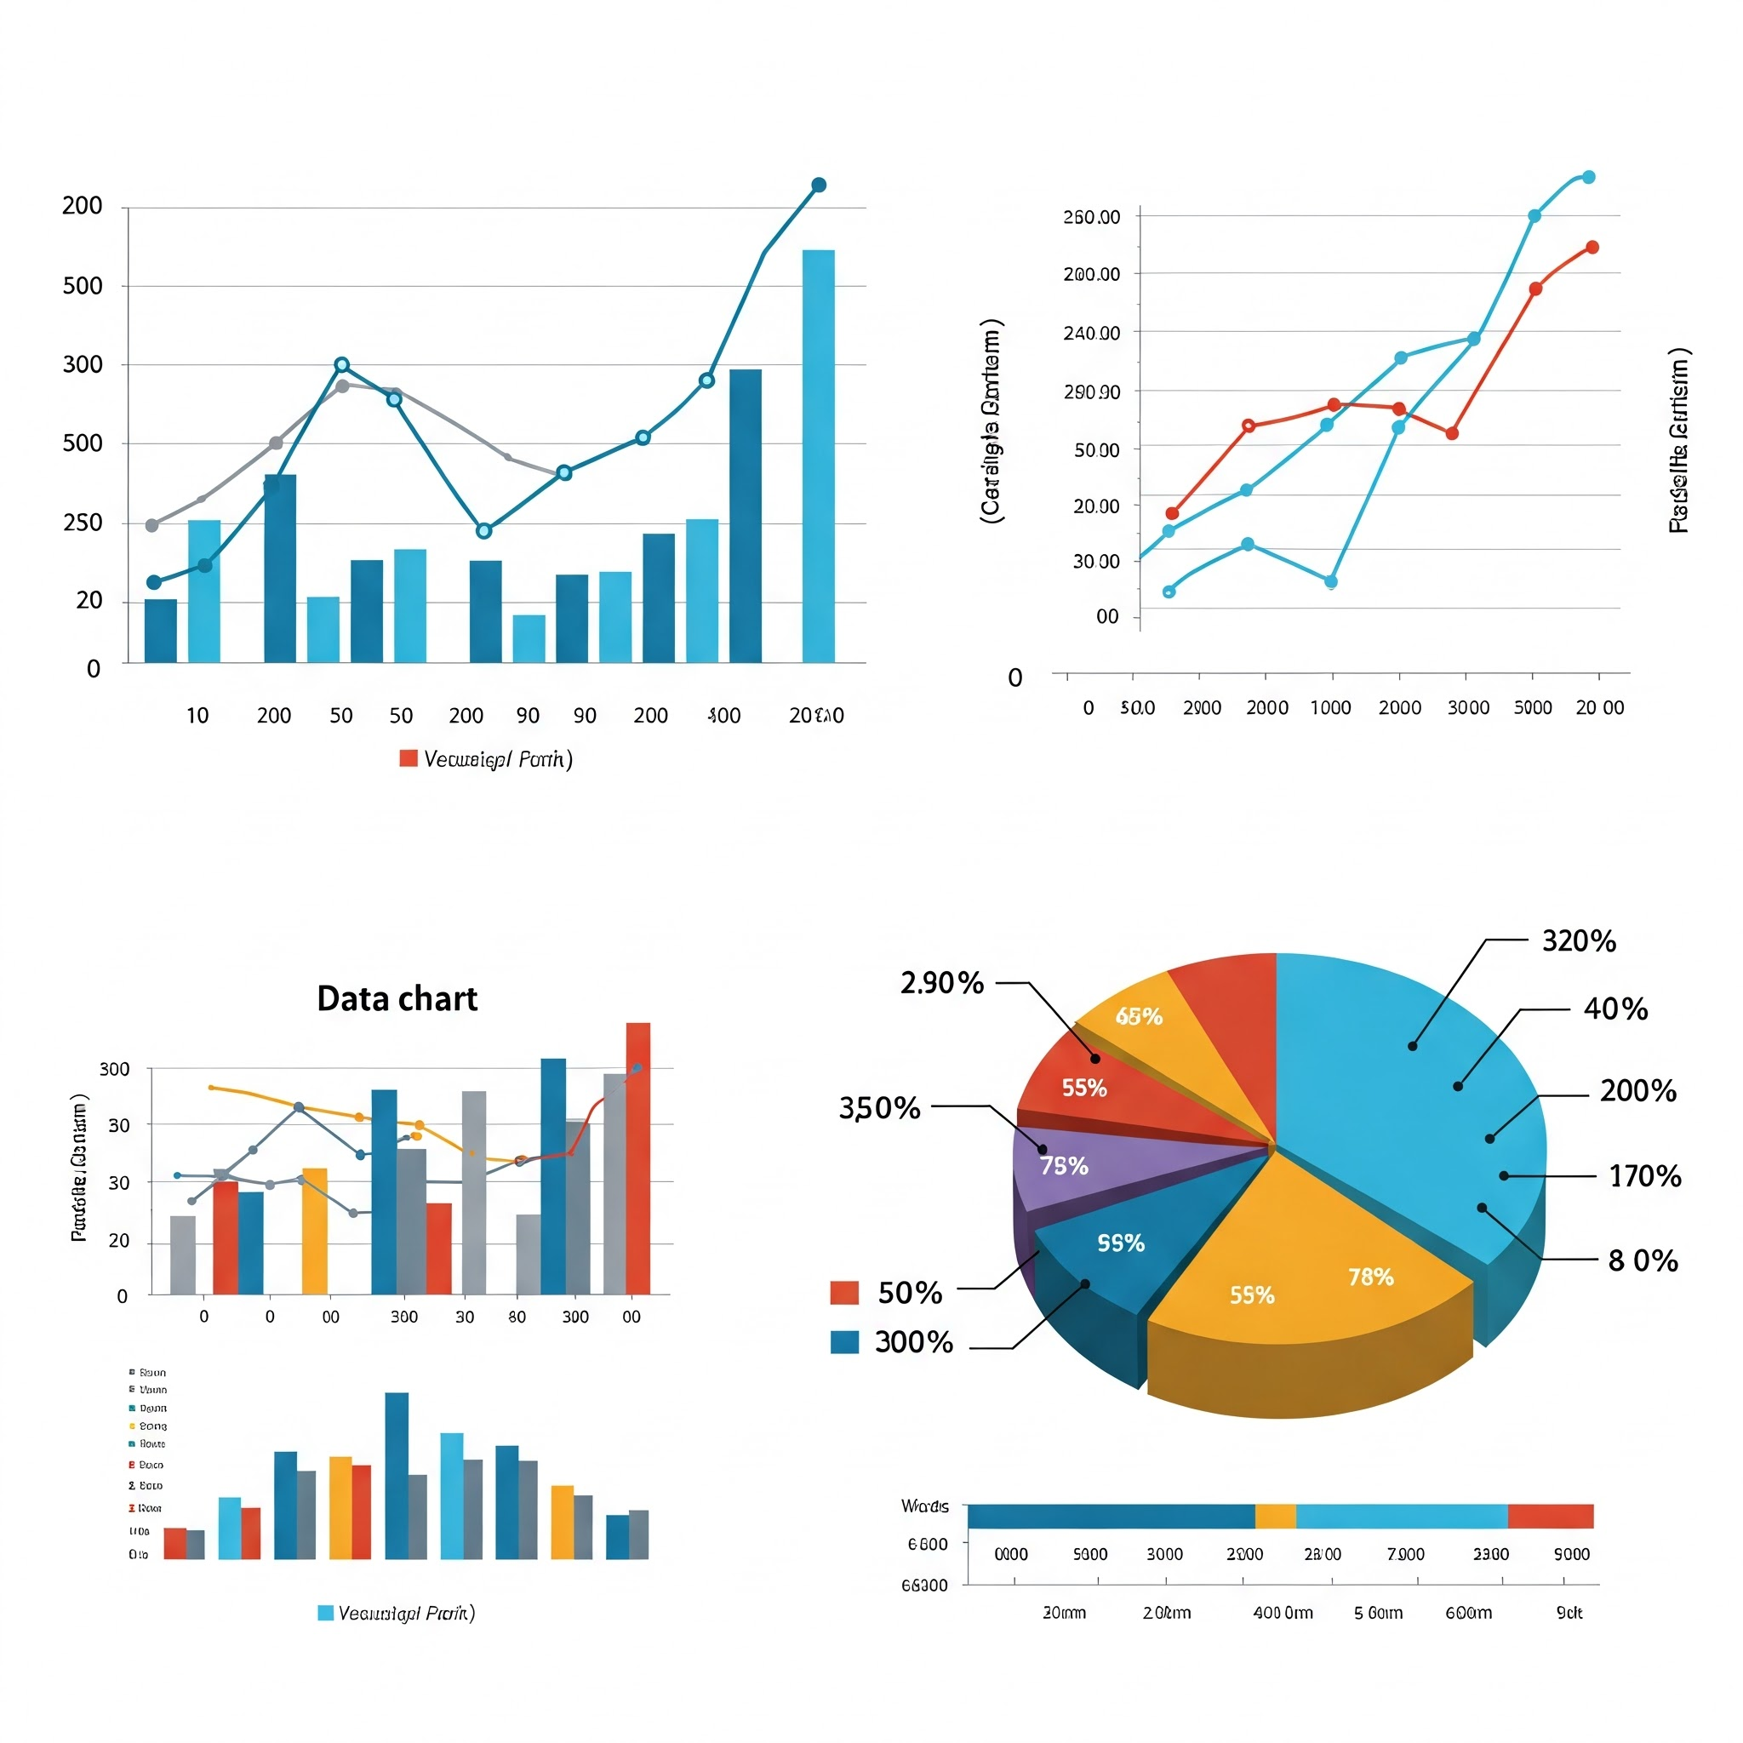
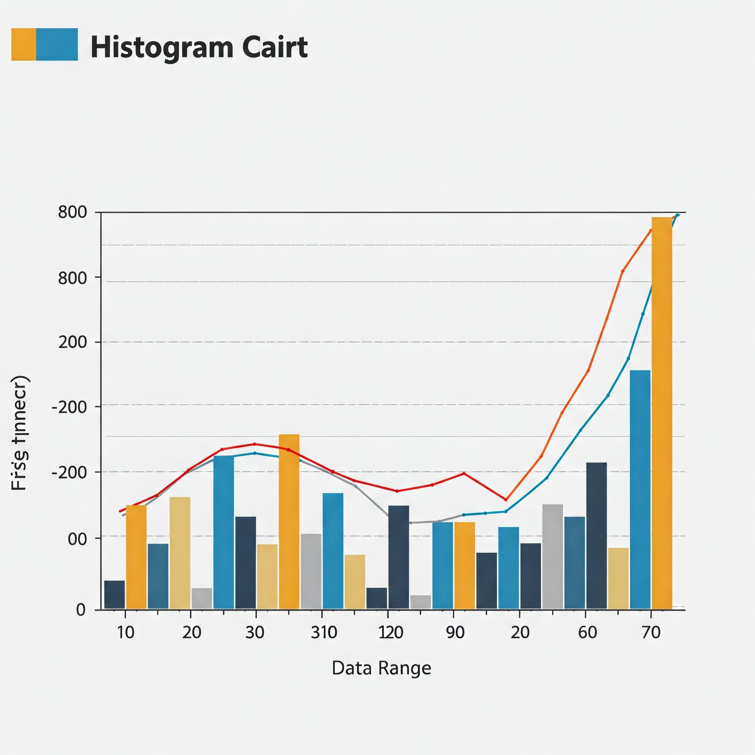
Types of Data Visualizations
Quantitative Data
• Numerical and measurable
• Includes discrete and continuous data
• Examples: Revenue, height, temperature
Qualitative Data
• Descriptive and categorical
• Includes nominal and ordinal data
• Examples: Colors, product categories, satisfaction level

Slide 9

Types of Visualizations by Purpose
Purpose | Common Charts
Show change over time | Line chart, area chart, bar chart, box plot
Show part-to-whole relationships | Pie chart, donut chart, stacked bar, treemap
Show distribution of data | Histogram, box plot, violin plot
Compare values | Bar chart, column chart, dot plot, grouped bar
Show relationships between variables | Scatter plot, bubble chart, heatmap
Show geographical patterns | Choropleth map, symbol map

Slide 10

Principles of Good Visualization
AESTHETICS
Use consistent color schemes and fonts to enhance readability.
Ensure that the design is visually appealing to maintain engagement.​
ACCURACY
Ensure that visualizations represent data truthfully.
Avoid misleading scales or distortions that can misrepresent the data.​
CLARITY
Design visuals that are easy to understand at a glance.
Use clear labels, legends, and avoid unnecessary clutter.​
EFFICIENCY
Present data in a way that allows viewers to quickly grasp insights.
Highlight key information without overwhelming details.​

Slide 11
Hands-on

Slide 12
Agenda
We will discover how to generate basic plots using Python libraries such as
Matplotlib
Seaborn

