Slide 1
SMART INDIA HACKATHON 2026
Internal round · idea submission
Problem Statement ID
26189
🛡
Problem Statement Title
AI-Powered Criminal Network Analysis System
Organisation
Ministry of Home Affairs · National Crime Records Bureau (NCRB), Women Safety Division
PRAHARI
Theme
Blockchain & Cybersecurity
Investigative Intelligence & Evidence Correlation Platform
PS Category
Software
Team ID
to be allotted
Evidence-cited leads · identities never auto-merged · every action on a hash chain
Team Name
PRAHARI
“Data connects what others overlook.”
Working prototype · 28 people · 78 evidence links · 3 clusters · 24 anomaly findings · 0 auto-merged identities · 190 automated tests
Notes:
Cover. Team ID is left as 'to be allotted' for the internal round. Every number on the footer is produced by the running code, not estimated.

Slide 2
PRAHARI · Team PRAHARI
SMART INDIA HACKATHON 2026 · PS 26189
Problems & Solution Uniqueness
📂
Evidence lives in silos
🧠
Connections are made in an officer's head
What makes PRAHARI different
FIRs in CCTNS, call records at telecoms, transfers at FIU-IND, registries, custody and travel logs sit apart. Cross-state links surface weeks late, or never.
Hundreds of rows are cross-checked by hand. Nothing records why two people were linked, so nothing can be re-checked.
Provenance by construction
An edge cannot exist without a source record: the ledger raises instead. Every finding cites its record ids, and /api/evidence answers what any record supports.
Confidence is derived, capped at 97
Base by evidence type plus corroboration across independent source types. Nothing is ever 100%.
👤
Same person, three spellings
🗣
Tools that overclaim
“R. Yadav”, “RAMESH YADAV”, “Ramesh Yadhav” split one trail three ways, while a look-alike name can be wrongly merged into it.
“Kingpin”, “risk score” and unsourced AI summaries create leads that no officer or court can trace back to a record.
Identities are never merged
Scored and banded; conflicting identifiers apply −35; the investigator confirms. Auto-merged is asserted to be 0.
A lead score, not a guilt score
Investigative Lead Score: 8 capped factors, every point explained and cited. VERIFIED / DISMISSED are human verdicts.
⏱
Time is flattened
🔒
No accountability for access
A 2021 custody overlap and a March 2026 call spike look alike without a case clock and time windows anchored to the records.
A system that can map anyone's contacts can be misused. Without an immutable log, misuse is invisible.
Audited, reversible, no LLM
A SHA-256 block per request; wrong batches are retracted with a reason, never deleted; the assistant answers only from records.
Notes:
Six problems on the left mirror the winner's structure. The right column is the pitch: every claim is enforced in code and covered by tests, not just described.

Slide 3
PRAHARI · Team PRAHARI
SMART INDIA HACKATHON 2026 · PS 26189
System Architecture
DATA SOURCES
FIR narratives (CCTNS)
1 · INGESTION
stable record ids: FIR_003, CDR-0007, TXN-0012
one shared FIR extractor for loader and preview
validate → quality score → duplicate & holder-conflict checks
malformed values held, never corrected
batches retractable with a reason; ids never shift
2 · EVIDENCE LEDGER
an Assertion with zero records raises
confidence = base(relation) + corroboration per independent source type + repeat
capped at 97, floored at 5
uncertainty list on every edge
reverse provenance per record
3 · TEMPORAL GRAPH
NetworkX; person · unresolved number · corporate entity · vehicle
co-accused · calls · money · custody · registry relations
windows all / 30d / 7d / 24h anchored to the case clock
timeless registries survive every window
4a · ANALYTICS
PageRank · betweenness · clusters
Investigative Lead Score: 8 capped factors
5 · API
FastAPI
graph · entity · case file · leads · anomalies · ask · intake · decisions · audit
Call detail records
Bank transfers (FIU-IND)
4b · ANOMALY ENGINE
10 detectors, each quantified against a baseline
median + MAD outliers, spikes, layering
Subscriber · account · vehicle registries
6 · BOARD
Case Board · Case File
Ask PRAHARI (grounded)
Add Data · Retract
Audit · Report
Custody rosters · travel manifests
4c · ENTITY RESOLUTION
phonetic + identifier scoring, banded
never auto-merged; −35 on conflicts
ADD DATA: JSON · CSV · FIR text
AUDIT CHAIN every request becomes a SHA-256 block before it is served · atomic writes under a lock · edits, deletions and reordering detected · tamper demo runs on a copy · decisions and retractions carry their reason
TECH STACK
Backend
Python 3 · FastAPI · NetworkX · pytest (190 tests on an isolated data copy)
Frontend
vis-network (vendored, offline) · HTML / CSS / JS · printable report
Integrity
SHA-256 hash chain · JSON stores with atomic writes · seed snapshot + reset
Principle
no LLM · no external calls · synthetic data · every number at /api/config
Notes:
Read left to right: sources, ingestion with stable ids, the evidence ledger that refuses unsupported edges, the temporal graph, three analysis engines, the API and the board. The audit chain sits under everything. Stack is entirely open source; there is no language model anywhere.

Slide 4
PRAHARI · Team PRAHARI
SMART INDIA HACKATHON 2026 · PS 26189
Potential Challenges → How We Tackle Them
POTENTIAL CHALLENGES
HOW WE TACKLE THEM
👥
False identity merges
One character separates “Ramesh Yadav” from “Ramesh Yadava”; a naive match fuses two people and taints every downstream finding.
✔
Identifier-weighted resolution
Names alone cannot reach LIKELY; conflicting phone/account apply −35; the look-alike scores 12 and stays separate. Auto-merged = 0, asserted by tests; a person confirms each match.
📣
Overclaiming and false positives
“Kingpin”, “burner”, “prime suspect” and a 100% badge turn correlation into accusation.
✔
Approved terminology, enforced
Potential Network Controller, Unresolved Number, Investigative Lead. Confidence capped at 97; every finding carries the human-verification notice; tests scan the API and the UI for banned terms.
🧾
Messy, malformed input
Real feeds carry bad dates, non-numeric amounts, missing ids, duplicates and a phone registered to two holders.
✔
Validate, hold, never correct
INVALID rows are held and shown, optional gaps stay null, duplicates and holder conflicts are flagged for review. The preview is the same extractor the board uses.
🛡
Misuse and privacy (DPDP Act 2023)
A contact-mapping tool without accountability can surveil anyone, and nobody would know.
✔
Accountability by construction
Each request is a SHA-256 block before it is served; call data is metadata only; no outbound calls; a live tamper test shows the chain break and recover.
↩
Wrong data enters a case
Rows from another case get pasted in; deleting them would renumber every later record and corrupt citations.
✔
Audited, reversible retraction
Batches are tombstoned with a mandatory reason; ids never shift; restore is one click; the shipped corpus is protected and a reset script exists.
📈
Scale and language
Regex extraction and an in-memory graph will not carry 12 languages or millions of edges.
✔
Same contracts, swappable engines
Trained NER (IndicBERT) replaces the regex behind the same trigger-and-name contract; Neo4j takes the same node/relation schema; analytics code does not change.
Notes:
Each challenge on the left has a mitigation that exists in the code today, not on a roadmap. The last row is the honest scaling story: the contracts stay, the engines swap.

Slide 5
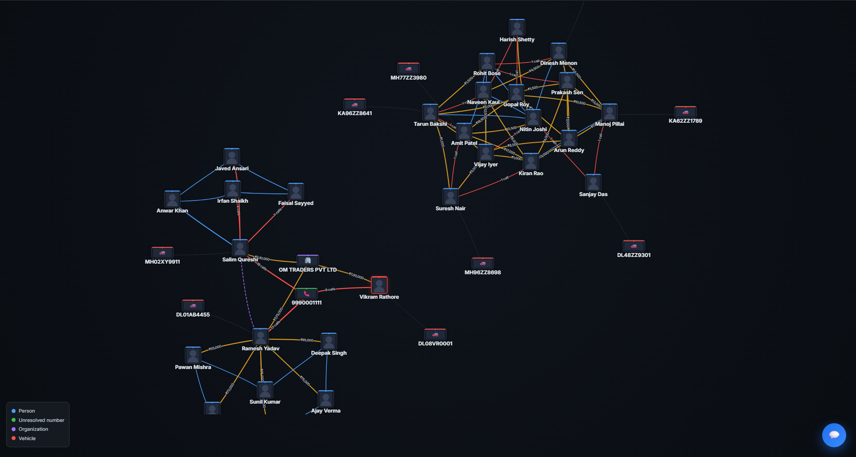
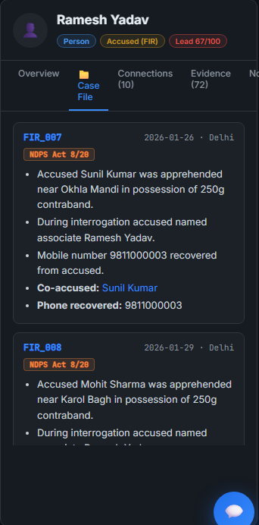
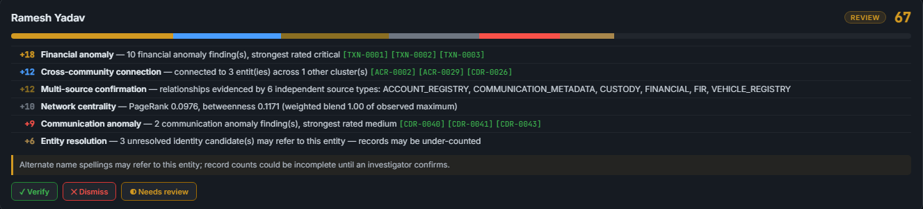
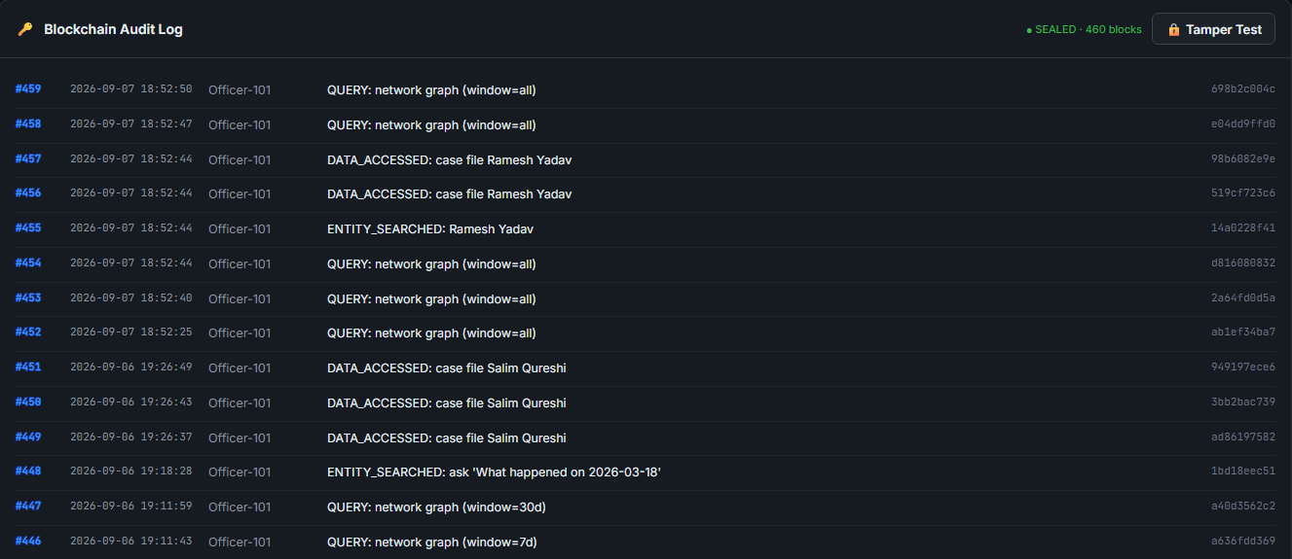
PRAHARI · Team PRAHARI
SMART INDIA HACKATHON 2026 · PS 26189
Prototype · Future Plans
Investigative Lead Score: every point explained and cited, human verdict buttons
Audit log: 460 sealed blocks, live Tamper Test
Case Board — 28 people, 3 clusters, strings coloured by evidence type; amounts and call counts on the links
Case file: FIR bullets, co-accused, phone recovered
FUTURE PLANS AND IMPROVEMENTS
Map & geo-fencing
OSINT & documents
RBAC + multilingual NER
Neo4j + live connectors
Permissioned ledger
CCTV/ANPR and GPS already ingest and stage
social records, FIR browser, multi-hop explore
IndicBERT behind the same extractor contract
CCTNS, telecom CDR, FIU-IND, e-Prisons, VAHAN
Hyperledger across NCRB nodes, HSM keys
Project Repo: github.com/varshithreddygujjulla/prahari
Prototype: runs offline — python -m uvicorn backend.main:app → localhost:8000
Prototype Video: in preparation
Notes:
All four screenshots are from the running prototype on the synthetic case. Future plans follow the specification's own priority order. Add the video link when it exists.

Slide 6
PRAHARI · Team PRAHARI
SMART INDIA HACKATHON 2026 · PS 26189
Resources & References
RESEARCH AND STANDARDS BEHIND THE DESIGN
₹
Economic impact
1
Criminal network analysis
Sparrow, M. K. (1991). The application of network analysis to criminal intelligence. Social Networks 13(3). · Morselli, C. (2009). Inside Criminal Networks. Springer.
Zero licence cost: fully open-source stack against per-seat foreign tools (i2 Analyst's Notebook, Palantir).
Weeks of cross-state file correspondence become one query with the reasoning attached.
Runs on a laptop today; the same schema scales on NIC MeghRaj with Neo4j. Pilot metric: time-to-lead versus manual work.
2
Centrality and communities
Brin, S. & Page, L. (1998). The anatomy of a large-scale hypertextual web search engine. · Clauset, Newman & Moore (2004). Finding community structure in very large networks. Phys. Rev. E 70.
3
Entity resolution
Fellegi, I. P. & Sunter, A. B. (1969). A theory for record linkage. JASA 64(328). · Christen, P. (2012). Data Matching. Springer.
4
Robust anomaly detection
Leys, C. et al. (2013). Detecting outliers: use absolute deviation around the median. J. Exp. Soc. Psych. 49(4).
🤝
Social benefits
Investigation reaches the financiers and brokers above street level, not only the foot soldiers.
Citizens are protected by design: no guilt scores, no automatic identity merges, human verdicts, an audit chain no administrator can rewrite.
For NCRB's Women Safety Division the same engine maps trafficking networks, where speed of connection-finding protects victims.
5
Tamper-evident logs
Haber, S. & Stornetta, W. S. (1991). How to time-stamp a digital document. J. Cryptology 3. · Hyperledger Fabric documentation.
6
Law and data shapes
Digital Personal Data Protection Act, 2023 · CCTNS (NCRB) FIR/charge-sheet schema · FIU-IND suspicious-transaction reporting · e-Prisons · VAHAN.
Notes:
References are the actual methods used: network analysis, PageRank and greedy modularity, Fellegi–Sunter record linkage, MAD outliers, hash-chained timestamps. Impact is framed as accountability plus reach, never as automated accusation.

