Slide 1

Notes:
1 Title

Slide 2

Notes:
2 Project overview

Slide 3
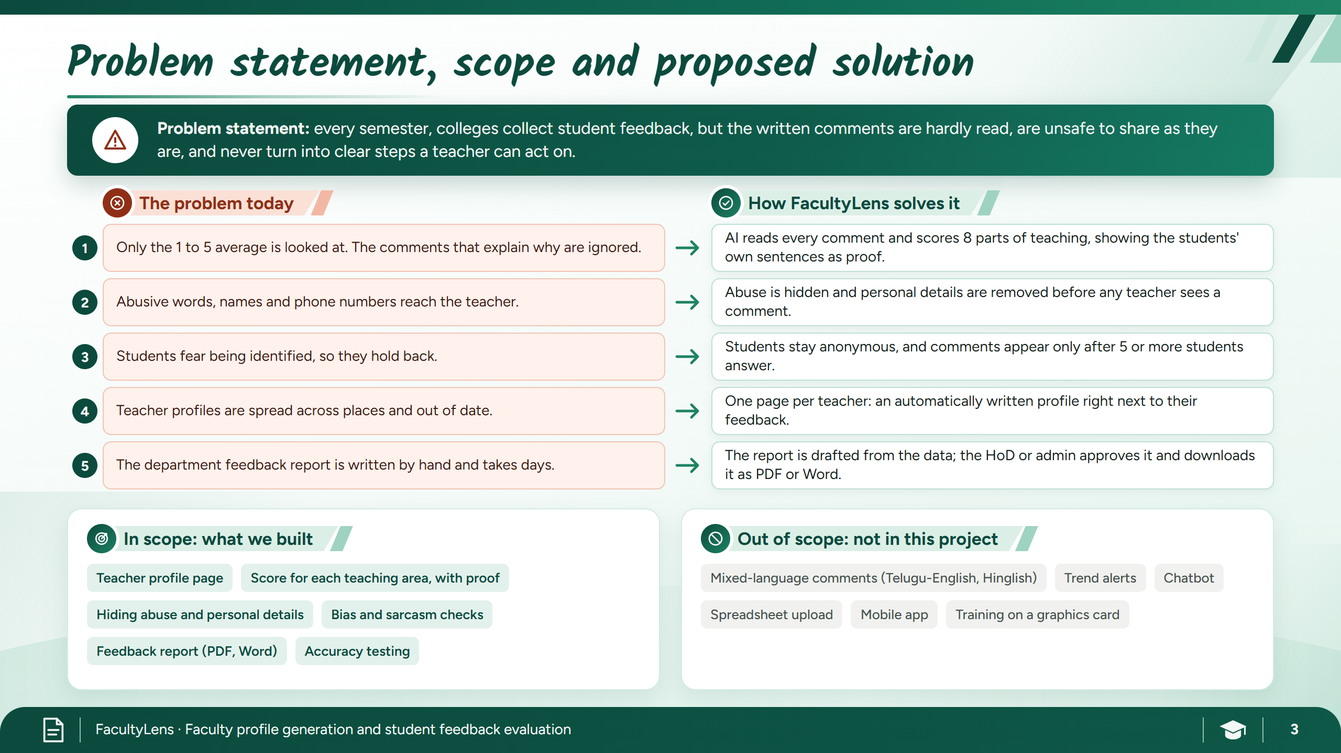
Notes:
3 Problem, scope, solution

Slide 4

Notes:
4 Background study

Slide 5

Notes:
5 Users and challenges

Slide 6
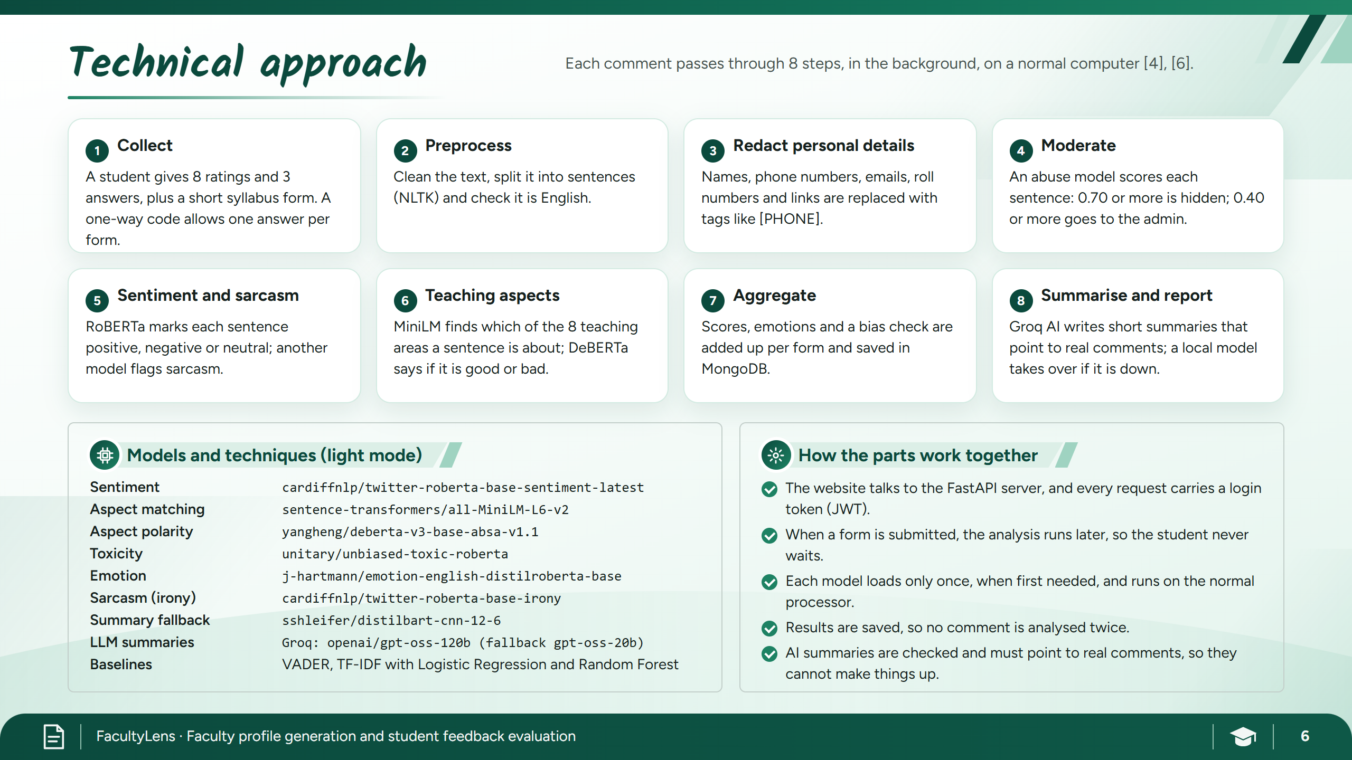
Notes:
6 Technical approach

Slide 7
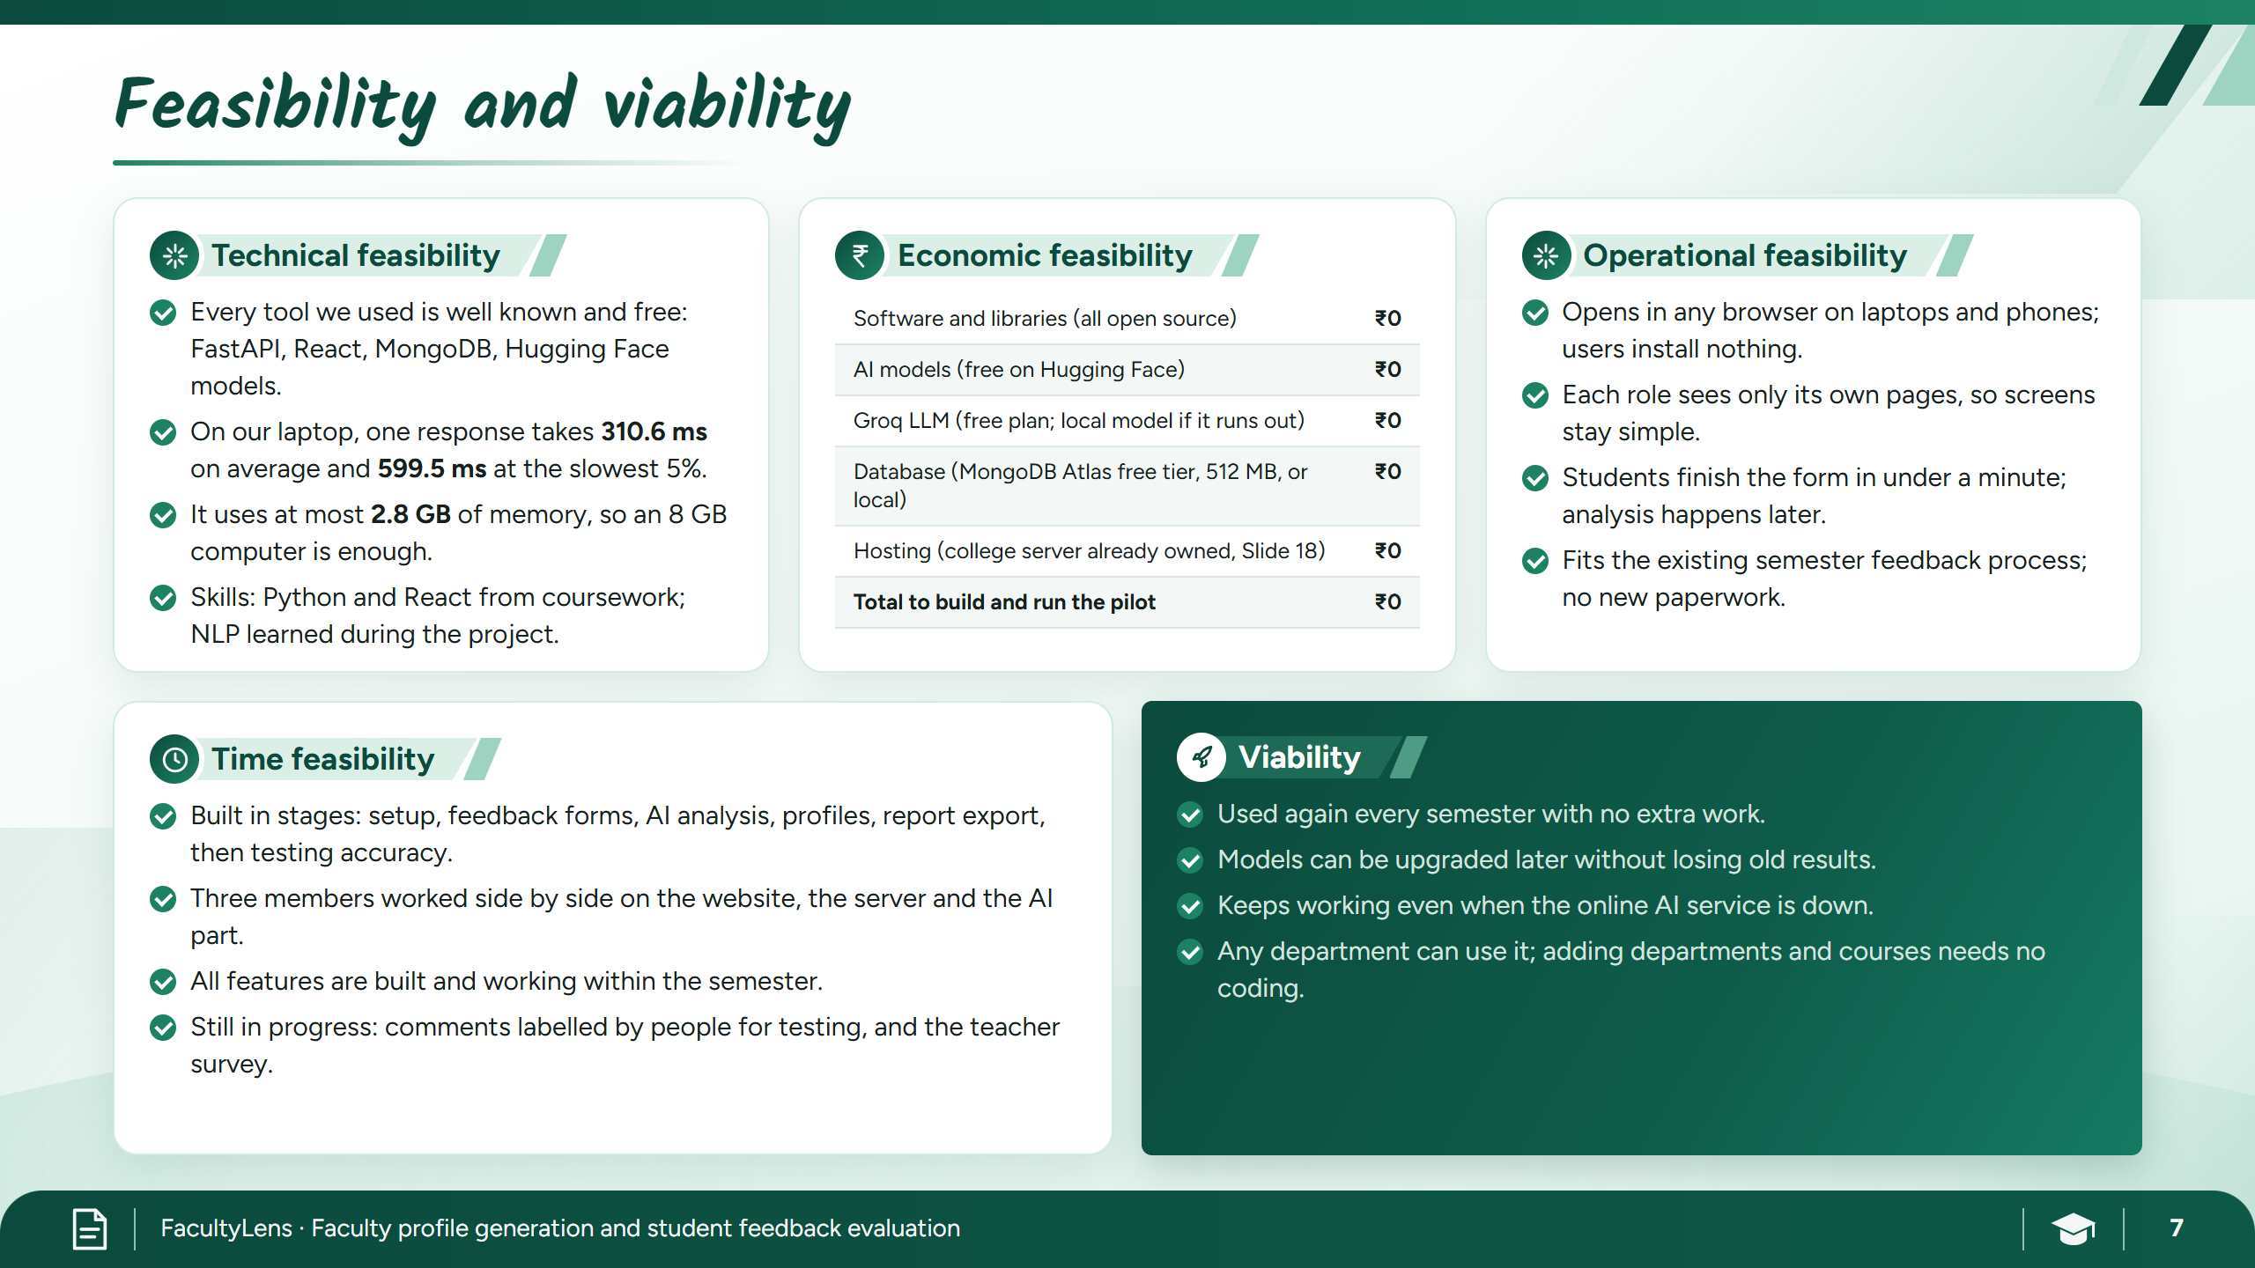
Notes:
7 Feasibility

Slide 8
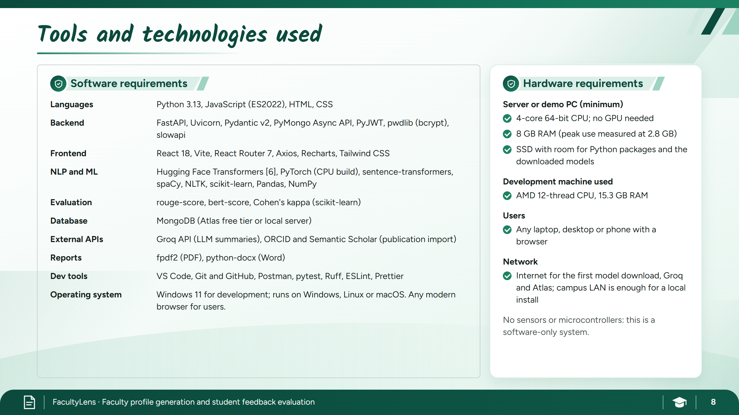
Notes:
8 Tools

Slide 9
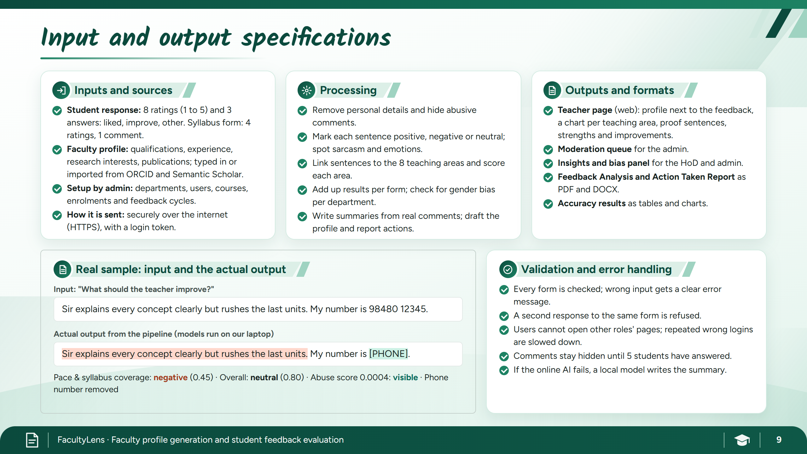
Notes:
9 Input and output

Slide 10
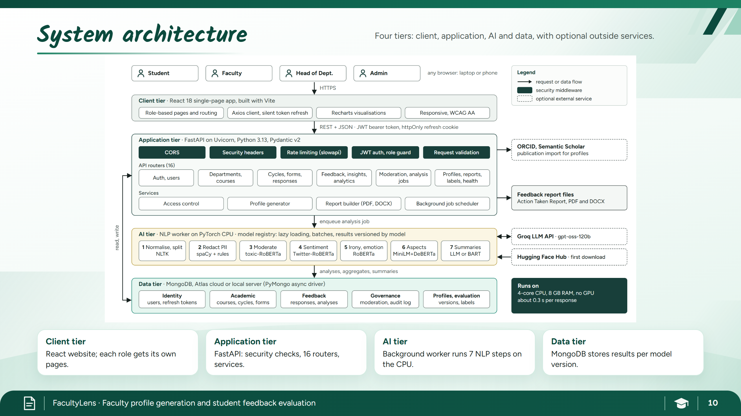
Notes:
10a Architecture

Slide 11
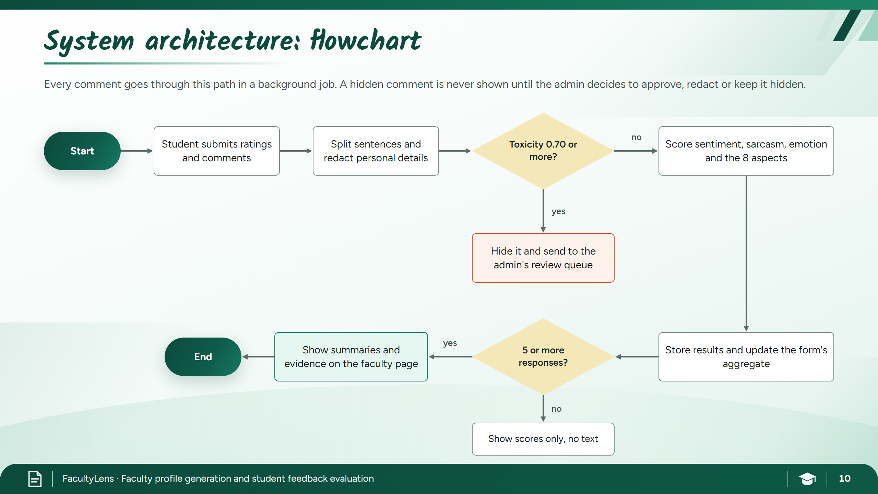
Notes:
10b Flowchart

Slide 12
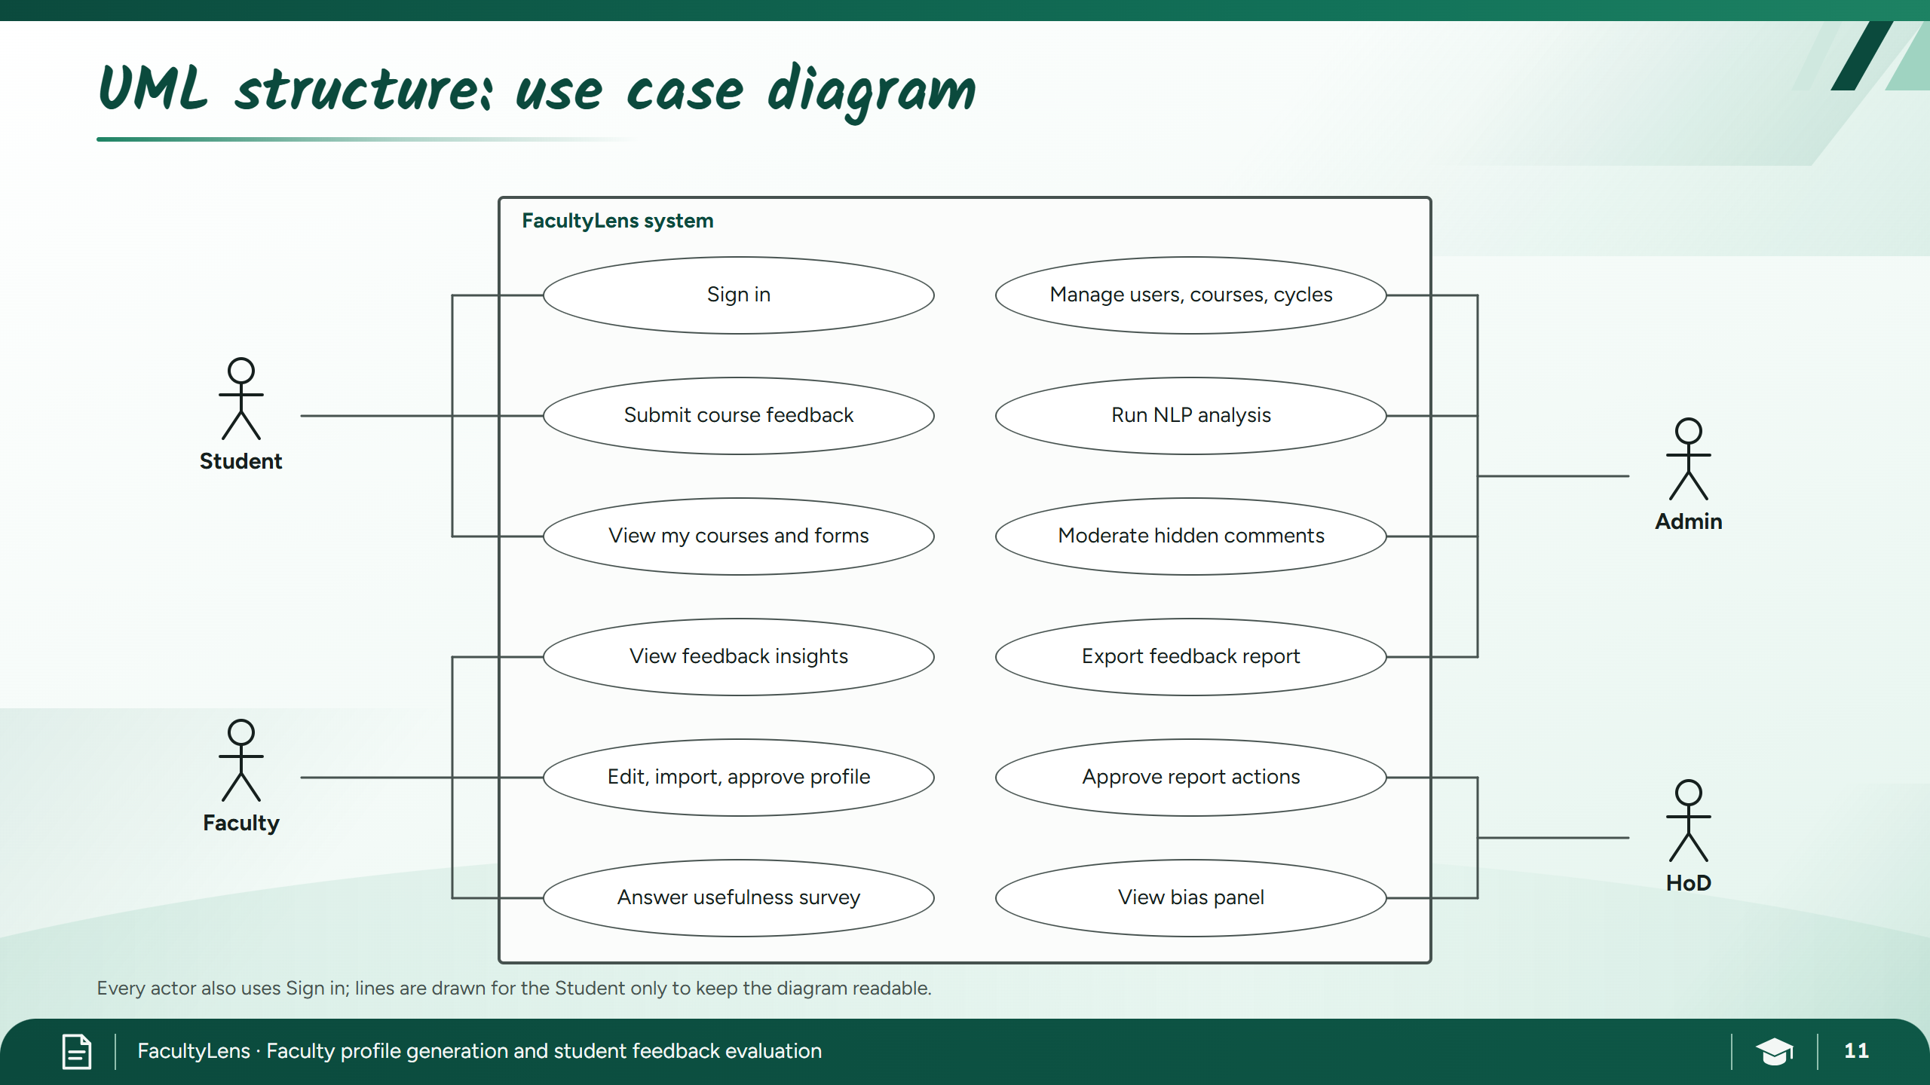
Notes:
11a Use case

Slide 13
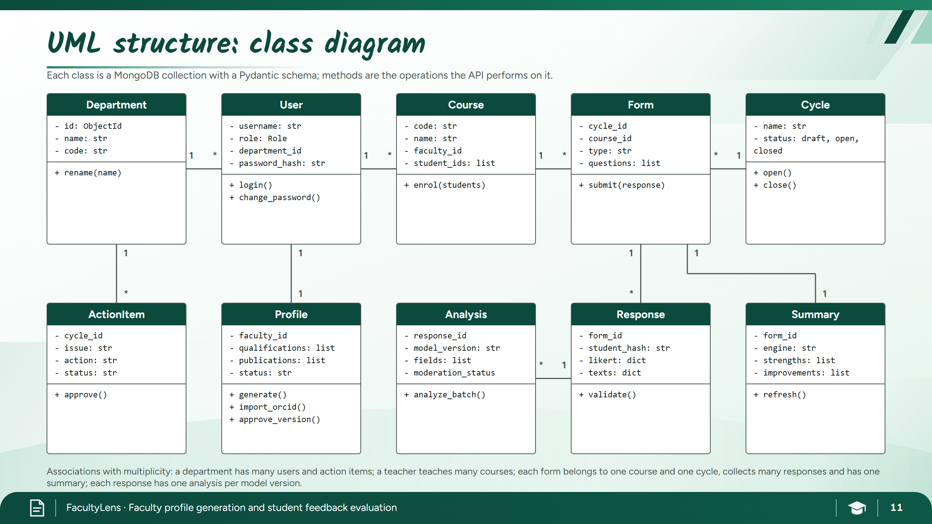
Notes:
11b Class

Slide 14
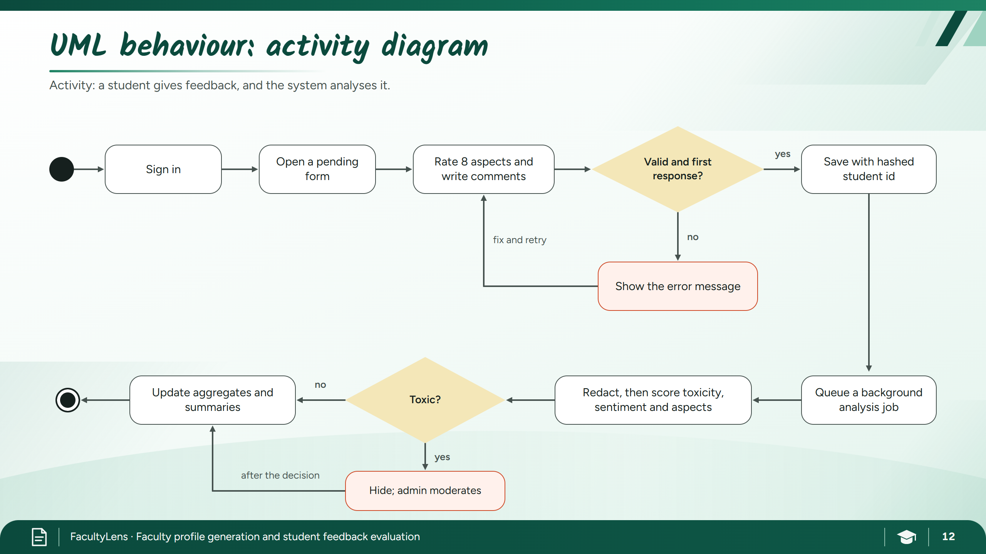
Notes:
12a Activity

Slide 15
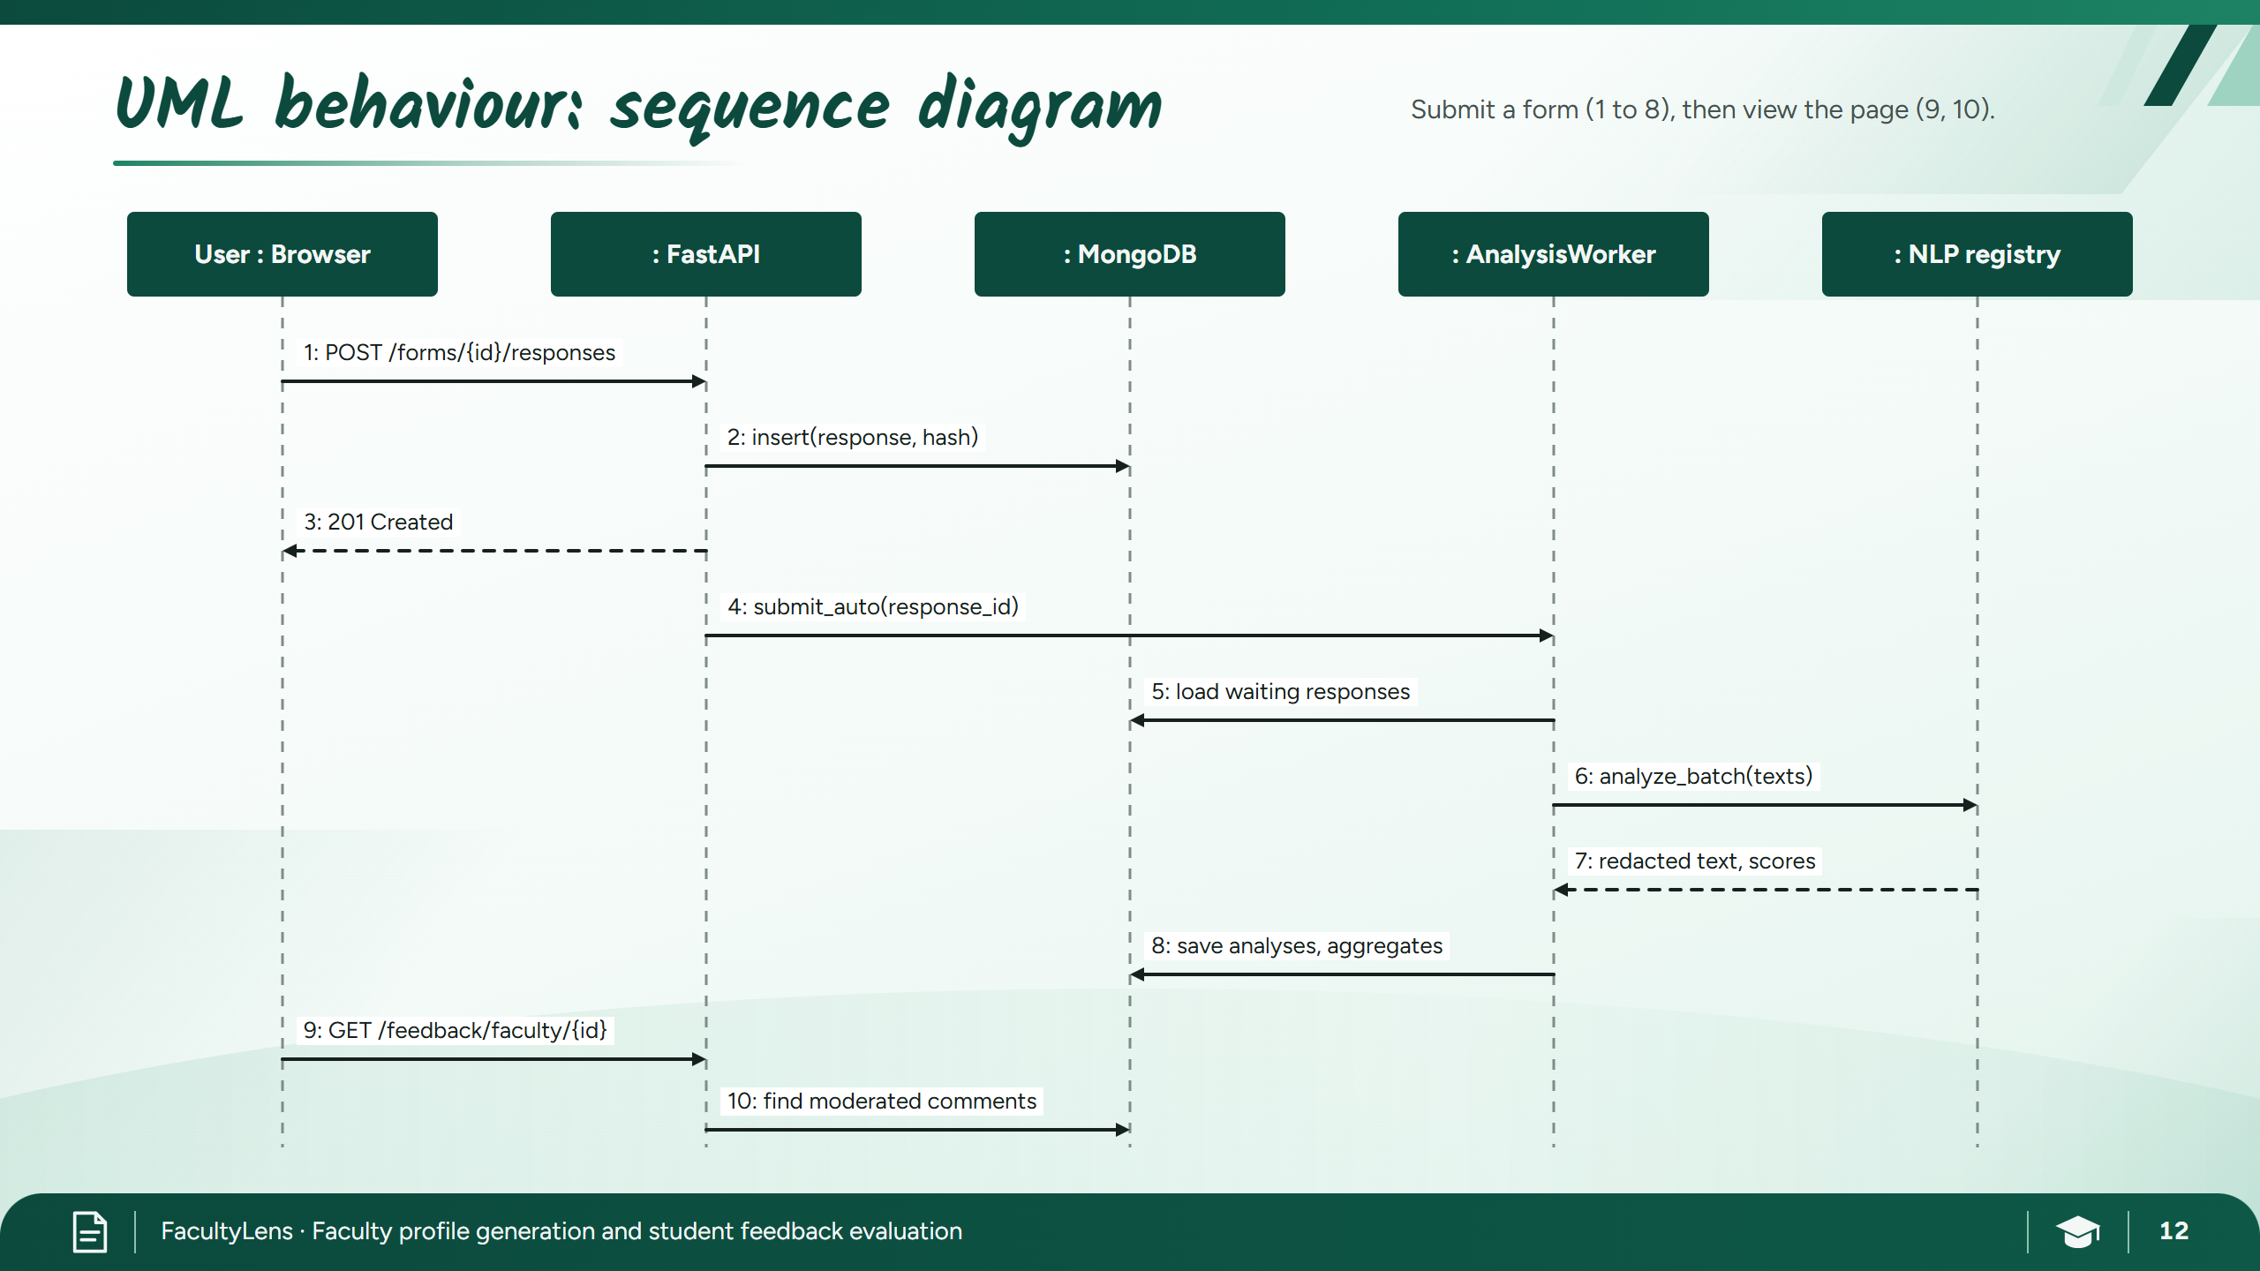
Notes:
12b Sequence

Slide 16
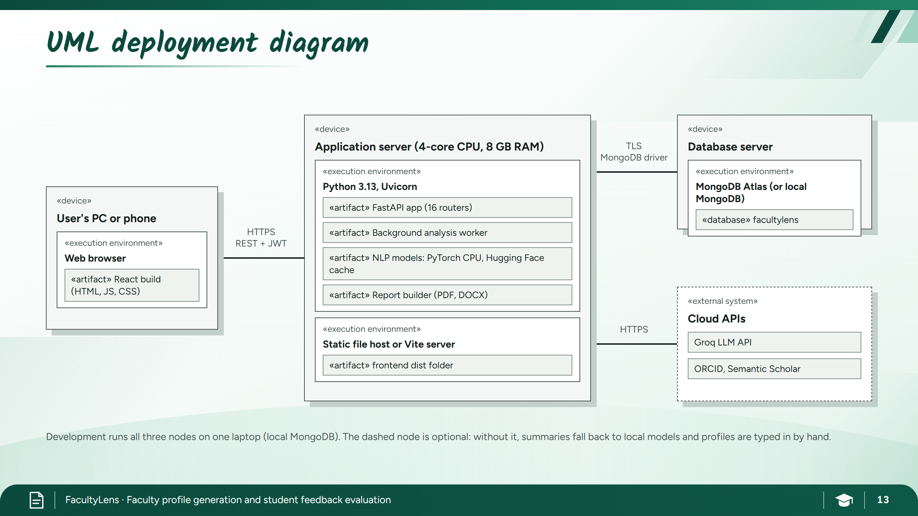
Notes:
13 Deployment

Slide 17
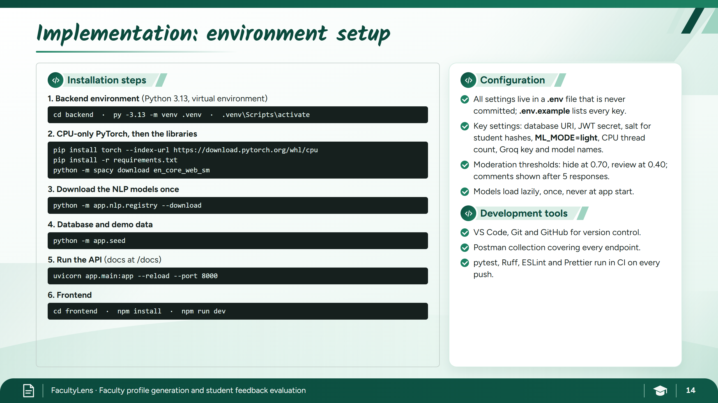
Notes:
14a Setup

Slide 18
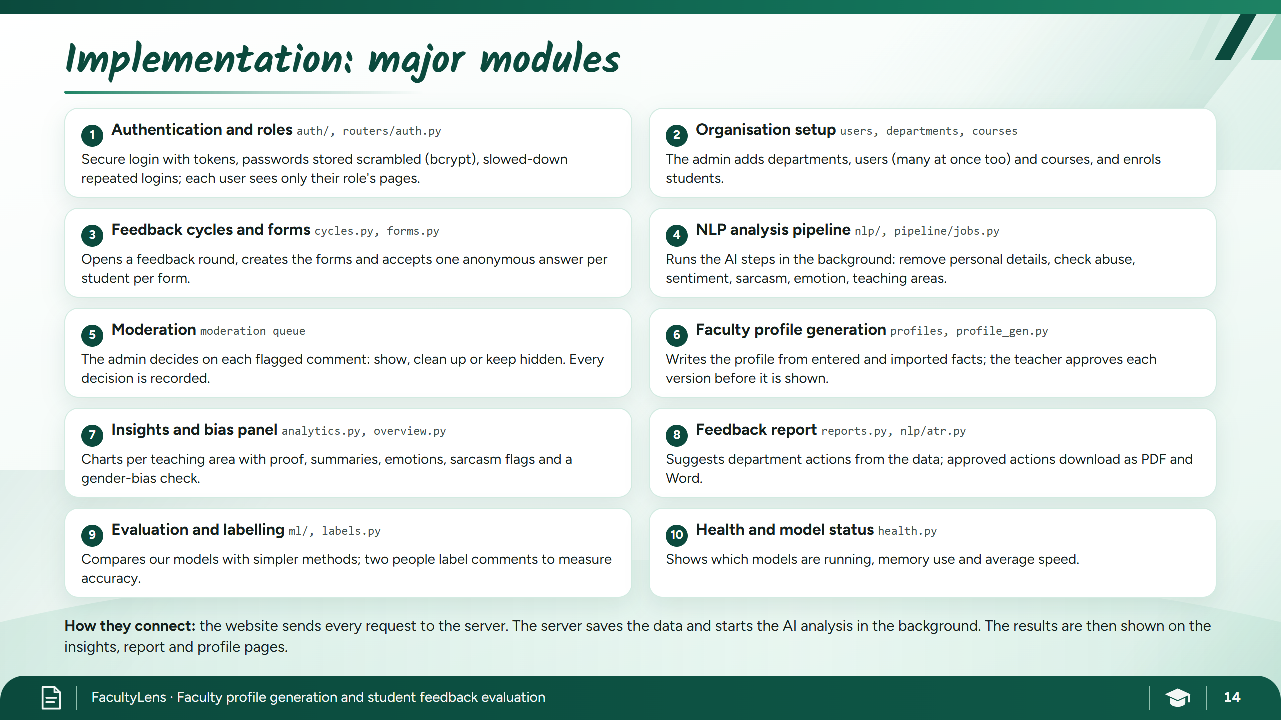
Notes:
14b Modules

Slide 19
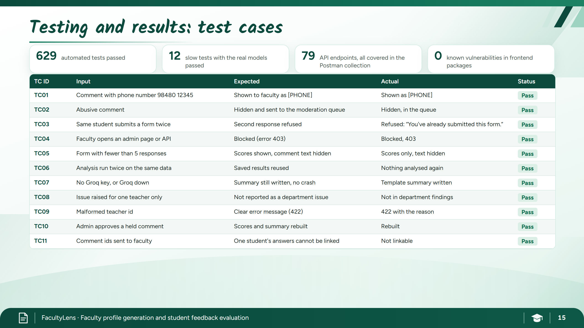
Notes:
15a Test cases

Slide 20

Notes:
15b Results

Slide 21
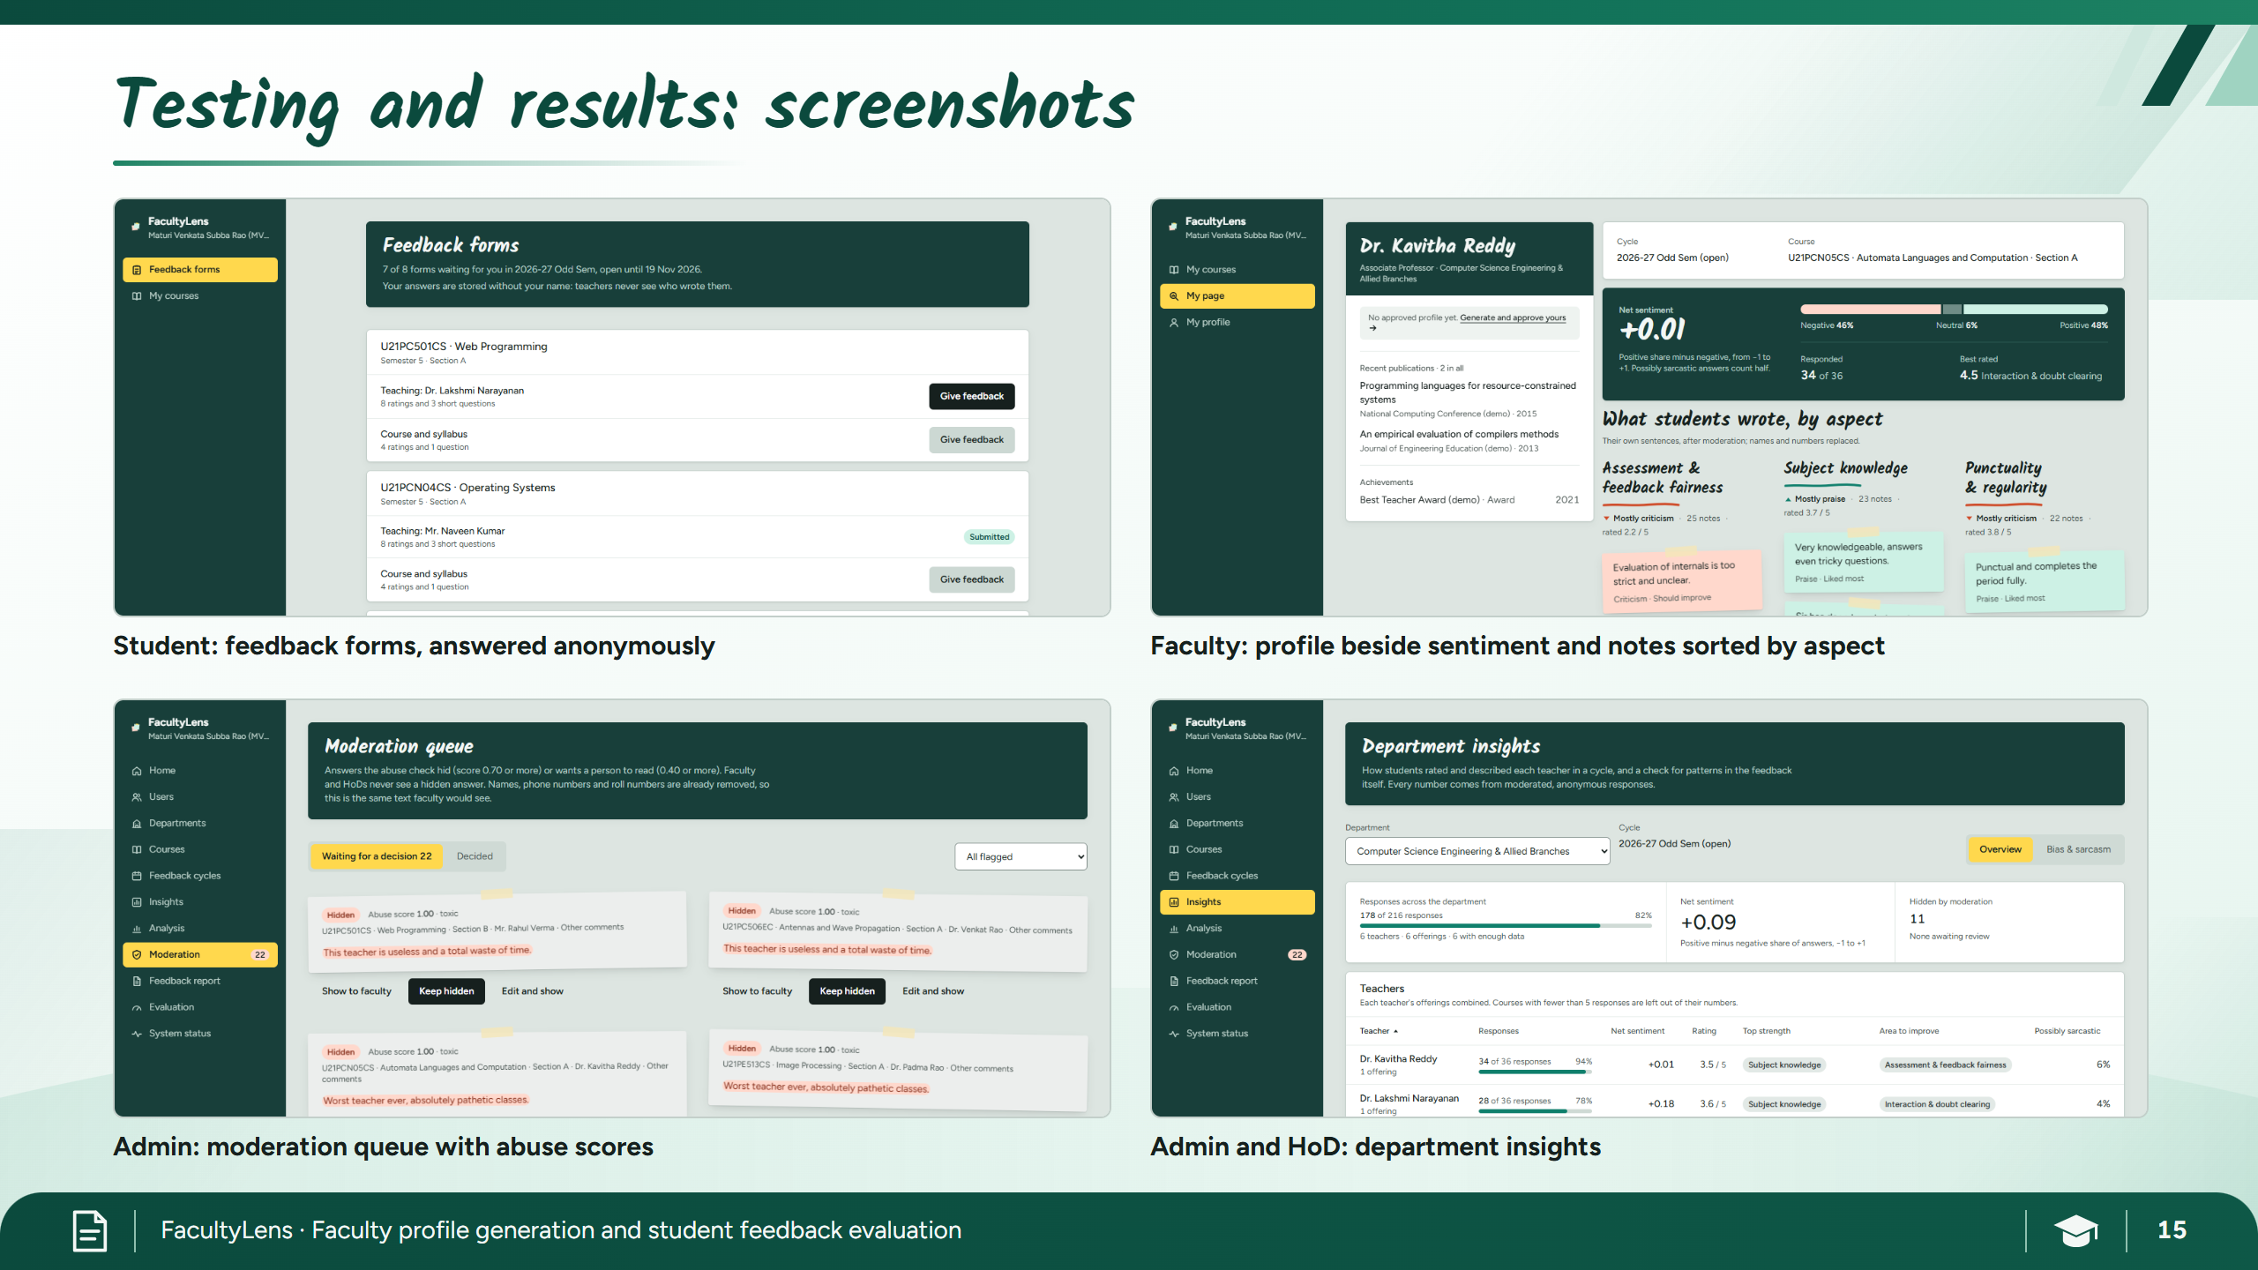
Notes:
15c Screenshots

Slide 22
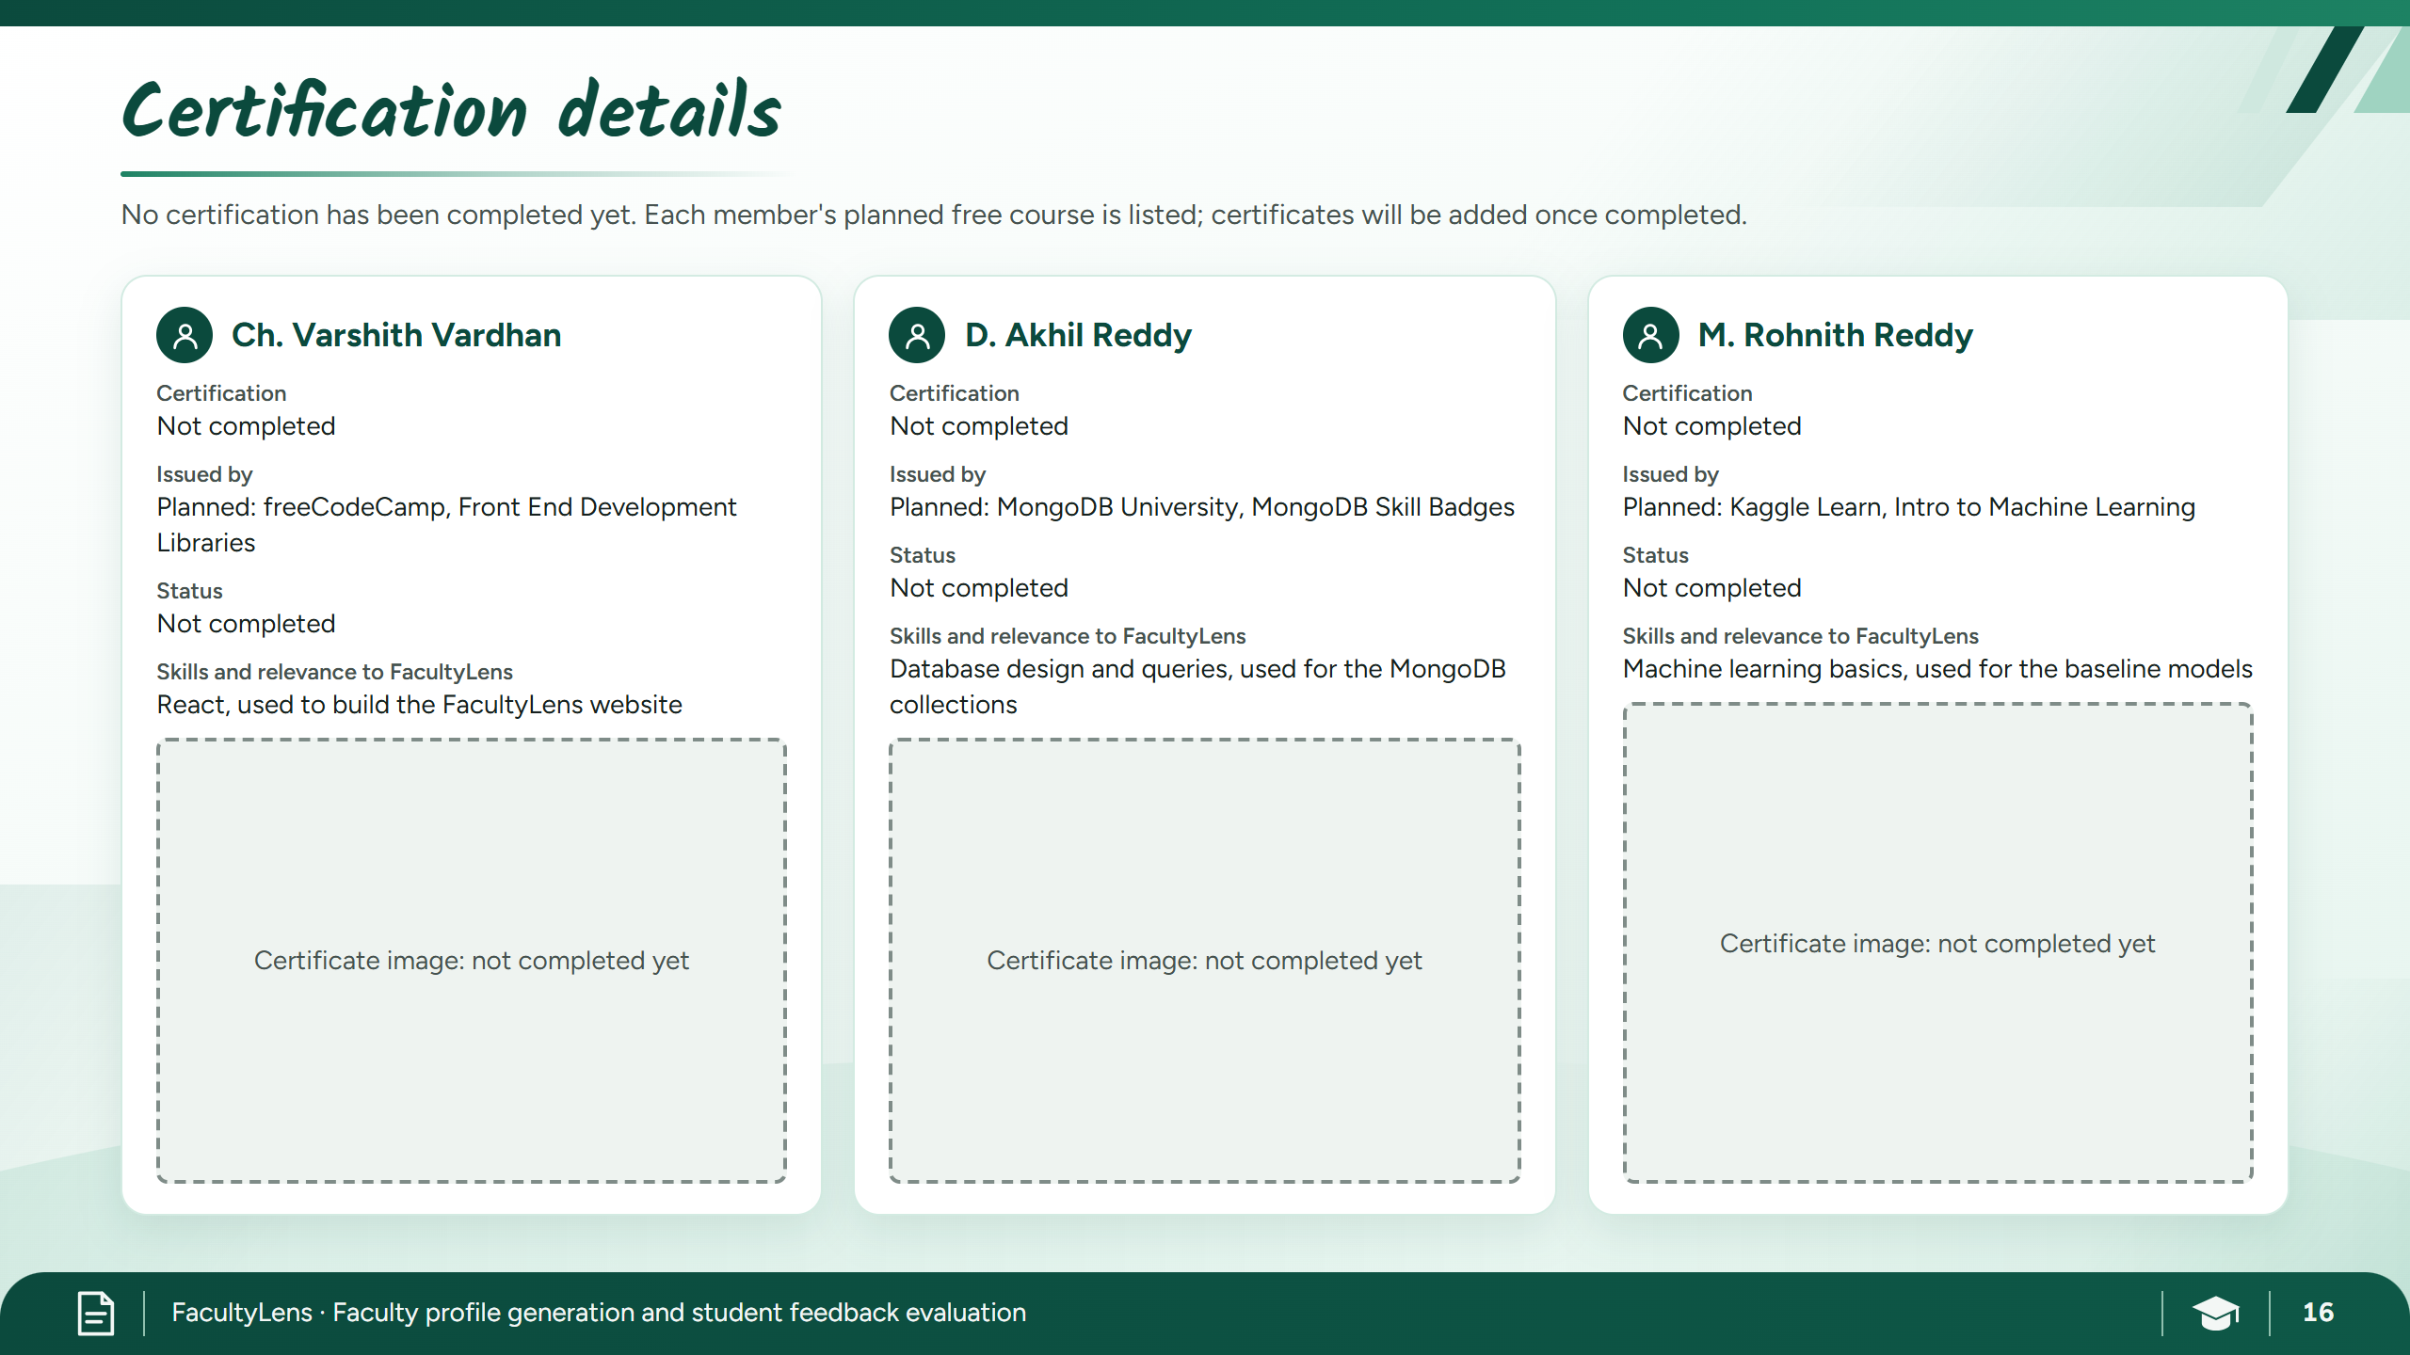
Notes:
16 Certification

Slide 23
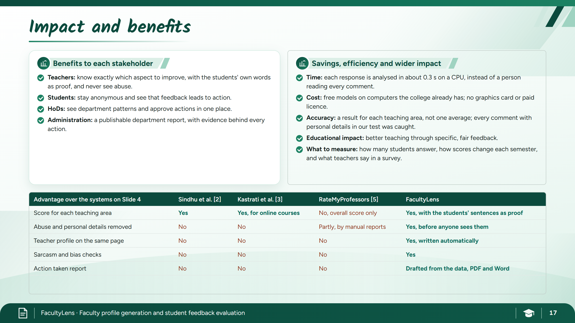
Notes:
17 Impact

Slide 24
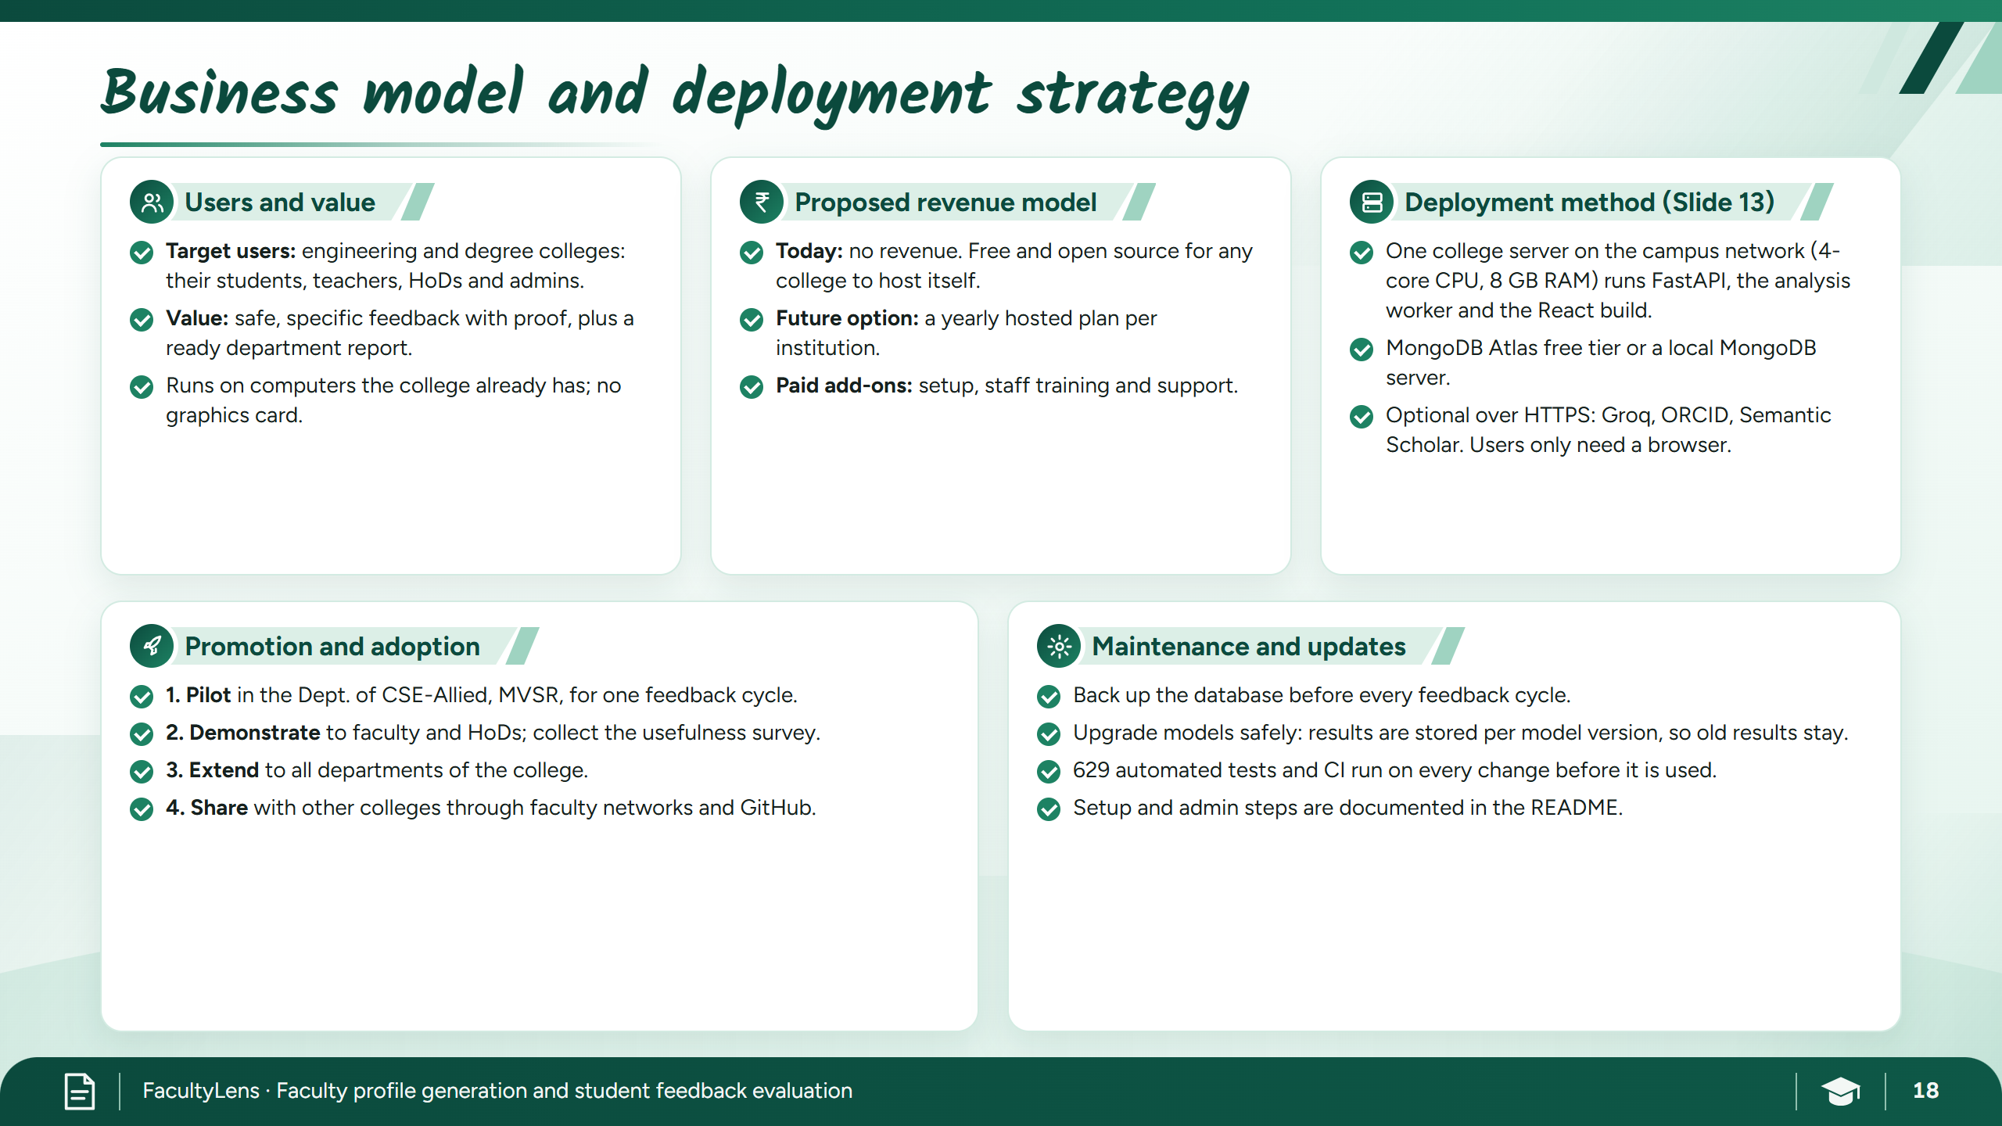
Notes:
18 Business model

Slide 25
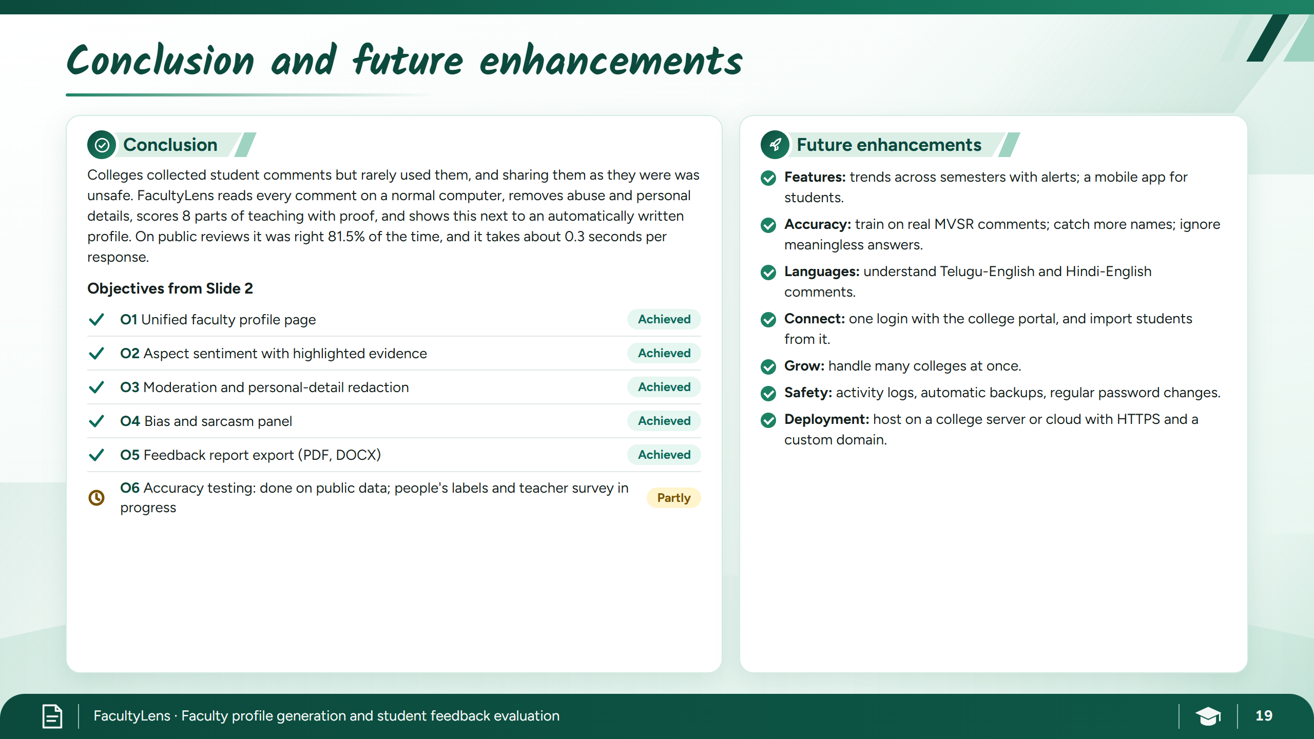
Notes:
19 Conclusion

Slide 26

Notes:
20 References

Slide 27

Notes:
21 Thank you

