Slide 1

GitHub
Utkarsh Gaikwad

Slide 2
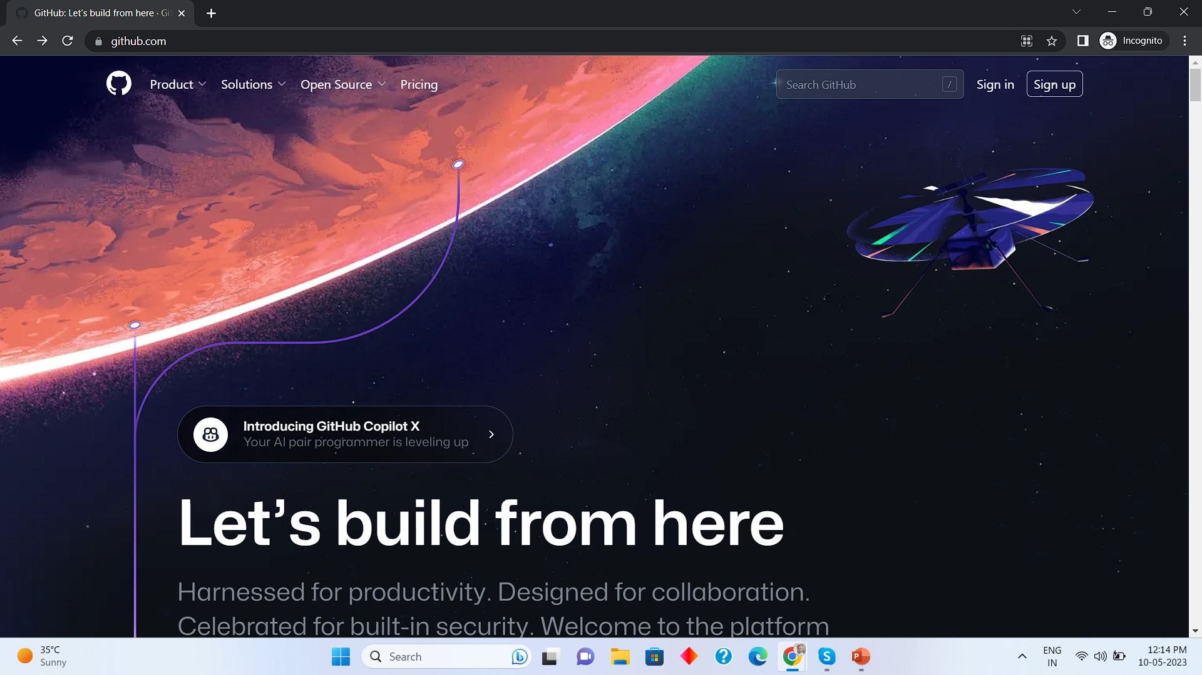
Signup for GitHub (Once completed type done)
https://github.com/
Sign Up

Slide 3
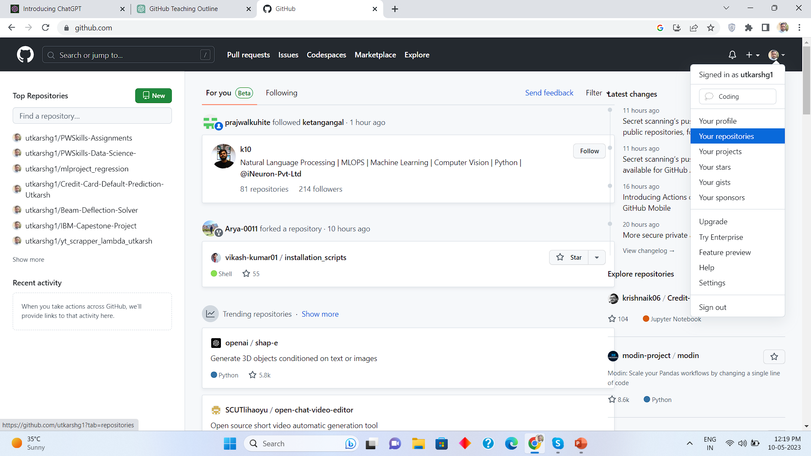
Adding New Repository in GitHub
Click here
Click
Your Repositories

Slide 4
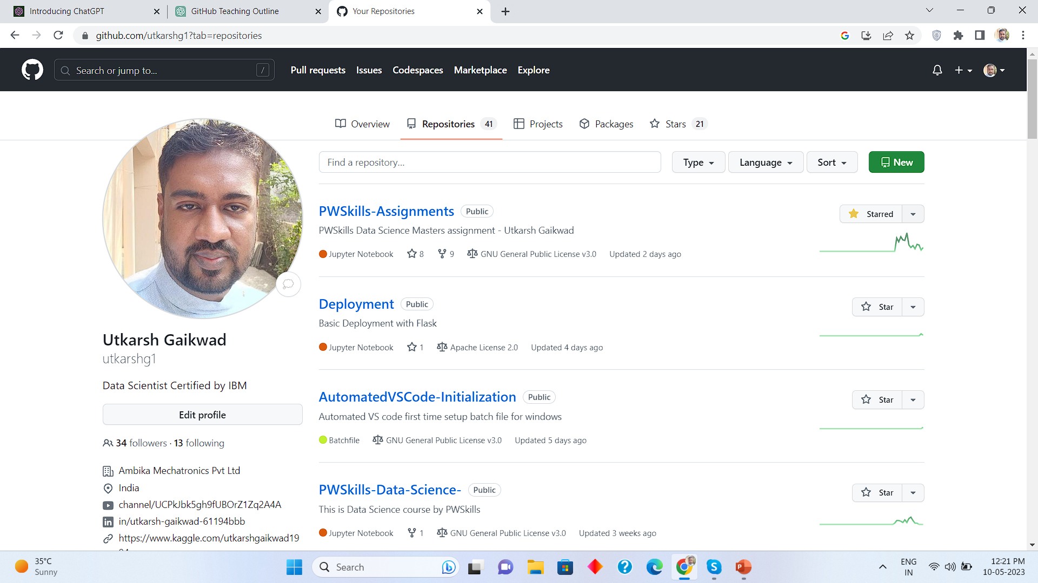
New Repository Continued
Click on New

Slide 5
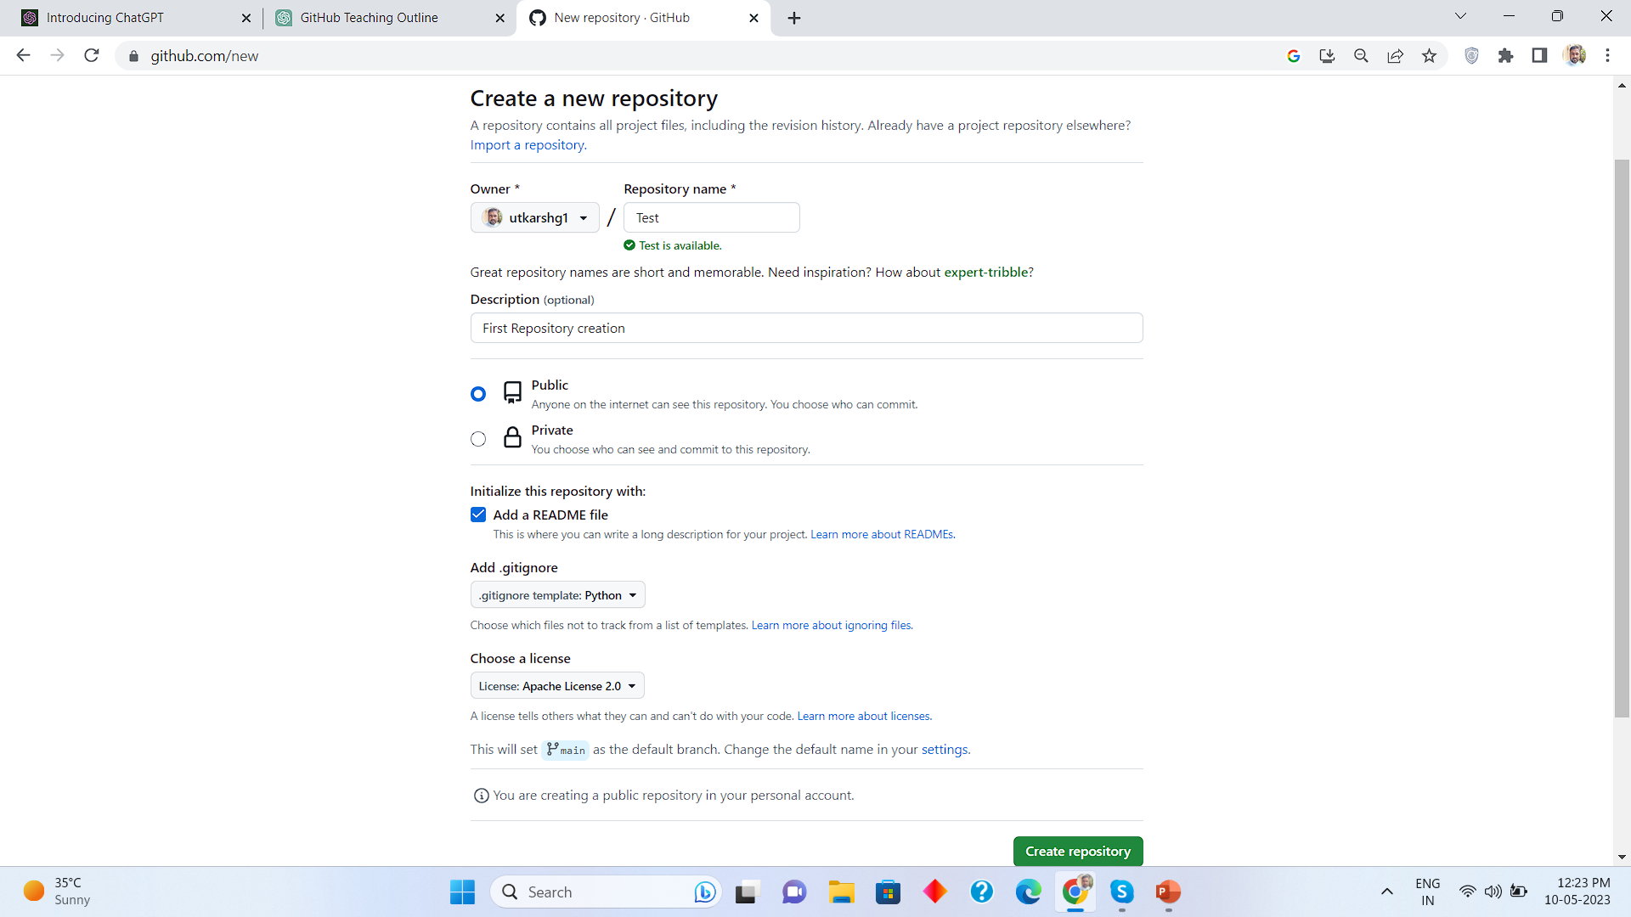
New Repository Continued
Write repo name
Tick this option
Select python
Select Apache licence

Slide 6
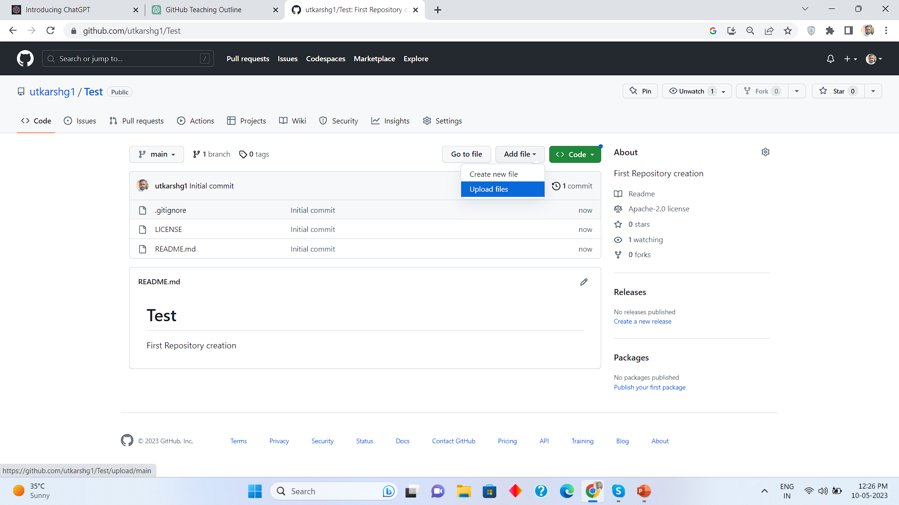
Adding Files in repository
Click add file
Click upload file

Slide 7
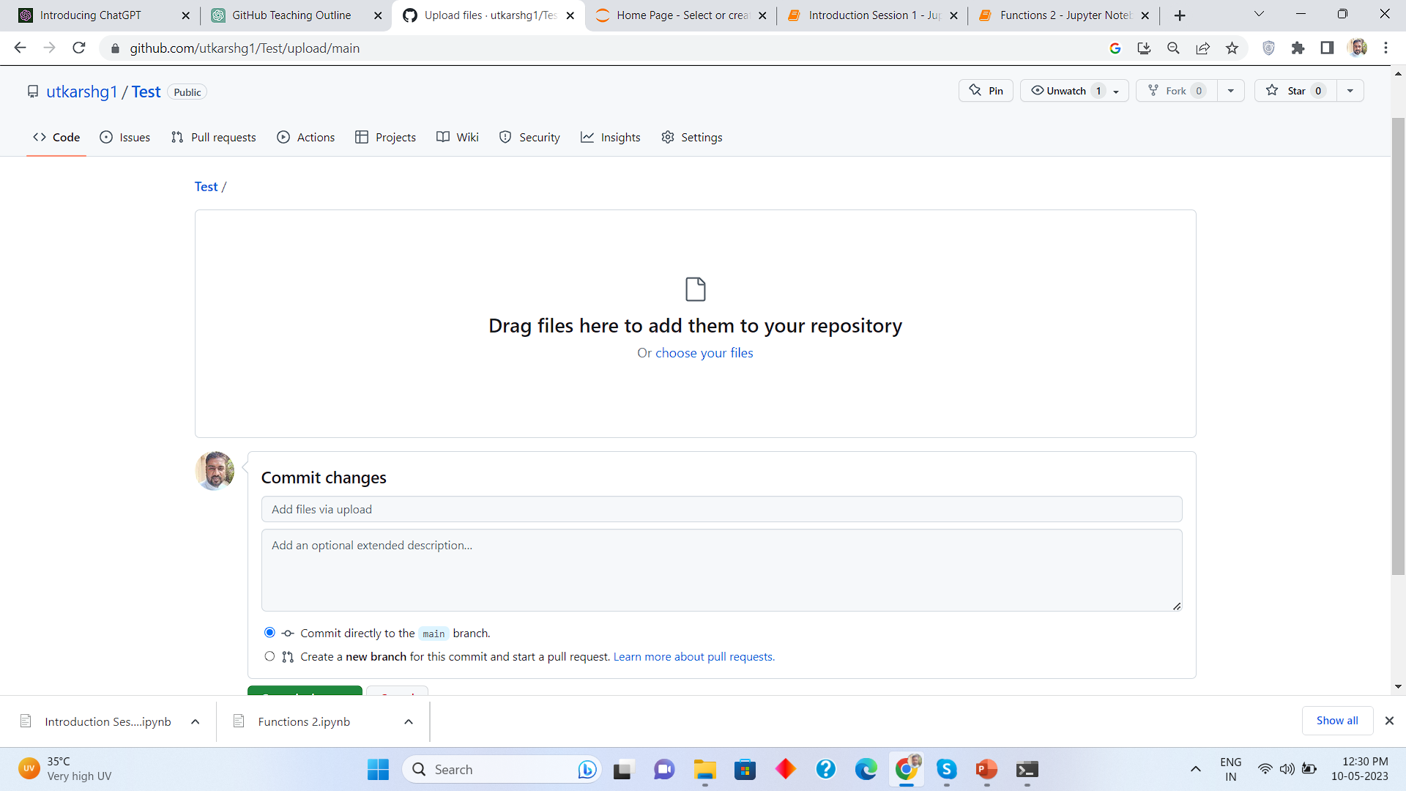
Adding Files
Click this link

Slide 8
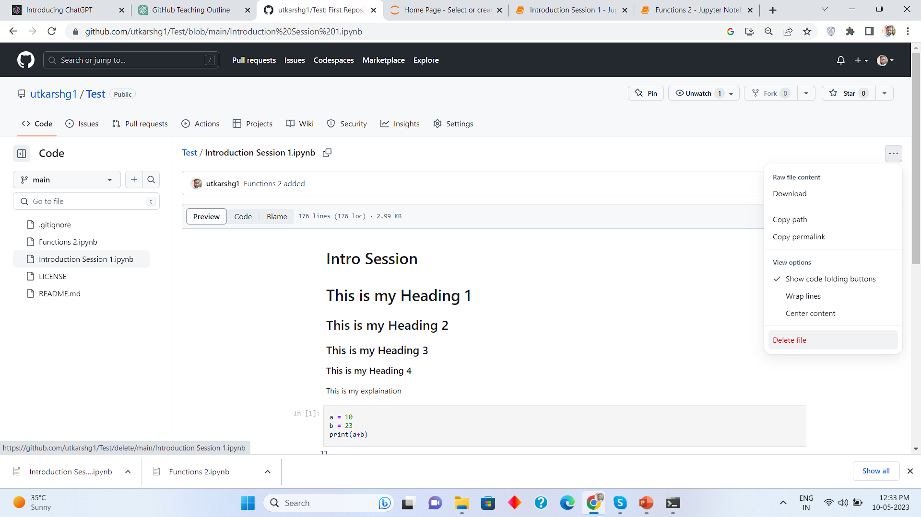
Deleting a file
Click this
Click delete file

Slide 9
Thank you
Ping me on skype for any queries

