Slide 1
Support Vector Machine Supervised Machine Learning

Slide 2
Course Topics
What is Support Vector Machine ?
How Support Vector Machine works?
Pros and Cons of Support Vector Machine
Applications of Support Vector Machine
Optimizing Support Vector Machine model performance
Modeling Support Vector Machine with Python

Slide 3
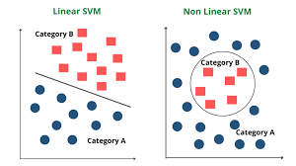
What is Support Vector Machine ?
Support Vector Machine” (SVM) is a supervised machine learning algorithm which can be used for both classification or regression challenges. However, it is mostly used in classification problems.
It use for Linearly separable data and Non-Linearly separable data.
SVM is a Non - probabilistic classifier.
SVM use marginal distance which Logistic and KNN doesn't use.

Slide 4
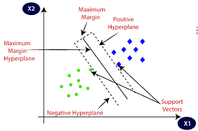
How Support Vector Machine works?
First SVM find the Support vector then it create a marginal line which passes through the support vector and it gives hyperplane between them.
Main aim of SVM is find the marginal line which has maximum marginal distance.

Slide 5
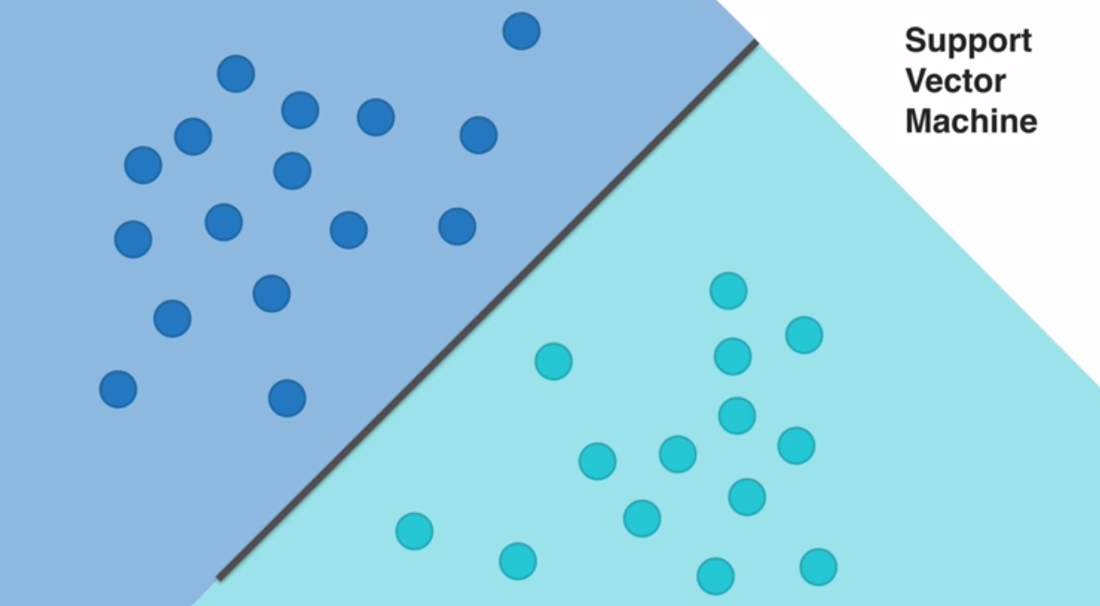
SVM: Hyperplane splitting Data

Slide 6
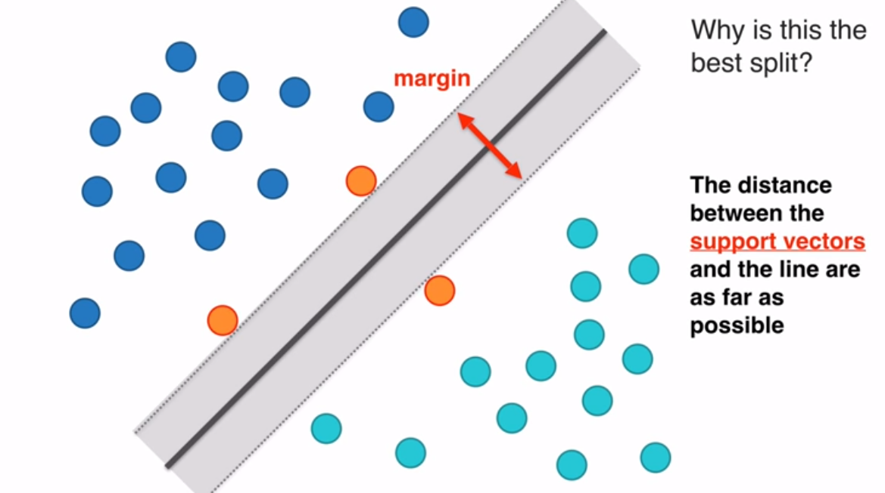
SVM : Margin

Slide 7
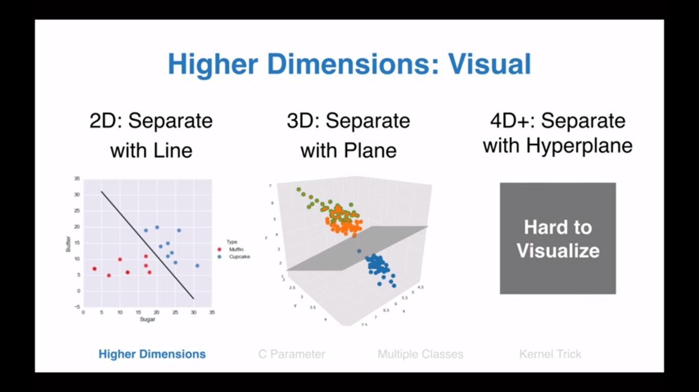
SVM Higher Dimensions Visual

Slide 8
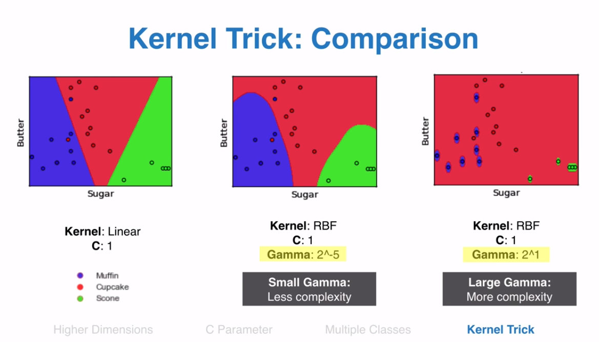
SVM Example: Kernel Trick

Slide 9
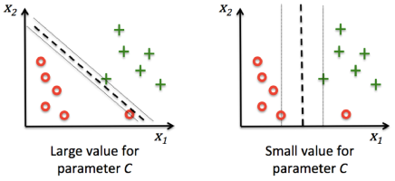
C Value

Slide 10
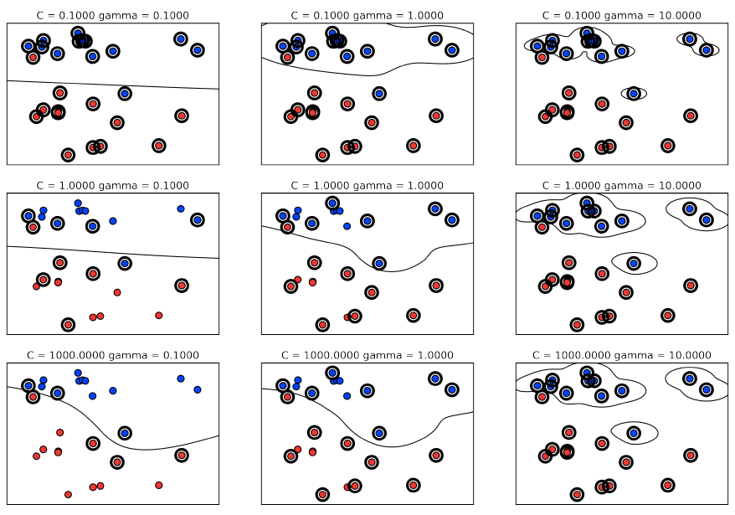
Gamma and C parameters

Slide 11
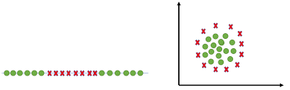
Pros of Support Vector Machine
Very good at dealing with higher dimensional data
Works well with smaller data set
Useful for both Linearly Separable (hard margin) and Non-linearly Separable (soft margin) data

Slide 12
Cons of Support Vector Machine
Picking right kernel and parameters can be computationally intensive.
In Natural Language Processing, structured representations of text yield better performances. Sadly, SVMs can not accommodate such structures (word embeddings).

Slide 13
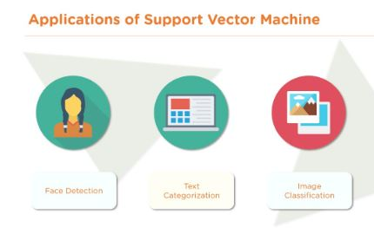
Applications of Support Vector Machine
Face Detection
Text Categorization
Image Classification

Slide 14
Modeling Support Vector Machine
Modeling Support Vector Machine Algorithm
(attached in resource section of this module)

Slide 15

Questions?
Q&A Session

