Slide 1

SQL

Slide 2
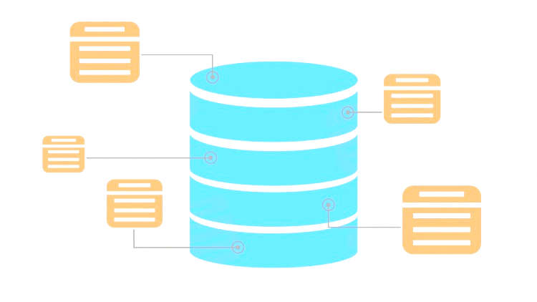
DATABASE
A database is an organized collection of data.
For Example:
A university database organizes
the data about students, faculty, admin staff, etc.
DATA
DATABASE

Slide 3







DBMS(Data Base Management System)
The software which is used to manage databases is called Database Management System. DBMS allows users to create ,read , update and delete data in database.
For example:
MySQL, Oracle, Microsoft SQL server, PostgreSQL are the popular commercial DBMS used in different applications.

Slide 4



WHY DBMS?
Data Storage
Data abstraction
Controls data redundancy
Multi - user access and views
Security

Slide 5
DATA MODELS
Data models define how the logical structure of a database is modelled.
Data models define how data is connected to each other ,how they are processed and stored inside the system.
Hierarchical Model
Network Model
Entity Relationship Model
Relational Model
No SQL

Slide 6
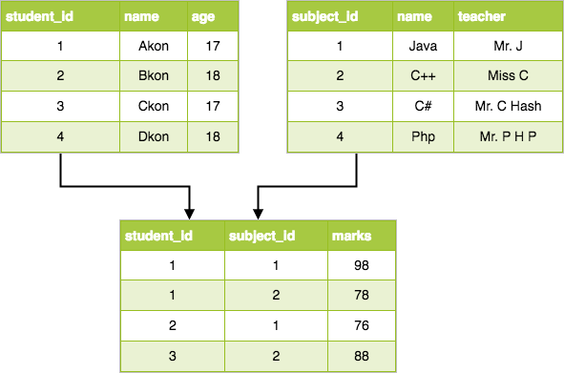
RELATIONAL DATA MODEL

Slide 7
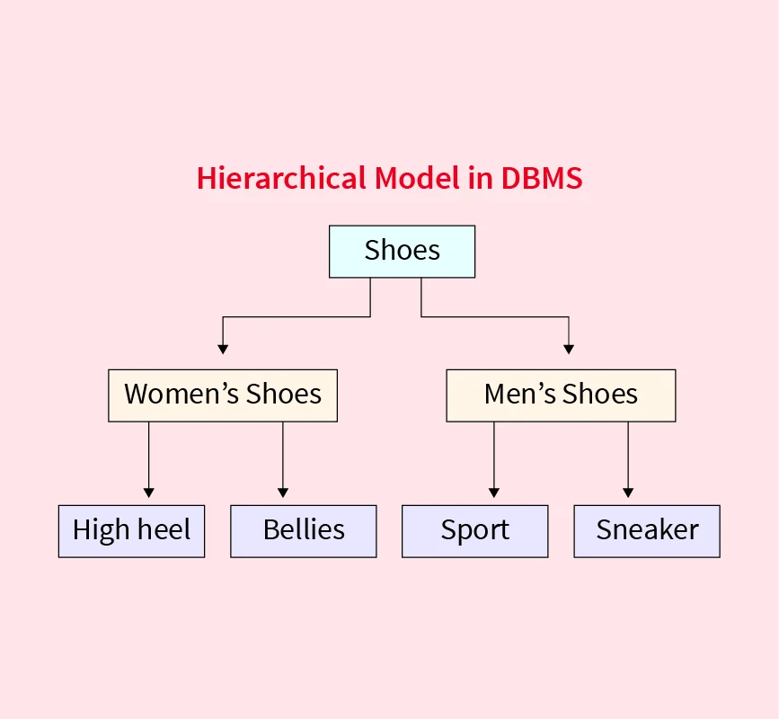
HIERARCHICAL DATA MODELS

Slide 8
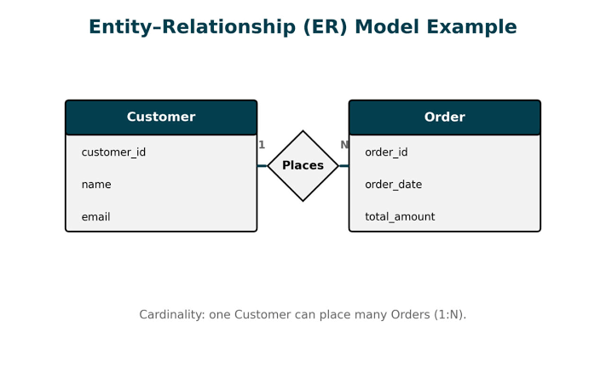

Slide 9
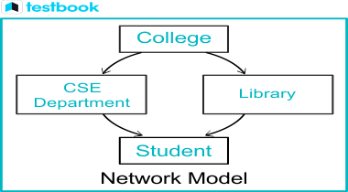
NETWORK MODEL

Slide 10
RELATIONAL MODEL
In this model , the data is organized in the form of two dimensional table. That means data is stored in the form of rows and columns.
For example:
The table here shows “STUDENT DETAILS” with attributes such as Stu_Id, Name and Branch which has 5 records.
Stu_Id | Name | Branch
201 | John | CSE
202 | Mary | ECE
203 | Britto | IS
204 | Harry | IT
205 | Steve | ME

Slide 11


RDBMS
RDBMS is a program which is used to manage Relational databases in which data is stored in the form of rows and columns which can be easily retrieved ,managed and updated.

Slide 12

MySQL
MySQL is an open source relational database that uses structured query language to interact with databases.
It stores data in the form of table and can be modified using SQL.

Slide 13
WHY MySQL ?
Easy to use
Cost effective
Secured
Platform-Friendly

Slide 14
SQL
SQL stands for Structured Query Language.
SQL is a database programming language designed for the retrieval and management of data in a relational database.
All relational database management systems like MySQL ,Oracle , MS Access and SQL server uses SQL as their standard database language.

Slide 15
WHAT SQL DOES?
SQL is used to create new databases and tables.
SQL execute queries against a database.
SQL is used to retrieve, update and insert records into a database.
SQL used to create stored procedures and views in a database.
SQL can also set permissions on tables, procedures and views.

Slide 16
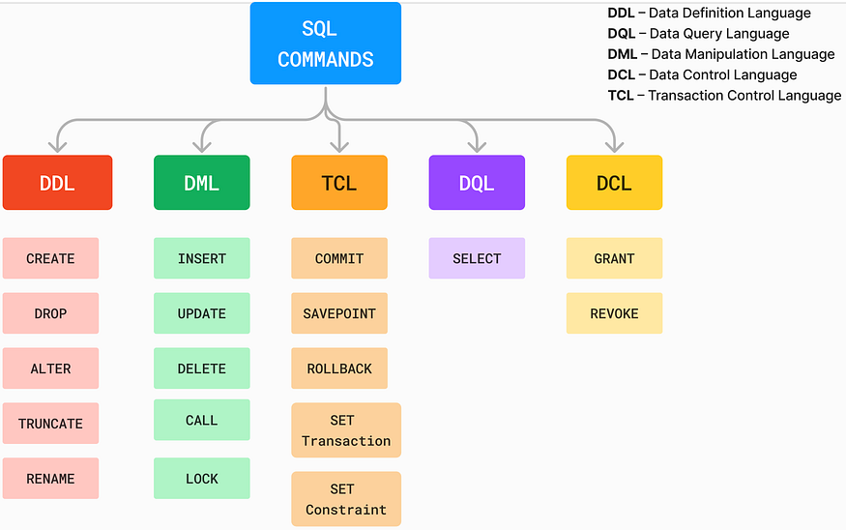
SQL COMMANDS

Slide 17

MySQL WORKBENCH
MySQL workbench is a Graphical tool developed by Oracle , which is used to work with MySQL server and databases.
MySQL provides data modelling , SQL development and various administration tools for configuration.

Slide 18
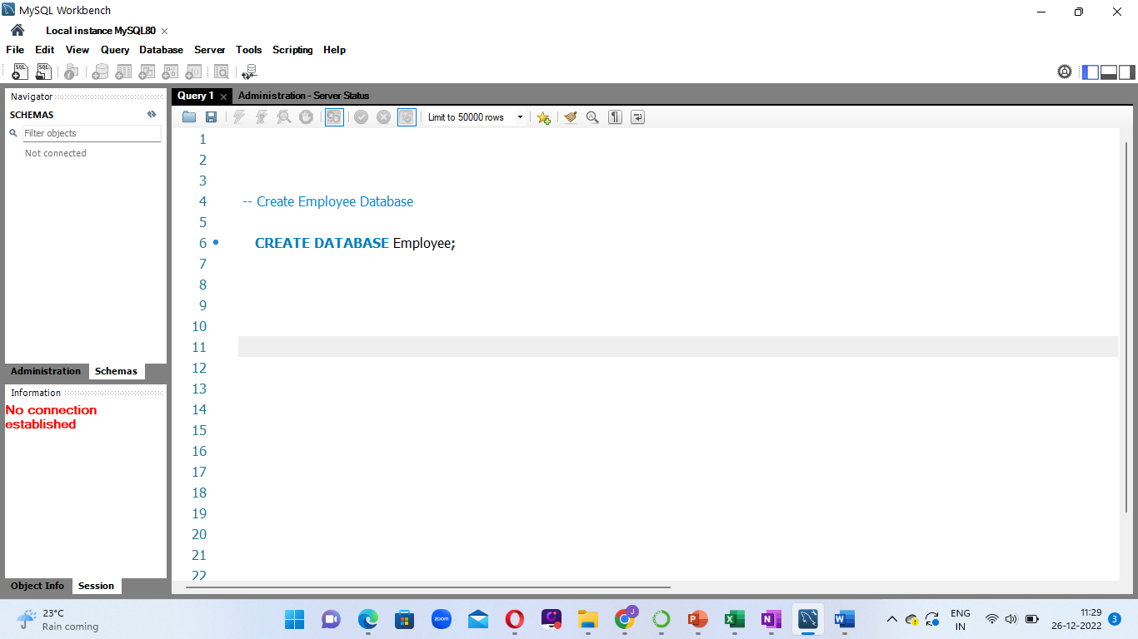
CREATE DATABASE
CREATE DATABASE <database name>:

Slide 19
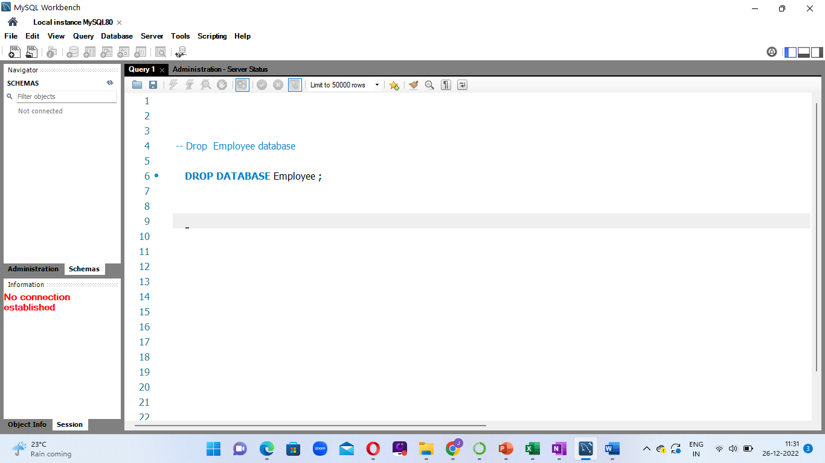
DROP DATABASE
DROP DATABASE <database name>:

Slide 20
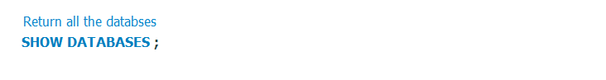
SHOW DATABASE
SHOW DATABASES:

Slide 21
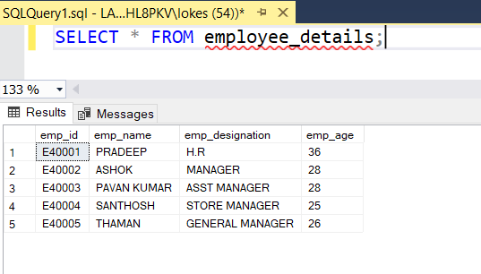
TABLE
SQL table is a collection of data which is organized in rows and columns. Each row represents unique record and each column represents field in the record.
For example:
Here is a table which contains employee data in which row represents each employee and column represents employee information such as employee number, name, designation and age.

Slide 22
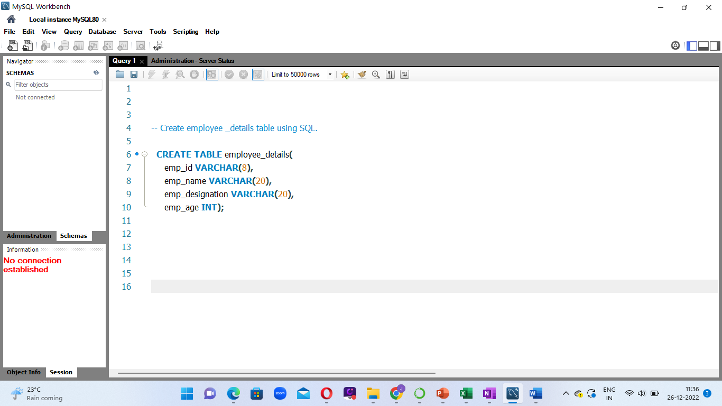
CREATE TABLE
CREATE TABLE < table name > (
< column1> <data type> ,
< column1> <data type> ,
< column1> <data type> ,
…
) ;

Slide 23
DATA TYPES
The data type of a column defines what sort of data that an object can store such as integer, character, money, date and time, binary, and so on.
NUMERIC
CHARACTER
DATE AND TIME

Slide 24
NUMERIC
Data Type
Range
bigint dd
-9,223,372,036,854,775,808 to 9,223,372,036,854,775,807
int(s)
-2,147,483,647 to 2,147,483,647
smallint
-32,768 to 32767
tinyint
0 - 255
decimal(s , d)
-10 ^38+1 to 10^38 -1

Slide 25
DATE AND TIME
Data Type
Format
Date
YYYY-MM-DD
Time
HH:MM:SS
Year
YYYY

Slide 26
CHARACTER
Data Type
Range
Char
0 - 255 characters
Varchar(s)
0 – 65535 characters
Text
65535 characters

Slide 27
SQL CONSTRAINTS
A DBMS keys are an attributes which help you uniquely identify a record or row of data in a relation.
NOT NULL
default
unique
keys
check
Primary key
Foreign key

Slide 28
SQL CONSTRAINTS
Not null
It ensures that column cannot have null values.
Unique
It ensures that all values in a column are unique.
Primary key
It’s a combination of not null and unique keys.
Foreign key
It prevents actions that would destroy link between tables.
Default
Sets a default value for a column if value is specified.
Check
It ensures that the values in a column satisfies the
specified condition.

Slide 29
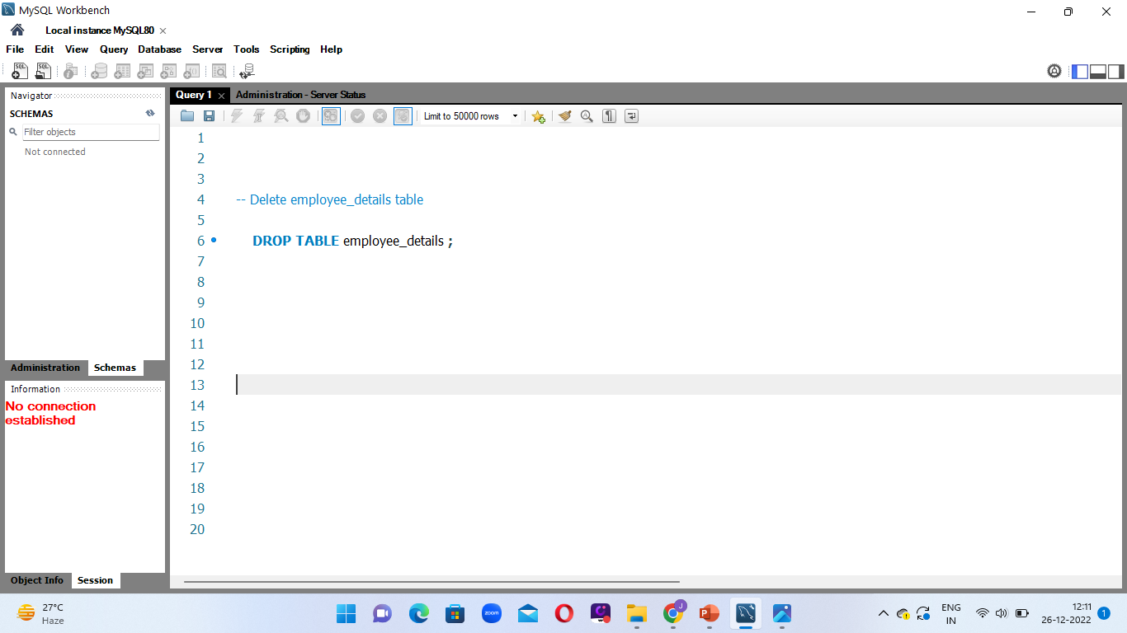
DROP TABLE
DROP TABLE < table name > ;

Slide 30
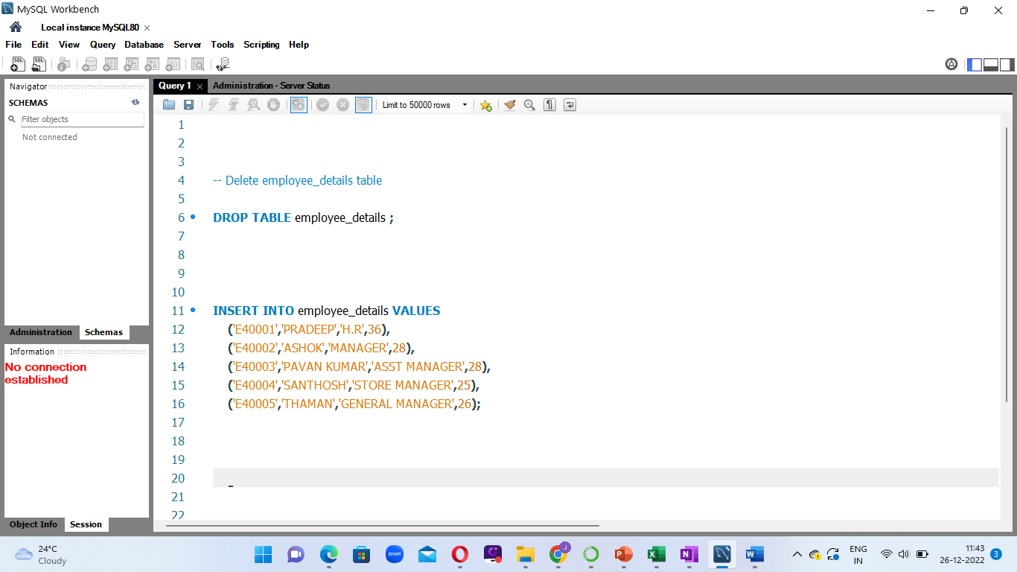
INSERT INTO
Insert into is used to insert new records in the table.
INSERT INTO < table name > (column1 ,column2,column3…)
VALUES (<val1>, <val2> ,<val3>…);

Slide 31
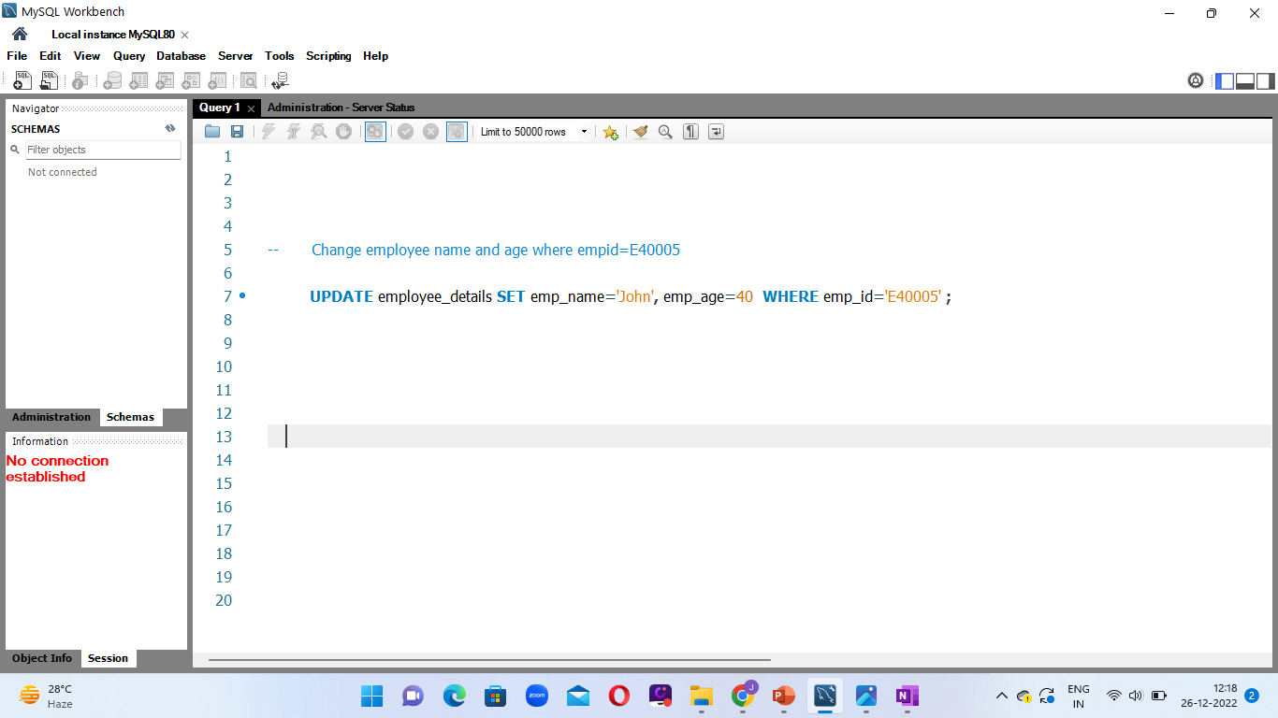
UPDATE
Used to modify the existing records in a table using where condition.
UPDATE TABLE < table name >
SET <column1>=<value1> ,<column2>=<value1> …
WHERE <condition> ;

Slide 32
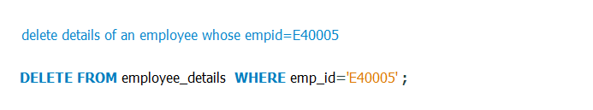
DELETE
Used to delete the existing records in a table using where condition.
DELETE FROM < table name >
WHERE <condition> ;

Slide 33
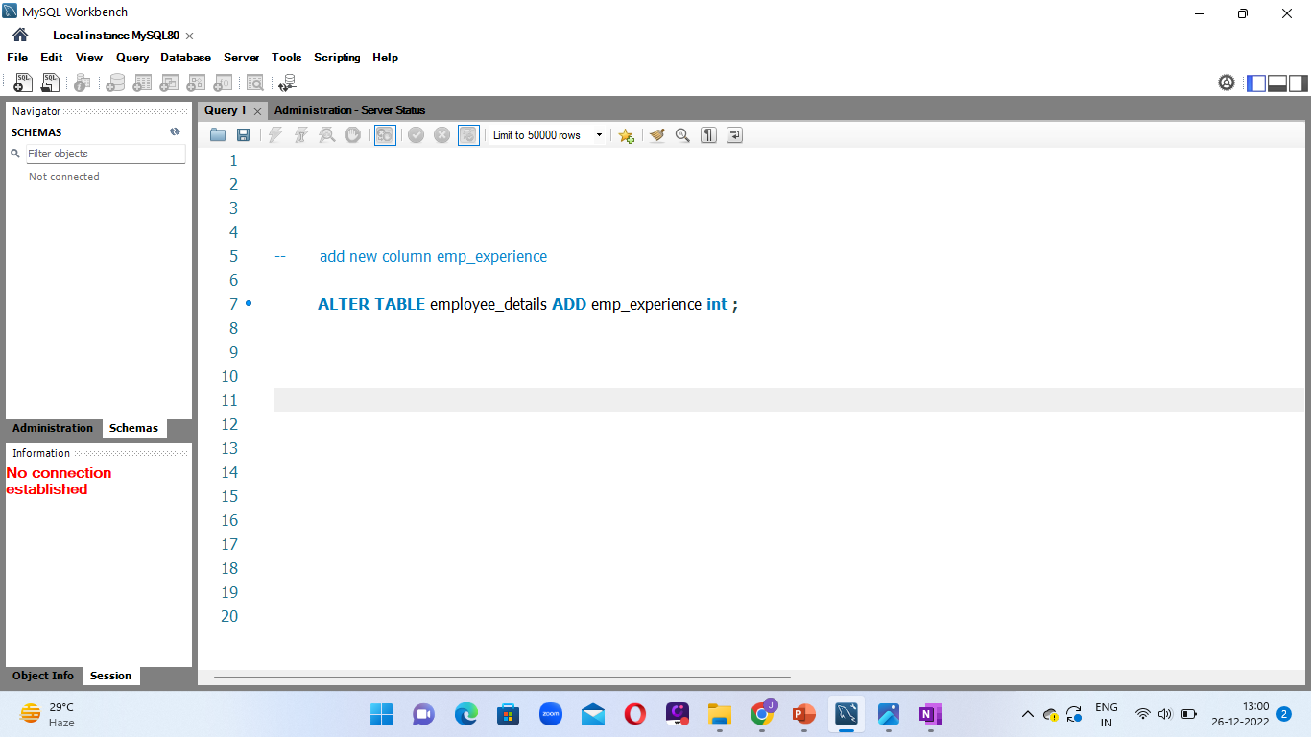
ALTER
ADD
It is used to add new column to the table.
ALTER TABLE < table name > ADD < column name > < data type > ;

Slide 34
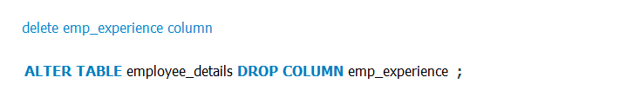
DROP
Used to drop existing column from the table.
ALTER TABLE < table name > DROP COLUMN < column name > ;

Slide 35
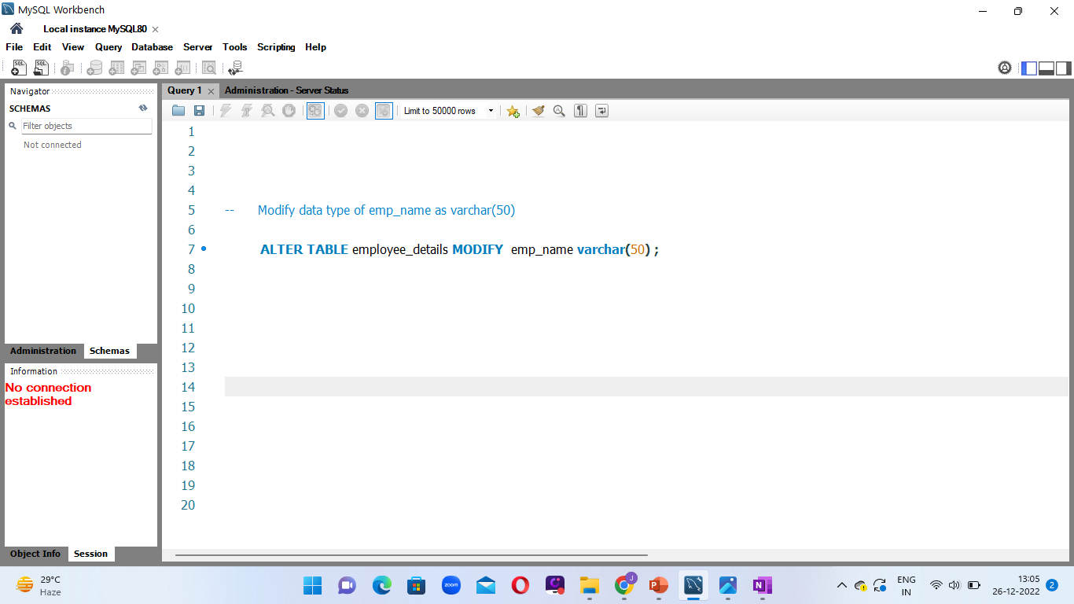
MODIFY
Used to modify data type of column.
ALTER TABLE < table name > MODIFY < column name > < data type > ;

Slide 36
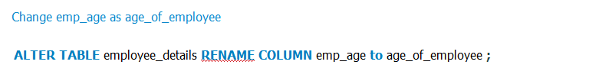
RENAME
Used to rename the existing column name.
ALTER TABLE < table name > RENAME COLUMN < old_column_name >
to <new_column_name> ;

Slide 37
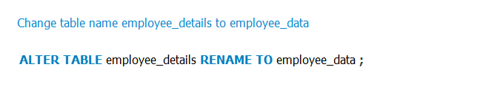
RENAME
Used to rename table.
ALTER TABLE < table name > RENAME TO <new_table_name> ;

Slide 38
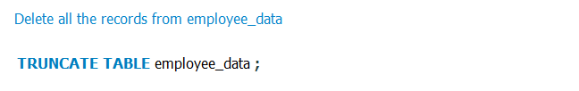
TRUNCATE
Truncate used to clear the records inside table.
TRUNCATE TABLE< table name > ;

Slide 39
IMPORT TABLE
Select database
Right click
Select Table data import wizard
Browse to select the file
Check on create new table
Click next
Import

Slide 40
IMPORT DATABASE
Click on Server
Select data import
Self contained file
Open Import progress
Start import

Slide 41
EXPORT TABLE
Select Table
Right click
Select Table data export wizard
Browse to select destination
Export

Slide 42
EXPORT DATABASE
Click on Server
Select data export
Select the database
Open export progress
Start export

Slide 43
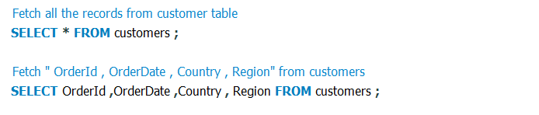
SELECT
Select statement is used to fetch all the records from the table or to fetch subset of columns.
SELECT <column1>, < column2 > FROM < table name > ;
SELECT < * > FROM < table name > ;

Slide 44
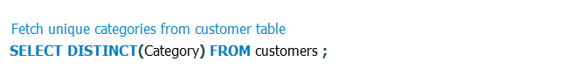
SELECT DISTINCT
Used to fetch unique records from the table.
SELECT <distinct(column1)> FROM < table name > ;

Slide 45
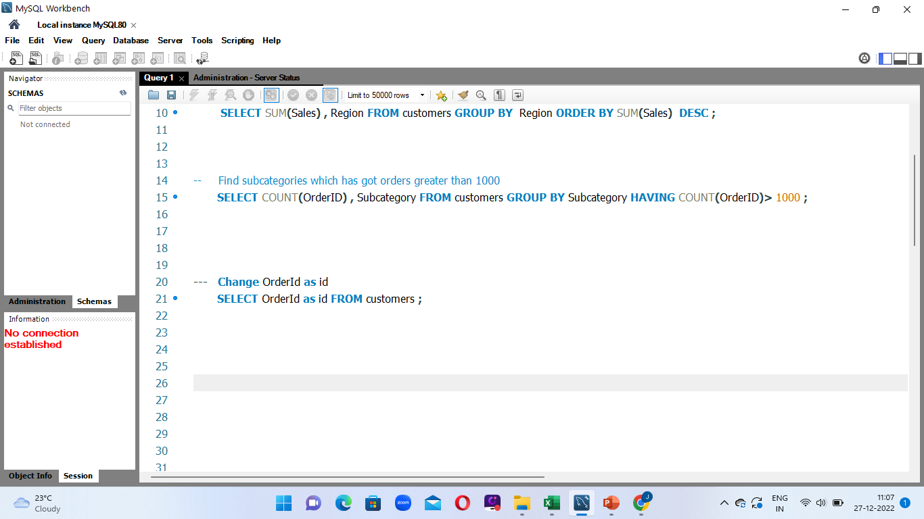
ALIASES
SQL Aliases are used to give temporary name for column and table .
SELECT <column_name> AS <alias_name> FROM < table name > ;

Slide 46
WHERE CLAUSE
Used to filter records based on condition.
Conditions are of two types:
Comparison : = , > ,< >= ,<= ,!=
Logical : and , or ,not

Slide 47
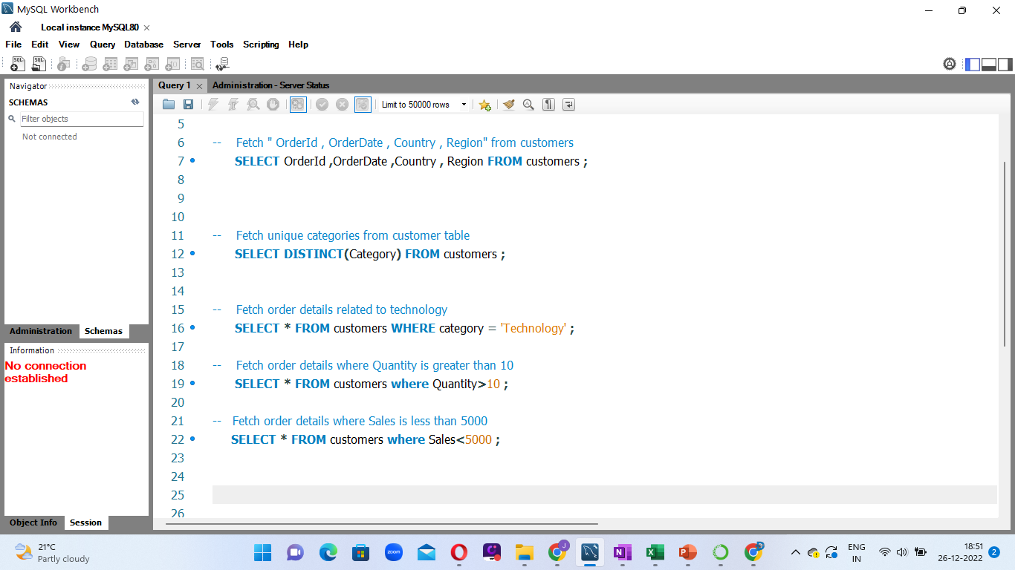
WHERE CLAUSE
Used to filter records based on condition.
SELECT * FROM < table name > where <condition> ;

Slide 48
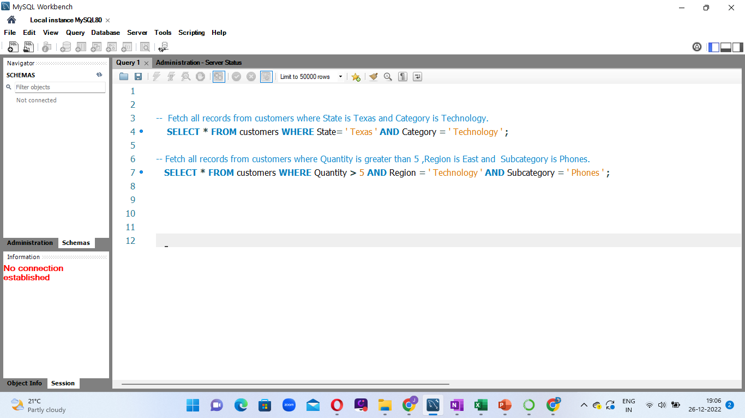
AND
Return records which satisfies both the conditions.
SELECT * FROM < table name > where <condition 1> AND <condition 2> ;

Slide 49
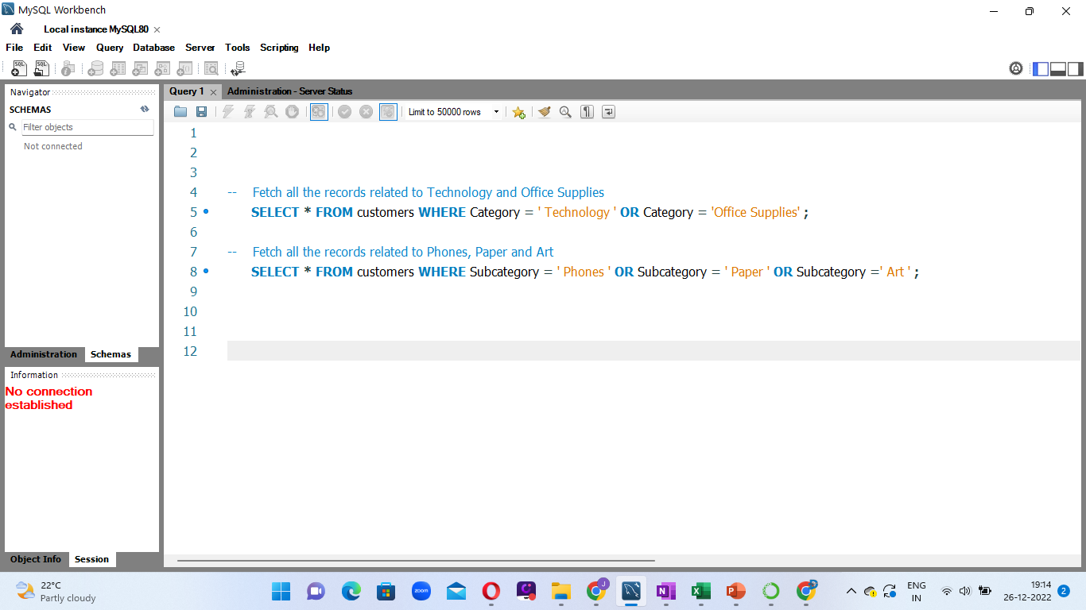
OR
Return records which satisfies either of the conditions.
SELECT * FROM < table name > where <condition 1> OR <condition 2> ;

Slide 50
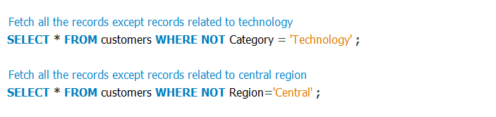
NOT
Return records if condition is true.
SELECT * FROM < table name > where not <condition > :

Slide 51
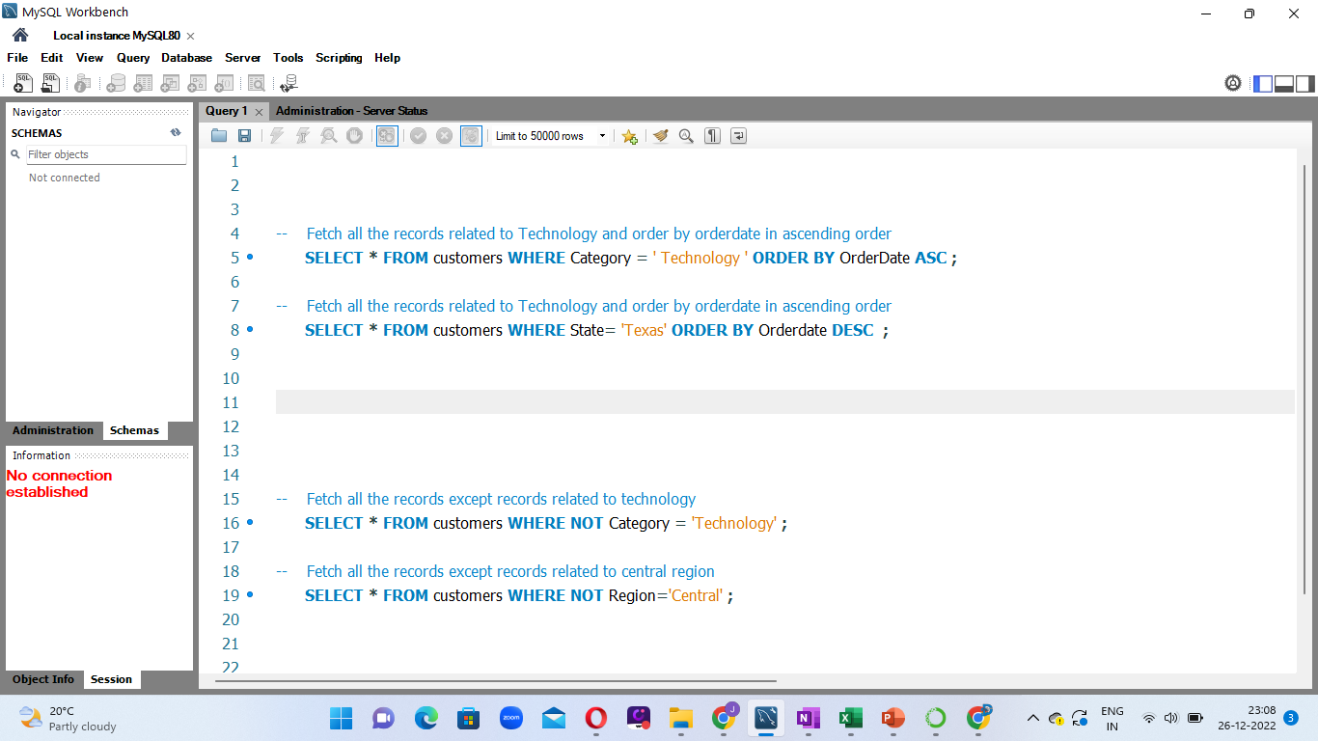
ORDER BY
Order by keyword is used to sort the records in Ascending or descending order.
SELECT * FROM < table name > where <condition > order by <column> asc/desc :

Slide 52
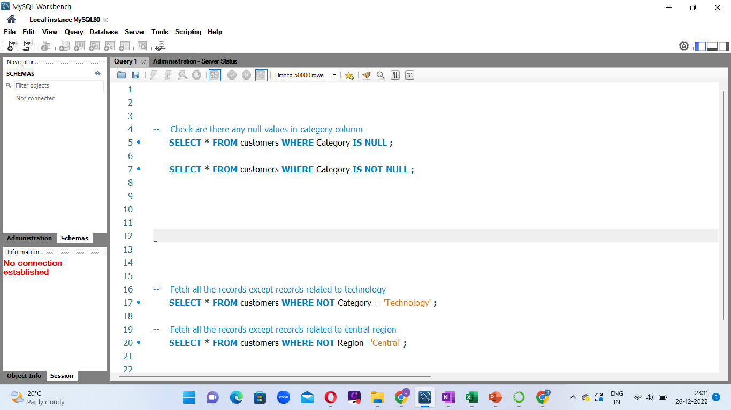
IS NULL/IS NOT NULL
Is null / Is not null are used to check whether null values exists in the table or not.
SELECT * FROM < table name > where <column1 > is null / not null :

Slide 53
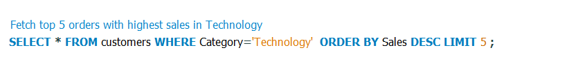
LIMIT
It is used to return the specified number of records.
SELECT * FROM < table name > WHERE <condition> LIMIT <value> :

Slide 54
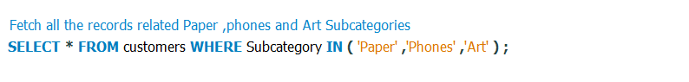
IN
It is used to return records by specifying multiple conditions.
SELECT * FROM < table name > WHERE <column1> IN (val1 ,val2,val3) :

Slide 55
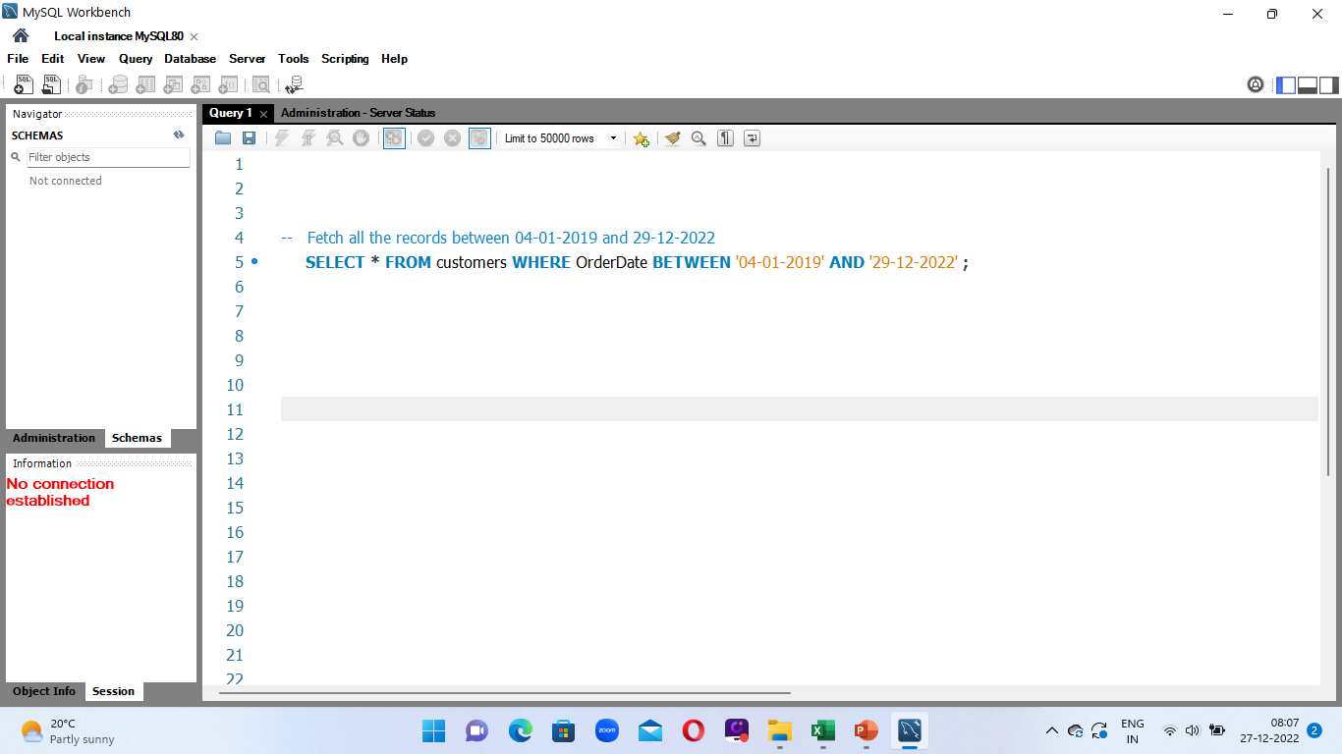
BETWEEN
It is used to return records within a certain range. It can be values ,dates or text.
SELECT * FROM < table name > WHERE <column1> BETWEEN <val1> AND <val2A> ;

Slide 56
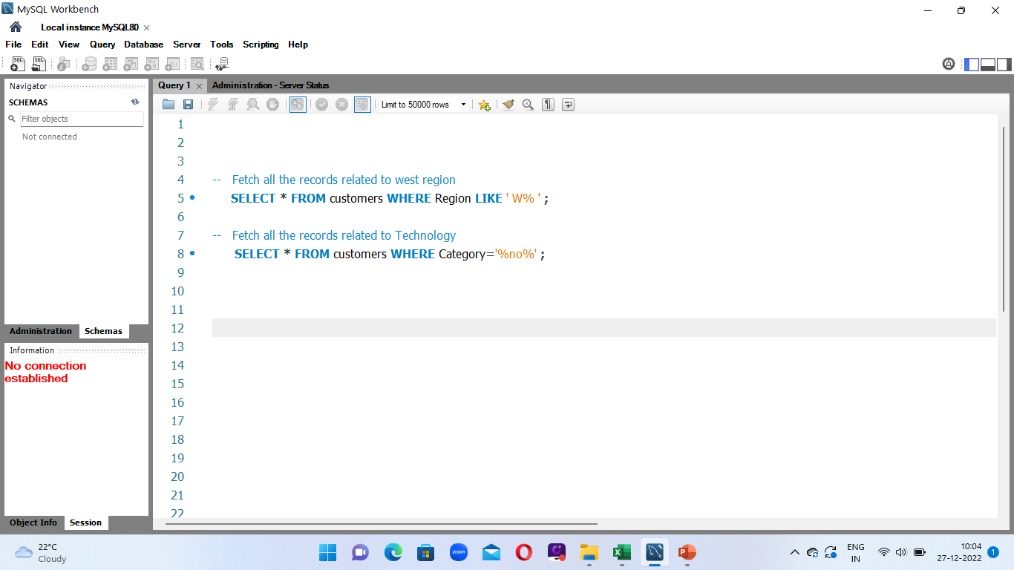
LIKE
It is used to return records based on the pattern.
SELECT * FROM < table name > WHERE <column1> LIKE <PATTERN> ;

Slide 57
LIKE
% 🡪 It represents zero ,one or multiple characters.
_ 🡪 It is used represent one or single character.
'a%’ 🡪 It returns values that start with a .
'%a’ 🡪 It returns values that end with a .
% or % 🡪 It returns values that have or in any position .
a %b 🡪 It returns values that start with a and end with b .
'a_’ 🡪 It returns values that start with a and are at least 2 characters in length.
‘_s’ 🡪 It returns values that has s in the second position.

Slide 58
AGGREGATE FUNCTIONS
SQL aggregate functions are used to perform the calculations on multiple rows of a single column and returns a single value.
TYPES OF AGGREGATE FUNCTIONS ARE:
Count()
Sum()
Avg()
Min()
Max()

Slide 59
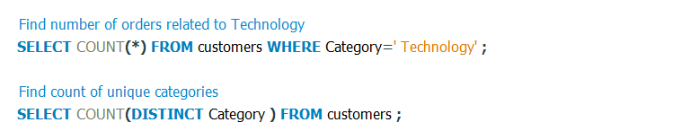
COUNT
Used to return number of rows in a table.
SELECT COUNT(*) FROM table_name WHERE <condition>;
SELECT COUNT(column1) FROM table_name WHERE <condition>;

Slide 60
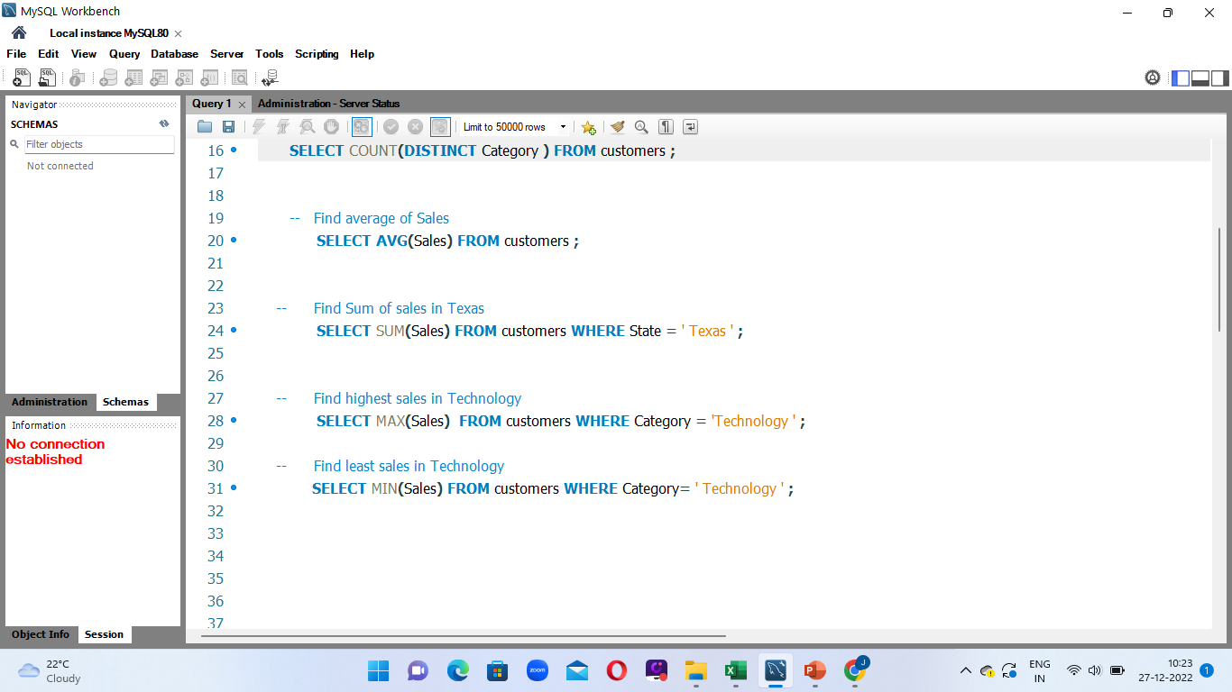
AVG()
Used to find average value of numeric column .
SELECT AVG(column_name) FROM table_name WHERE<condition>;

Slide 61
SUM()
Used to find total sum of column .
SELECT SUM(column_name) FROM <table_name> WHERE <condition>;

Slide 62
MIN()
Used to find smallest value in selected column .
SELECT MIN(column_name) FROM table_name WHERE <condition>;

Slide 63
MAX()
Used to find largest value in selected column
SELECT MAX(column_name) FROM table_name WHERE <condition>;

Slide 64
GROUP BY
The group by statement in SQL is used to arrange identical data into groups with the help of aggregate functions.
For eg:
1) What if I want to find total sales in different categories?
2) What if I want to find highest sales for each segment?

Slide 65
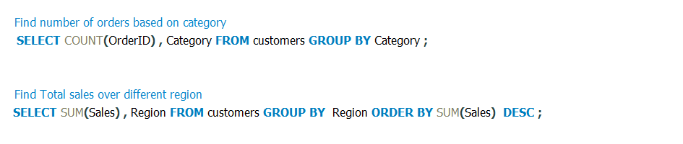
GROUP BY SINGLE COLUMN
SELECT column1 , function(column2) FROM <table_name> GROUP BY <column1> ORDER BY <column1>;

Slide 66
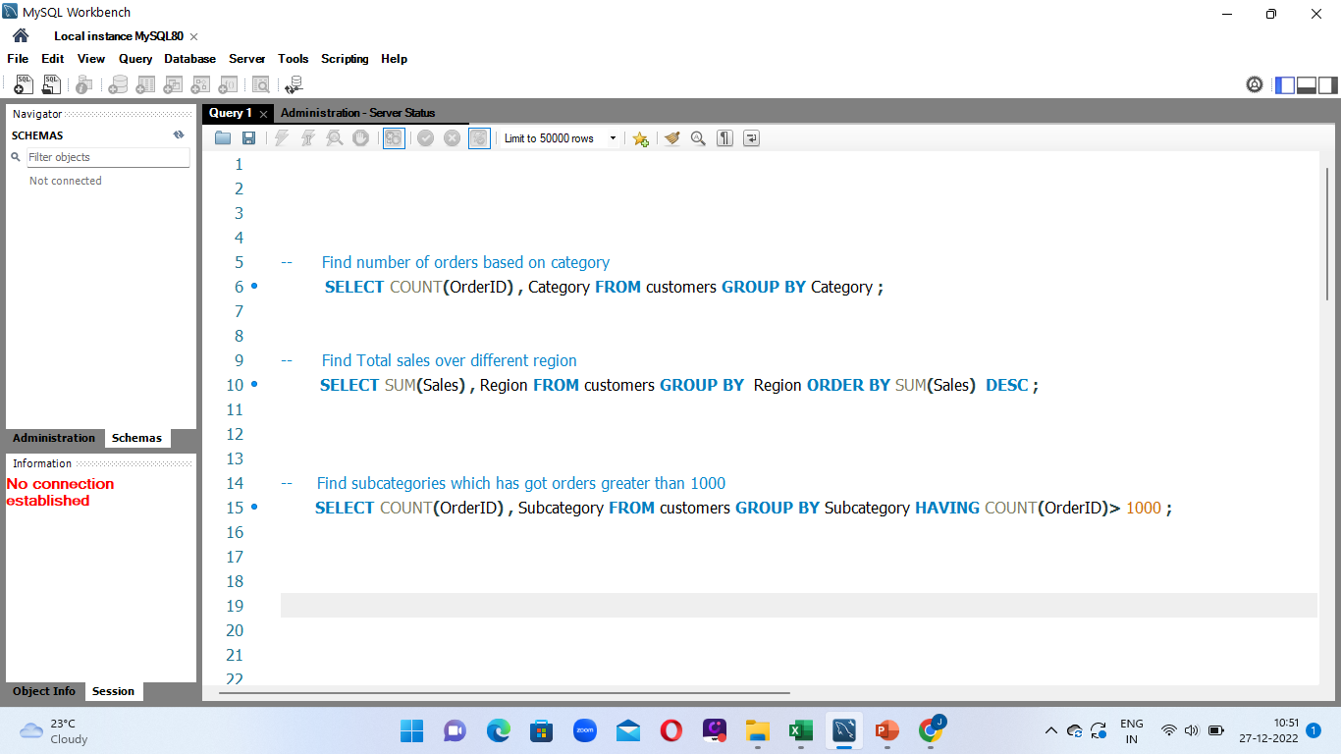
HAVING CLAUSE
Having clause is used to filter the result obtained by the group by clause based on specific condition.
SELECT column1 ,function(column2) FROM <table_name> GROUP BY <column1 ,column2> HAVING <condition> ORDER BY <column1, column2>;

Slide 67
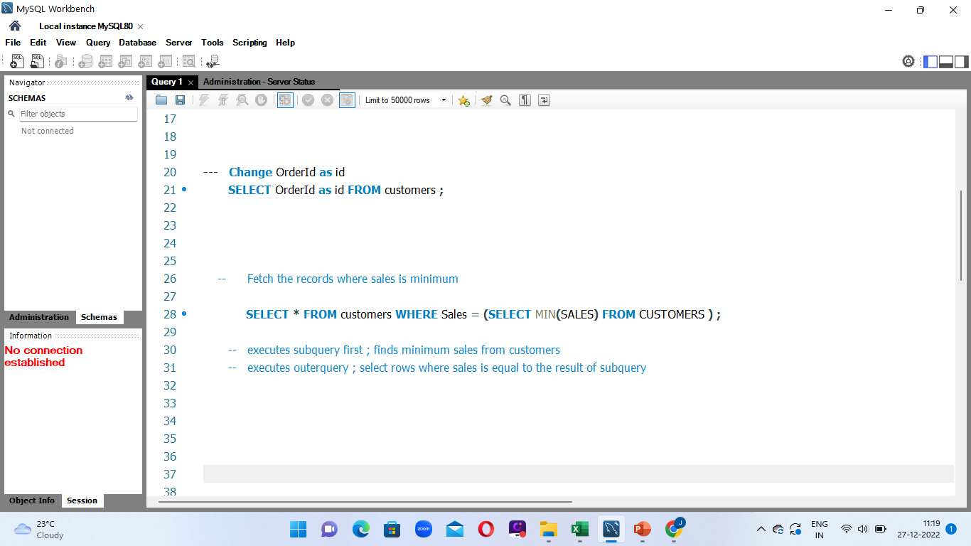
SUBQUERY
SQL subquery is a query within another SQL query. Subquery is used to fetch data from two tables.
Subquery must be enclosed within parenthesis.
Order by cannot be used in a subquery.
Between operator cannot be used.
A subquery can have only single column in subquery.

Slide 68
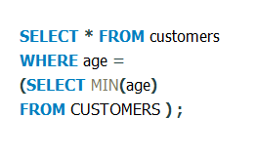
SUBQUERY
Customer_id | f_name | l_name | age | country
1 | John | Doe | 32 | USA
2 | Robert | Luna | 22 | USA
3 | David | Robinson | 22 | UK
4 | John | David | 25 | UK
5 | Betty | Doe | 28 | UAE
Customer_id | f_name | l_name | age | country
2 | Robert | Luna | 22 | USA
3 | David | Robinson | 22 | UK

Slide 69
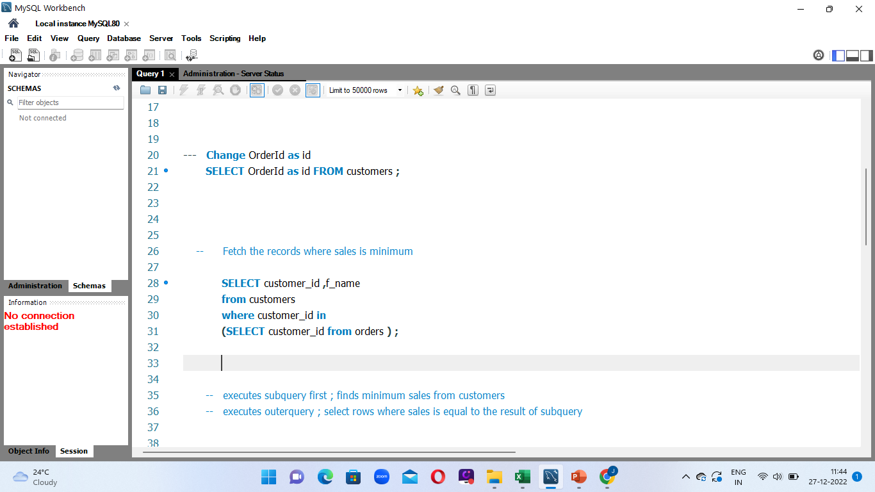
SUBQUERY
Customer_id | f_name
1 | John
2 | Robert
3 | David
4 | John
5 | Betty
Order_id | amount | Customer_id
1 | 200 | 4
2 | 500 | 10
3 | 300 | 3
4 | 800 | 1
5 | 150 | 2
customer_id | f_name
1 | John
2 | Robert
3 | John
4 | David

Slide 70
RULES TO USE GROUP BY
The group by clause is used with select statement.
Group by is placed before having clause.
Group by clause is placed before order by.
Having clause is placed before order by.
Conditions are specified in having clause.

Slide 71
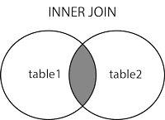
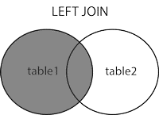
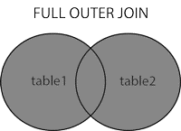
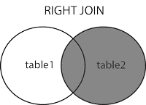
JOINS
SQL Joins are used combine two tables based on common column, and selects records that have matching values in these columns.
Types of Joins in SQL
INNER JOINS
LEFT JOIN
Right join
Full outer join

Slide 72
INNER JOIN
Inner join return those records which a have matching values in both tables.
SELECT <column_names> FROM Table1
INNER JOIN Table2
ON Table1.matching_column=Table2.matching_column ;

Slide 73
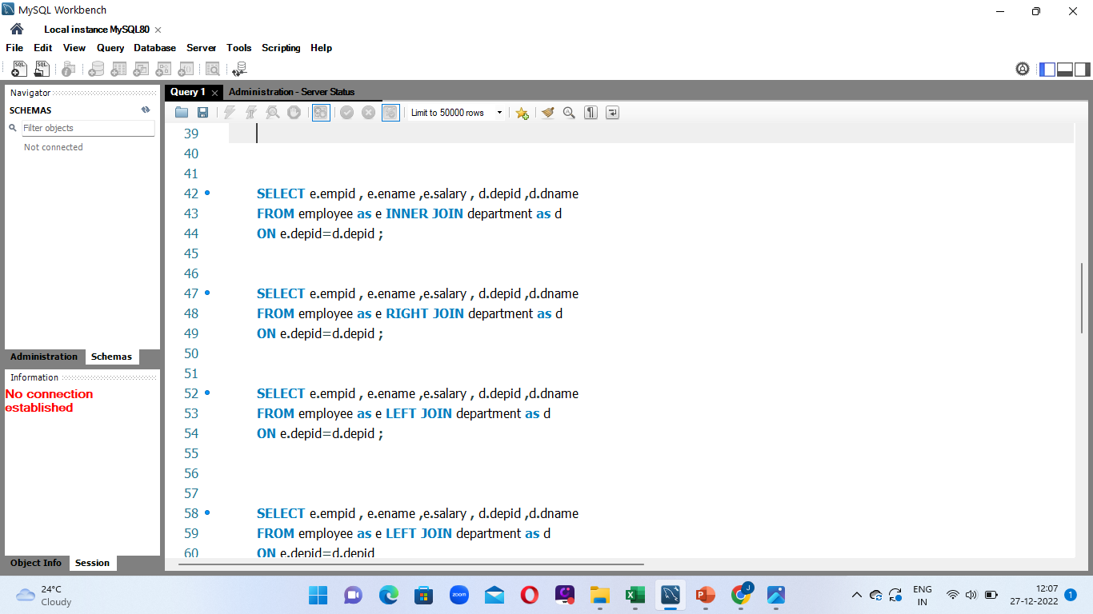
empid | ename | Salary | depid
E1 | John | 45000 | D1
E2 | Mary | 60000 | D2
E3 | Steve | 73000 | D3
E4 | Helen | 86000 | D4
E5 | Joe | 35000 | D7
depid | dname
D1 | IT
D2 | HR
D3 | Admin
D4 | Finance
D5 | Sales
empid | ename | Salary | depid | dname
E1 | John | 45000 | D1 | IT
E2 | Mary | 60000 | D2 | HR
E3 | Steve | 73000 | D3 | Admin
E4 | Helen | 86000 | D4 | Finance

Slide 74
LEFT JOIN
Left join returns all the records from left table and also matching records from right table.
SELECT <column_names> FROM Table1
LEFT JOIN Table2
ON Table1.matching_column=Table2.matching_column ;

Slide 75
empid | ename | Salary | depid
E1 | John | 45000 | D1
E2 | Mary | 60000 | D2
E3 | Steve | 73000 | D3
E4 | Helen | 86000 | D4
E5 | Joe | 35000 | D7
depid | dname
D1 | IT
D2 | HR
D3 | Admin
D4 | Finance
D5 | Sales
empi | ename | Salary | depid | dname
E1 | John | 45000 | D1 | IT
E2 | Mary | 60000 | D2 | HR
E3 | Steve | 73000 | D3 | Admin
E4 | Helen | 86000 | D4 | Finance
E5 | Joe | 35000 | D7 | NULL

Slide 76
RIGHT JOIN
Right join returns all the records from right table and also matching records from left table.
SELECT <column_names> FROM Table1
RIGHT JOIN Table2
ON Table1.matching_column=Table2.matching_column ;

Slide 77
empid | ename | Salary | depid
E1 | John | 45000 | D1
E2 | Mary | 60000 | D2
E3 | Steve | 73000 | D3
E4 | Helen | 86000 | D4
E5 | Joe | 35000 | D7
depid | dname
D1 | IT
D2 | HR
D3 | Admin
D4 | Finance
D5 | Sales
depid | dname | empid | ename | Salary
D1 | IT | E1 | John | 45000
D2 | HR | E2 | Mary | 60000
D3 | Admin | E3 | Steve | 73000
D4 | Finance | E4 | Helen | 86000
D5 | Sales | NULL | NULL | NULL

Slide 78
FULL OUTER JOIN
Full outer join returns all the matching records from both the tables.
SELECT <column_names> FROM Table1
LEFT JOIN Table2
ON Table1.matching_column=Table2.matching_column
UNION
SELECT <column_names> FROM Table1
LEFT JOIN Table2
ON Table1.matching_column=Table2.matching_column ;

Slide 79
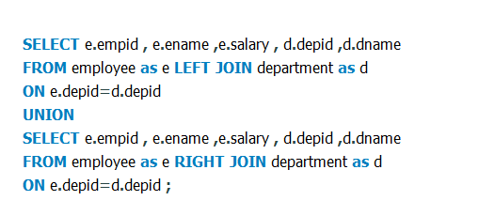
empid | ename | Salary | depid
E1 | John | 45000 | D1
E2 | Mary | 60000 | D2
E3 | Steve | 73000 | D3
E4 | Helen | 86000 | D4
E5 | Joe | 35000 | D7
depid | dname
D1 | IT
D2 | HR
D3 | Admin
D4 | Finance
D5 | Sales
empid | ename | Salary | depid | dname
E1 | John | 45000 | D1 | IT
E2 | Mary | 60000 | D2 | HR
E3 | Steve | 73000 | D3 | Admin
E4 | Helen | 86000 | D4 | Finance
E5 | Joe | 35000 | D7 | Null
NULL | NULL | NULL | D5 | Sales

Slide 80
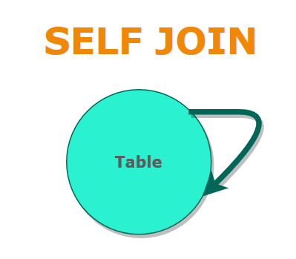
SELF JOIN
A self join is a regular join which helps you to join a table to itself
SELECT column_name(s) FROM table1 T1, table T2 WHERE <condition> ;

Slide 81
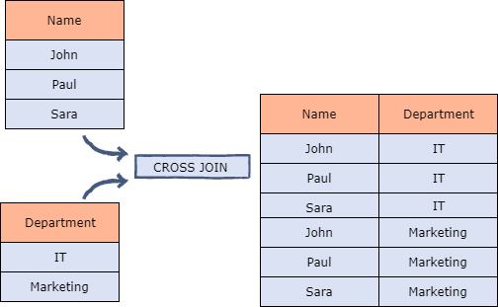
CROSS JOIN
The cross join returns all the records from both the tables.
SELECT column_name(s) FROM <Table 1> CROSS JOIN <Table 2>:

Slide 82
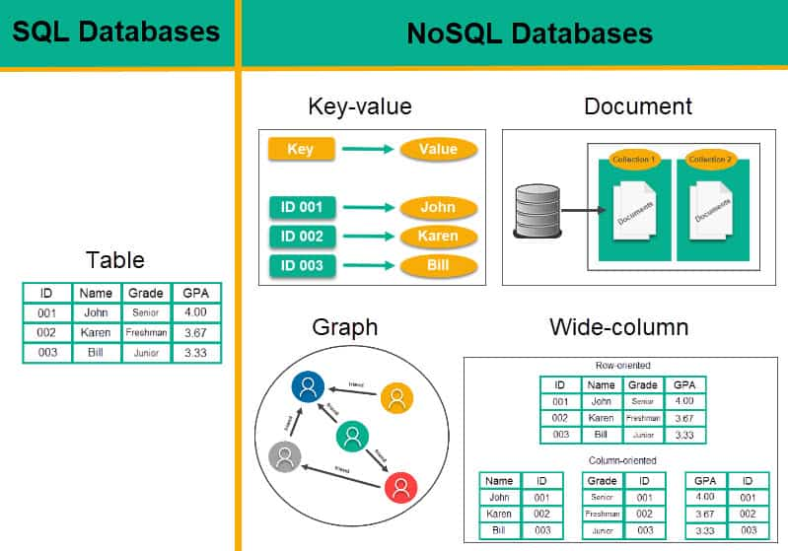
NO SQL
No SQL stands for “Not only SQL”.
No SQL database is non-relational database management system.
No SQL database stores information in JSON documents instead of rows and columns.
No SQL databases are flexible ,scalable and capable of rapidly responding to the data management demands of modern businesses.

Slide 83

POPULAR NO SQL DATABASES
Document databases
Key-value stores
Wide-column databases
Graph databases

Slide 84
APPLICATIONS OF NO SQL
Support large number of concurrent users.
Deliver highly responsive experience to a globally distributed base of users.
It can store structured , semi-structure ,unstructured and polymorphic data.
No SQL is used for Big data and real-time web apps.
Companies like Twitter , Facebook and Google collect terabytes of user data every single day.

