Slide 1
Digital Portfolio
STUDENT NAME: YAGAVARSHNI RK
REGISTER NO AND NMID: 2428B0368
DEPARTMENT: Bsc.CSDA
COLLEGE: COLLEGE/ UNIVERSITY

Slide 2
PROJECT TITLE Digital portfolio for future plans(higher studies/job roles)

Slide 3


AGENDA
Problem Statement
Project Overview
End Users
Tools and Technologies
Portfolio design and Layout
Features and Functionality
Results and Screenshots
Conclusion
Github Link
3/21/2024 Annual Review

Slide 4

PROBLEM STATEMENT
Students and early professionals often struggle to present their higher studies aspirations and career goals in a clear, structured, and professional way. Traditional resumes may not capture learning roadmaps, milestones, or long-term career vision. A digital portfolio that combines academic goals, project outcomes, and job readiness provides a more dynamic way to showcase both current progress and future plans.

Slide 5
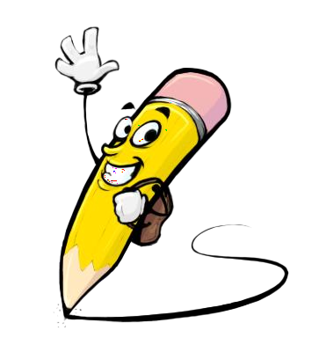
PROJECT OVERVIEW
This project is a responsive digital portfolio website that highlights future plans for higher education and job goals. It allows the user to track milestones, display skills, showcase project results, and provide recruiters or academic committees with a well-structured overview of their career trajectory. The portfolio integrates features such as roadmaps, progress bars, and printable sections for easy sharing.

Slide 6

WHO ARE THE END USERS?
Undergraduate students preparing for higher studies (M.Sc., M.Tech, MBA, etc.)
Fresh graduates entering the job market
Career mentors and academic counselors
Recruiters and admissions officers

Slide 7

TOOLS AND TECHNIQUES
Frontend: HTML, CSS, JavaScript (Vanilla)
Design: Responsive layout using Flexbox and CSS Grid
Storage: LocalStorage for saving milestones and progress
Hosting (optional): GitHub Pages / Netlify
Version Control: Git & GitHub for collaboration and updates

Slide 8
POTFOLIO DESIGN AND LAYOUT
A hero section introducing the user’s name, career vision, and quick KPIs (target degree, dream role, milestones).
Tabbed sections separating Higher Studies goals and Job Goals.
Cards and roadmaps for milestones, exams, certifications, and projects.
Contact section with links to resume, GitHub, LinkedIn, and email.
Print-friendly design with light/dark theme toggle.
8

Slide 9
FEATURES AND FUNCTIONALITY
Editable roadmaps with progress tracking (saved to the browser).
KPI cards highlighting academic and career targets.
Timeline for exams, certifications, and application deadlines.
Progress bars for funding goals and job applications.
Contact form with basic validation.
Export/print portfolio to PDF for sharing.

Slide 10
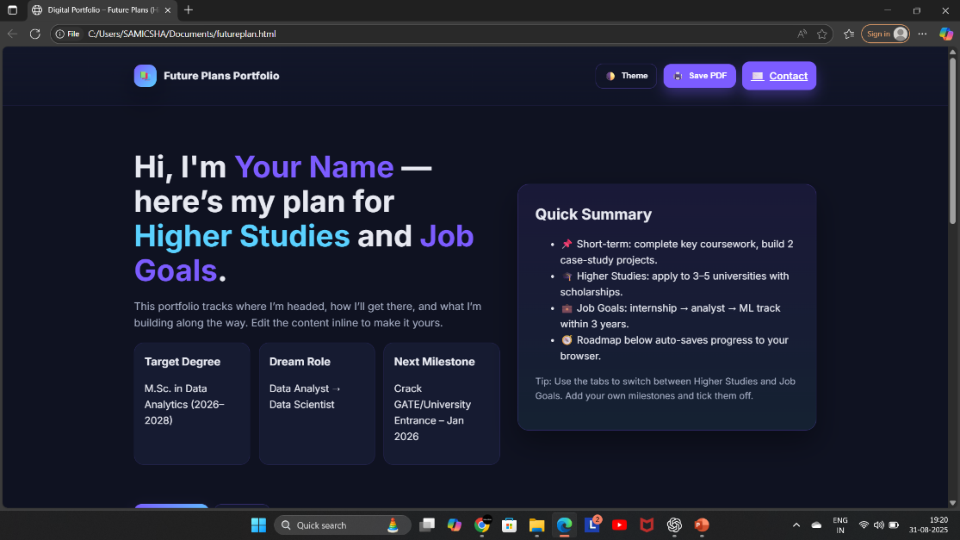

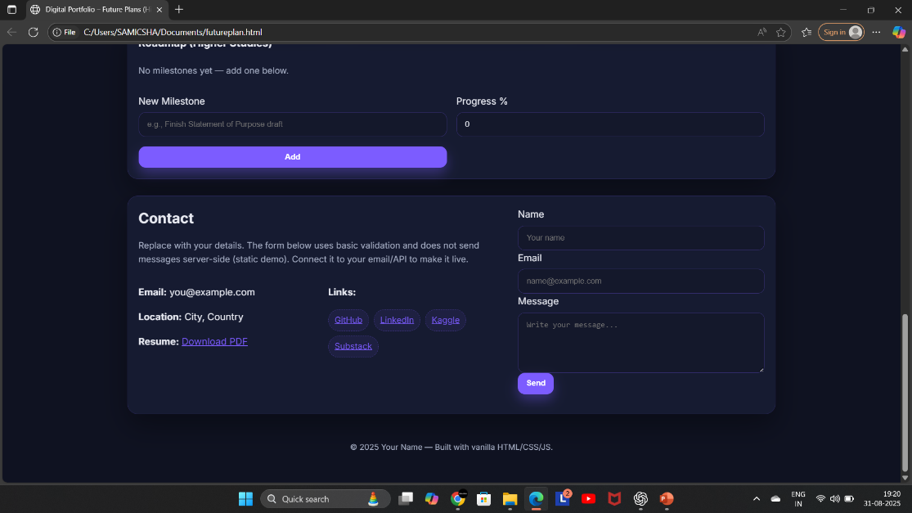
RESULTS AND SCREENSHOTS
3/21/2024 Annual Review
10

Slide 11
CONCLUSION
The Future Plans digital portfolio bridges the gap between academic aspirations and job goals. It provides an interactive, customizable platform for students and professionals to communicate their vision effectively to universities, recruiters, and mentors. Its modular design makes it easy to expand with more features such as project showcases, analytics dashboards, or integrated blogs.
11

Slide 12
GITHUB LINK
https://yagavarshni.github.io/yaga09/

