Slide 1
The Power of gRPC-Go
Varinder.singh@walmartlabs.com

Slide 2
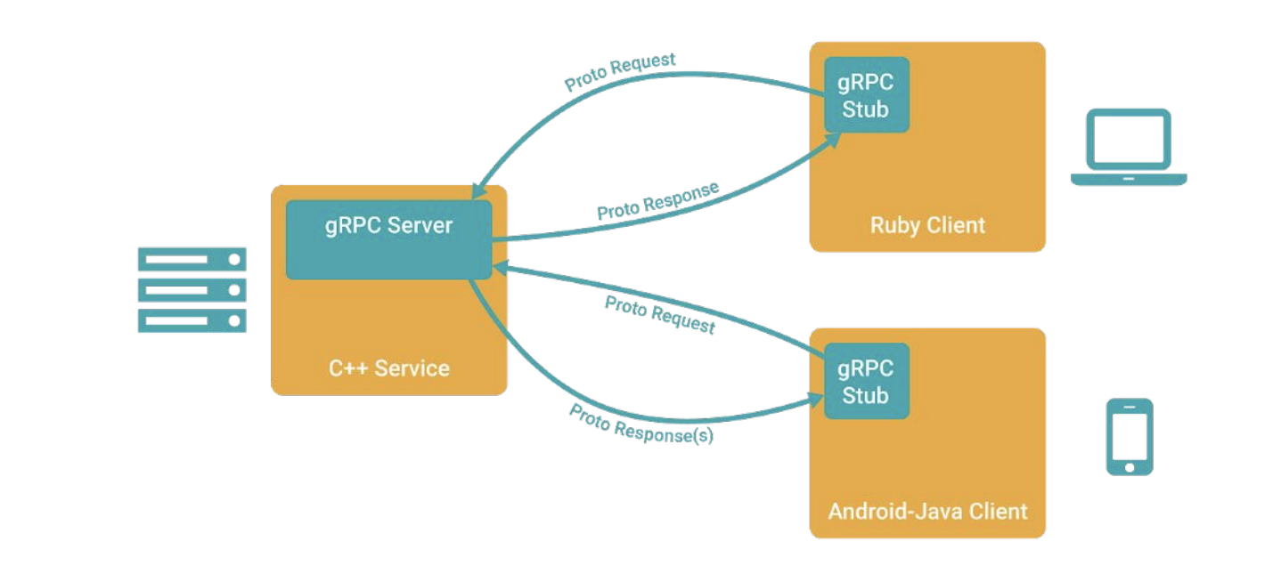
gRPC-Go
Why?
Supports Http/2
Payload agnostic, protobuf are light weight
A single framework for:
Scalability
Load Balancing
Language interoperability
Inter Process Communication
Security

Slide 3
Unary
One request: One response
Client
Server
REQ
RES

Slide 4
Client side
Client
Server
Many Requests : One Response
Use Case: File Uploading to Server
REQ
RES

Slide 5
Server side
Client
Server
One Request : Many Responses
Use Case: File Downloading from Server
REQ
RES

Slide 6
BiDi:
Client
Server
Many Requests : Many Responses
Use Case: File Downloading from Server
REQ
RES

Slide 7
Demo:
Set up:
go get –u google.golang.org/grpc
go get -u github.com/golang/protobuf/protoc-gen-go

Slide 8
Take aways:
Leverage the power of Http/2
Protobuffers will auto- generate helper code
gRPC is a natural fit for microservice world
Thank you

