Slide 1

JAVASCRIPT PROJECT PRESENTATION
Project Title: Movie Search App (API Integration)
Course: JavaScript Project
Student Name & Roll No: Varsitha.A-24bct059
Vetrivel.K.P-24bct060
Vigneshkumar.R-24bct061
Vinisha.S-24bct062
Yoga Sanjay.S-24bct063
Sri sanjeev kumar.B -24bct064
Department: Computer Technology
Mentor :Mr.Dilipan Sir[Technical Trainer]

Slide 2
INTRODUCTION
The Movie Search App is a web application that allows users to search for movies and view their details such as title, year, genre, poster, and IMDb rating.
This project was chosen because it demonstrates real-time API integration and JavaScript-based DOM manipulation in a simple, user-friendly interface.
It highlights the power of JavaScript in creating dynamic, interactive web experiences.
Technologies Used:
HTML
CSS
JavaScript
OMDb API

Slide 3
OBJECTIVES
Build an interactive web app using JavaScript and Fetch API
Learn and apply Async/Await concepts
Understand JSON data handling
Use DOM manipulation to display movie results dynamically
Practice error handling with try...catch blocks

Slide 4
PROBLEM STATEMENT
Users often visit multiple sites to find movie information.
Existing platforms are either too complex or filled with advertisements.
Our project provides a simple and elegant web interface to search movies instantly using real-time API integration.

Slide 5
TOOLS & TECHNOLOGIES USED
Language: JavaScript
Markup & Styling: HTML, CSS
API: OMDb (Open Movie Database)
Editor: Visual Studio Code
Browser: Google Chrome

Slide 6
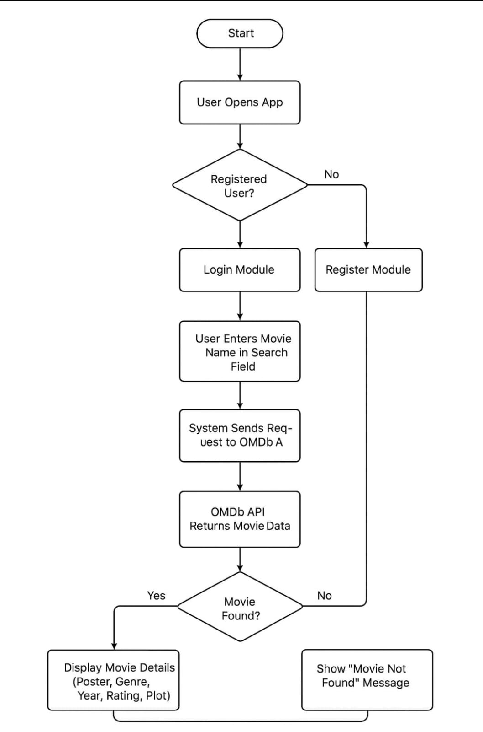
SYSTEM DESIGN
Workflow:
1. User enters movie name
2. JavaScript sends Fetch request to OMDb API
3. API returns movie data (JSON format)
4. Data displayed dynamically on webpage
5. Invalid inputs handled gracefully

Slide 7
MODULE DESCRIPTION
UI Module: Handles HTML layout and responsive CSS design
Logic Module: JavaScript functions for Fetch API and JSON parsing
Error Handling Module: Displays messages for invalid searches
Output Module: Dynamically updates movie poster and details

Slide 8
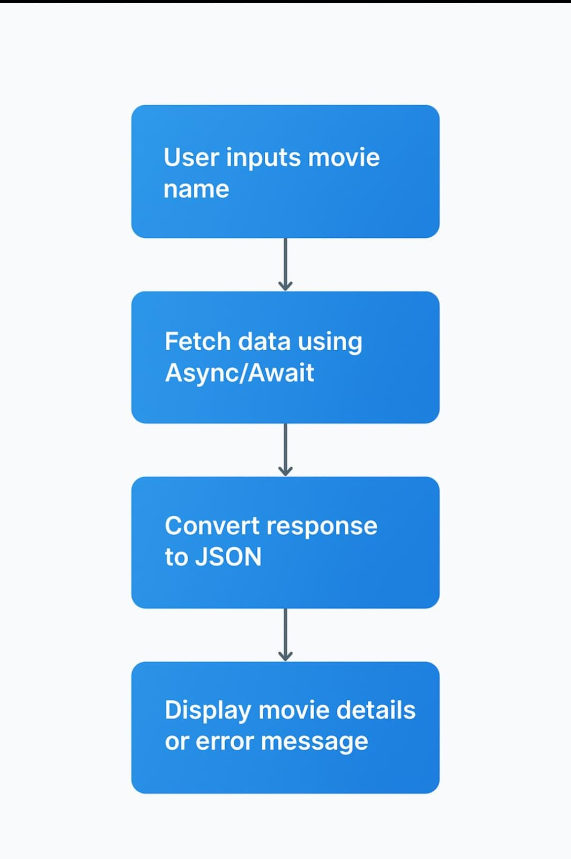
CORE LOGIC & ALGORITHM
Algorithm Steps:
1. Get movie name from input box
2. Fetch data using API URL
3. Convert response to JSON
4. Display title, year, genre, rating, and poster
5. Handle errors using try...catch

Slide 9
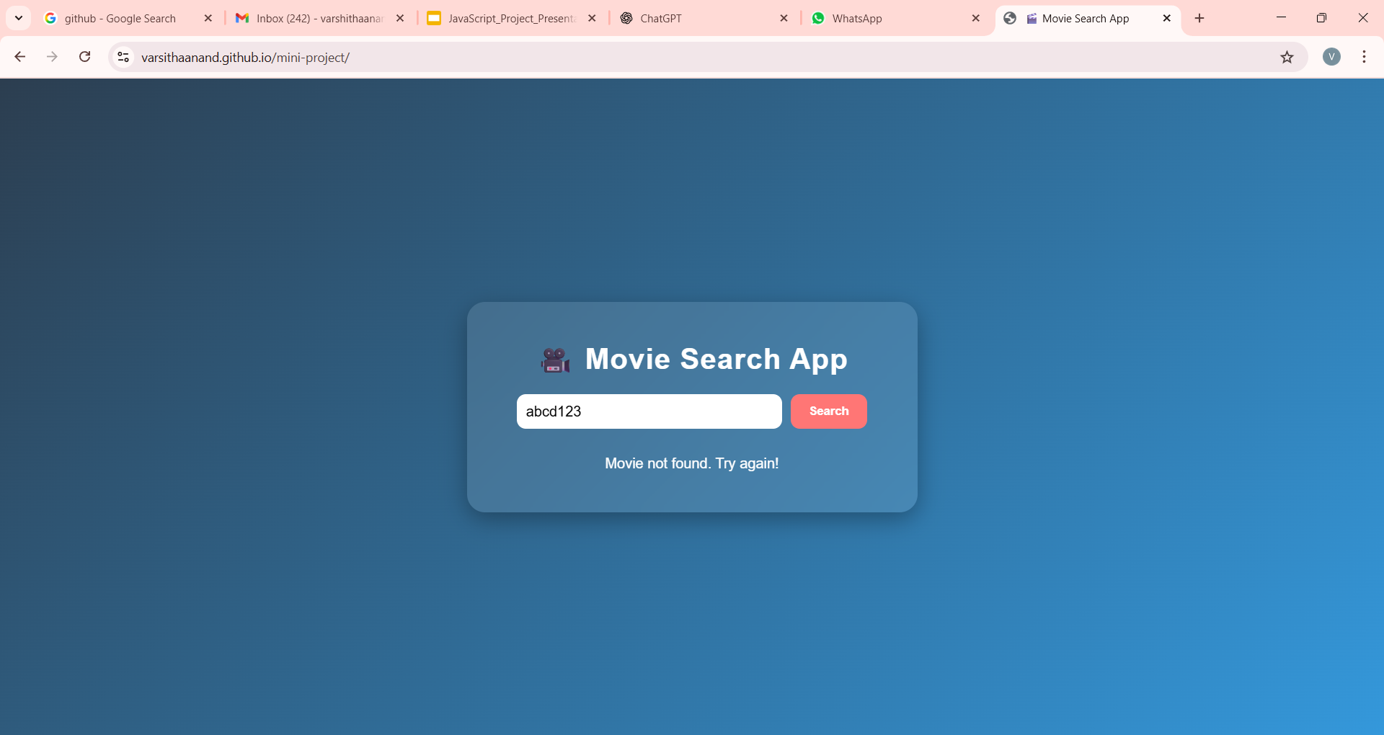
IMPLEMENTATION
Key JavaScript Features:
fetch() for API calls
await response.json() for JSON conversion
DOM manipulation using innerHTML
Event handling using addEventListener
Graceful error display

Slide 10
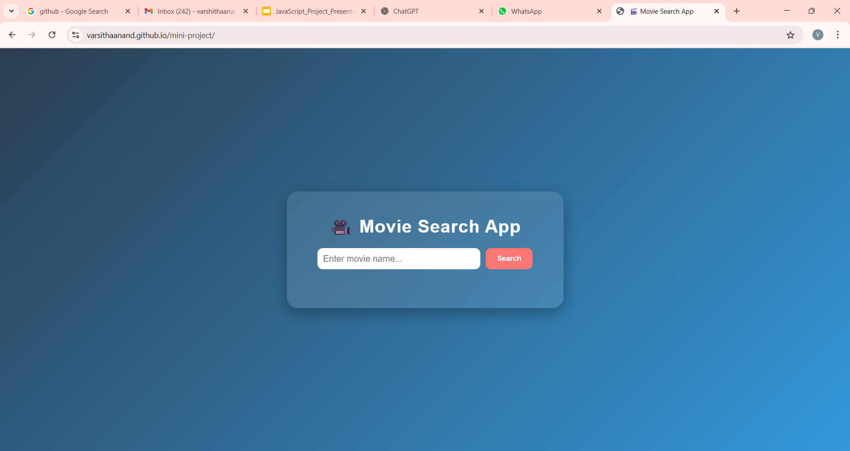
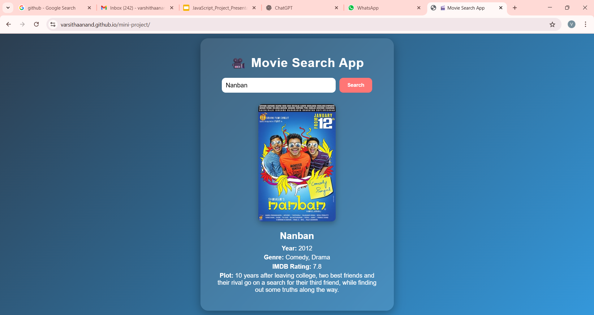
OUTPUT SCREENS

Slide 11
RESULTS & TESTING
Results:
Successful API integration
Accurate and fast search results
Responsive Ul on mobile and desktop
Testing:
Browser tested on Chrome and Edge
Handles empty and invalid movie names properly

Slide 12
CONCLUSION & FUTURE SCOPE
Conclusion:
This project demonstrates the use of JavaScript Fetch API, JSON, and DOM manipulation to build real-time web applications.
Future Scope:
Add "Favorites" section using LocalStorage
Display multiple results for a search term
Integrate backend and authentication
Convert to a Progressive Web App (PWA)

Slide 13
REFERENCES / ACKNOWLEDGEMENT
References :
https://www.omdbapi.com/
https://developer.mozilla.org/en-US/docs/Web/API/Fetch_API/
https://www.w3schools.com/js/
https://www.chatgpt.com/
Acknowledgement:
Special thanks to faculty mentors and teammates for their guidance and support.

Slide 14
THANK YOU
TEAM 12-Movie Search App:
Coding-Varsitha.A , Sri Sanjeev Kumar.B
Documentation-Vinisha.S, Vigneshkumar.R
Presentation-YogaSanjay.S, Vetrivel.K.B
Github link-https://github.com/varsithaanand/js-mini-project.git/

