Slide 1
Leprino Integration Tool [LIT]
Users Guide – Processing Mass Balance
[reports]
09/14/2017

Slide 2
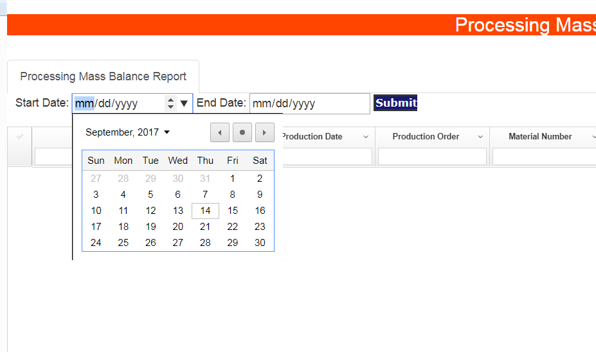
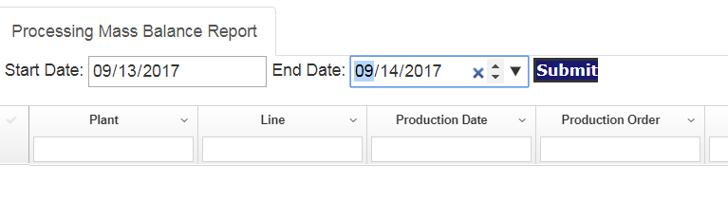
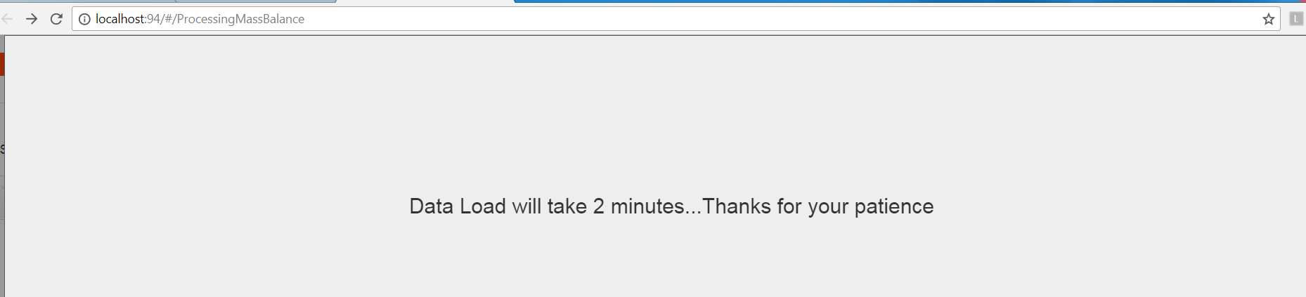
Leprino Integration Tool (LIT)
WIS Reports
Processing Mass Balance Report
Navigation
Use Google Chrome for better result
http://DENM2008MESADM:94/#/ProcessingMassBalance
1
Navigate to http://DENM2008MESADM:94/#/ProcessingMassBalance
Select Start Date and End Date
2
Click Submit
Entry
Please wait for few minutes for results to appear
3
Process

Slide 3
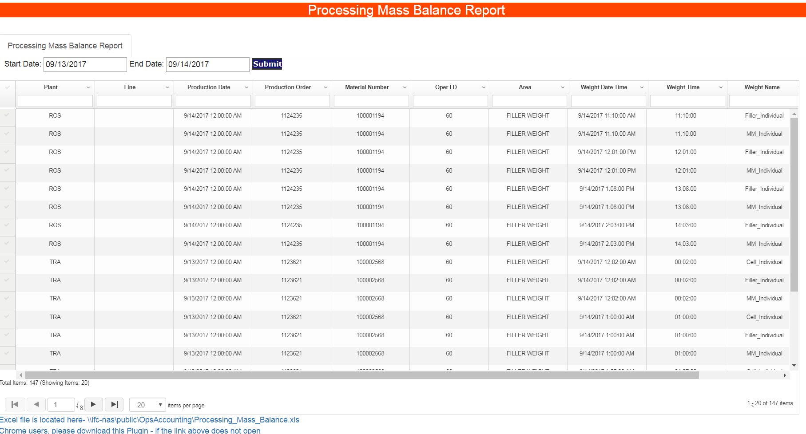
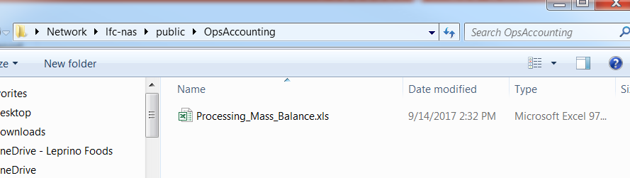
Result
Results will be displayed in a GRID
4
5
Click on this link to Download the Excel File
6
Excel File can also be found from this location
\\lfc-nas\public\OpsAccounting

