Slide 1
RECEIVING (MILKREC)- TRUCK SCALE TO RECEIVING BAY TO SILOS
HTST/
PASTURIZER TO SEPARATOR
STANDARDIZER
- WHEY CREAM ADDED
VATS
DMC (Draining and Matting Conveyor)
PRE-HEAT TANK
MIXER AREA: WET MIXER+DRY MIXER +EXTRUDER + BRINE BELT
HSS
SAP
QUALITY
STARTER
CHEESE MAKE AND FINISH
QUALITY
SAP
CONSUME
CONSUME
QUALITY
SAP
PRODUCE
CONSUME
PRODUCE
PRODUCE
PRODUCT FLOW
PRODUCT FLOW
PRODUCT FLOW
PRODUCT FLOW
PRODUCT FLOW
PRODUCT FLOW
PRODUCT FLOW
BULKOFF
PACKAGING LOAD - METAL DETECTOR
CUBER
DICER
FREEZER
WEIGHT BELT OR LA BELT
HIGH SPEED FILLERS
FINISHED PRODUCT-BOX MAKERS /PACKAGING
CHEESE PROCESSING AND PACKAGING
PRODUCT FLOW
PRODUCT FLOW
PRODUCT FLOW
PRODUCT FLOW
PRODUCT FLOW
PRODUCT FLOW
QUALITY
QUALITY
SAP
CONSUME
CONSUME
SAP
PRODUCE
PRODUCE

Slide 2


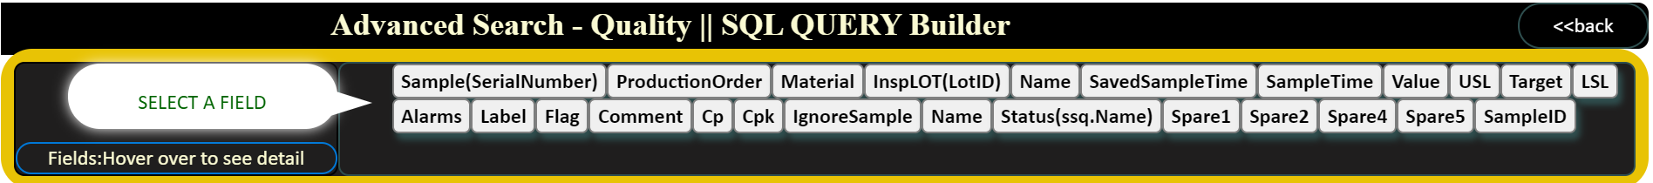


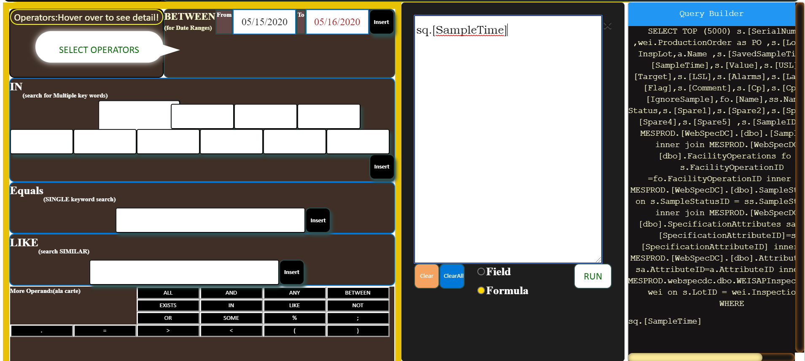


Click on a Field
Selecting a Field
Primary FOCUS area
FOCUS area will shift
Text will appear

Slide 3
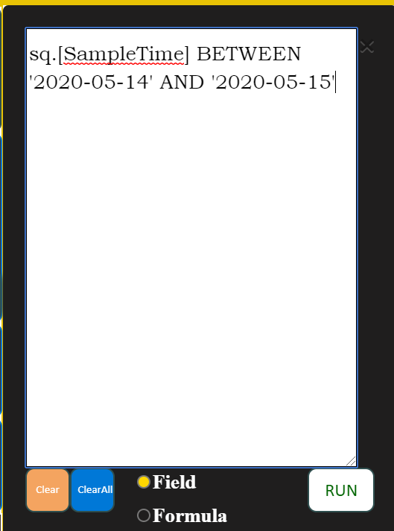
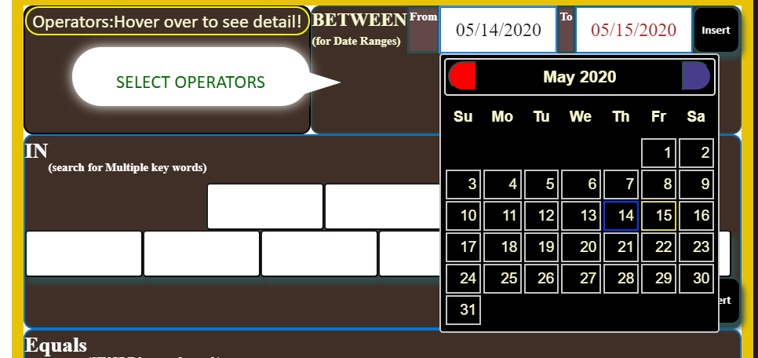
Selecting an Operator
SELECT Dates or enter text(for Equals, IN or LIKE)
Click INSERT
Text will be appended
Click RUN to execute
SAME APPLIES FOR
‘IN’, ‘EQUALS’, and ‘LIKE’ OPERATORS

Slide 4
Angular to DOT NET to DATABASE Connectivity
USERS INTERFACE IN AngularJS
MIDDLEWARE IN DOT NET
Web.Config
IMessage.CS
DIV
HTML
Controller.JS
Sevice.JS
Message Controller.CS
MessageGenerator.CS
DBConnection.CS
Message.CS
Main DB
LITDB- SHELL

Slide 5
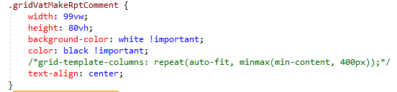
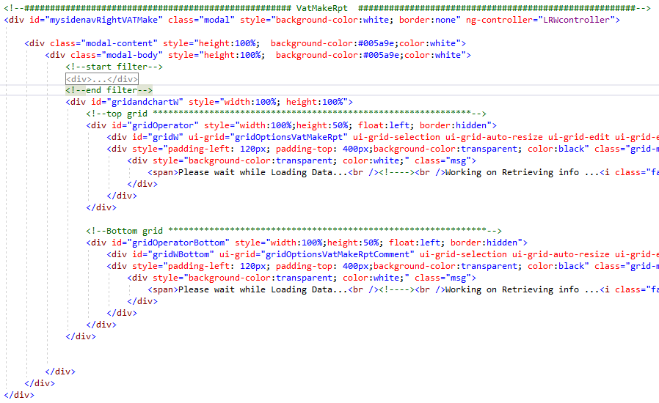
LRSWeb.html
CSS
Binding

Slide 6
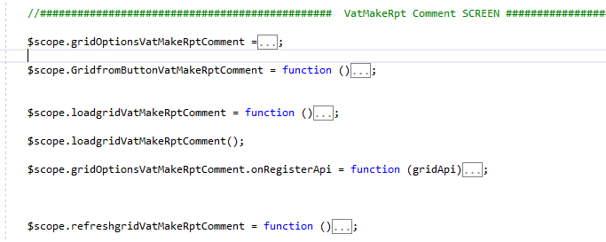
LRWController.js
Column Define & Event Register

Slide 7
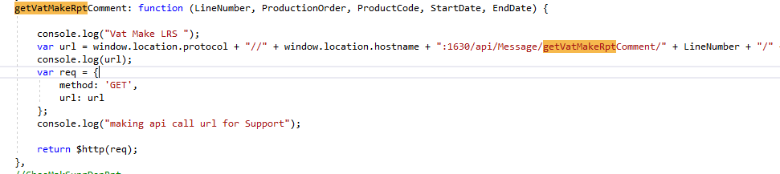
LRWService.js
Create function and http route

Slide 8
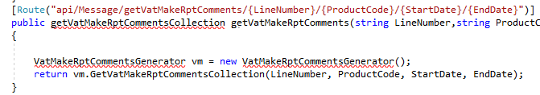
MessageController.cs
Create function and return Collection

Slide 9
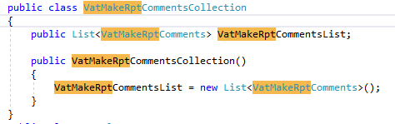
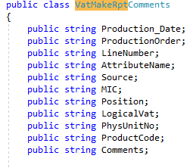
Message.cs / Imessage.cs
Define Collection function and List

Slide 10
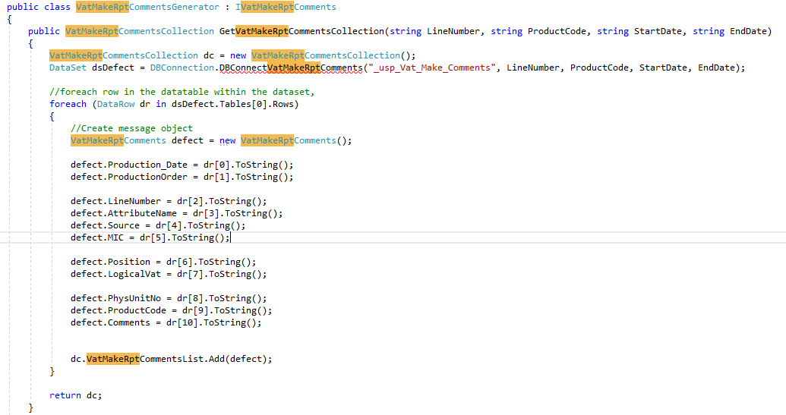
MessageGenerator.cs
Define Collection function and List

Slide 11
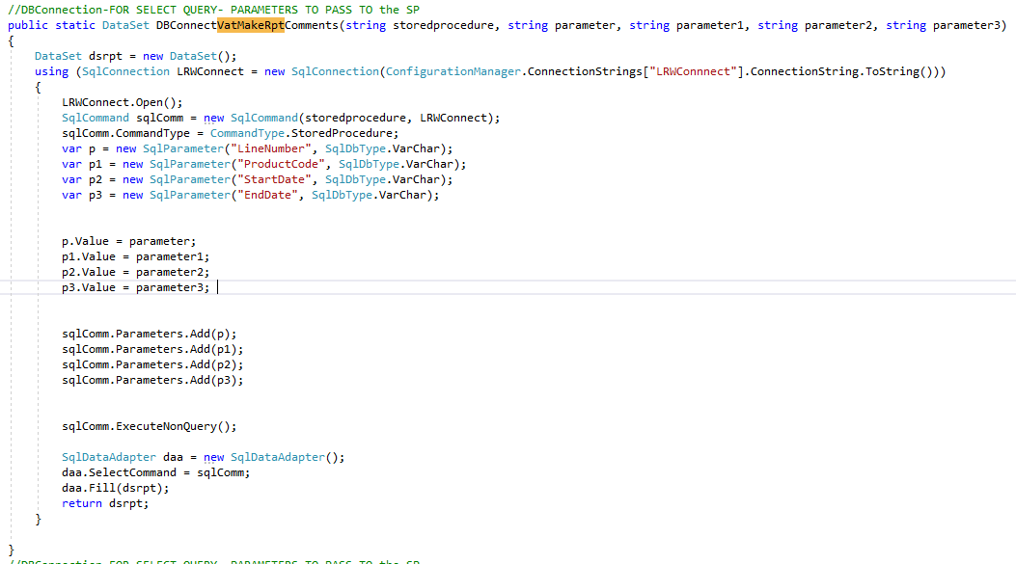
DBConnection.cs
Create DBConnection

