Slide 1
MARKET BASKET ANALYSIS
VARSHA SRINIVASAN

Slide 2
Agenda & Executive Summary of the data

Slide 3
Contents of the ppt
Problem Statement
About Data – Info and Summary Statistics
Exploratory Analysis – Univariate & Bivariate Analysis -Yearly, Weekly, Monthly , Quarterly Day-wise and Day-Name Order Trends.
Use of Market Basket Analysis (Association Rules)
Associations Identified
Suggestion of Possible Combos with Lucrative Offers

Slide 4
Problem Statement
A Grocery Store shared the transactional data with you. Your job is to identify the most popular combos that can be suggested to the Grocery Store chain after a thorough analysis of the most commonly occurring sets of menu items in the customer orders. The Store doesn’t have any combo meals. Can you suggest the best combo meals?

Slide 5
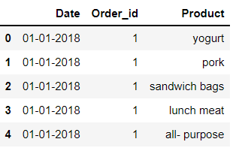
About Data
The first 5 rows of the dataset returned by head function in Python shown here belongs to Order Id of 1.
The Date of the Order is January 1 , 2018.
Some of the items purchased in the order are Yogurt, Pork, Sandwich Bags, Lunch Meat, All-purpose.
The transactions from October to December are not present in the dataset for all the years.

Slide 6
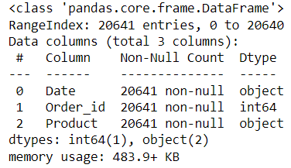
About Data - Info
Info of the data given by info function in Python is shown below
Null and Datatype information of each column in the dataset given by info function in Python.
Dataset contains 20641 records.
There are 3 columns in the dataset.
There are no null values in the dataset.
Date and Product is of object datatype.
Order_id is of Integer datatype.

Slide 7
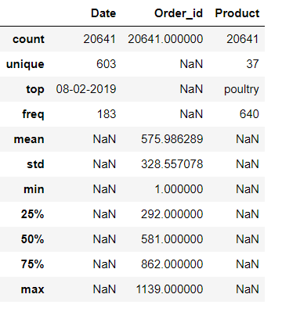
About Data – Summary statistics
Summary Statistics of the data given by describe function in Python is shown below
Date column has an unique value of 603 which means that the dataset contains data for 603 days.
The Date 08-02-2019 occurs 183 times in the dataset which implies that it is the day on which most number of items are sold.
Product column has an unique value of 37 meaning that there are 37 different products sold at Grocery Store.
The top product inferred from the data is Poultry which is sold 640 times.

Slide 8
About Data
Shape of the Data:
The data has 20641 rows with 3 columns.

Slide 9
Exploratory Analysis

Slide 10
UNIvariate analysis

Slide 11
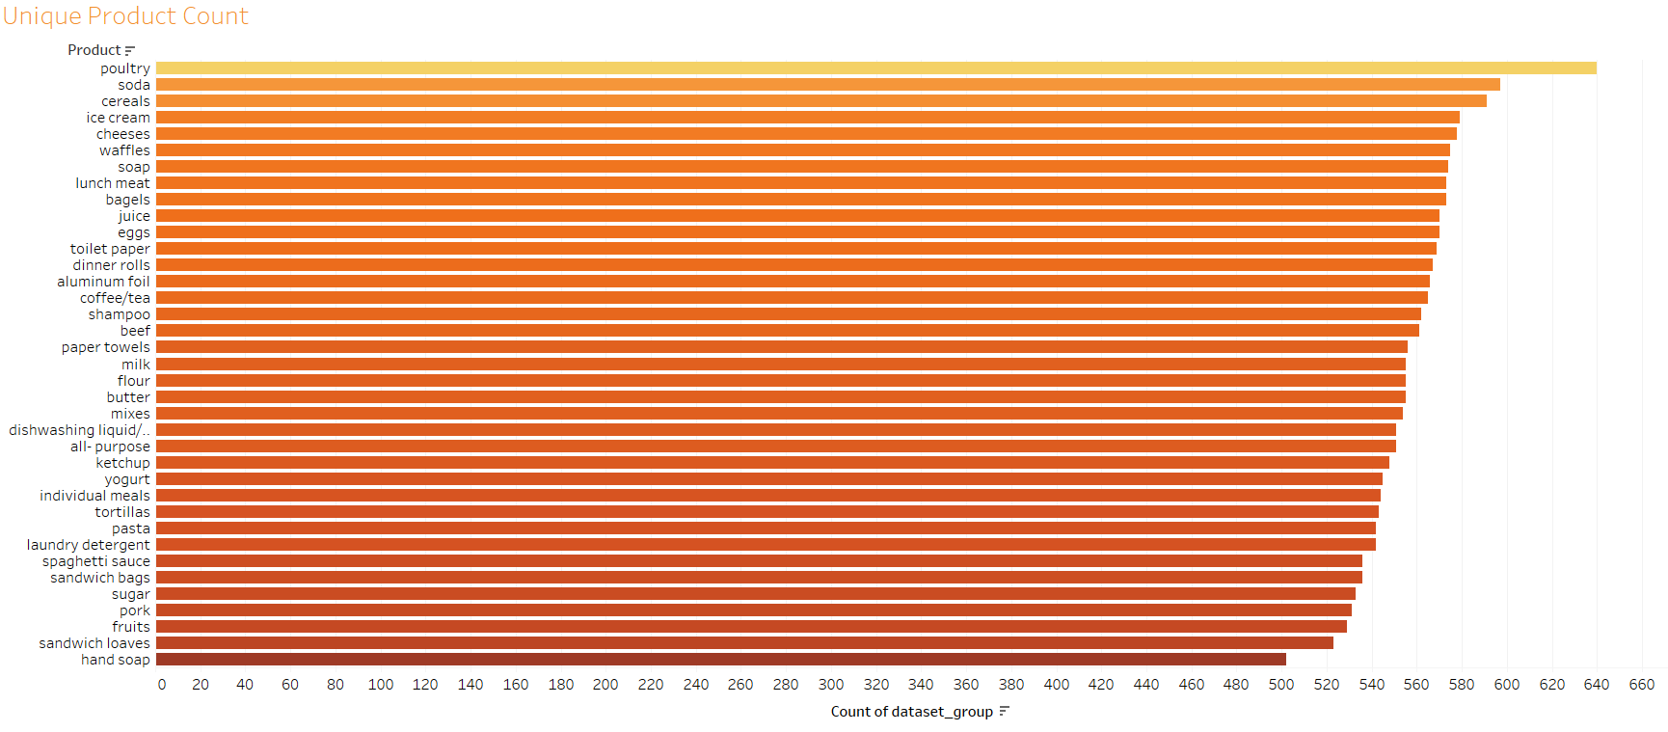
UNIVARIATE ANALYSIS - Product
Poultry is the product most sold.
Soda is the second most sold product at the Grocery Store.
Hand soap and Sandwich loaves are the least sold product with count 502 and 523 respectively.

Slide 12
BIVARIATE ANALYSIS

Slide 13
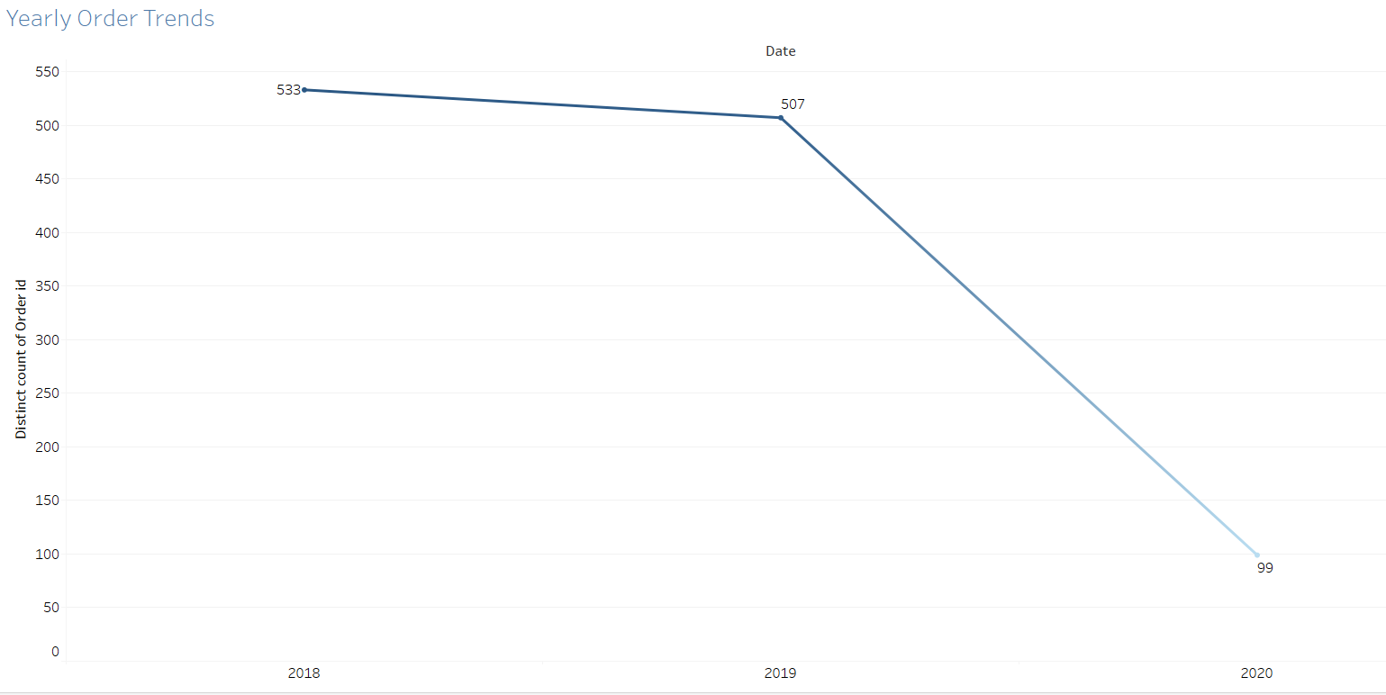
BIVARIATE ANALYSIS – yearly Order Trend
Year 2018 has the highest number of orders.
Year 2020 has the lowest number of orders.
There is a decrease in orders with increase in years.
A feedback form can be given to customers after purchasing to check customer satisfaction.

Slide 14
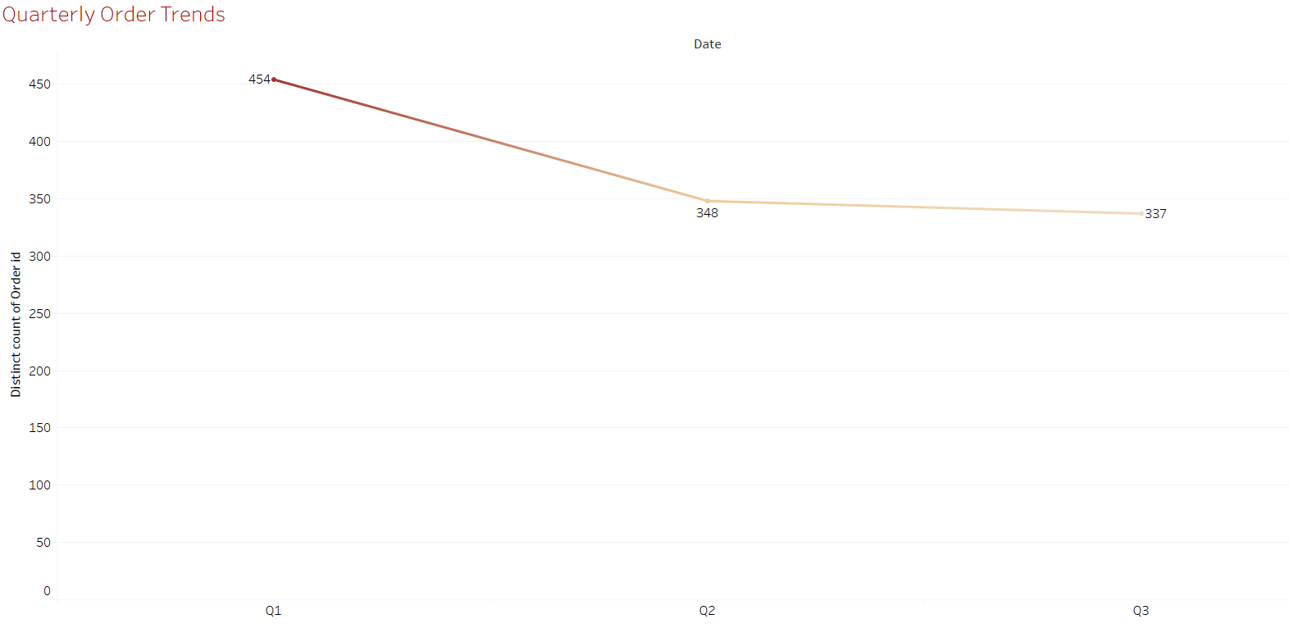
BIVARIATE ANALYSIS- Quarterly Order Trend
The first quarter Q1 has the highest number of orders among all the quarters.
Q3 has the lowest number of orders among all the quarters.
Number of orders decreases from second quarter. More offers and discounts can be given during this time to encourage customers to purchase more items.

Slide 15
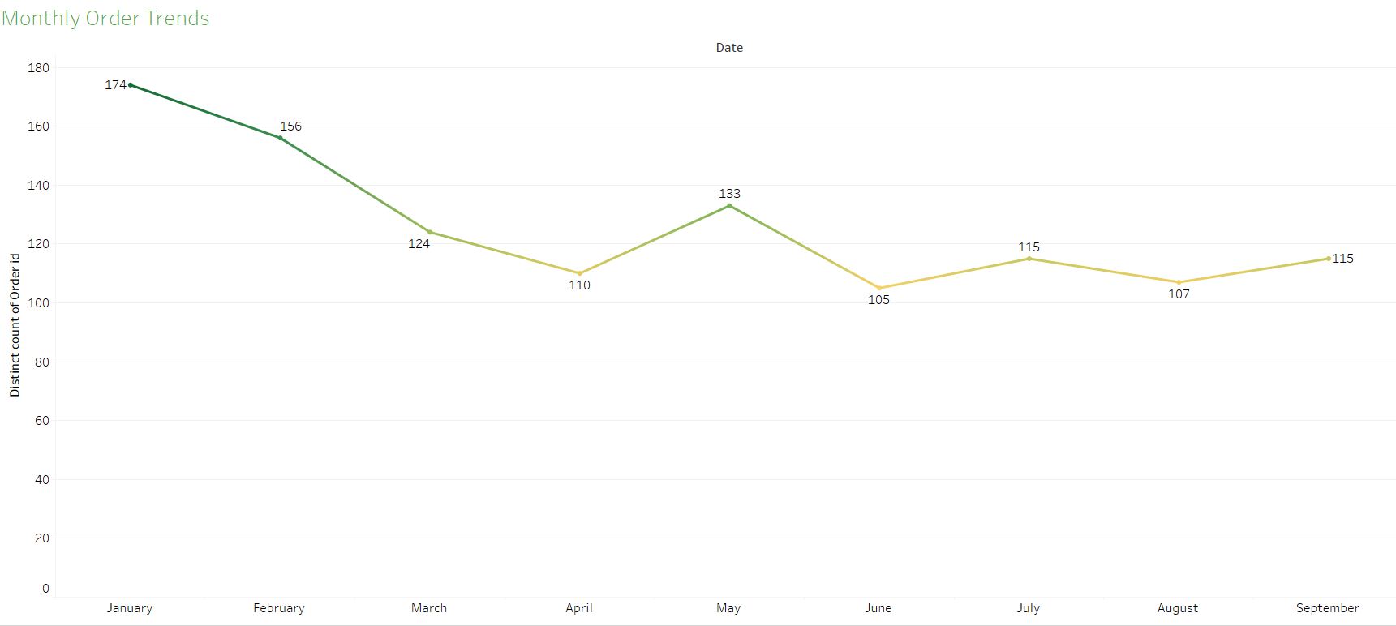
BIVARIATE ANALYSIS- monthly Order Trend
January has the highest number of orders among all the months. It can be because of the new year starting.
June has the lowest number of orders among all the months.
The transactions from October to December are not present in the dataset for all the years.
After March there is a decrease in number of orders and there is a sudden increase in May. This could be because of the Summer season related purchase. So items like juice and ice-cream can be sold as a combo from April to increase the sales even more.

Slide 16
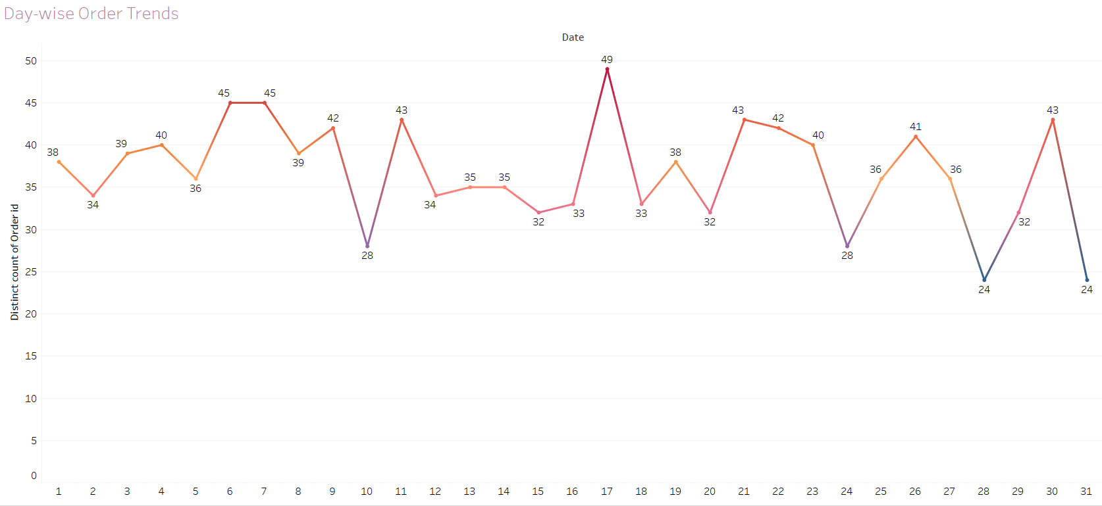
BIVARIATE ANALYSIS- DAY-WISE Order Trend
Beginning of the month has the highest number of orders . This can be because of the salaried people being credited with their salary and start purchasing for their needs in that particular month.
Middle of the month has the lowest number of orders.

Slide 17
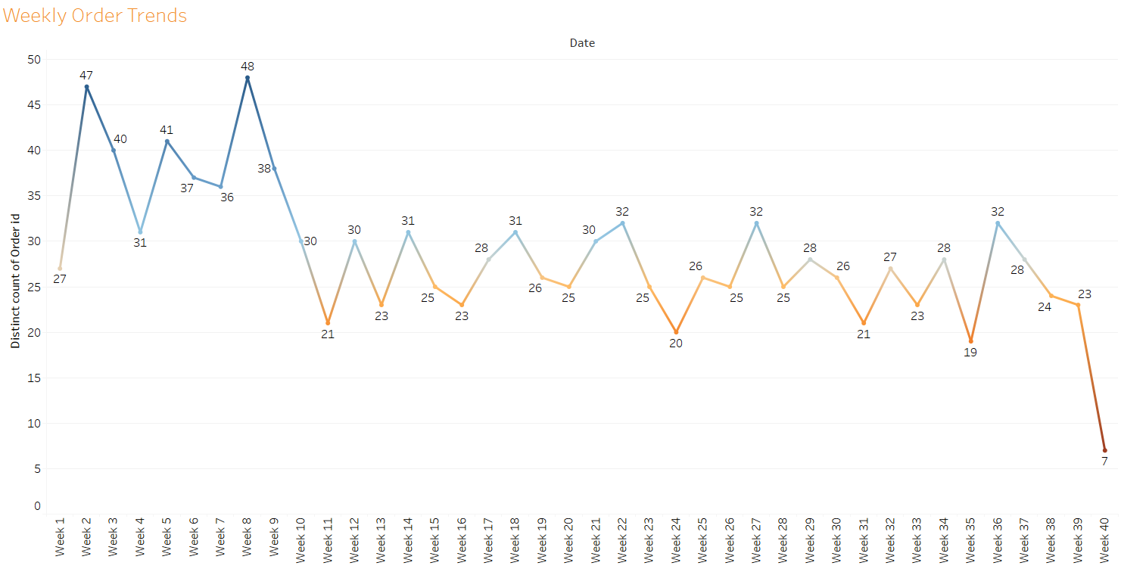
BIVARIATE ANALYSIS- Weekly Order Trend
Week 8 has the highest number of orders of 48.
Week 40 has the lowest number of orders of 7.

Slide 18
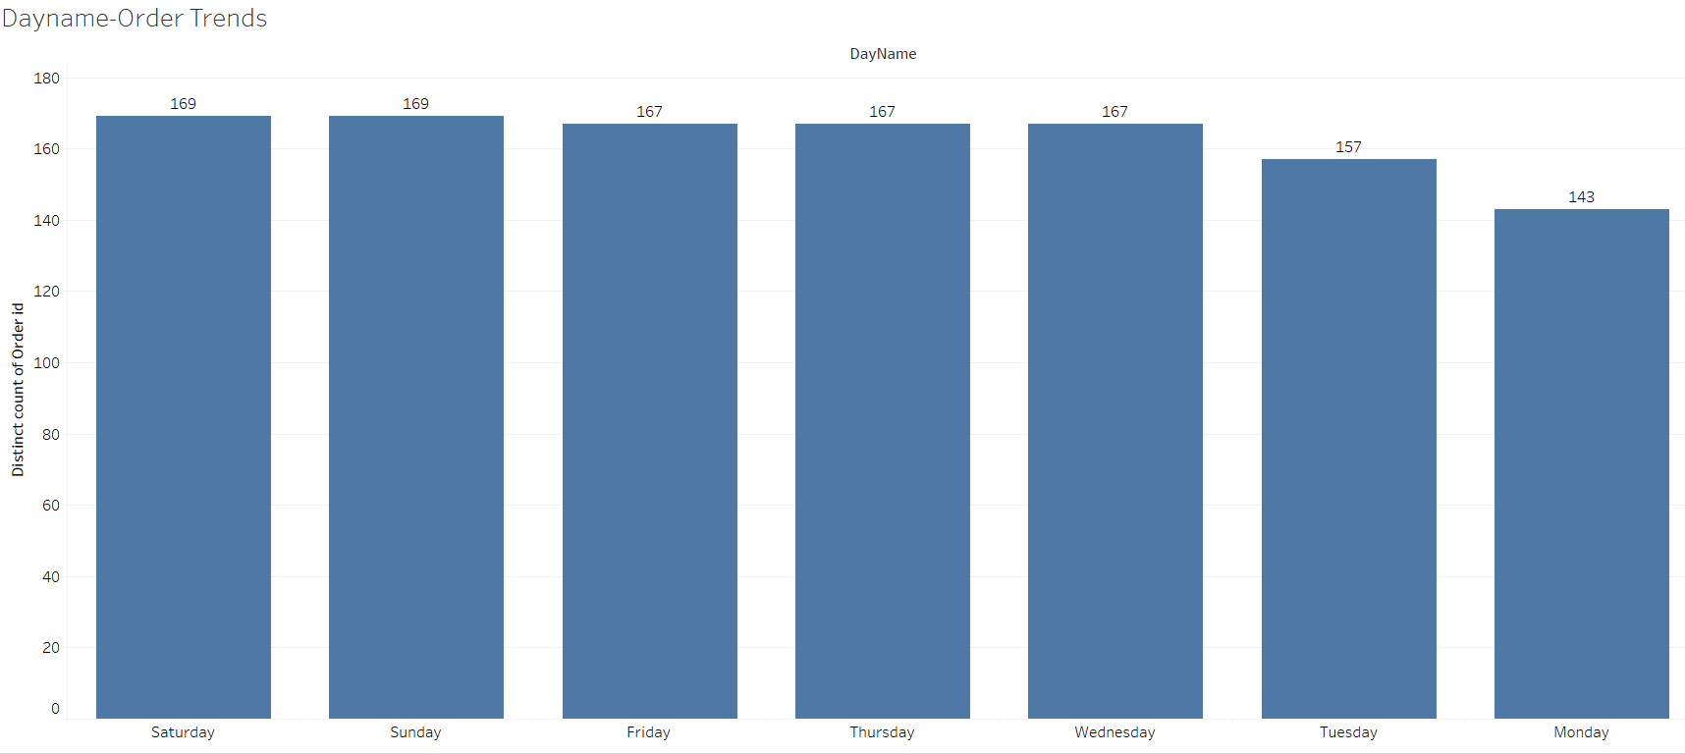
BIVARIATE ANALYSIS – Dayname-Order Trends
Saturday and Sunday has the highest number of orders of 169 among all days of a week.
Monday has the lowest number of orders of 143 among all days of a week.
Combos and offers can be offered on Monday and Tuesday to increase the sales. This can be applied to Snacks, Individual meals and edible items to attract office-goers and school goers to purchase on their way.

Slide 19
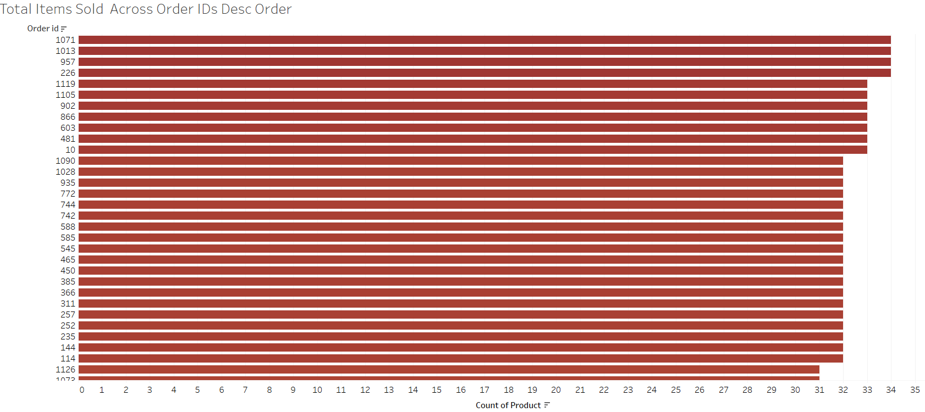
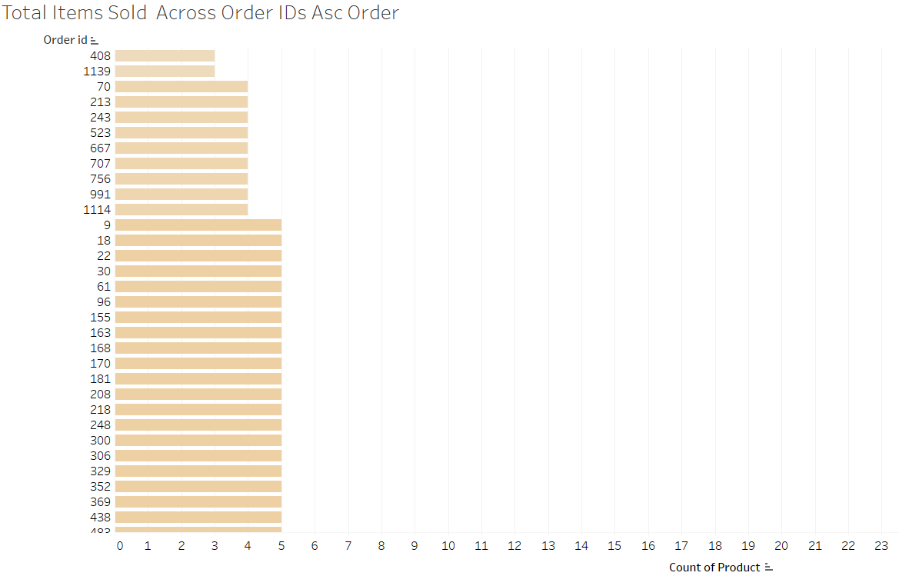
BIVARIATE ANALYSIS - Total Items Sold Across Order IDs

Slide 20
BIVARIATE ANALYSIS - Total Items Sold Across Order IDs
The data over 3 years has been sorted in descending order(left image) and ascending order(right image) based on the number of items sold by the store across all Order Ids.
Order Id 1071,1013, 226, 957 has bought most number of items of 34.
Order Id 408, 1139 has bought lowest number of items of 3.
The Customers associated with the Order_IDs with lowest number of items can be offered coupons, discounts to encourage purchasing. Proper advertising can be done to them.

Slide 21
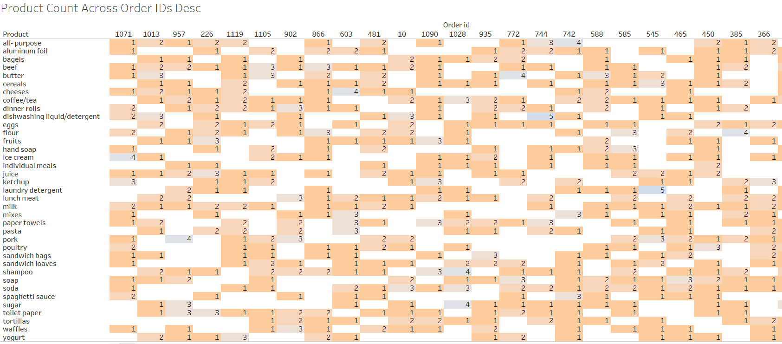
BIVARIATE ANALYSIS – Product count across order id
The data is sorted based on descending order of number of items sold.
Order Id 1071 contains 1 all-purpose item, aluminium foil , beef, butter, cheeses, juice, hand soap , waffles, soap, soda, sandwich bags, sandwich loaves, mixes, paper towels, pork item sold. Also 2 dinner rolls, detergent/dishwashing liquid, flour, milk, poultry, spaghetti sauce, 3 ketchups and 4 ice-creams are sold. It is the order with highest number of items sold.

Slide 22
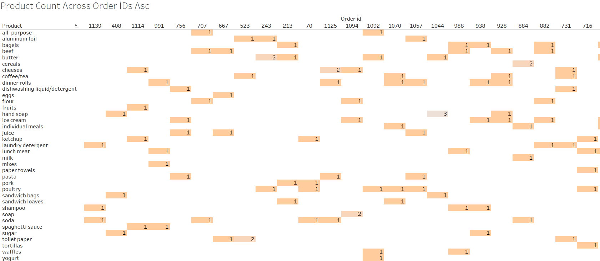
BIVARIATE ANALYSIS – Product count across order id
The data is sorted based on ascending order of number of items sold.
Order Id 1139 contains 1 laundry detergent, shampoo and soda sold. It is the order with lowest number of items sold.
These purchasing behaviour is used to identify the products most sold in big purchases and understand customers’ purchasing behaviour which in-turn can be used to provide coupons related to specific items like food coupons, household item coupons.

Slide 23
Use of Market Basket Analysis (Association Rules)

Slide 24
What is Market Basket Analysis?
Frequent itemset mining leads to the discovery of associations and correlations between items in huge transactional or relational datasets. With vast amounts of data continuously being collected and stored, many industries are becoming interested in mining such kinds of patterns from their databases. A popular example of frequent itemset mining is Market Basket Analysis.
Market Basket Analysis(MBA) is one of the best applications of machine learning in the retail industry. By analyzing the past buying behavior of customers, we can find out which are the products that are bought frequently together by the customers. It is used to identify a firm's best clients based on their spending habits and perform targeted marketing campaigns.
Retailers can use the insights gained from MBA in a number of ways like the following below:
Grouping products that co-occur in the design of a store’s layout to increase the chance of cross-selling;
Driving online recommendation engines (“customers who purchased this product also viewed this product”)
Targeting marketing campaigns by sending out promotional coupons to customers for products related to items they recently purchased.

Slide 25
What is Association Rules?
Association Rules is one of the very important concepts of machine learning being used in market basket analysis.
In a store all vegetables are placed in the same aisle, all dairy items are placed together and cosmetics form another set of such groups. Investing time and resources on deliberate product placements like this not only reduces a customer’s shopping time, but also reminds the customer of what relevant items they might be interested in buying, thus helping stores cross-sell in the process. Association rules help uncover all such relationships between items from huge databases.
Association rules are useful for analyzing and predicting customer behavior. They play an important part in customer analytics, market basket analysis, product clustering, catalog design and store layout.
Association rules consists of an antecedent and a consequent, both of which are a list of items.
An antecedent is an item found within the data. It is the IF component of an association rule.
A consequent is an item found in combination with the antecedent. It is the THEN component of an association rule.

Slide 26
3 metrics in Association Rules
We measure the strength of a rule by calculating the following three metrics:
Support: The percentage of transactions that contain all of the items in an itemset(set of items). The higher the support , the more frequently the itemset occurs. Rules with a high support are preferred since they are likely to be applicable to a large number of future transactions.
Support(A⇒ B) = P(A ∪ B)
Confidence: This measure defines the likeliness of occurrence of consequent on the cart given that the cart already has the antecedents.
Confidence(A⇒ B) = P(B|A)=P(A ∪ B) / P(A)
Lift: Lift value is a measure of importance of a rule. Lift can be found by dividing the confidence by the probability of the consequent without any knowledge about presence of antecedent, or by dividing the support by the probability of the antecedent times the probability of the consequent. A value of lift greater than 1 vouches for high association between antecedent and consequent.
Lift(A⇒ B) = P(A ∪ B) / P(A)*P(B)

Slide 27
Example - Association Rules
Examples of areas in which association rules have been used are:
Credit card transactions: items purchased by credit card give insight into other products the customer is likely to purchase.
Supermarket purchases: common combinations of products can be used to inform product placement on supermarket shelves.
Telecommunication product purchases: commonly associated options (call waiting, caller display, etc) help determine how to structure product bundles which maximize revenue .
Banking services: the patterns of services used by retail customers are used to identify other services they may wish to purchase.
Insurance claims: unusual combinations of insurance claims can be a sign of fraud.
Medical patient histories: certain combinations of conditions can indicate increased risk of various complications

Slide 28
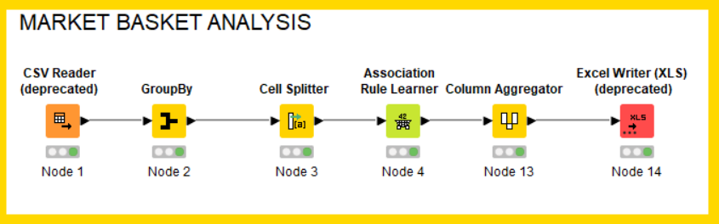
Knime workflow
CSV reader node is used to read the data from the dataset_group csv file and the data is passed to GroupBy Node.
GroupBy node is used to concatenate the Product names grouped by Order_Id. It is connected to Cell Splitter Node.
Cell Splitter is used to convert the Product column to a set to remove duplicates.
Association rule learner Node searches for frequent itemsets meeting the minimum support(which is given as 0.05) and minimum confidence criterion(which is given as 0.5). Maximal Itemset length is given as 10. It gives out association rules. It is connected to Column Aggregator Node.
Column Aggregator converts the Items from Set into a concatenated string column in order to write into an Excel. It is connected to Excel Writer Node.
Excel writer writes the updated data into an excel file in our local system.

Slide 29
Associations Identified

Slide 30
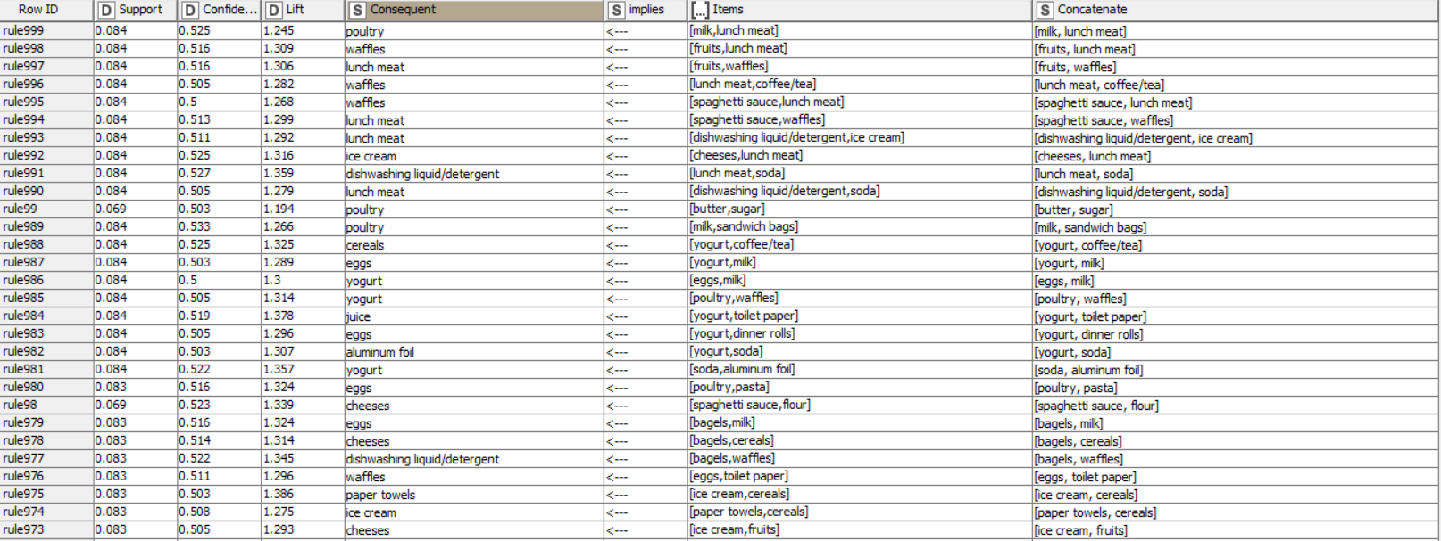
Associations Identified

Slide 31
Associations Identified
These are the few association rules identified.
Support of 0.05 means that the rule is identified in 5% of transactions.
Confidence of 0.5 says that 50% of transaction that contains antecedent item also contains the consequent item.
Lift value of less than 1 shows that having toothbrush on the cart does not increase the chances of occurrence of milk on the cart in spite of the rule showing a high confidence value for those products.
If the lift is equal to 1, it means that antecedent and consequent are independent.
A value of lift greater than 1 vouches for high association between consequent item and antecedent item. More the value of lift, greater are the chances of preference to buy consequent item if the customer has already bought antecedent item.
Lift is the measure that will help store managers to decide product placements on aisle.

Slide 32
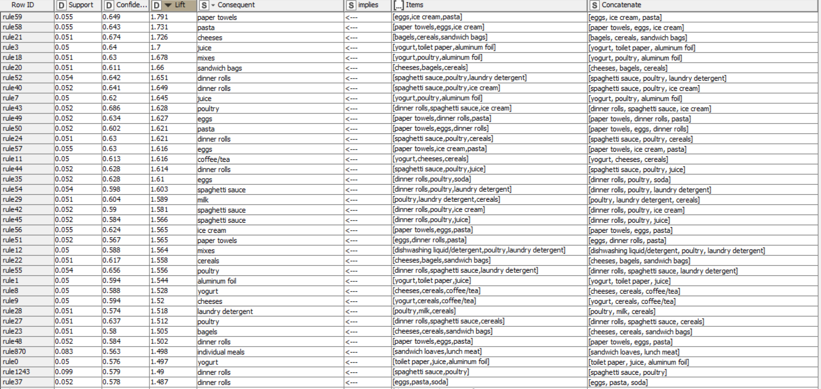
Associations – SORTED ON LIFT
The strong rule also has a high lift value. Lift is an important metric.
Hence the data is sorted on descending order of Lift value.

Slide 33
A suggestion of Possible Combos with Lucrative Offers

Slide 34
recommendations
[yogurt, cheeses, cereals] → coffee/tea with a lift value of 1.62. Coffee and Tea can be placed on the same shelf as Yogurt , Cheeses and Cereals so that a customer who buys one product does not walk to buy the other one.
[mixes, juice] → Ketchup with a lift value of 1.44. Advertising to those who buys mixes and juice to buy Ketchup.
[cheeses, ketchup] → sandwich loaves with a lift value of 1.47. Cheeses, Ketchup and Sandwich loaves can be placed on the same shelf near to each other so that the customer can be reminded to buy one of the product when other two is picked to buy.
[milk, tortillas] → Sandwich bags with a lift value of 1.4. Milk, Tortillas and Sandwich bags can be placed on the same shelf to increase the customers’ propensity to buy all one of these when the other two is put on the cart.
Paper towels and detergent can be placed in a section near to the food section(poultry,ice-ceam) as there are many transactions in which they are bought together.
After March there is a decrease in number of orders and there is a sudden increase in May. This could be because of the Summer season related purchase. So items like juice and ice-cream can be sold as a combo from April to increase the sales even more.
Number of orders decreases from second quarter. More offers and discounts can be given during this time to encourage customers to purchase more items.

Slide 35
discount offers or combos
[bagels, cereals, sandwich bags] → Cheeses with a lift value of 1.73. Hence Bagels, Cereals, Sandwich bags and Cheeses can be sold as a Combo pack at a discounted rate.
[dinner rolls, poultry, juice] → spaghetti sauce with a lift value of 1.57. The store can make a offer of ‘Buy 3 get 1 free’ with these items.
[flour, individual meals] → sandwich loaves with a lift value of 1.45. The store can sell the Sandwich Loaves at a discounted rate to those who buy Individual meals and Flour.
[poultry, beef] → Sugar with a lift value of 1.42. Sugar can be offered for free for those who buy Poultry and Beef in a ‘Buy 2 get 1 free’ offer.
Summer Sales can be conducted from April to June to increase the sales.

Slide 36
THANK YOU

