Slide 1
COURSE COMPLETION REPORT
Next Gen
Technologies
An Infosys Springboard Certification Program
Vartika Keshari
Roll No. 25SCS1003005238 | IILM University, Greater Noida
Infosys Springboard • Next Gen Technologies • Vartika Keshari
01

Slide 2





ABOUT THE LEARNER
Candidate Profile
ROLL NUMBER
25SCS1003005238
Vartika
Keshari
INSTITUTE
IILM University, Greater Noida, U.P.
PROGRAMME
B.Tech – Computer Science & Engineering
B.Tech CSE
COURSE
Next Gen Technologies
PLATFORM & COMPLETION
Infosys Springboard — September 8, 2026
Infosys Springboard • Next Gen Technologies • Vartika Keshari
02

Slide 3



ABOUT THE PROGRAM
Infosys Springboard & Infosys Limited
Infosys Springboard is Infosys’ flagship digital learning platform, powered by Infosys Wingspan, offering free access to courses spanning digital, emerging-technology, and life skills. Learners who complete a course and clear its assessment receive a Course Completion Certificate issued by Infosys Limited, verifiable online through the Wingspan verification portal.
Free & Accessible
Curriculum-Rich Platform
Verifiable Certification
Zero-cost, industry-relevant courses open to students, graduates and professionals.
Content spans digital and emerging technologies, delivered on any device.
Every certificate carries a unique ID, verifiable at verify.onwingspan.com.
Infosys Springboard • Next Gen Technologies • Vartika Keshari
03

Slide 4
COURSE RATIONALE
Why Next Gen Technologies
Emerging fields such as Artificial Intelligence, Cloud Computing, IoT, Blockchain and Cybersecurity are reshaping every industry, yet most academic curricula cover them only at a conceptual level. The Next Gen Technologies course was designed to close that gap — giving learners a structured, self-paced introduction to the technologies driving digital transformation today.
This course guided learning across the emerging-technology stack:
01
02
03
04
Explore
→
Understand
→
Apply
→
Assess
Infosys Springboard • Next Gen Technologies • Vartika Keshari
04

Slide 5






LEARNING OBJECTIVES
What the Course Set Out to Achieve
Foundational Concepts
AI & Machine Learning
Cloud Computing
Build first-principles understanding of emerging technology domains and their real-world relevance.
Explore core AI/ML concepts, use cases and how intelligent systems are built.
Understand cloud service models and how modern infrastructure is deployed and scaled.
IoT & Automation
Blockchain Basics
Cybersecurity Awareness
Learn how connected devices sense, process and exchange data across networks.
Grasp distributed-ledger principles and their impact on trust and transactions.
Recognise common digital threats and the fundamentals of staying secure online.
Infosys Springboard • Next Gen Technologies • Vartika Keshari
05

Slide 6



TECHNOLOGIES & DOMAINS
The Emerging-Tech Landscape Explored
Artificial Intelligence
Machine Learning
Cloud Computing
Internet of Things
Core concepts & applications
Algorithms & data-driven models
Deployment & scalability
Connected devices & sensors
Blockchain
Cybersecurity
Data Science
Automation
Distributed ledgers & trust
Digital threats & defence
Analysis & visualisation
Process & workflow efficiency
Infosys Springboard • Next Gen Technologies • Vartika Keshari
06

Slide 7

LEARNING PATHWAY
From Foundations to Certification
Foundation Modules
Core concepts across emerging technology domains
↓
Guided Learning Content
Videos, readings and interactive lessons per module
↓
Practice & Quizzes
Module-level assessments to reinforce concepts
↓
Final Assessment
Comprehensive evaluation of course learning outcomes
↓
Certification
Course Completion Certificate issued by Infosys Limited
Infosys Springboard • Next Gen Technologies • Vartika Keshari
07

Slide 8
COURSE STRUCTURE
Modules Covered in the Course
1
2
3
4
Introduction to Emerging Tech
Artificial Intelligence
Machine Learning Basics
Cloud Computing
Landscape of next-gen technologies & their industry impact
Fundamentals of AI and intelligent systems
Core algorithms and data-driven approaches
Service models, deployment & scalability
5
6
7
8
Internet of Things
Blockchain Technology
Cybersecurity Fundamentals
Final Credential Assessment
Connected devices, sensors & data exchange
Distributed ledgers & decentralised trust
Common threats & digital defence practices
Consolidated evaluation & certification
Infosys Springboard • Next Gen Technologies • Vartika Keshari
08

Slide 9

EXPECTED OUTCOMES
Skills & Capabilities Gained
Ability to explain core concepts across AI, Cloud, IoT, Blockchain and Cybersecurity
Awareness of how emerging technologies are applied to real-world industry problems
Foundational vocabulary to engage confidently in next-gen technology discussions
Familiarity with the Infosys Springboard learning platform and its assessment structure
A verifiable Course Completion Certificate issued by Infosys Limited
Infosys Springboard • Next Gen Technologies • Vartika Keshari
09

Slide 10
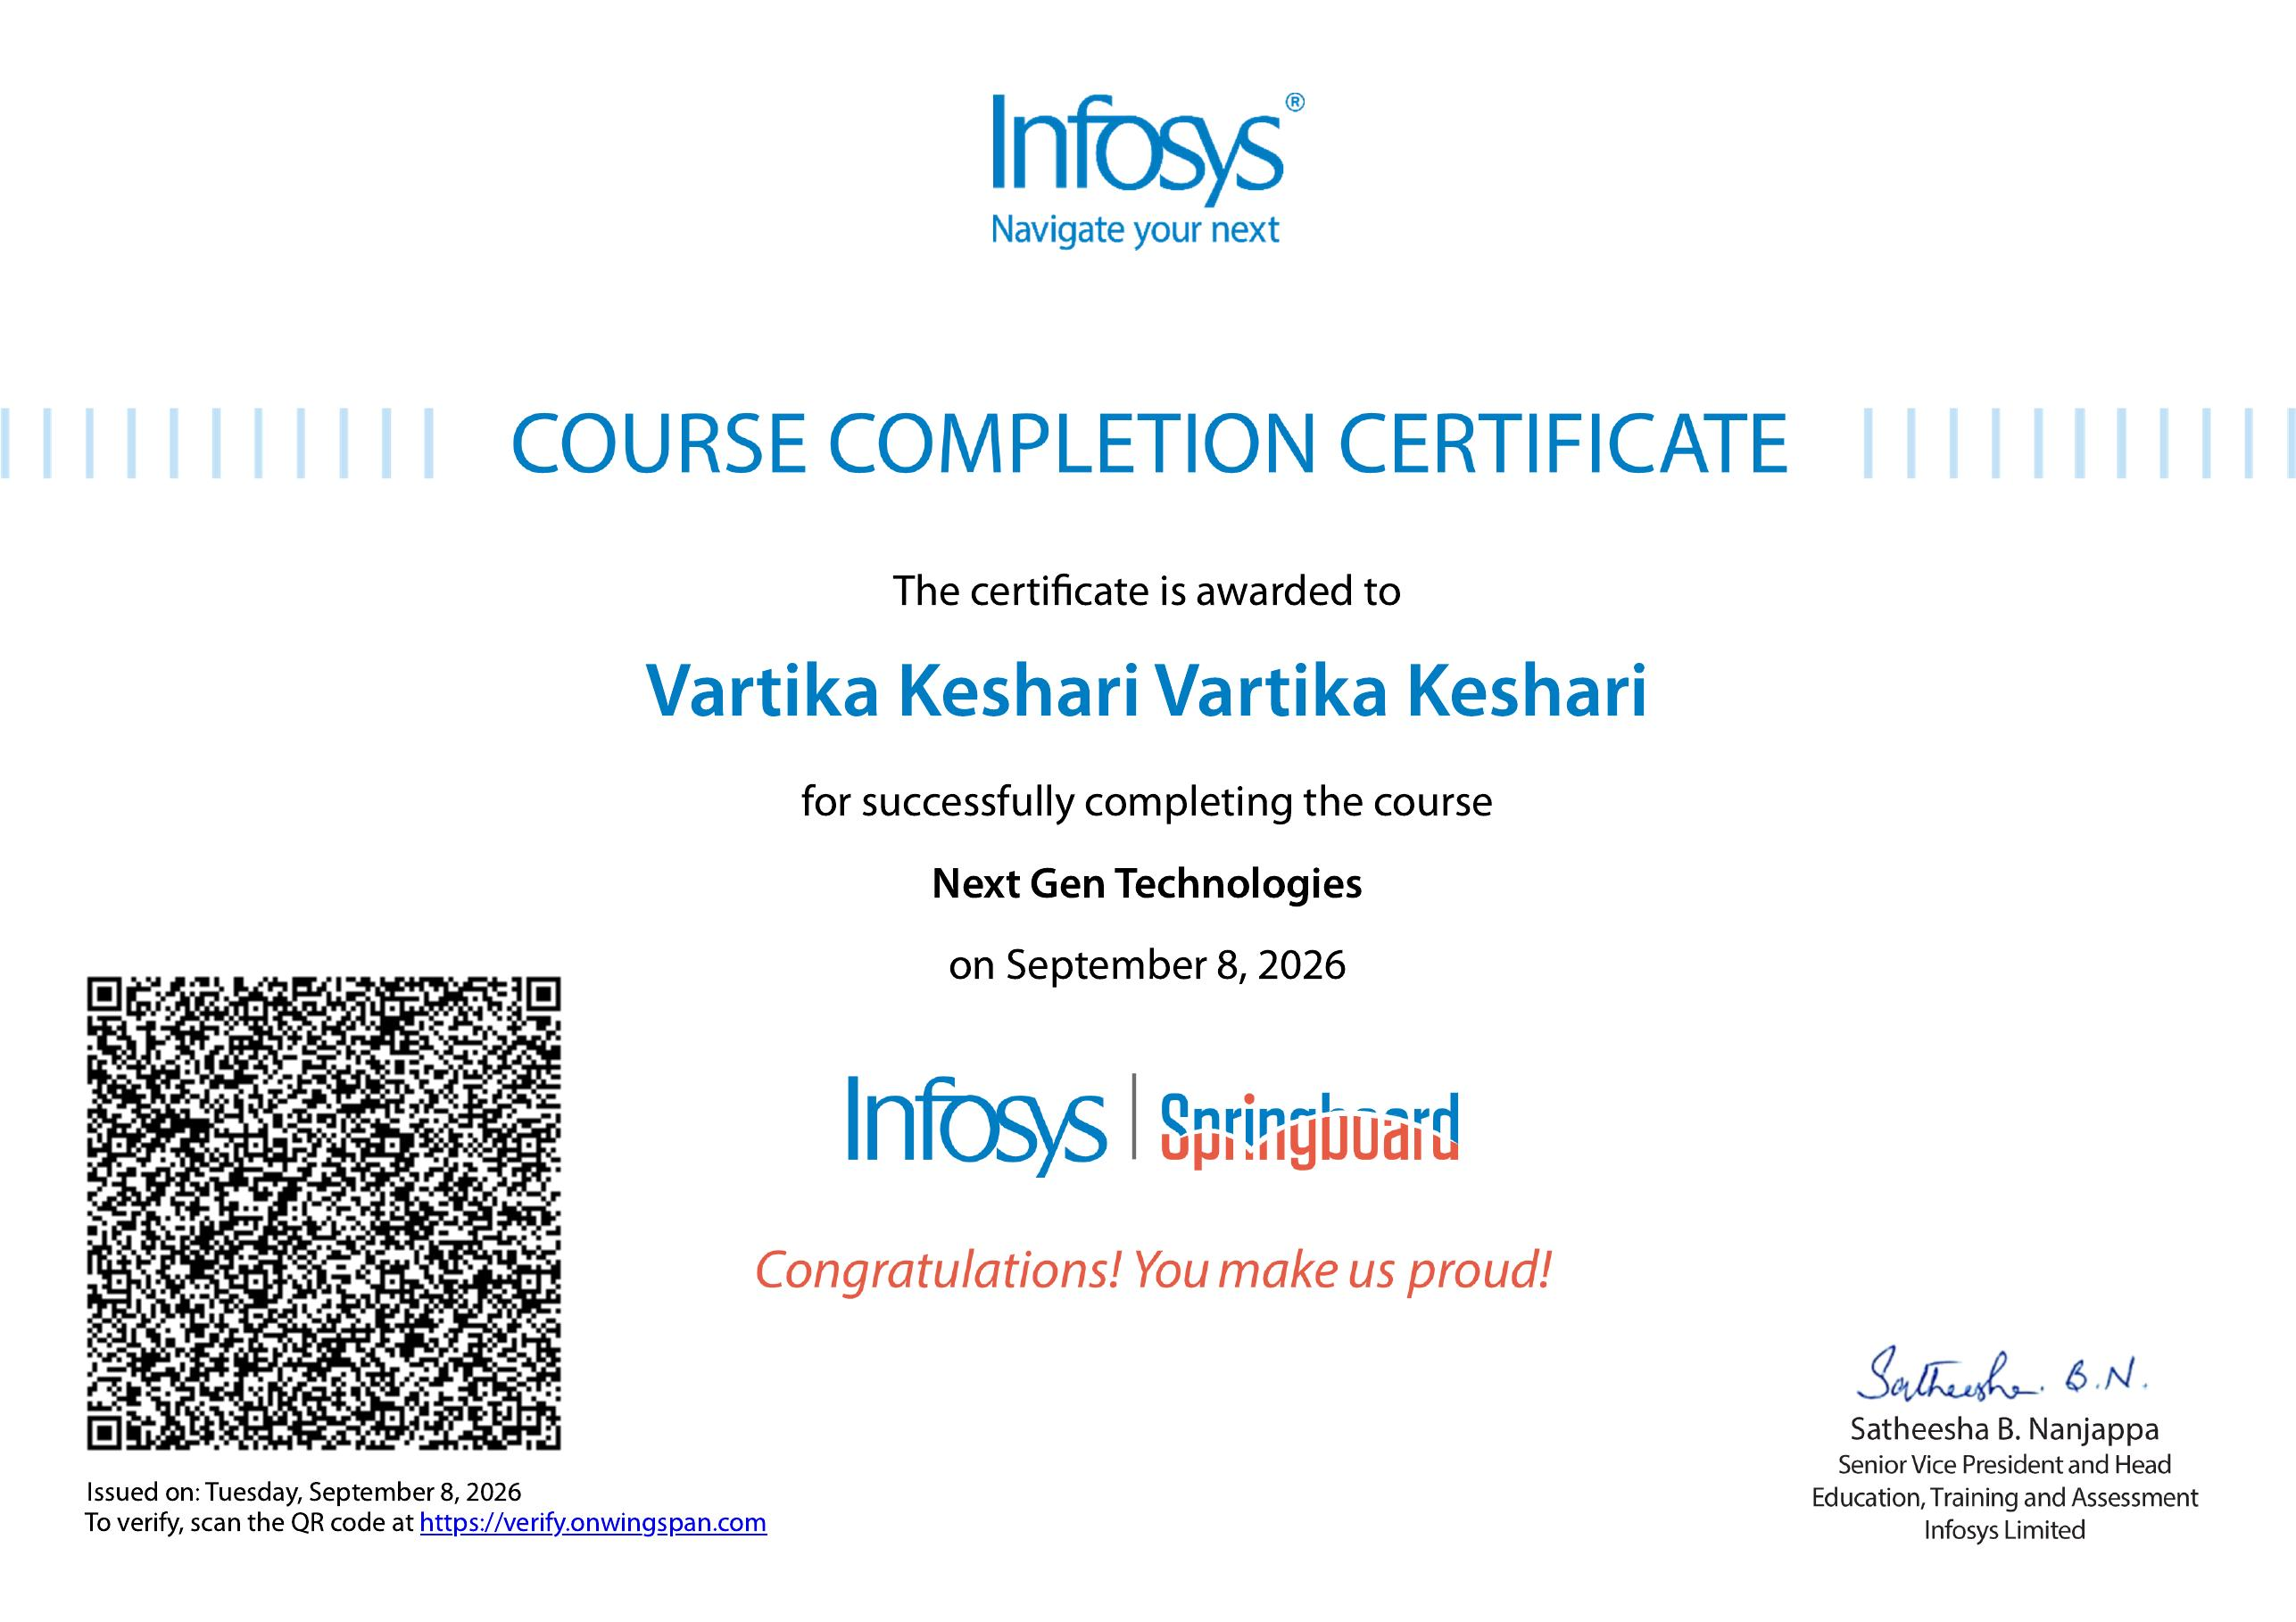

CERTIFICATION
Successfully Completed
COURSE
Next Gen Technologies
COMPLETION DATE
September 8, 2026
ISSUED BY
Infosys Limited, via Infosys Springboard
VERIFICATION
verify.onwingspan.com
Infosys Springboard • Next Gen Technologies • Vartika Keshari
10

Slide 11
Thank You
Next Gen Technologies | Infosys Springboard Certification
Vartika Keshari
Roll No. 25SCS1003005238 | IILM University, Greater Noida

