Slide 1
Call Center Analytics and Workforce Optimization
Магістерський інженерний проєкт
City service contact center analytics
SQL Server warehouse, Streamlit dashboard, forecasting, Erlang C, OR-Tools scheduling
Public NYC 311 demand data plus documented synthetic operational metadata
Denys Vartsab | Master of Science in Data Science | 2026
1

Slide 2
Проблема
Попит у contact center змінюється за часом доби, днем тижня, сезоном і категорією звернення.
Недостатній staffing знижує service level і збільшує abandonment.
Надмірний staffing створює зайві labor costs.
Потрібне interval-level planning, а не тільки історичний dashboard.
2

Slide 3
Мета продукту
Побудувати end-to-end analytical product для workforce planning.
Перетворити public-service demand data на forecast, staffing requirements і schedule.
Зробити pipeline прозорим: data, SQL, model comparison, Erlang C, optimizer, dashboard.
Показати не black-box WFM, а відтворювану engineering implementation.
3

Slide 4
Дані та synthetic enrichment
NYC 311 Service Requests, 2023-01-01 to 2025-12-31.
10,336,480 source records loaded into SQL Server.
Public data provides real demand pattern, complaint type, borough, status and timestamps.
Call-center fields such as AHT, hold time, ACW, abandonment, SLA and agent assignment are generated and documented.
4

Slide 5
Архітектура
NYC 311 public data -> SQL raw landing table.
Raw table -> synthetic call-center warehouse.
Warehouse -> SQL views -> Streamlit dashboard.
Forecasting -> Erlang C staffing -> OR-Tools schedule optimizer.
The product mirrors enterprise WFM flow, but keeps every step inspectable.
5

Slide 6
SQL Server warehouse
Fact_Calls: 10,336,480 simulated calls.
Dim_Date: 1,096 dates; Dim_Time: 48 half-hour intervals.
Dim_Queue: 217 queues; Dim_Agent: 160 synthetic agents.
Dashboard-ready views validate offered, answered and abandoned calls.
6

Slide 7
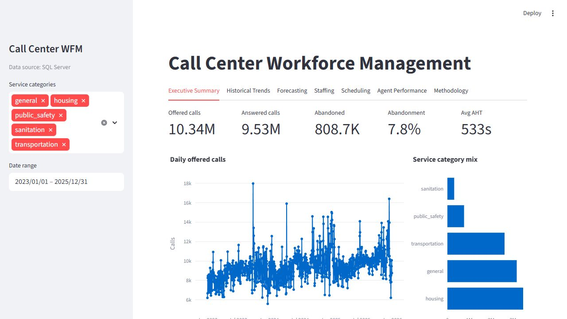
Dashboard overview
Executive KPIs over full 2023-2025 history.
Service category filtering and operational summary.
SQL-backed analytics with CSV fallback for local demo mode.
7

Slide 8
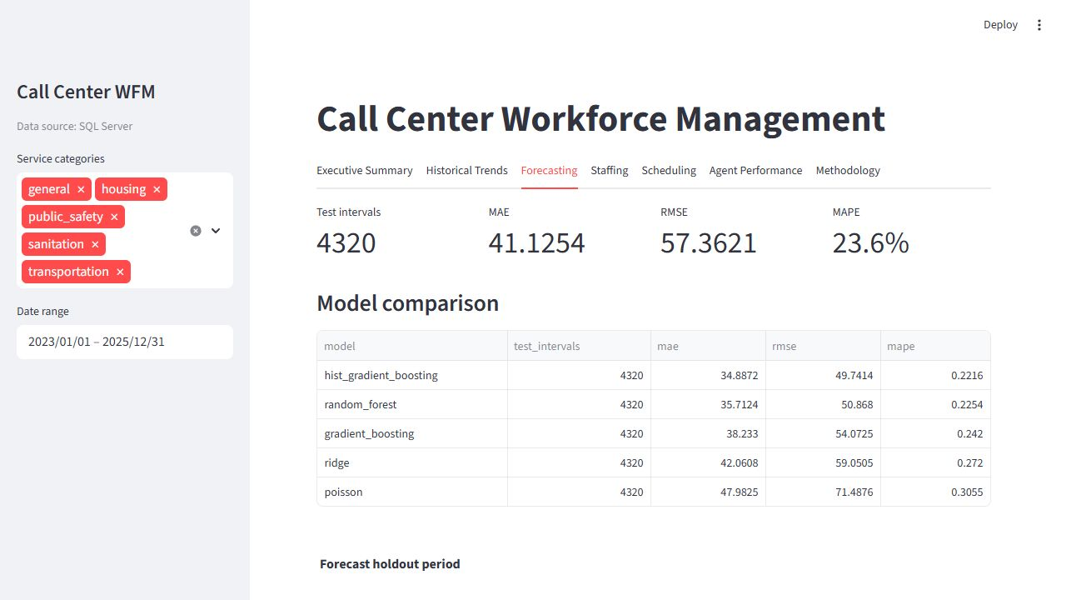
Forecasting and model comparison
Forecast target: 30-minute call volume.
Features: time cycles, calendar fields, weekend, US federal holidays, previous-week lag.
Selected model: histogram gradient boosting.
Holdout metrics: MAE 34.8872, RMSE 49.7414, MAPE 22.16%.
8

Slide 9
Model-aware planning
Forecasting models are registered, not hardcoded.
Current models: histogram gradient boosting, random forest, gradient boosting, ridge, Poisson.
Dashboard can compare holdout predictions and future planning scenarios.
Planning pipeline supports model selection: .\scripts\run_planning_pipeline.ps1 -Model random_forest
9

Slide 10
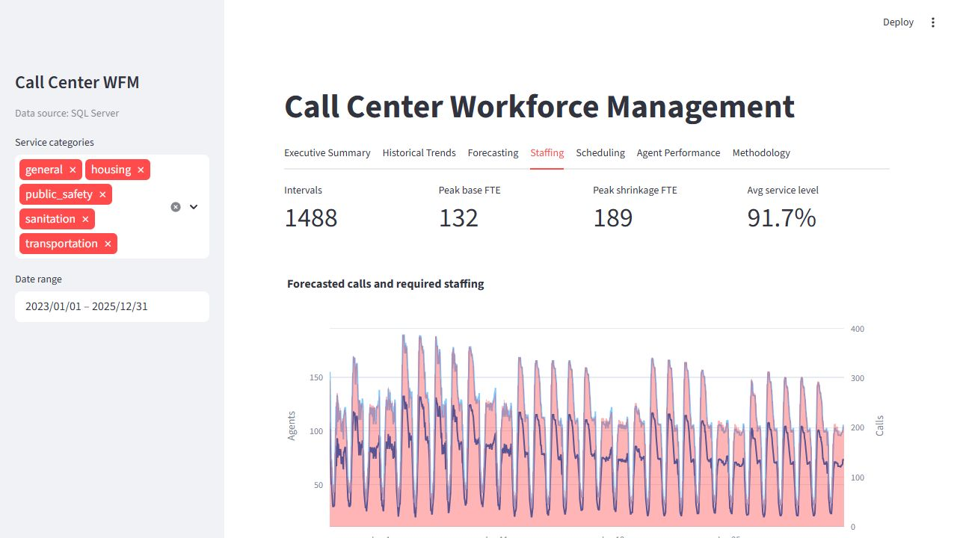
Staffing with Erlang C
Forecasted calls and AHT are converted into required agents.
Target service level: 80% answered within 20 seconds.
Max occupancy: 85%; shrinkage: 30%.
Peak shrinkage-adjusted requirement for January 2026: 189 agents.
10

Slide 11
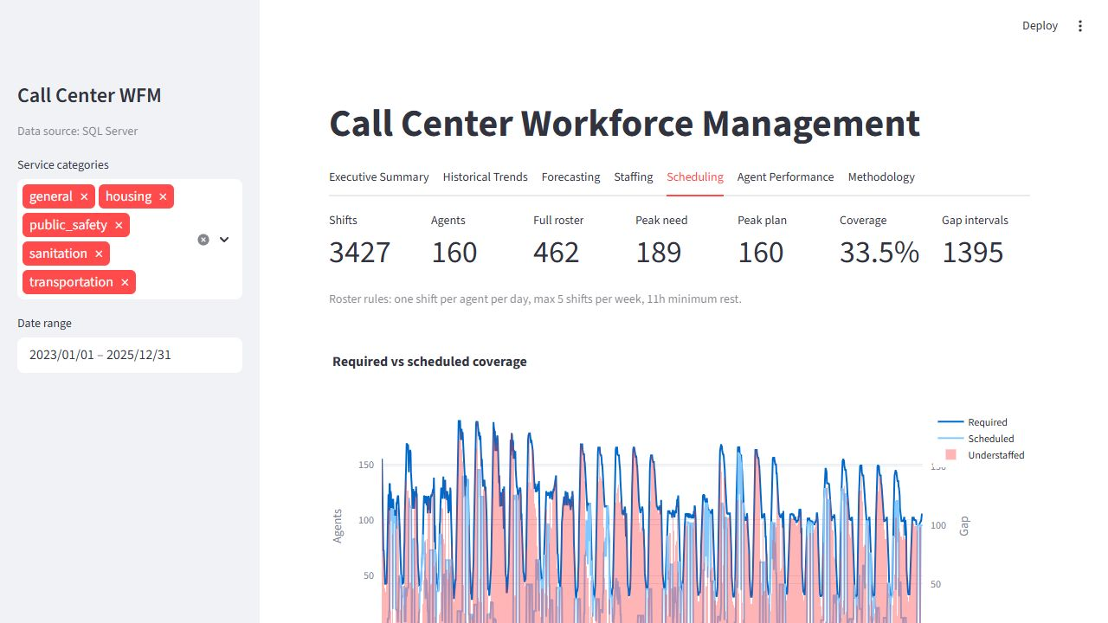
Schedule optimization
OR-Tools CP-SAT creates a legal future roster.
160-agent planning pool, 8-hour shifts, 30-minute break.
Rules: one shift per day, max 5 shifts per week, 11-hour minimum rest.
Planning insight: 160 agents are legal but insufficient for full 24/7 coverage; estimate is 462.
11

Slide 12
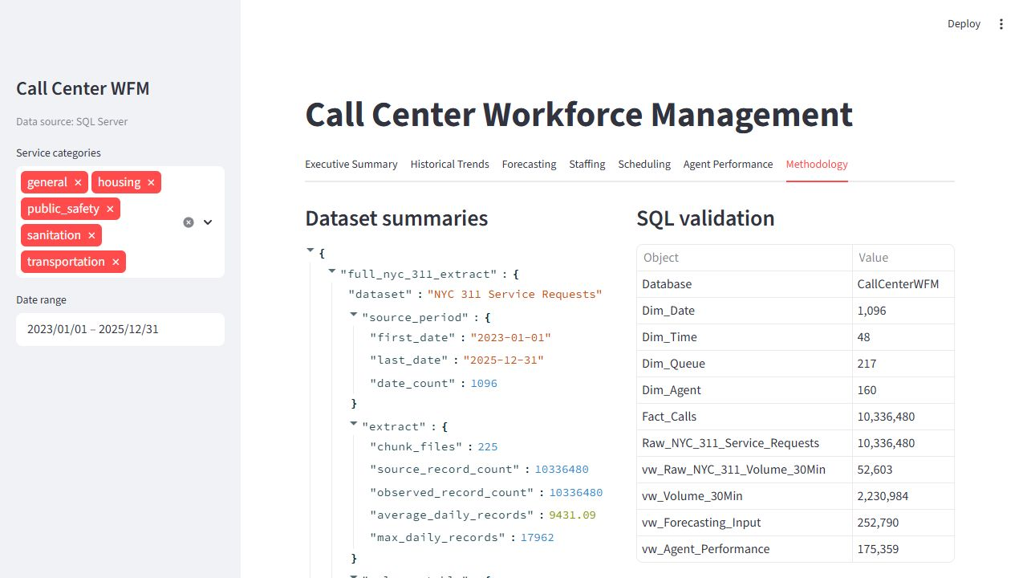
Validation
SQL row counts reconcile from raw table to fact table and dashboard views.
Forecasting models are compared on a 90-day holdout period.
Schedule validation shows zero daily-shift, weekly-limit and rest violations.
Automated tests: 13 passed; public dashboard smoke test passed.
12

Slide 13
Public portfolio deployment
Public URL: https://wfm.vartsab.com:8443.
Docker Compose runs PostgreSQL, Streamlit and Caddy on a small VPS.
Caddy provides HTTPS on port 8443 while the existing VPN keeps port 443.
The deployed dashboard uses compact Postgres seed tables and a simple password gate.
13

Slide 14
Why this is an engineering project
The project does not claim to invent WFM as a new market category.
Its novelty is the transparent, reproducible, open-data implementation of an enterprise WFM workflow.
Academic value: every layer can be inspected, changed, evaluated and extended.
Market relevance: commercial WFM suites solve the same real operational problem.
14

Slide 15
Limitations
311 records are public-service demand records, not guaranteed calls.
Operational call-center fields are synthetic and must be presented as assumptions.
Skill-based routing is not yet enforced in the schedule optimizer.
The public VPS demo uses compact seed tables, not the full SQL Server warehouse.
15

Slide 16
Future work
Compare Erlang C with Erlang A and discrete-event simulation.
Add intraday re-forecasting and scenario controls.
Extend the optimizer to multi-skill scheduling and agent preferences.
Optional productization: MLflow tracking, managed database, monitoring and backups.
16

Slide 17
Conclusion
The project demonstrates a complete path from public demand data to workforce planning decisions.
Implemented layers: SQL warehouse, dashboard, forecasting, staffing and schedule optimization.
The result is a working analytical product, public portfolio demo and defensible capstone engineering artifact.
17

