Slide 1
ARTIFICIAL INTELLIGENCE
Introduction: Chapter 1
Note: All the slides used are modified version of Hwee Tou Ng's (Singapore) course slides

Slide 2
Outline
What is AI?
A brief history
The state of the art

Slide 3
What is AI?
Views of AI fall into four categories:
Thinking humanly Thinking rationally
Acting humanly Acting rationally

Slide 4
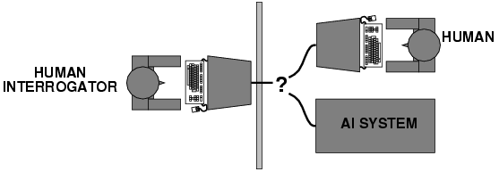
Acting humanly: Turing Test
Turing (1950) "Computing machinery and intelligence":
"Can machines think?" → "Can machines behave intelligently?"
Operational test for intelligent behavior: the Imitation Game

Slide 5
Thinking humanly: cognitive modeling
Getting inside the actual working of human brain.
When we have the theory, we can express it as computer program.
Cognitive science brings computer models from AI and experimental techniques from psychlogy.

Slide 6
Thinking rationally: "laws of thought"
Attempt to codify ''Right thinking''
Syllogisms (Deductive reasoning)
Kishore is a man. All men are mortal. Therefore,
Kishore is mortal.
Gave birth to the field of logic.
Problem: Everything can not be written formally in logical notation

Slide 7
Acting rationally: rational agent
Rational behavior: doing the right thing
The right thing: that which is expected to maximize goal achievement, given the available information
Doesn't necessarily involve thinking – e.g., blinking reflex – but thinking should be in the service of rational action

Slide 8
Rational agents
An agent is an entity that perceives and acts
This course is about designing rational agents
Abstractly, an agent is a function from percept histories to actions:
[f: P* → A]
For any given class of environments and tasks, we seek the agent (or class of agents) with the best performance
Caveat: computational limitations make perfect rationality unachievable therefore Limited rationality is what we try to achieve
→ Acting appropriately when computational resources are not enough

Slide 9
State of the art
Deep Blue defeated the reigning world chess champion Garry Kasparov in 1997
Proved a mathematical conjecture (Robbins conjecture) unsolved for decades
No hands across America (driving autonomously 98% of the time from Pittsburgh to San Diego)
During the 1991 Gulf War, US forces deployed an AI logistics planning and scheduling program that involved up to 50,000 vehicles, cargo, and people
NASA's on-board autonomous planning program controlled the scheduling of operations for a spacecraft
Proverb solves crossword puzzles better than most humans
CNN solved the ImageNet object recognition challenge.
An architecture consisting of CNN+RNN are used for image caption generation.

Slide 10
Which of the following can be done at present?
Play a decent game of table tennis.

Slide 11
Which of the following can be done at present?
Play a decent game of table tennis.
Drive safely along a curvy mountain road.

Slide 12
Which of the following can be done at present?
Play a decent game of table tennis.
Drive safely along a curvy mountain road.

Slide 13
Which of the following can be done at present?
Play a decent game of table tennis.
Drive safely along a curvy mountain road.
Drive safely along a Goa road.

Slide 14
Which of the following can be done at present?
Play a decent game of table tennis.
Drive safely along a curvy mountain road.
Drive safely along a Goa road.

Slide 15
Which of the following can be done at present?
Play a decent game of table tennis.
Drive safely along a curvy mountain road.
Drive safely along a Goa road.
Buy a week's worth of grocerries on the web.

Slide 16
Which of the following can be done at present?
Play a decent game of table tennis.
Drive safely along a curvy mountain road.
Drive safely along a Goa road.
Buy a week's worth of grocerries on the web.

Slide 17
Which of the following can be done at present?
Play a decent game of table tennis.
Drive safely along a curvy mountain road.
Drive safely along a Goa road.
Buy a week's worth of grocerries on the web.
Play a decent game of chess.

Slide 18
Which of the following can be done at present?
Play a decent game of table tennis.
Drive safely along a curvy mountain road.
Drive safely along a Goa road.
Buy a week's worth of grocerries on the web.
Play a decent game of chess.
Discover and prove a new mathemetical theorem.

Slide 19
Which of the following can be done at present?
Play a decent game of table tennis.
Drive safely along a curvy mountain road.
Drive safely along a Goa road.
Buy a week's worth of grocerries on the web.
Play a decent game of chess.
Discover and prove a new mathemetical theorem.

Slide 20
Which of the following can be done at present?
Play a decent game of table tennis.
Drive safely along a curvy mountain road.
Drive safely along a Goa road.
Buy a week's worth of grocerries on the web.
Play a decent game of chess.
Discover and prove a new mathemetical theorem.
Write an intentionally funny story.

Slide 21
Which of the following can be done at present?
Play a decent game of table tennis.
Drive safely along a curvy mountain road.
Drive safely along a Goa road.
Buy a week's worth of grocerries on the web.
Play a decent game of chess.
Discover and prove a new mathemetical theorem.
Write an intentionally funny story.

Slide 22
Which of the following can be done at present?
Play a decent game of table tennis.
Drive safely along a curvy mountain road.
Drive safely along a Goa road.
Buy a week's worth of grocerries on the web.
Play a decent game of chess.
Discover and prove a new mathemetical theorem.
Write an intentionally funny story.
Converse successfully with another person for an hour.

Slide 23
Which of the following can be done at present?
Play a decent game of table tennis.
Drive safely along a curvy mountain road.
Drive safely along a Goa road.
Buy a week's worth of grocerries on the web.
Play a decent game of chess.
Discover and prove a new mathemetical theorem.
Write an intentionally funny story.
Converse successfully with another person for an hour.

Slide 24
Which of the following can be done at present?
Play a decent game of table tennis.
Drive safely along a curvy mountain road.
Drive safely along a Goa road.
Buy a week's worth of grocerries on the web.
Play a decent game of chess.
Discover and prove a new mathemetical theorem.
Write an intentionally funny story.
Converse successfully with another person for an hour.
Perform a complex surgical operation.

Slide 25
Which of the following can be done at present?
Play a decent game of table tennis.
Drive safely along a curvy mountain road.
Drive safely along a Goa road.
Buy a week's worth of grocerries on the web.
Play a decent game of chess.
Discover and prove a new mathemetical theorem.
Write an intentionally funny story.
Converse successfully with another person for an hour.
Perform a complex surgical operation.
Unload any dish washer and put everything away.

Slide 26
Which of the following can be done at present?
Play a decent game of table tennis.
Drive safely along a curvy mountain road.
Drive safely along a Goa road.
Buy a week's worth of grocerries on the web.
Play a decent game of chess.
Discover and prove a new mathemetical theorem.
Write an intentionally funny story.
Converse successfully with another person for an hour.
Perform a complex surgical operation.
Unload any dish washer and put everything away.

Slide 27
Which of the following can be done at present?
Play a decent game of table tennis.
Drive safely along a curvy mountain road.
Drive safely along a Goa road.
Buy a week's worth of grocerries on the web.
Play a decent game of chess.
Discover and prove a new mathemetical theorem.
Write an intentionally funny story.
Converse successfully with another person for an hour.
Perform a complex surgical operation.
Unload any dish washer and put everything away.

Slide 28
Which of the following can be done at present?
Play a decent game of table tennis.
Drive safely along a curvy mountain road.
Drive safely along a Goa road.
Buy a week's worth of grocerries on the web.
Play a decent game of chess.
Discover and prove a new mathemetical theorem.
Write an intentionally funny story.
Converse successfully with another person for an hour.
Perform a complex surgical operation.
Unload any dish washer and put everything away.

Slide 29
Intelligent Agents
Chapter 2

Slide 30
Agents
An agent is anything that can be viewed as perceiving its environment through sensors and acting upon that environment through actuators
Human agent: eyes, ears, and other organs for sensors; hands, legs, mouth, and other body parts for actuators
Robotic agent: cameras and infrared range finders for sensors; various motors for actuators

Slide 31
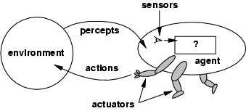
Agents and environments
The agent function maps from percept histories to actions:
[f: P* → A]
The agent program runs on the physical architecture to produce f
agent = architecture + program

Slide 32
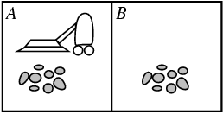
Vacuum-cleaner world
Percepts: location and contents, e.g., [A,Dirty]
Actions: Left, Right, Suck, NoOp

Slide 33
A vacuum-cleaner agent
Percept Sequence | Action
[A,Clean] | Right
[A,Dirty] | Suck
[A,Clean],[A,clean] | Right
[A,Clean],[A,Dirty] | Suck
[A,Clean],[B,Clean] | Left
And so on...

Slide 34
Rational agents
An agent should strive to "do the right thing", based on what it can perceive and the actions it can perform. The right action is the one that will cause the agent to be most successful
Performance measure: An objective criterion for success of an agent's behavior
E.g., performance measure of a vacuum-cleaner agent could be amount of dirt cleaned up, amount of time taken, amount of electricity consumed, amount of noise generated, etc.

Slide 35
Rational agents
Rational Agent: For each possible percept sequence, a rational agent should select an action that is expected to maximize its performance measure, given the evidence provided by the percept sequence and whatever built-in knowledge the agent has.

Slide 36
Rational agents
Rationality is distinct from omniscience (Knowing the actual outcome of action)
Rationality doesnot require omniscience coz' rational choice depends only on percepts to date.
Agents can perform actions in order to modify future percepts so as to obtain useful information (information gathering, exploration)
An agent is autonomous if its behavior is determined by its own experience (with ability to learn and adapt)

Slide 37
PEAS
PEAS: Performance measure, Environment, Actuators, Sensors
Must first specify the setting for intelligent agent design
Consider, e.g., the task of designing an automated taxi driver:
Performance measure
Environment
Actuators
Sensors

Slide 38
PEAS
Must first specify the setting for intelligent agent design
Consider, e.g., the task of designing an automated taxi driver:
Performance measure: Safe, fast, legal, comfortable trip, maximize profits
Environment: Roads, other traffic, pedestrians, customers
Actuators: Steering wheel, accelerator, brake, signal, horn
Sensors: Cameras, sonar, speedometer, GPS, odometer, engine sensors, keyboard

Slide 39
PEAS
Agent: Medical diagnosis system
Performance measure: Healthy patient, minimize costs, lawsuits
Environment: Patient, hospital, staff
Actuators: Screen display (questions, tests, diagnoses, treatments, referrals)
Sensors: Keyboard (entry of symptoms, findings, patient's answers)

Slide 40
PEAS
Agent: Part-picking robot
Performance measure: Percentage of parts in correct bins
Environment: Conveyor belt with parts, bins
Actuators: Jointed arm and hand
Sensors: Camera, joint angle sensors

Slide 41
PEAS
Agent: Interactive English tutor
Performance measure: Maximize student's score on test
Environment: Set of students
Actuators: Screen display (exercises, suggestions, corrections)
Sensors: Keyboard

Slide 42
Environment types
Fully observable (vs. partially observable): An agent's sensors give it access to the complete state of the environment at each point in time.
Deterministic (vs. stochastic): The next state of the environment is completely determined by the current state and the action executed by the agent. (If the environment is deterministic except for the actions of other agents, then the environment is strategic)
Episodic (vs. sequential): The agent's experience is divided into atomic "episodes" (each episode consists of the agent perceiving and then performing a single action), and the choice of action in each episode depends only on the episode itself.

Slide 43
Environment types
Static (vs. dynamic): The environment is unchanged while an agent is deliberating. (The environment is semidynamic if the environment itself does not change with the passage of time but the agent's performance score does)
Discrete (vs. continuous): A limited number of distinct, clearly defined percepts and actions.
Single agent (vs. multiagent): An agent operating by itself in an environment.

Slide 44
Environment types
Chess with Chess without Taxi driving
a clock a clock
Fully observable Yes Yes No
Deterministic Strategic Strategic No
Episodic No No No
Static Semi Yes No
Discrete Yes Yes No
Single agent No No No
The environment type largely determines the agent design
The real world is (of course) partially observable, stochastic, sequential, dynamic, continuous, multi-agent

Slide 45
Agent functions and programs
An agent is completely specified by the agent function mapping percept sequences to actions
Aim: find a way to implement the rational agent function concisely

Slide 46
Table-lookup agent
Drawbacks:
Huge table
Take a long time to build the table
No autonomy

Slide 47
Agent program for a vacuum-cleaner agent

Slide 48
Agent types
Four basic types in order of increasing generality:
Simple reflex agents
Model-based reflex agents
Goal-based agents
Utility-based agents
Learning agents

Slide 49
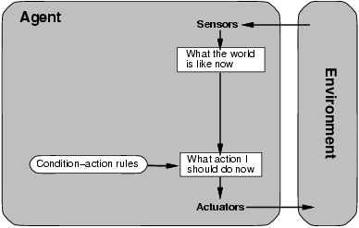
Simple reflex agents

Slide 50
Simple reflex agents
function SIMPLE-REFLEX-AGENT(percept) returns action
static: rules, a set of condition-action rules
State <- lNTERPRET-lNPUT(percept)
rule <- RULE-MATCH(state, rules)
action <- RULE-ACTION[rule]
return action

Slide 51
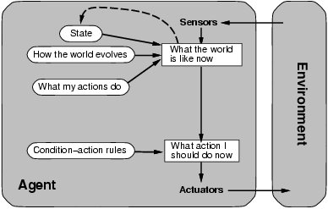
Model-based reflex agents

Slide 52
Model-based reflex agents
function REFLEX-AGENT-WITH-STATE(percept) returns action
static: state, a description of the current world state
rules, a set of condition-action rules
state <- UPDATE-STATE(state, percept)
rule <- RULE-MATCH(state, rules)
action <- RULE-ACTION[rule]
state <- UPDATE-STATE(state, action)
return action

Slide 53
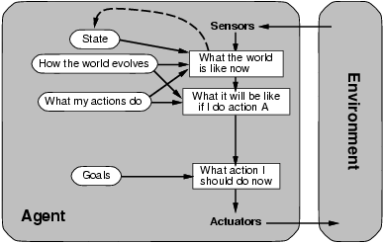
Goal-based agents

Slide 54
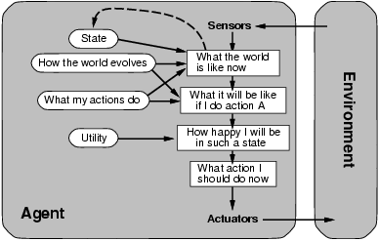
Utility-based agents

Slide 55
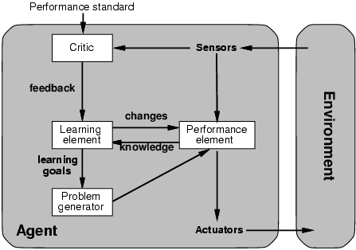
Learning agents

