Slide 1
Multi-Agent LLM Systems
Technical Seminar
by
Varun B Karmikanda
261100610029
Master of Engineering (Computer Science and Engineering)
Panel members
Panel Member 1: | Panel Member 2:
Dr Sathyendranath Malli | Mr Balaji B
Associate Professor | Assistant Professor - Selection Grade
Manipal School of Information Sciences | Manipal School of Information Sciences
MAHE, Manipal | MAHE, Manipal

Slide 2
Presentation Outline
1. Introduction | 3
2. Objectives | 4
3. Literature Review | 5
4. From LLMs to Agents | 6 - 7
5. How Multi-Agent Systems Work | 8 – 13
6. Case Study: Research Assistant | 14 – 15
7. Applications, Challenges & Future Work | 16
8. Conclusion | 17
9. References | 18

Slide 3
1. Introduction
One LLM can answer. An agent can act. Give an LLM a role, memory and tools, and it stops just chatting and starts doing.
One agent hits a ceiling. Complex tasks need planning, checking and specialization, and a single model does everything alone, with nobody to catch its mistakes.
So we build teams. Specialized LLM agents divide the work, talk to each other and cross-check results.
The field is moving fast, but it’s scattered. Li et al. (2024) pull it together in one framework: profile → perception → self-action → interaction → evolution.

Slide 4
2. Objectives
By the end of this session, you will be able to:
Explain what LLM-based multi-agent systems are and why one LLM is not enough
Describe how they work: single-agent components plus the interaction layer
Apply the framework to a case study, an autonomous research assistant
Identify real applications, key challenges

Slide 5
3. Literature Review
Title | Authors | Purpose of Study | Key Findings
A survey on LLM-based multi-agent systems: workflow, infrastructure, and challenges | Xinyi Li, Sai Wang, Siqi Zeng, Yu Wu, Yi Yang | To give a systematic overview of LLM-based multi-agent systems organized around their workflow, since earlier work was scattered and lacked a unified framework | •Proposes a 5-module framework: profile, perception, self-action, mutual interaction, evolution • Splits applications into problem solving and world simulation. • Lists open problems
Large language model based multi-agents: A survey of progress and challenges | Taicheng Guo, Xiuying Chen, Yaqi Wang, Ruidi Chang, Shichao Pei, Nitesh V. Chawla, Olaf Wiest, Xiangliang Zhang | To explain the essential aspects and challenges of LLM-based multi-agent systems | • Organizes the field by the agents-environment interface, agent profiling, communication, and capability growth

Slide 6
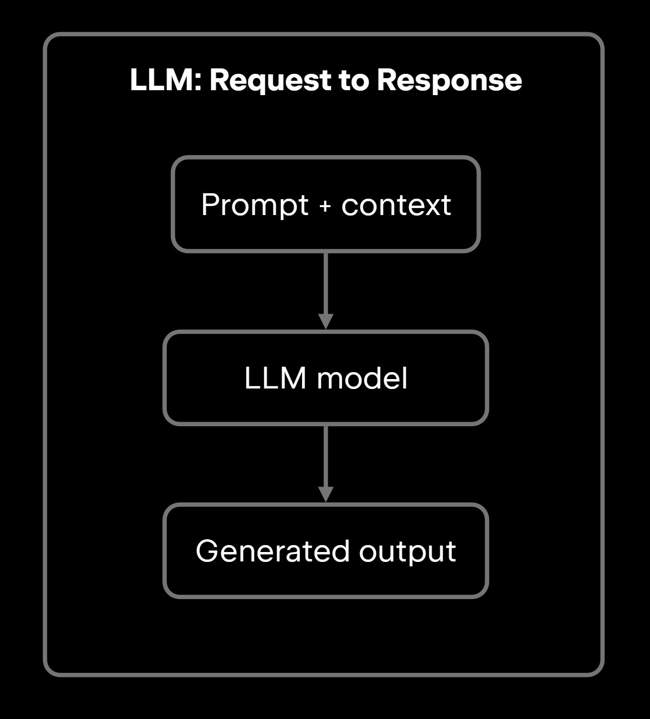
4. From LLM to Agents
Why Is a Single LLM Not Enough?
Outdated knowledge: training data lags behind the real world.
Hallucination: without grounding in verified facts, it can produce fluent but wrong answers.
Weak planning: one-shot reasoning is brittle on long, complex tasks, and a single model explores large search spaces inefficiently.
Limited long-context handling: it struggles to keep track of long or multi-part tasks.
No ability to act: without tools or an environment, it can only generate text.
No specialization or cross-checking: one model does everything, and nobody reviews its answer.

Slide 7

4. From LLM to Agents
Agent = entity that perceives its environment and takes action
LLM = the brain providing reasoning and planning
An LLM-based agent adds:
Profile (who am I?)
Perception (what do I see?)
Memory + knowledge (what do I know?)
Reasoning/planning (what should I do?)
Action (do it, via tools or messages)

Slide 8
5. How Multi-Agent systems work
A multi-agent system is a team of single agents + an interaction layer.
Inside every agent (single-agent parts)
Profile: role, goals, constraints
Perception: text, images, audio from the environment and other agents
Self-action: memory, knowledge/tools, reasoning and planning, action
Evolution: reflect on feedback and improve
Between agents (what makes it multi-agent)
5. Mutual interaction
  Message delivery: direct (broadcast, point-to-point) or via a shared pool
  Structure: hierarchical, centralized, decentralized, shared message pool
  Scene: cooperative, adversarial, mixed
What changes in a team
Profiles become specialized roles
Memory stays private per agent, unless shared through a message pool
Evolution can use other agents feedback as a learning signal

Slide 9
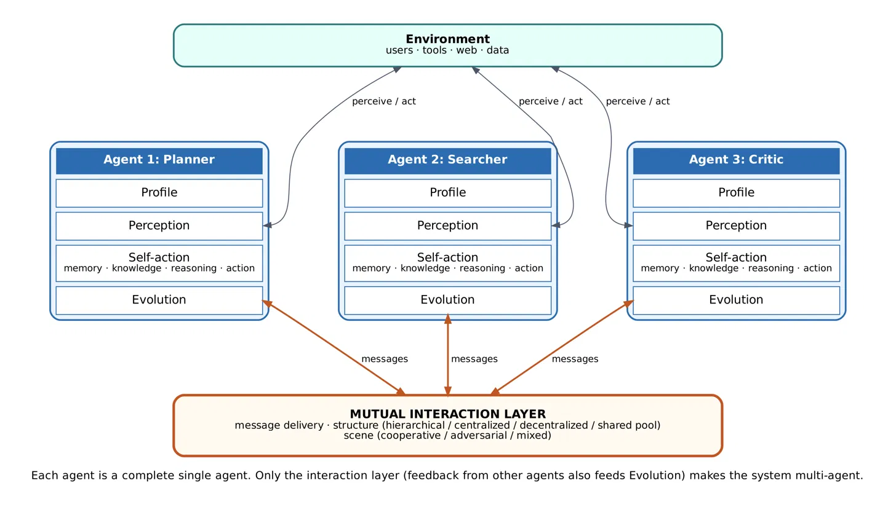
5. How Multi-Agent systems work

Slide 10
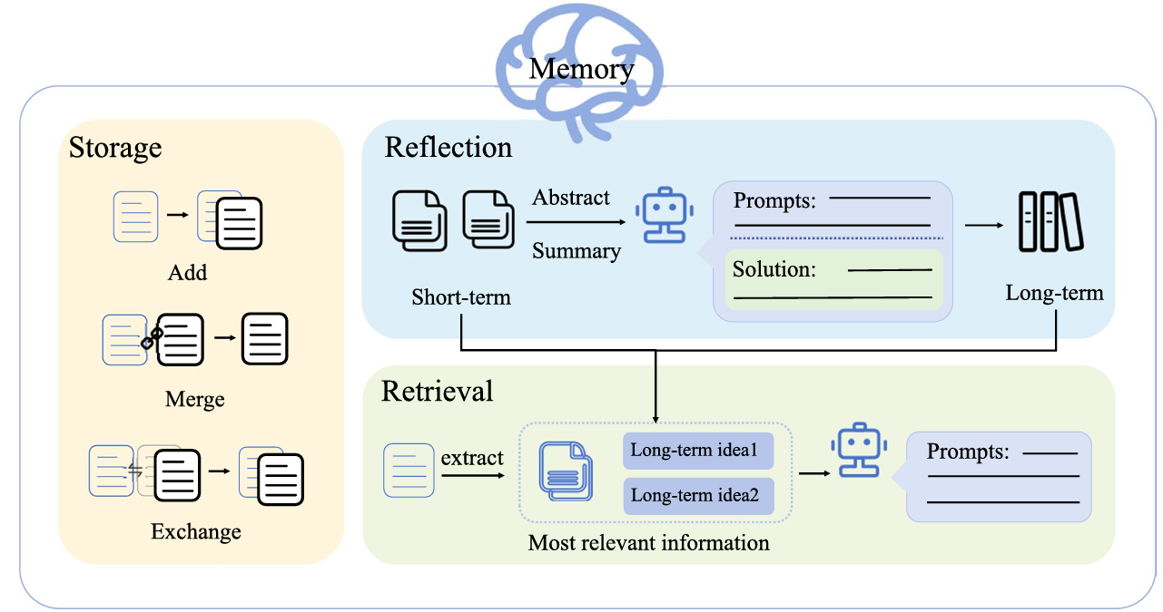
5. How Multi-Agent systems work
Memory
Short-term memory (STM): Context of current session
Long-term Memory (LTM): Knowledge or data over time
  Episodic Memory: Specific events and experiences
  Semantic Memory: Facts and world knowledge
  Procedural Memory: Rule based data for immediate tasks.

Slide 11
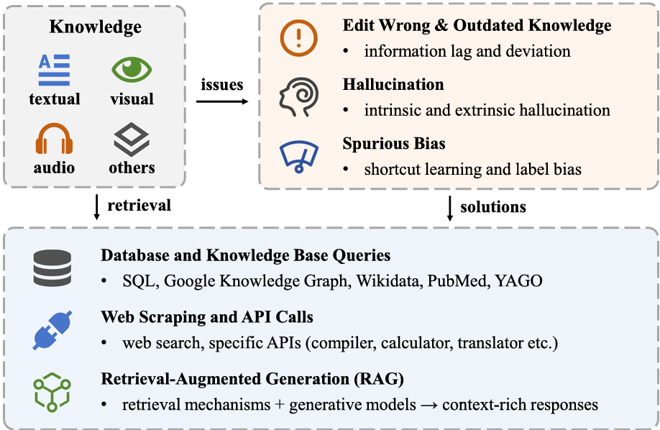
5. How Multi-Agent systems work
Knowledge and tools

Slide 12
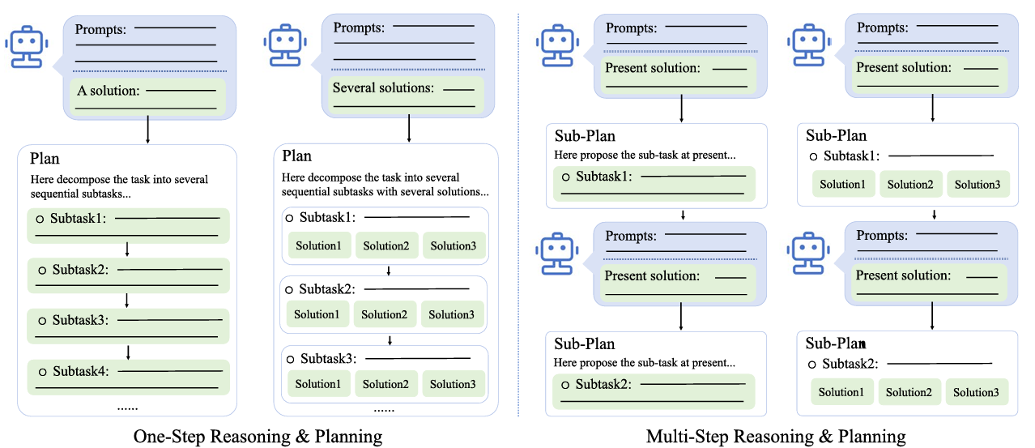
5. How Multi-Agent systems work
Reasoning and planning

Slide 13
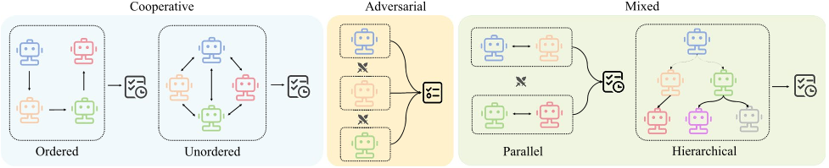
5. How Multi-Agent systems work
How Agents Coordinate
Interaction structures
Hierarchical: manager agents direct subordinates
Centralized: a central agent orchestrates all others
Decentralized: peer-to-peer
Shared message pool: agents publish and subscribe
Interaction Patterns and Collaboration

Slide 14
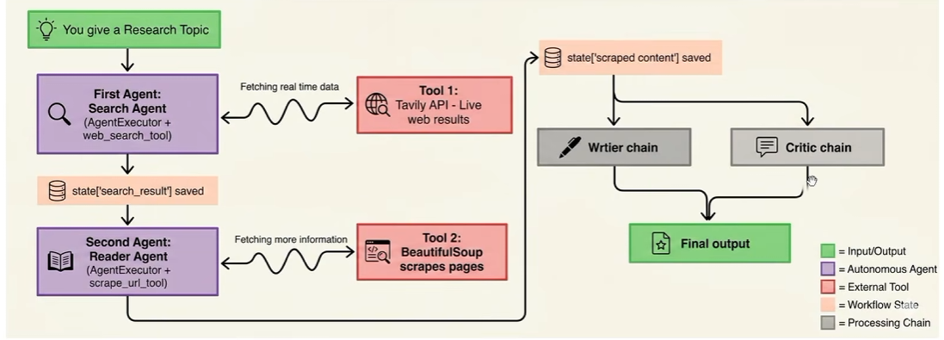
6. Case Study
An Autonomous Research Assistant
Role | Type | Job
Search Agent | Agent (tools: web search, scrape) | Finds sources for the topic
Reader Agent | Agent (tool: scrape) | Reads the pages and summarizes them
Writer | LLM chain | Writes the 7-section report from the research
Critic | LLM chain | Scores the report /10 and gives feedback and a verdict

Slide 15
6. Case Study
Workflow
Topic → Search Agent → Reader Agent → Writer → Critic → Report + score
Profile: four fixed system prompts.
Perception: the topic, search results and scraped page text.
Self-action: the two agents choose and call tools. The writer and critic only generate text.
Mutual interaction: a cooperative, ordered pipeline where each output is passed as text to the next step. It is centralized because the script controls the flow.
Evolution: none yet. The critic’s verdict isn’t fed back.

Slide 16
7. Applications and Challenges
Applications
Software Engineering
Robotics, Embodied AI & Interactive Gaming
Scientific Discovery, Research & Synthesis
Economics, Finance & Recommender Systems
Industrial Operations & Societal Simulations
Challenges
LLM intrinsic constraints
  Black box: hard to explain or assess decisions
  Hallucination: one agent's error can propagate to the others
  Bias: inherited from training data
Misuse: disinformation, cyber-attacks
Scaling up: compute, communication cost, coordination
Dynamic environment adaptation: multi-modal and changing conditions

Slide 17
Conclusion
A single LLM is limited; teams of specialized agents extend what is possible
Five modules describe any LLM-MAS:
Profile → Perception → Self-action → Interaction → Evolution
Coordination structure and interaction style (cooperative, adversarial, mixed) shape system behaviour
The field is young: collective intelligence and AaaS are the next frontier

Slide 18
References
[1] Li, X., Wang, S., Zeng, S., Wu, Y., & Yang, Y. (2024). A survey on LLM-based multi-agent systems: workflow, infrastructure, and challenges. Vicinagearth, 1, Artikel 00009-2. https://doi.org/10.1007/s44336-024-00009-2
[2] Guo, T., Chen, X., Wang, Y., Chang, R., Pei, S., Chawla, N. V., Wiest, O., & Zhang, X. (2024). Large language model based multi-agents: A survey of progress and challenges. In Proceedings of the Thirty-Third International Joint Conference on Artificial Intelligence (IJCAI-24) (pp. 8048–8057). https://doi.org/10.24963/ijcai.2024/890

Slide 19
            Queries
            &
            Suggestions

Slide 20
            THANK YOU…

