Slide 1
Deep Learning
Mahendra Suthar
16501A1249

Slide 2
What is it ?
Deep learning is a sub-field of machine learning dealing with algorithms inspired by the structure and function of the brain called artificial neural networks

Slide 3
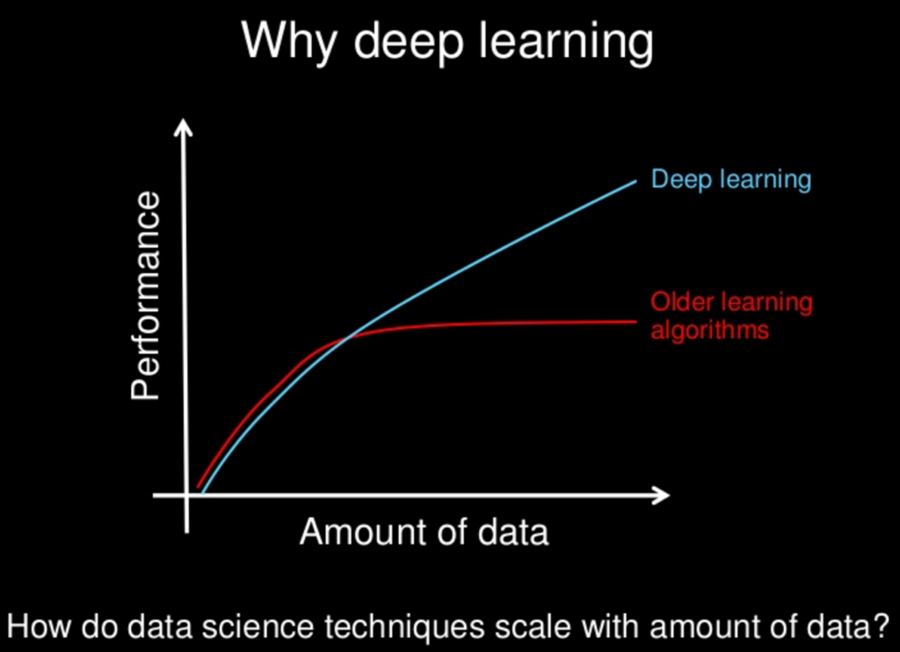
Why Deep learning ?

Slide 4
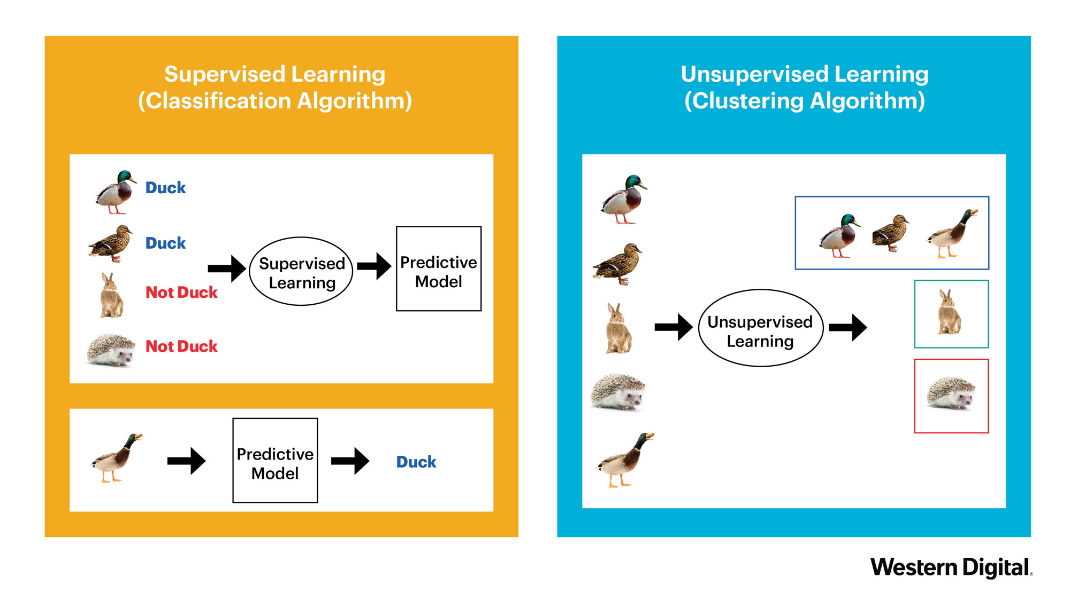
Supervised vs unsupervised learning

Slide 5
How does deep learning attain such impressive results?
Labelled Data
computing power

Slide 6
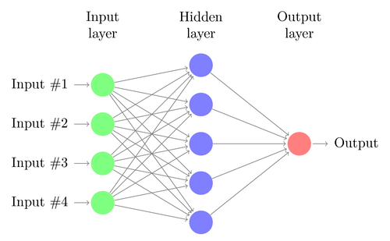
How Does it work ?
A simple neural network
Each node represents a neuron

Slide 7
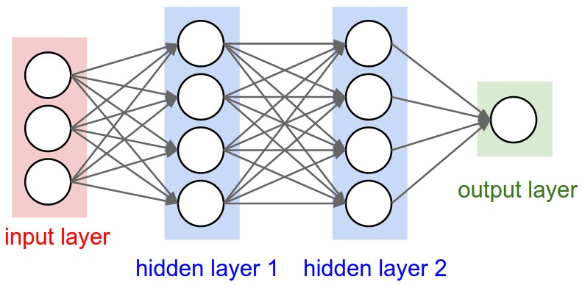
A neural netwrok with 2 hidden layers

Slide 8
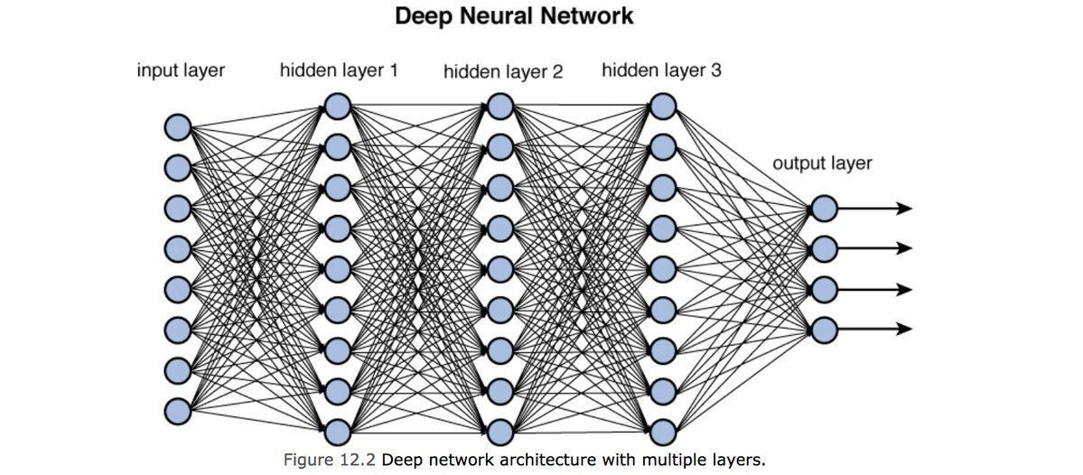

Slide 9
Connections Types
Feed forward neural network
Back propagation neural network

Slide 10
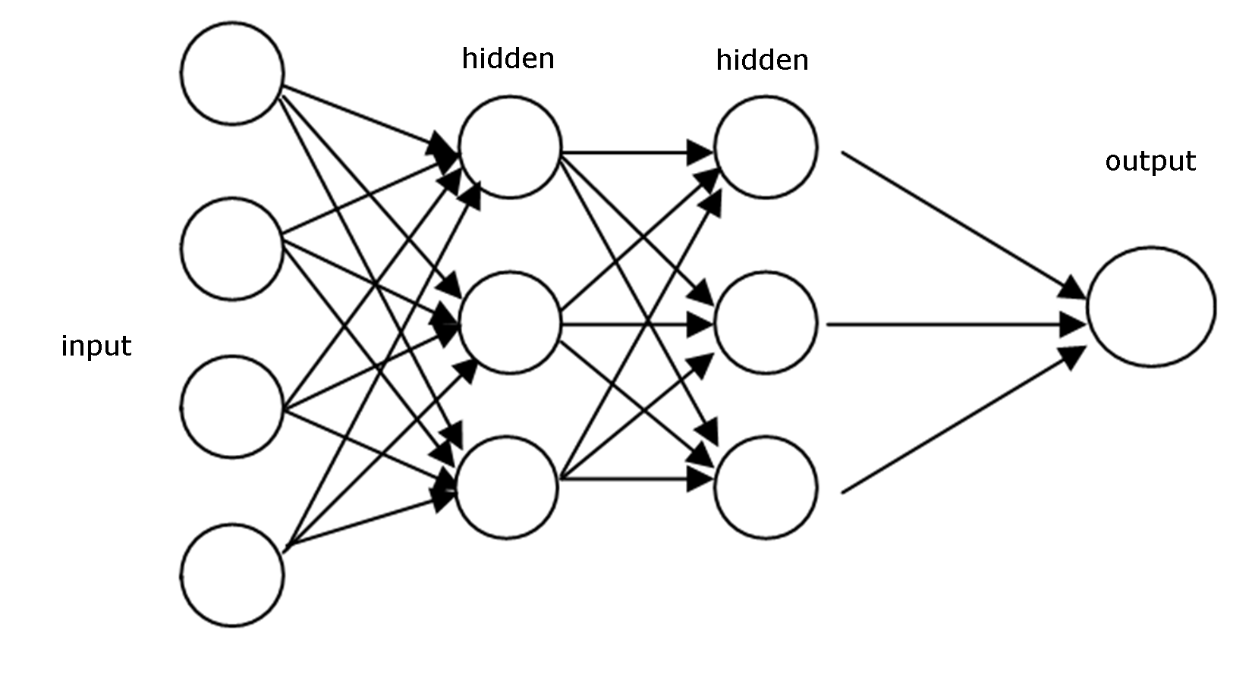
Feed forward neural network
By propagating values from the first layer (the input layer) through all the mathematical functions represented by each node, the network outputs a value. This process is called a forward pass.

Slide 11
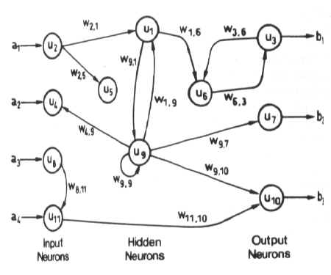
Backpropagation neural network
Feedback networks can have signals travelling in both directions by introducing loops in the network.
Feedback networks are very powerful and can get extremely complicated.
Feedback networks are dynamic

Slide 12
Convolutional Neural Network
A convolutional neural network (CNN or ConvNet) is one of the most popular algorithms for deep learning, a type of machine learning in which a model learns to perform classification tasks directly from images, video, text, or sound.
CNNs are particularly useful for finding patterns in images to recognize objects, faces, and scenes.

Slide 13
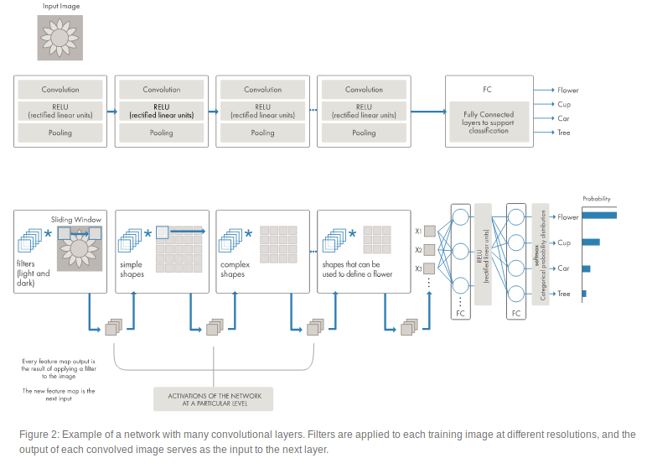
Convolutional Neural Networks (CNN or ConvNet).

Slide 14
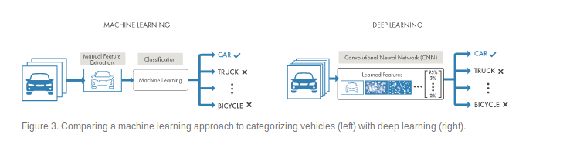
Difference between Deep learning and Machine learning
A machine learning workflow starts with relevant features being manually extracted from images. The features are then used to create a model that categorizes the objects in the image. With a deep learning workflow, relevant features are automatically extracted from images.

Slide 15
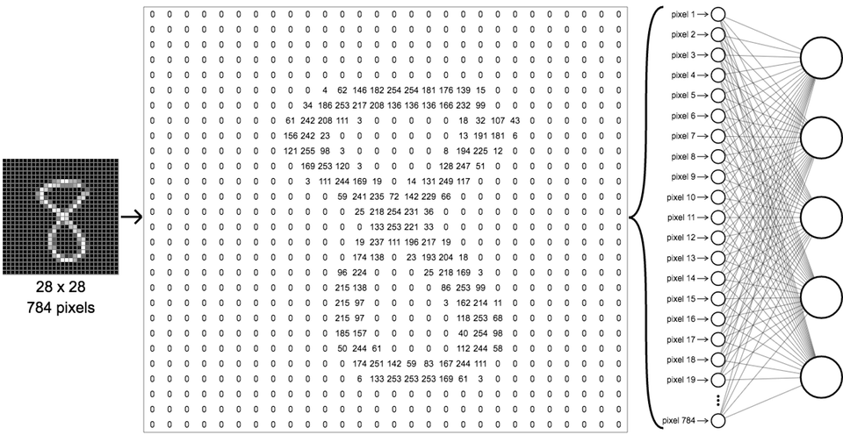

Slide 16
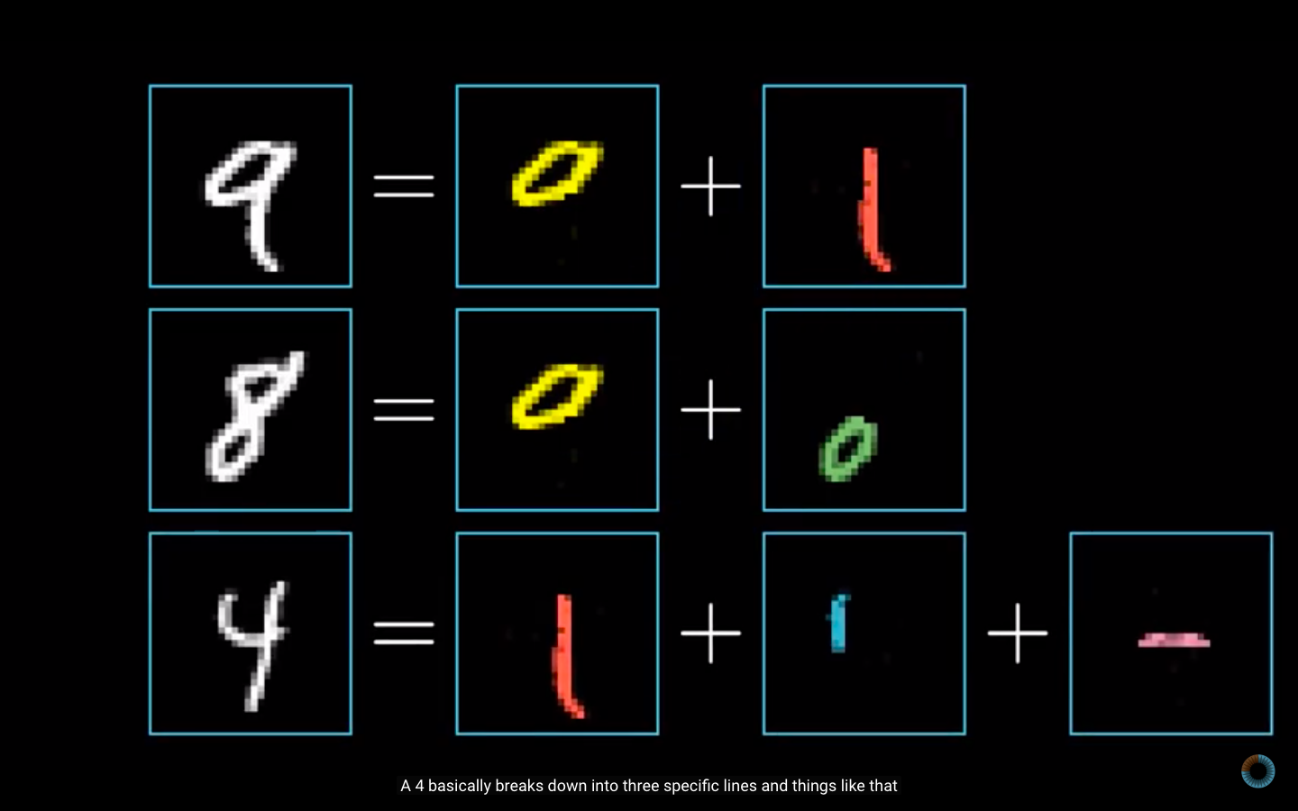

Slide 17
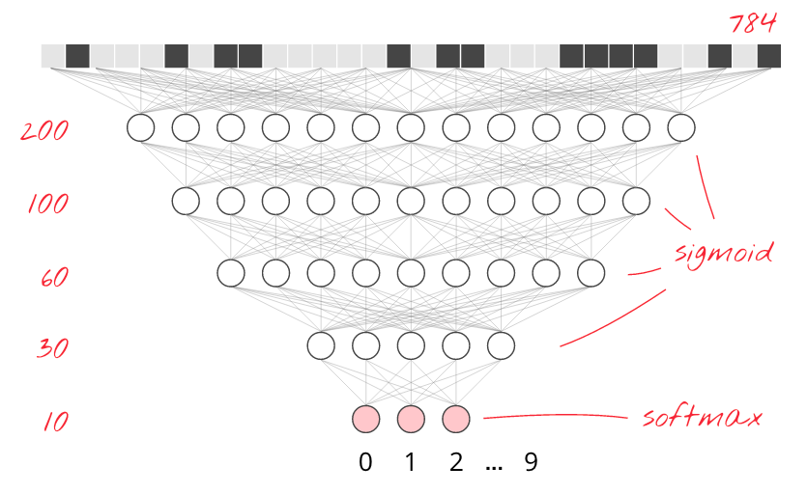

Slide 18
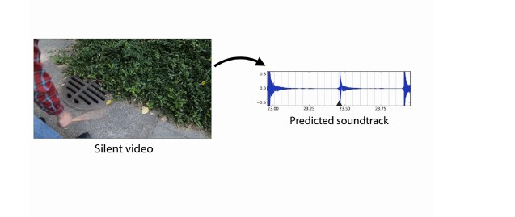
Applications

Slide 19
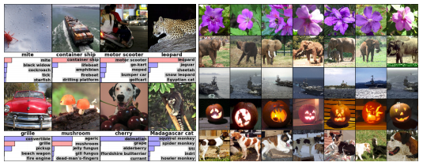
Object Classification and Detection in Photographs

Slide 20
Automated Driving
Aerospace and Defense
Medical Research
Industrial Automation
Electronics

Slide 21
Contents
What is it ?
Why now ?
Supervised vs unsupervised learning
How Deep Learning Works ?
Convolutional Neural Networks
Machine learning vs Deep learning
Applications

Slide 22
References
https://in.mathworks.com/solutions/deep-learning.html
https://medium.com/intro-to-artificial-intelligence/deep-learning-series-1-intro-to-deep-learning-abb1780ee20
https://en.wikipedia.org/wiki/Deep_learning

Slide 23
