Slide 1
INVESTMENT ASSIGNMENT SUBMISSION
Name: Varun Kotian

Slide 2
Spark Funds Investment Analysis
Spark Funds is an asset management company.
Objective:
Spark Funds wants to invest into companies, looking at the current global trends in investor funding.
Strategy:
The investments should be focused where majority of investors are investing.
Data:
The data is sourced from crunchbase.
I have carried out the task to mention in details the potential investment areas, where the investments will proliferate.Taking into conisderations the constraints laid out by the CEO.

Slide 3
Problem Solving Methodology
Load the Data Files in Python
Cleaning the data with encoding and deleting
Merge the two csv files
Finding the right funding type
Investing amount between 5 and 15 Mn
Filtering the data according to the constraints
Sort the data according to 8 main sectors
Merge the data to include top9 and mapping data
Create a dataframe to include top 9 countries with raised amount and selected FT
Create 3 dataframes to include top 3 English speaking countries
Do the sector analysis of top 3English speaking countries
Plot the graphs

Slide 4
Step1 : Data Handling
Importing the Companies and rounds2 csv files and perform the necessary data cleaning and encoding.
Merging the two data frame
Fixing the null values wherever necessary
Dropping the column which wont help in further analysis.
Step 2: Funding Analysis
1. Create a master data frame which includes the four funding type i.e (venture, angel, seed, private equity).
2. Sorting the funding type according to the total amount raised.
3. Picking out the highest funding type, we can see that venture has received the highest investment.
4. From the above data I found that the venture lies within the constraints provided that Spark Funs wants to invest between 5 -15 Million.

Slide 5
Step 3: Country Analysis
Create a new dataframe which includes the top 9 countries according to the size of investments.
Filter the dataframe to include data which has funding type has venture only.
Now we can sort the countries according to the raised amount by the companies, and we can see clearly the top countries leading by USA.
Step 4 : Sector Analysis
Filter the top9 data frame to include only the top 9 countries found earlier.
Merge the top9 and mapping data frame
Creating a main sector using mapping data which when merged will display the sector and relevant main sector it belongs to.

Slide 6
Step 5: Sector Analysis II
Include the data which falls between 5 – 15 Million raised amount, as it is a necessary constraint laid by the CEO.
Clean and drop unnecessary columns which wont help in finding the analysis of top three English speaking countries.
Creating 3 data frames D1, D2, D3 to include Unites States of America, Great Britain and India respectively.
We can now find the top performing sectors according to the country, find the raised amount in each main sector and help us in investing easier once we sort the data according to top 3 sectors and the number of investments.
Now we can find the individual companies which fit our criteria.

Slide 7
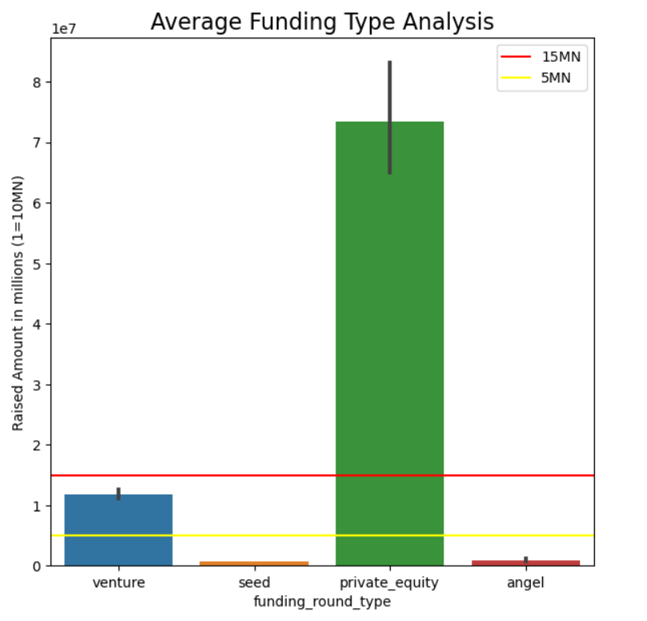
Appropriate Funding Type for Spark Fund

Slide 8
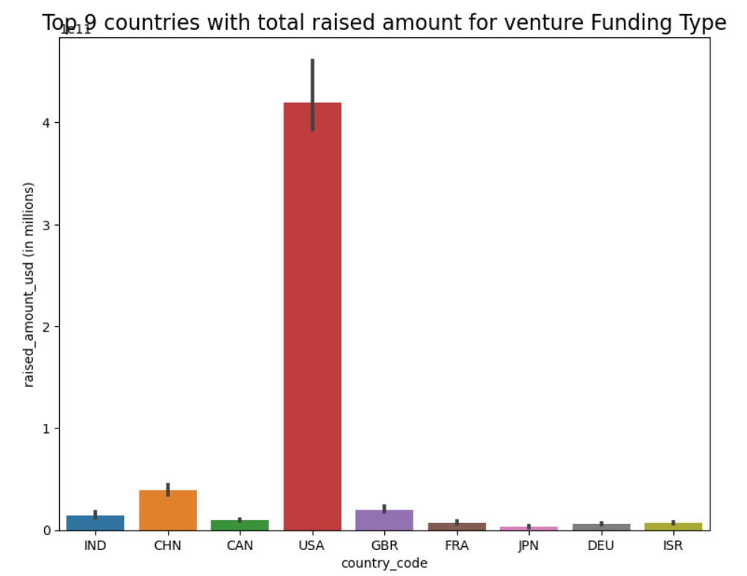
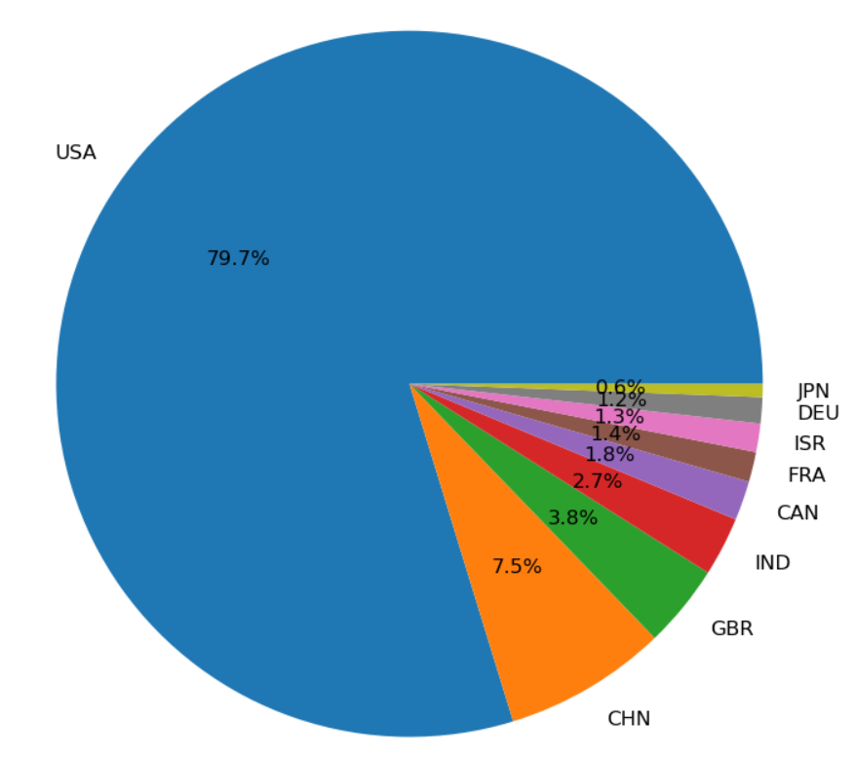
Top 9 Countries with total raised amounts for venture funding type

Slide 9
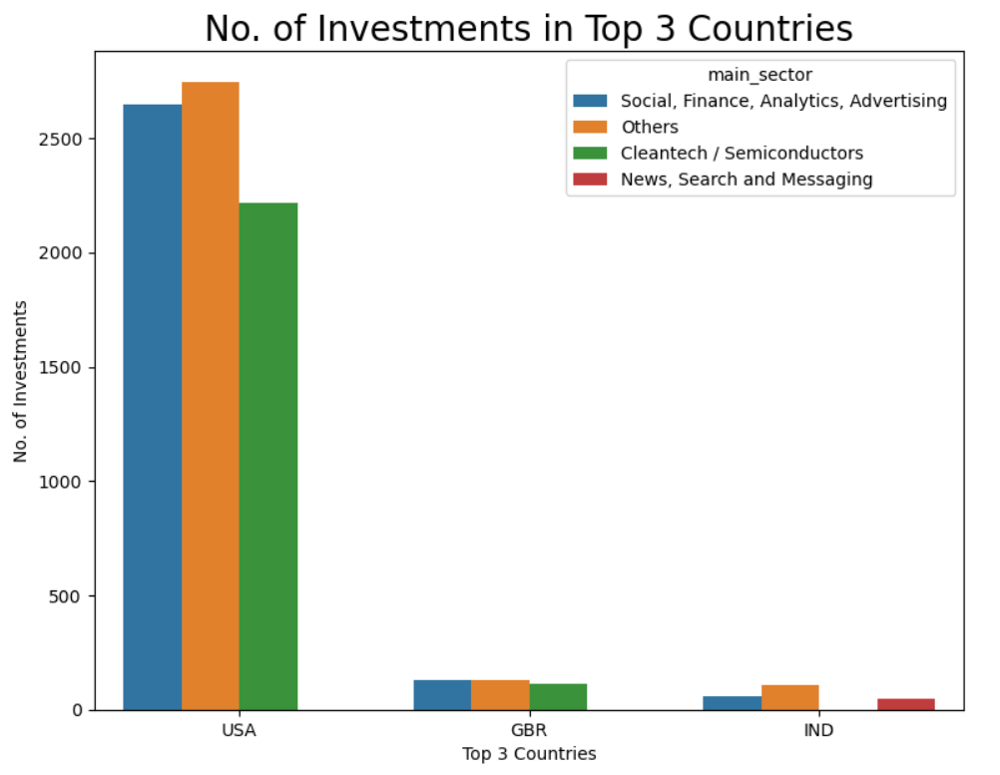
Top 3 Countries Analysis with respect to their Sectors

Slide 10
Conclusion
After going through the raw data and analyszing it we have come to our conclusion.
Spark Fund should invest in ‘Venture’ Funding Type, as it meets the criteria set by the CEO.
The top 3 English speaking countries with respective to the raised amount of investments are USA, GBR, IND.
Top 3 performing sectors as per the countries
Country | USA | GBR | IND
1st Sector | Others | Others | Others
2nd Sector | Social,Fiannce,Analytics,Advertising | Social,Fiannce,Analytics,Advertising | Social,Fiannce,Analytics,Advertising
3rd Sector | Cleantech/Semiconductors | Cleantech/Semiconductors | News, Search and Messaging

