Slide 1
Classification
Summer 2024
© IIT Roorkee India

Slide 2
Univariate
Explaining the past
Exploration
Linear classifiers (e.g. Logistic Regression)
Non-linear classifiers (e.g.
K-Nearest Neighbors)
Support Vector Machines
Neural Networks
Bivariate
Classification algorithms
Data Analytics
Training, testing and validation datasets
Metrics for evaluating classification models
Classification
Model Selection and Evaluation
Handling Imbalanced Datasets
- Strategies for handling imbalanced datasets (undersampling, oversampling, class weighting)
Predicting the future
Modeling
Regression
Clustering
2

Slide 3
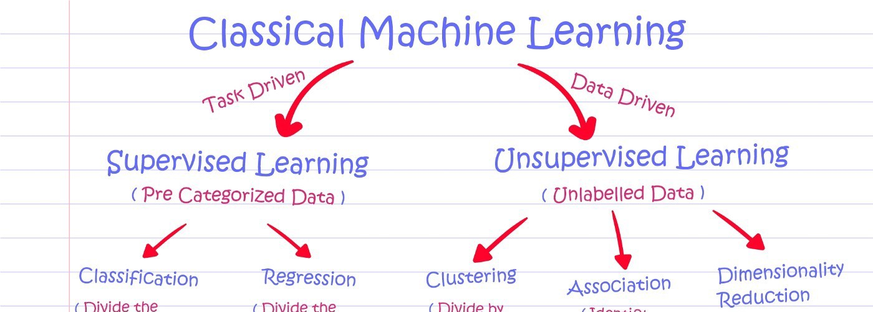
Output:
A category
A real-value
patterns
identify associations between different data objects
identify wider dependencies
within a group of uncategorized data
Objective:
Predictive analysis
Pattern recognition

Slide 4
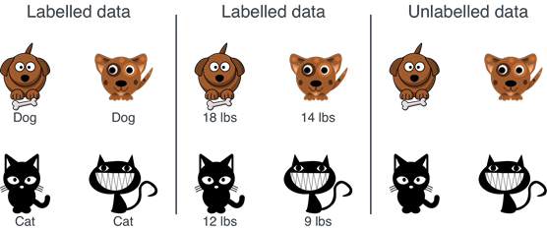
Labeled vs Unlabeled data

Slide 5
Introduction to Classification

Slide 6
What?
Classification is a fundamental concept in the field of machine learning
It involves identifying the category or class to which a new observation belongs based on a set of labeled training data.
It is a supervised learning technique that is used to categorize or label a set of data into different classes or categories.

Slide 7
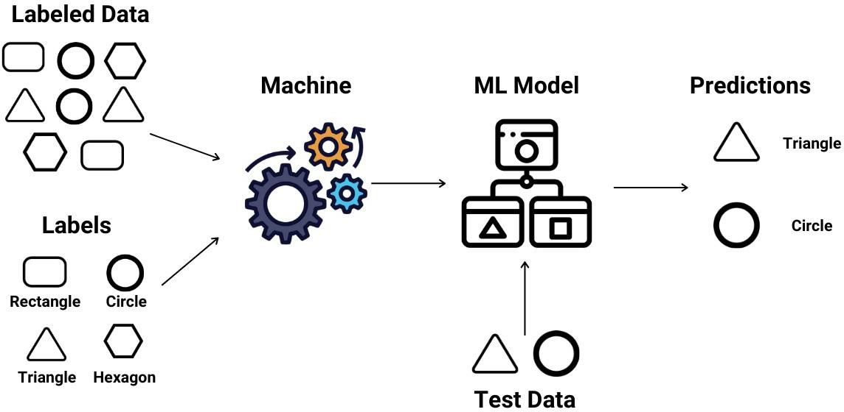

Slide 8
Types of classification
Binary Classification: predicting one of two possible outcomes, typically represented by 1 and 0,True and False, or Positive and Negative.
− For example, classifying an email as spam or not spam, or diagnosing a patient as having a disease or not.
Multiclass Classification: predicting one of more than two possible outcomes.
− For example, classifying an object as a car, bicycle, or motorcycle, or recognizing different types of fruits.
Multilabel Classification: predicting one or more outcomes for each sample. In other words, each sample can belong to multiple categories or classes at the same time.
− For example, classifying a movie as belonging to multiple genres such as action, comedy, and drama.

Slide 9
Real-world applications of classification
− Image classification: recognizing objects or people in images and categorizing them into specific classes
− Spam filtering: classifying emails as spam or not spam
− Medical diagnosis: diagnosing diseases based on symptoms and test results
− Credit risk assessment: predicting the likelihood of a loan default based on various factors such as credit history, income, and job stability

Slide 10
Real-world applications of classification
− Sentiment analysis: classifying the sentiment of a piece of text as positive, negative, or neutral
− Customer segmentation: dividing customers into different groups based on their purchasing behavior and demographics
− Fraud detection: identifying fraudulent transactions in financial systems
− Marketing: classifying customers based on their likelihood to respond to a marketing campaign, or to purchase a certain product or service.

Slide 11
Basic Terminology

Slide 12
Feature and Target Variables
Feature variables: (also called predictors, inputs, or attributes) are the variables used to describe an instance (such as an individual, item, or event).
− These features are used to build a model that makes predictions about the target variable (also called response, label, or output).
Target variable: is the variable that we want to predict based on the feature variables.
− In a classification problem, the target variable is categorical (e.g.Yes/No, A/B/C), while in regression problems the target variable is continuous (e.g. age, salary, height).

Slide 13
Examples
In a housing price prediction dataset, the feature variables could be the number of bedrooms, square footage, neighborhood, and so on, while the target variable would be the price of the house.
In a medical diagnosis dataset, the feature variables could be patient symptoms, medical history, and test results, while the target variable would be the diagnosis (e.g. flu, pneumonia, etc.).

Slide 14
Model Training
This is the process of building a machine learning model using a training dataset.
The model is trained to learn the relationship between the features (input variables) and the target variable.
This process involves selecting an appropriate algorithm, defining the hyperparameters, and fitting the model to the training data.

Slide 15
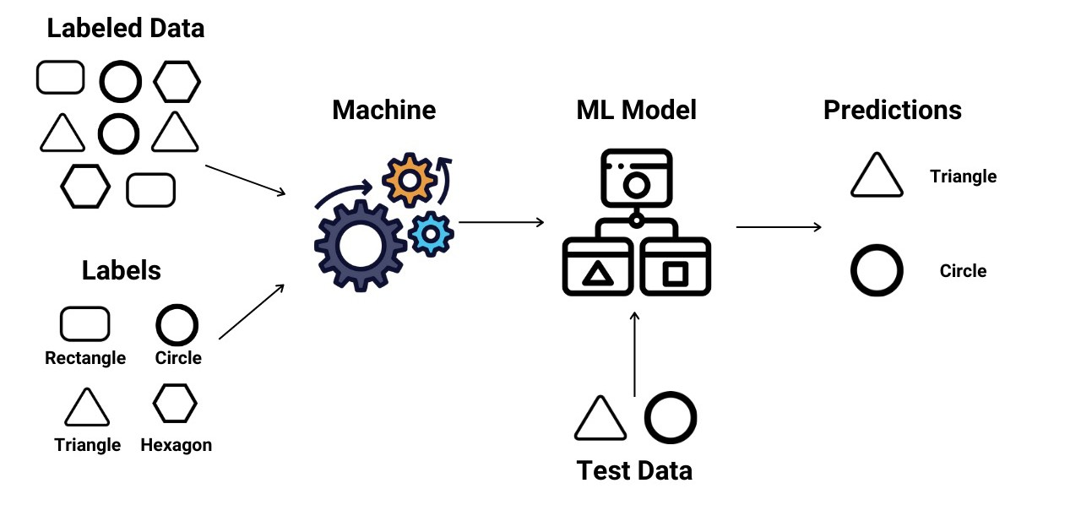
Prediction
Once the model is trained, it can be used to make predictions on new, unseen data.
During prediction, the feature values are input into the model, and the target variable is predicted based on the learned relationship.

Slide 16
Overfitting and Underfitting
Overfitting and underfitting are two common issues faced while training machine learning models.
Overfitting occurs when a model is trained too well on the training data and fits the noise in the data instead of the underlying pattern.
As a result, it performs well on the training data but poorly on the unseen data or validation data.
Overfitting can be identified by having a high accuracy on the training data but a low accuracy on the validation data.

Slide 17
Overfitting and Underfitting
Underfitting, on the other hand, occurs when a model is not complex enough to capture the underlying pattern in the data. It results in a low accuracy on both the training and validation data.
It is important to strike a balance between overfitting and underfitting to build an effective model.

Slide 18
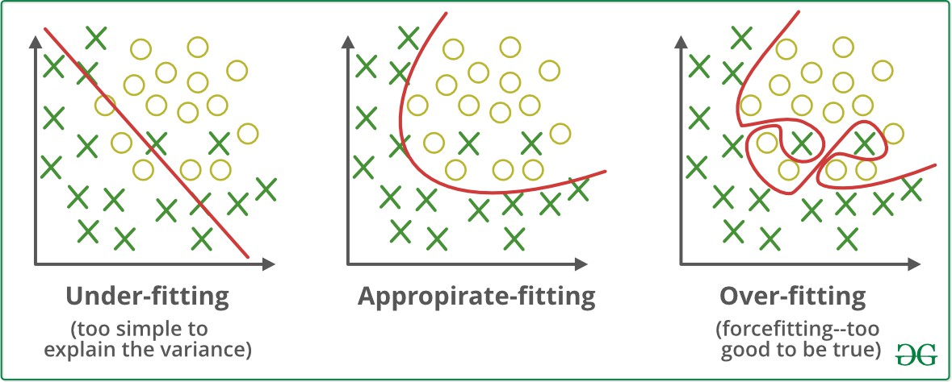
Overfitting and Underfitting

Slide 19
Bias and Variance
Bias and variance are two important concepts in machine learning that describe the error in a model's predictions.
Bias refers to the error that is introduced by assuming that the relationship between the features and target is too simple.
A model with high bias pays little attention to the training data and oversimplifies the relationship between the features and target.
As a result, it often has a high training error and a high test error.

Slide 20
Bias and Variance
Variance, on the other hand, refers to the error that is introduced by the model being too complex and fitting the training data too closely.
A model with high variance pays too much attention to the training data and overfits it, capturing the noise in the data as well as the underlying relationship.
As a result, it has a low training error but a high test error.
The goal in building a machine learning model is to find a balance between bias and variance to minimize the total error.This is often referred to as the bias-variance trade-off.

Slide 21
Classification Algorithms

Slide 22
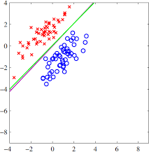
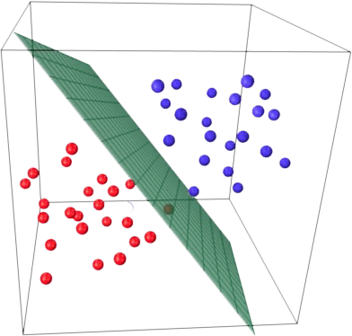
Linear classifiers
A linear classifier is a machine learning algorithm that uses a linear function to separate data into different classes.
The goal of a linear classifier is to find the hyperplane (a line or a plane in high-dimensional space) that best separates the data into their respective classes.
The hyperplane is defined by a set of coefficients that
are estimated during the training phase.

Slide 23
Linear classifiers
Examples of linear classifiers include
Logistic Regression,
Support Vector Machines (SVM) with linear kernels, and
Linear Discriminant Analysis (LDA).
These algorithms make predictions based on the values of the features and the coefficients of the hyperplane, which are used to determine the class of an observation.

Slide 24
Logistic Regression: Definition
Logistic Regression is a popular supervised machine learning algorithm used for binary classification problems.
In logistic regression, the target variable is binary and the prediction is made based on the relationship between the independent (or feature) variables and the dependent (or target) variable.
The main objective of logistic regression is to find the best fitting model (i.e., a line or hyperplane) that separates the classes in the feature space.

Slide 25
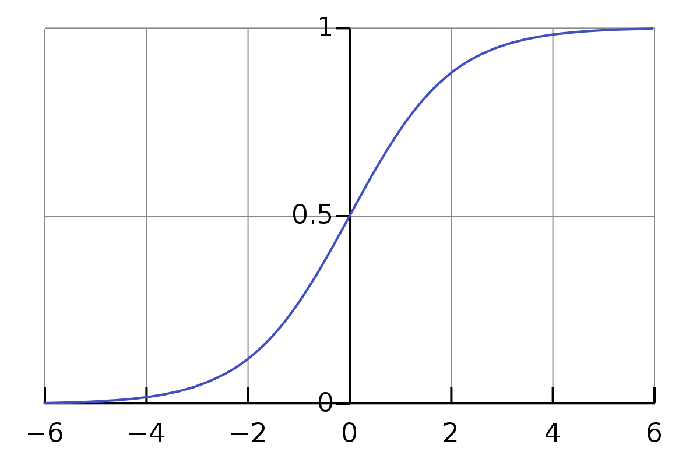

Logistic Regression: How it works
The algorithm works by modeling the probability of an event occurring (e.g., a customer buying a product) using a sigmoid function (the logistic function).
The output of the logistic regression model is a probability score between 0 and 1, which can then be used to make a binary classification.

Slide 26
Logistic Regression: How it works
x is a linear combination of one or more features in the dataset.
f(x) is a probability between 0 and 1.
For example, if the output of the function is above 0.5, the output is considered as 1. On the other hand, if the output is less than 0.5, the output is classified as 0.

Slide 27
Model Selection and Evaluation

Slide 28
Training,Training and Validation datasets
Training, testing, and validation datasets are used in the process of developing and evaluating a machine learning model.
1.Training dataset:This dataset is used to train the machine learning model.
− The model is trained by fitting the model to the training data.The model learns the patterns in the data and uses them to make predictions.

Slide 29
Training,Training and Validation datasets
2.Testing dataset:This dataset is used to evaluate the performance of the machine learning model after it has been trained.
− The model is presented with new, unseen data and it makes predictions based on what it has learned from the training data.
− The accuracy of these predictions is then used to evaluate the performance of the model.

Slide 30
Testing,Training and Validation datasets
3.Validation dataset:This dataset is used to tune the hyperparameters of the machine learning model.
− The model is trained on the training data and then evaluated on the validation data.
− The hyperparameters are adjusted based on the performance of the model on the validation data.
− This helps to prevent overfitting of the model to the training data.

Slide 31
Metrics for evaluating classification models
Classification models can be evaluated using a variety of metrics, depending on the specific use case and requirements.
Some of the most used metrics are:
Accuracy
Confusion matrix
Precision
Recall
F1 score
ROC curve (Receiver Operating Characteristic)
AUC (Area Under the Curve)

Slide 32
Accuracy
Ratio of correct predictions made by a classifier to the total number of predictions made
_{Accuracy =} Number of correct predictions
Total number of predictions

Slide 33
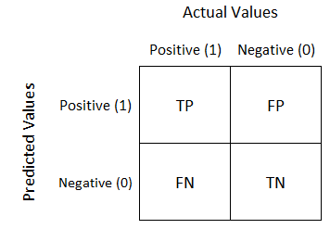
Confusion Matrix
A 2-D table that shows the number of true positive, true negative, false positive, and false negative predictions made by the model.
The entries in the matrix can then be used to calculate various performance metrics, such as precision, recall, F1-score, and AUC for the ROC curve.

Slide 34
Precision
the number of true positive predictions (i.e. positive predictions that are actually correct) divided by the total number of positive predictions made by the model.
_{Precision =} True Positives True Positives + False Positives

Slide 35
Recall
The proportion of actual positive instances that are correctly classified as positive by the model.
Also called TPR (True Positive Rate) or Sensitivity.
_{Recall =} True Positives True Positives + False Negatives

Slide 36
F1 score
A metric that combines precision and recall. It is calculated as the harmonic mean of precision and recall.
_{F1-score =} 2 * (Precision * Recall)
Precision + Recall
The F1 Score ranges between 0 and 1, with 1 being the best possible score and 0 the worst.

Slide 37
ROC curve
A graphical representation of the performance of a binary classification model as the discrimination threshold (probability threshold) is varied.
It plots the true positive rate (TPR) against the false positive rate (FPR) at various threshold settings.
The ROC curve is a useful tool for evaluating the trade-off between the true positive rate and the false positive rate of a classifier.

Slide 38
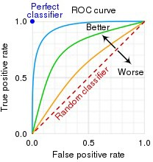
ROC curve
FPR = FP / (FP + TN)
i.e. probability of false alarm
TPR = TP / (TP + FN)
i.e. probability of detection

Slide 39
AUC
The interpretation of the ROC curve is based on the Area Under the Curve (AUC), which summarizes the overall performance of the model.
An AUC of 1 indicates a perfect model, while an AUC of 0.5 represents a random model.
A higher AUC value indicates a better performance, with a larger area under the curve meaning a greater balance between TPR and FPR.

Slide 40
Demo: Logistic Regression

