Slide 1
Classification
Summer 2024
© IIT Roorkee India

Slide 2
Support Vector machine (SVM)

Slide 3
Support Vector Machine Algorithm
Most popular Supervised Learning algorithms, which is used for Classification as well as Regression problems.
Goal: To create the best line or decision boundary that can segregate n-dimensional space into classes so that we can easily put the new data point in the correct category in the future. This best decision boundary is called a hyperplane.
SVM chooses the extreme points/vectors that help in creating the hyperplane.
These extreme cases are called as support vectors, and hence algorithm is termed as Support Vector Machine.

Slide 4
SVM
SVM finds a hyperplane that segregates the labeled dataset (supervised machine learning) into two classes
To choose the right hyperplane we need margin.
Margin is the distance between the hyperplane and the closest point from either set.

Slide 5
Hyperplane and Support Vectors
Hyperplane: There can be multiple lines/decision boundaries to segregate the classes in n-dimensional space, but we need to find out the best decision boundary that helps to classify the data points. This best boundary is known as the hyperplane of SVM.
The dimensions of the hyperplane depend on the features present in the dataset, which means if there are 2 features then hyperplane will be a straight line. And if there are 3 features, then hyperplane will be a 2-dimension plane.
We always create a hyperplane that has a maximum margin, which means the maximum distance between the data points.
Support Vectors: The data points or vectors that are the closest to the hyperplane and which affect the position of the hyperplane are termed as Support Vector. Since these vectors support the hyperplane, hence called a Support vector.

Slide 6
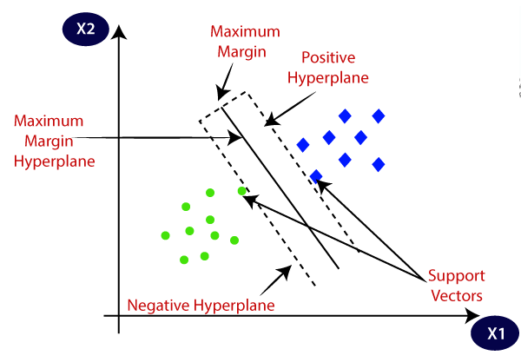
Two different categories that are classified using a decision boundary or hyperplane:

Slide 7
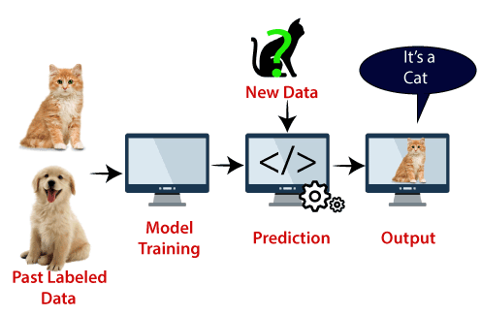
Example:
support vector creates a decision boundary between these two data (cat and dog) and choose extreme cases (support vectors), it will see the extreme case of cat and dog. On the basis of the support vectors, it will classify it as a cat.
Other applications: Face detection, image classification, text categorization, etc.

Slide 8
Types of SVM
Linear SVM: Linear SVM is used for linearly separable data, which means if a dataset can be classified into two classes by using a single straight line, then such data is termed as linearly separable data, and classifier is called as Linear SVM classifier.
Non-linear SVM: Non-Linear SVM is used for non-linearly separated data, which means if a dataset cannot be classified by using a straight line, then such data is termed as non-linear data and classifier used is called as Non-linear SVM classifier.

Slide 9
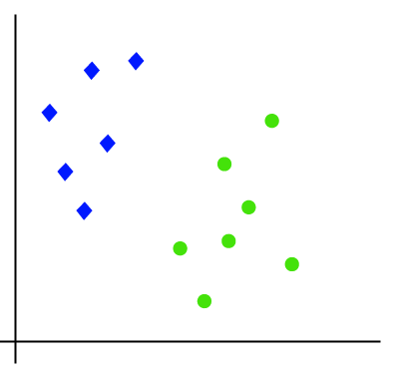
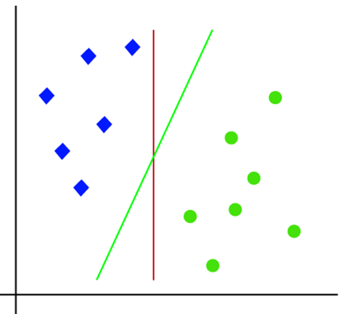
How does SVM works?
Linear SVM:
Suppose we have a dataset that has two tags (green and blue), and the dataset has two features x1 and x2.
We want a classifier that can classify the pair(x1, x2) of coordinates in either green or blue.
It is 2-d space so by just using a straight line, we can easily separate these two classes. But there can be multiple lines that can separate these classes.
Hence, the SVM algorithm helps to find the best line or decision boundary; this best boundary or region is called as a hyperplane.

Slide 10
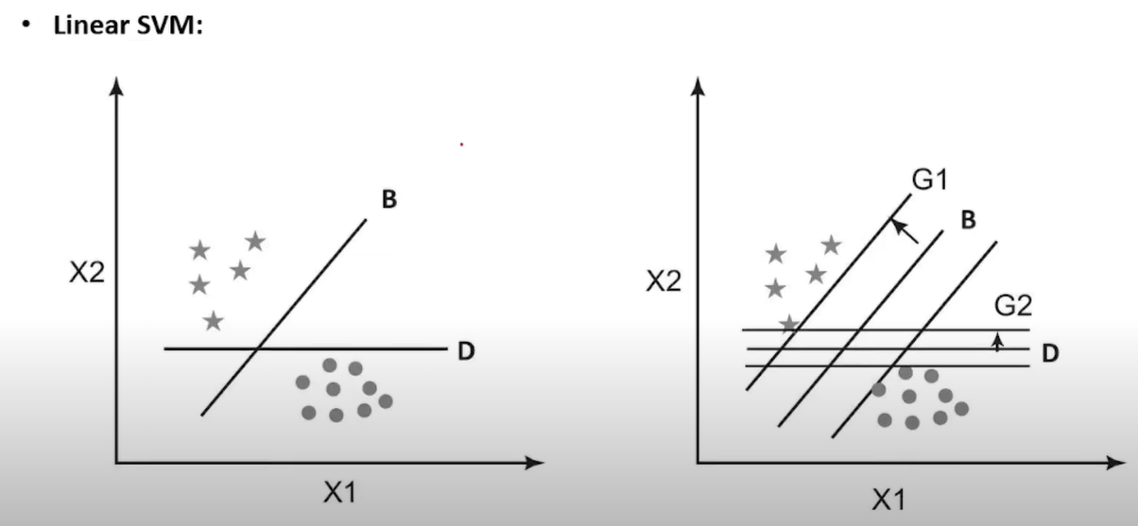

Slide 11
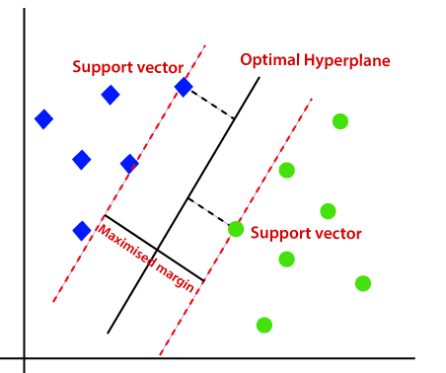
How to get best line or decision boundary?
SVM algorithm finds the closest point of the lines from both the classes. These points are called support vectors.
The distance between the vectors and the hyperplane is called as margin.
The goal of SVM is to maximize this margin. The hyperplane with maximum margin is called the optimal hyperplane.

Slide 12
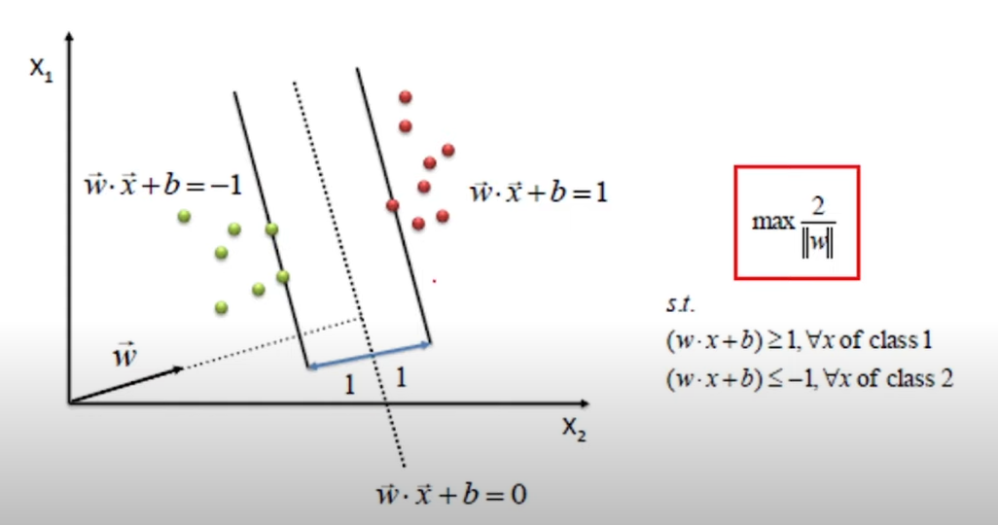
Notes:
The calculation of this particular max margin can be shown something mathematically like this. Let us assume that this is our HP and this is the first support vector and this is second SP. What actually happens over here is that for this particular HP, we will write this eq. Now when I write something like this, on this particular side, on this side, for this particular SV, we will get this eq. and for this particular SV, we will get this eq. Means if we go beyond this, one side we get less than -1 and on another side it will be greater than or equal to +1. Bc of that from here to here we get distance 1 and from here to here we will get dist. 1 for each and every support vectors. So, what we need to do over here is we need to get a hyperplane where we get the max. value for this particular condition i.e. If we get this particular max value that particular w should be considered, that we can say the final HP over here also called optimal hyperplane or HP with max margin.

Slide 13
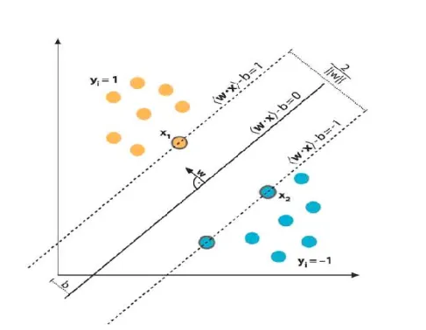
Mathematical Interpretation of Optimal Hyperplane
We have l training examples where each example x are of D dimension and each have labels of either y=+1 or y= -1 class, and our examples are linearly separable. Then, our training data is form ,

Slide 14
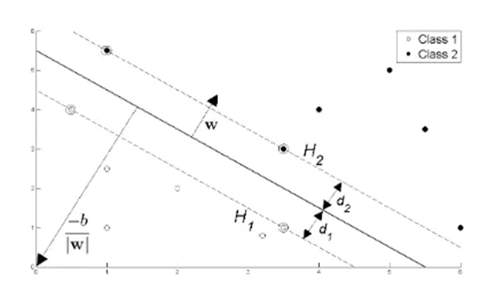
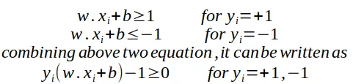
We consider D=2 to keep explanation simple and data points are linearly separable, The hyperplane w.x+b=0 can be described as :
Support vectors examples are closest to optimal
hyperplane and the aim of the SVM is to orientate
this hyperplane as far as possible from the closest
member of the both classes.
From the Fig 2, SVM problem can be formulated as,

Slide 15


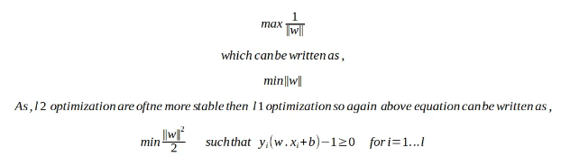
From the Fig.2 we have two hyperplane H1 and H2 passing through the support vectors of +1 and -1 class respectively. So
And distance between H1 hyperplane and origin is (-1-b)/|w| and distance between H2 hyperplane and origin is (1–b)/|w|. So, margin can be given as
Where M is nothing but twice of the margin. So, margin can be written as 1/|w|. As, optimal hyperplane maximize the margin, then the SVM objective is boiled down to fact of maximizing the term 1/|w|,

Slide 16
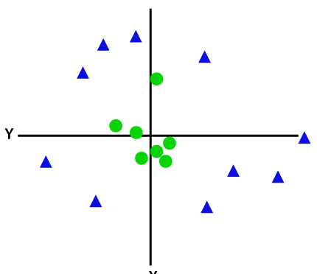
Non-Linear SVM
If data is linearly arranged, then we can separate it by using a straight line, but for non-linear data, we cannot draw a single straight line.
To separate these data points, we need to add one more dimension. For linear data, we have used two dimensions x and y, so for non-linear data, we will add a third-dimension z.
It can be calculated as:
z=x² +y²

Slide 17
kernel
The kernel trick in SVM allows us to handle complex data patterns that can’t be separated by a simple straight line. Kernels are functions that transform (or "project") data into a higher-dimensional space, where it becomes easier to find a dividing line between different classes.
Types of Kernel:
1. Linear Kernel: Draws a straight line for simpler separable data.
2. Polynomial Kernel: Adds curved boundaries for more complex, non-linear separations.
3. RBF Kernel: Adapts flexibly around data points, creating complex, non-linear boundaries suitable for highly intricate patterns.
Each kernel provides a different way of “reshaping” the data to help SVM find a clear boundary, no matter how complex the data distribution is.

Slide 18
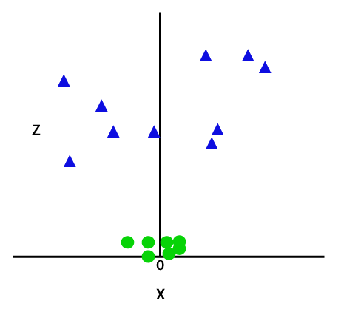
By adding the third dimension, the sample space will become as below image:

Slide 19
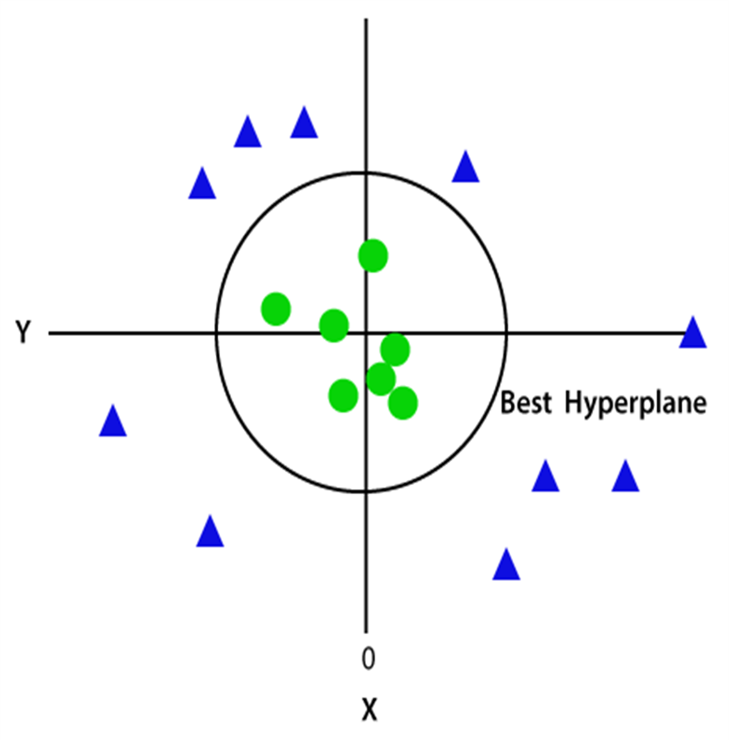
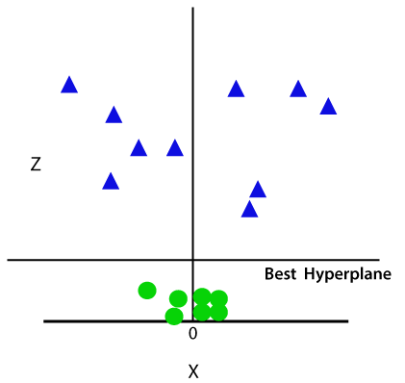
SVM will divide the datasets into classes. Since we are in 3-d Space, hence, it is looking like a plane parallel to the x-axis.
If we convert it in 2d space with z=1, then it will look like below Figure. We get a circumference of radius 1 in case of non-linear data.

Slide 20
Class Exercise
Revise Jupiter notebook from previous lecture for the dataset using SVM.
Note the change in the performance of the model for different hyperparameters.

Slide 21
Task to perform
Run SVM with default hyperparameters
Run SVM with linear kernel
Run SVM with polynomial kernel
Run SVM with sigmoid kernel
Confusion matrix
Classification metrices
ROC - AUC
Stratified k-fold Cross Validation with shuffle split
Hyperparameter optimization using GridSearch CV and RandomSearch CV

