Slide 1
AI vs Generative AI: From Analyzing the World to Creating It

Slide 2
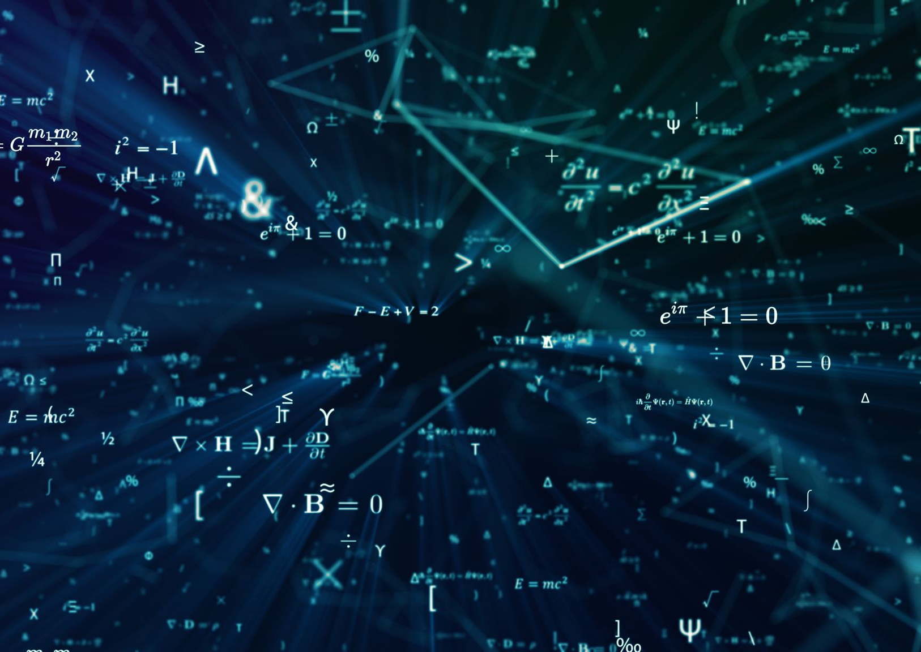
AI vs Generative AI – Setting the Stage
Traditional AI Focus
Traditional AI analyzes data, identifies patterns, and predicts outcomes based on historical information.
Generative AI Innovation
Generative AI creates new content like text, images, code, and ideas that previously did not exist.

Slide 3

Traditional AI – The Analyst
Core Functionality
Typical Applications
Reliability and Efficiency
Distinct from Human Creativity

Slide 4

Generative AI – The Creator
Creative Content Generation
Conversational and Intuitive
Enhanced Productivity and Personalization
Human Responsibility

Slide 5
Traditional AI is your expert analyst; Generative AI is your creative co-pilot.

