Slide 1

Restaurant Management System

Slide 2
Group Members
Erarica Mehra - 002113683
Jason Paul Darivemula - 002198774
Varun Venkatesh Gowda - 002126161
Manoj Amireddy - 002196218

Slide 3
Idea - Restaurant Management Application
Designed a Restaurant Management Application that supports the following features
Building an Order
Building Lunch and Dinner Menu
Notifying the kitchen and chef whenever Order is placed.
Prepping the Order
Creating the invoice
Different Modes of Payment
In house Pickup and Delivery options

Slide 4

Design patterns
Singleton Pattern
Factory Pattern
Abstract Factory Pattern
Builder Pattern
Prototype Pattern
Strategy Pattern
Command Pattern
Adapter Pattern
Decorator Pattern
Composite Pattern
Template Pattern
State Pattern

Slide 5
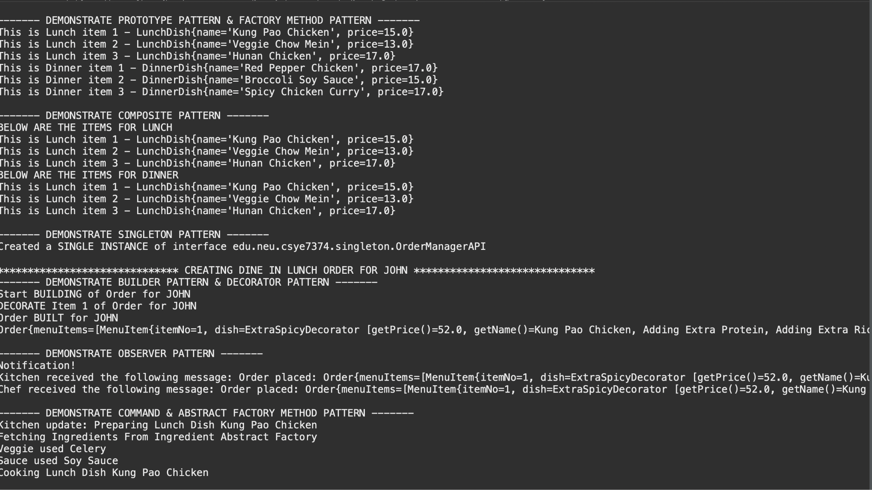
Output

Slide 6
Factories and Singleton
fesf
Used Lazy and Eager Implementations of Singleton Factories to create the following :
DishFactory : a factory interface that represents a factory for obtaining new Dish objects
Lunch Dish Factory and Dinner Dish Factory: a concrete implementations of DishFactory
Ingredient Abstract Factory : declare methods for creating different types of ingredients
Standard Ingredient Factory : a concrete implementation of Ingredient Abstract Factory and returns a set of regular ingredients
Spicy Ingredient Factory : a concrete implementation of Ingredient Abstract Factory and returns a set of spicy ingredients
OrderManager: class is a central repository of all orders in the application

Slide 7
Decorator Design Pattern
fesf
Used Decorator Pattern to decorate the different dishes in an Order
ExtraProteinDecorator
ExtraRiceDecorator
ExtraSpicyDecorator
MildSpicyDecorator

Slide 8
Builder Design Pattern
fesf
Used Builder Pattern to create objects
OrderBuilder is the builder interface that has the steps to build an Order object.
TakeAwayOrderBuilder extends Order and represents a Take away order
DineInOrderBuilder extends Order and represents a Dine In order

Slide 9
Adapter Design Pattern
fesf
Used Adapter Pattern to implement Delivery modes
InHouseDelivery is the Client API
DoorDashDelivery represents the Third party API

Slide 10
Prototype Design Pattern
fesf
Used Prototype Pattern
MenuItem is an abstract class that implements the Cloneable interface
MenuRegistry is a central location of the different menu items. Anytime we need a menu item we get a clone of a menu item from here.

Slide 11
Strategy Design Pattern
fesf
Used Strategy Pattern
PaymentStrategy is an interface that represents a different payment strategies to pay for the order
OnlinePaymentStrategy
CreditCardPaymentStrategy
CashPaymentStrategy

Slide 12
Template Design Pattern
fesf
We used Template Design Pattern to implement the the primitive steps to generate an Order Invoice (OrderInvoice_Template)
DineIn_Invoice is used to generate Dine In Invoices
TakeOut_Invoice is used to generate Take Out Invoices

Slide 13
Composite Design Pattern
fesf
LunchSection is a composite of MenuItem
DinnerSection is a composite of MenuItem

Slide 14
State Design Pattern
fesf
Used RestaurantTakeoutStateAPI is an interface containing the state transition methods
RestaurantDelivery is the class that sets the initial state and holds the initial state transition into the selected state
SelectItemsState
SelectPaymentMethodState
PlaceOrderState
CancelState

Slide 15
Command Design Pattern
fesf
Used Command Pattern
KitchenCommandAPI represents a command/request to the kitchen.
CookDishCommand : command to cook a dish
ServeDishCommand : command to serve a dish

Slide 16
Observer Design Pattern
fesf
Used Observer Pattern to notify the kitchen and the chef about the upcoming orders
ObserverAPI is an interface that the Observers implement to be able to notify users of the set message
ObservableAPI is an interface that the RestaurantObservable implements
RestaurantObservable add/notify/remove observers and set message for notifying users
KitchenObserver, ChefObserverAPI observers participate in the app to notify the kitchen and chefs of any new orders

Slide 17
Future Scope
Build User Interface for the application
Integrate the application with a database
Login feature for users can be added
Improve the efficiency by implementing more design patterns
Improve Scalability to handle millions of users

Slide 18

CONTRIBUTIONS
Erarica Mehra
Factory and Abstract factory Design Pattern
Decorator Design Pattern
Builder Factory Pattern
Unit Testing, Bug fixes, Presentation
Jason Paul
Prototype Design Pattern
Strategy Design Pattern
Composite Factory Pattern
Template Factory Pattern
Unit Testing, Bug fixes
Varun Mehra
State and Singleton Design Pattern
Command Design Pattern
Singleton Design Pattern
Unit Testing, Bug fixes
Manoj Mehra
Builder Design Pattern
Adapter Design Pattern
Driver class, Integration
Unit Testing, Bug fixes

Slide 19
THANK YOU

