Slide 1
Agenda
1
Problem Statement
2
Approach
3
Solution Overview
4
Benefits
5
Q & A

Slide 2
Solution Overview
Package Purge Automation Tool is a JDE Batch Program
Solution Overview
Tool reads through Package Header File (F9603) to get Pathcode and Package Names
Validates the build status of the packages selected for purge
Purges the records from System tables and Packages from Deployment Server
All packages purged by the tool gets printed as part of the report output which be archived for reference.

Slide 3
Tool Process Flow
Select Packages based on Build Date from Package Header
Validate for build Status
Purge Physical packages from Deployment Server
Purge relevant records from System Tables
Print the Purged Packages as PDF output
System Tables Purged
F9603 Software Package Header
F9631 Software Package Detail
F96021 Software Package Build header
F9622 Software Package Build Detail
F96608 Client MSDE Databases
F98825/26 Package Deployment Scheduling
PO

Slide 4




Tool Process Flow
Solution Overview
Regression Test Suite Development
Execute Regression Test Suite
Enhance Regression Test Suite
AXA SMEs
Input from AXA SMEs for scenario selection
Test cases to be shared with AXA
Test cases
Regression Test Suite
Test cases
Regression Test Suite
Regression test case selection
Regression test case selection
Selection based on business critical functional, defects and experience from similar engagement
Set up regression test suite
Execute test cases
Record Results
Analyze defect data
Add new test cases
Periodic evaluation and update existing test suite
Regression suite to validate incremental development
Release 0
Release 1
Release 2
Release n
Prepare
Add/update
Add/update
Add/update
Regression suite
Regression suite
Regression suite
Regression suite

Slide 5

SYSTEM
SYSTEM INTEGRATION
SMOKE
UAT
AUTOMATION
KEY EXECUTION
COMPONENTS
E2E
REGRESSION
PERFORMANCE

Slide 6
Health Claims Service
Implementation
Existing Systems
Modifications and Changes
In Scope Applications
& Systems
IBM GIAS
Core Platform Implementation
BI & Reporting
Modified and Reused
Services & Interfaces
Modified and Reused

Slide 7



Automation Roadmap
2015
Automation Roadmap for Budget Neutral Automation Testing
Strengthen regression automation coverage
Re-evaluate the automation design premium for 6 iterations to shift risk from MetLife to Cognizant
2014
Assume risk of automation ROI through budget Neutral automation
Automation Test Execution with a premium of Automation design cost in 6 iterations
Two pronged approach
Static test cases – Automating the existing manual regression test cases
Dynamic test cases – Progressively improve the automation coverage for new test cases
2013
Transition knowledge from current vendor on the application landscape, current automation coverage, automation framework and reusable components
Maintain the current automation scripts
Define Automation Strategy
Implement iFrame automation framework
Analyze the current manual regression test bed and automate the right candidates
Focus on improving the regression automation coverage
7

Slide 8
AIT Cycle 2 & 3
AIT Cycle 1
UAT Support
String/Smoke
Testing Support
Functional
Testing
End to End & Automated Regression Testing
Cross Browser/
Devices Testing
Web Services Validation
Go Live
Parallel
Testing
UI/RWD Validation
Test
Automation
Regression
Testing

Slide 9


Best Practices
Framework
GRAFT – Customizable, Hybrid & Device independent & tool agnostic framework for GuideWire
Test Data
Dynamic data handling feature from application
Others
Free Start-up kit with GuideWire specific custom testing functions
Object Repository
Shared Object Repository for ease of handling between teams
Combined Script-less, Keyword & Data driven approach for lower maintenance efforts
Highly Reusable business Components – Enables Plug and Play testing across Envts.
Independent Functionality based data sheets for easy editing
Customized results and reporting feature
Mandatory and non-Mandatory flag for field identification
Easy Maintenance - Hungarian notations for Objects in Repository matching with field values
Dynamic object handling through customized Descriptive approach
Single repository shared for multiple suites
Customized Data handling functions
Scientific approach to Test Case Selection – C2Auto
Inbuilt Automated Script review facility
Robust error handling & fault recovery through Recovery Scenarios
Promotes Agile Development / Implementation model
Integration with HP Quality Center
Maximizes Return on Investment
hort learning Curve for Developers and Testers

Slide 10
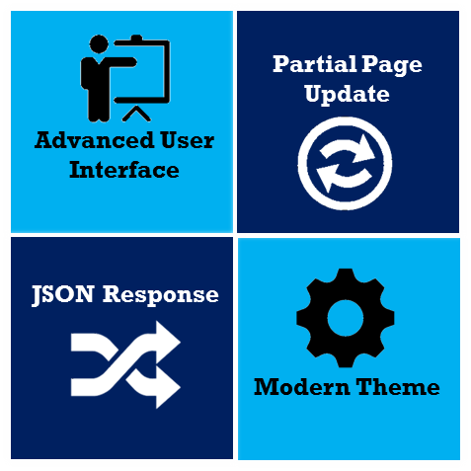
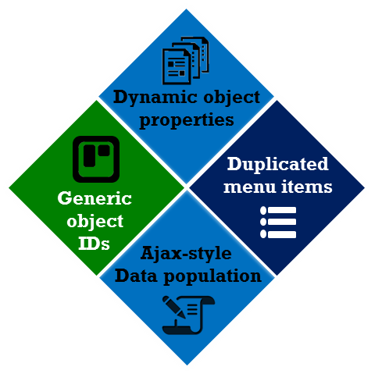





Guidewire 8: Automation Challenges & our Solution
The modern theme of Guidewire Version 8 features
resulting in the challenges
means..?
Complex UI elements
Objects no identified by their native class
Highly dynamic object properties
Difficulty in simulating exact user actions on data fields
Handle all of them with
Guidewire QA COE
For
UFT
For Selenium
Customized methods to
handle new types of objects
Functions to handle dynamic object properties
Object Identification by additional properties

Slide 11

GRAFT: Automation PoV : Policy Center
OVERALL COVERAGE
Modules
60% - 70%
REGERESSION TEST
60% of total Manual Test Cases are eligible for Regression Testing.
80% of Regression Test Cases will be considered for Automation. Remaining 20% of Regression Test Cases are not considered due to automation limitations.
WIP slide
LIMITATIONS
The miscellaneous modules like Reporting, Matters, SIU, Documents, Notes, Performance Monitoring and Contacts are considered low priority and are not taken up for Automation Coverage experience analysis

