Slide 1

Analysis of SWEET Ontology
Under the guidance of Professor Dennis McLeod
Presented By: Shashank Jivan Vernekar
Tanvi Juneja
Varun Mittal
Hema Narayana Reddy

Slide 2
Flow of Presentation
Introduction
Development of SWEET
Applications
Success of SWEET
Evaluation of SWEET
Extension of SWEET
Demo
Accomplishments With SWEET
Problems Encountered
Conclusion

Slide 3
SWEET
It stands for Semantic Web for Earth and Environmental Terminology (SWEET)
Prototype for improving the discovery and use of Earth science data
Evolution of SWEET
Built using keywords of Global Change Master Directory ( GCMD )
DAML
GCMD
Uncontrolled Keywords
GCMD
Controlled Keywords
OWL
20000 words
1000 words
OWL Full
SWEET
Language Evolution
3

Slide 4
Development of SWEET Ontology
Natural
Phenomena
Living
Substances
Non-Living
Substances
Physical
Process
Human
Activities
Earth
Realm
Physical
Properties
Data
Space
Time
Units
Numeric
4

Slide 5
Applications of SWEET
Data Mining
Intelligent Search Tool
Developing Other Ontologies

Slide 6
Projects developed using SWEET
SESDI
DOLCE
HARE
ESML
SWEET
NOESIS
MMI
Geo-Informatics
GENESIS

Slide 7
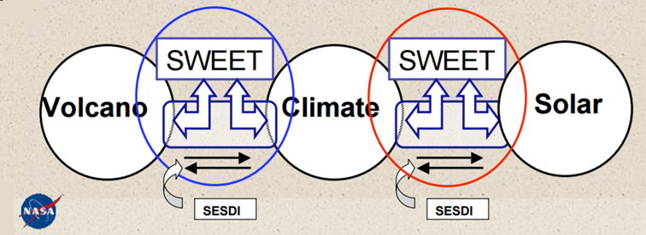
SESDI
Semantically Enabled Science Data Integration
Developed at National Center for Atmospheric Research (NCAR)
Resolve interoperability issues among different Earth science sources

Slide 8
Success of SWEET
Common Platform
Modularity and Knowledge Reusability
Natural Language Independent
SWEET ONTOLOGY
Scalability
Application Independence
Complex Concept Resolution
Community Involvement
Orthogonality

Slide 9
Evaluation of SWEET
Extending Sweet Methodology
Implementation Language
Development Methodology
Structural Content Measures
Functional Measures
Evaluation of Sweet Ontology
Usability Related Measures
Topic
Users of SWEET
Agreement
Popularity
Task
Cost of using SWEET

Slide 10
Extension of SWEET
Get existing sweet ontology and make changes using Protege
Organize terms as classes, individuals and properties in the new domain to be formulated as ontology
Form the relationships between all existing and new concepts
Thorough concept search after defining domain specific terms
Define returned results under existing sweet concepts to get more significant concepts
Publish new Ontology
Validate the new ontology using OWL validators
Use Protege for incorporating new concepts and relationships

Slide 11
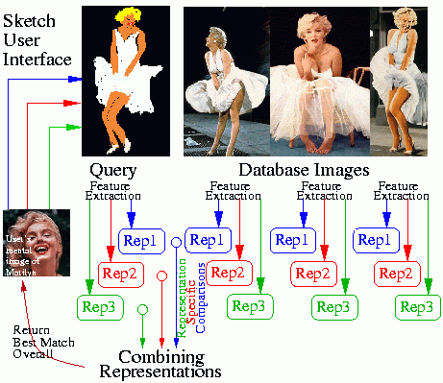
Accomplishments with SWEET
Helps achieve interoperability among different type of datasets.
Provides :
Conceptual schema
Content-based data discovery
Content-based data retrieval
Shared Ontologies
Common Vocabulary
Domain semantic Vocabulary
11

Slide 12
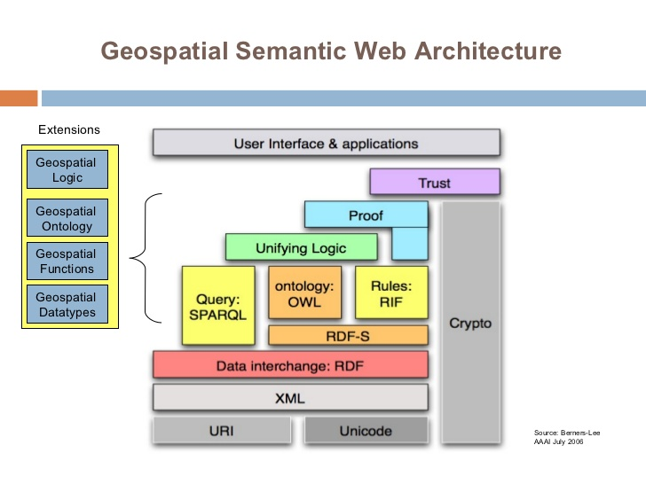
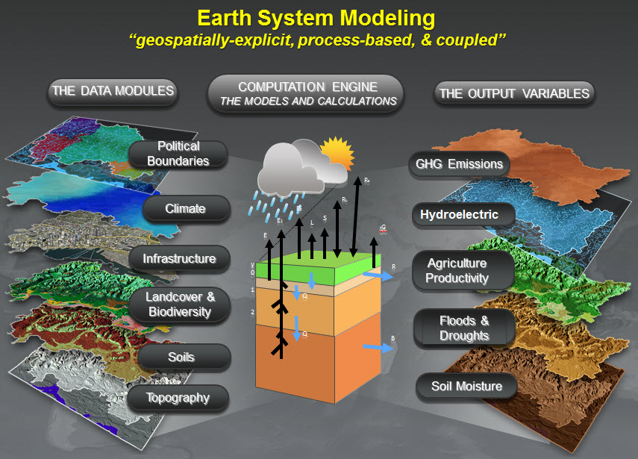
Accomplishments with SWEET
Semantic descriptions for various environmental models.
Enables usage of standard language like OWL and RDF for users.
Provides flexibility by letting users to reuse it for multiple applications.
12

Slide 13
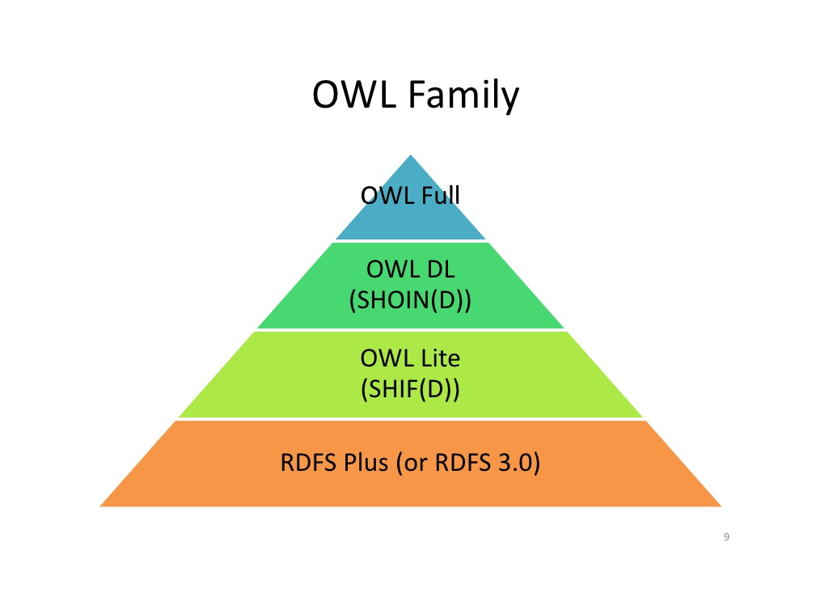
Problems encountered by SWEET
Limitations in data interoperability
Different data formats, schemas and semantics.
3 categories :
Numerical aspects – Eg. OWL – Limited numerical operations
Storage – OWL cannot store large amounts of data or robust ontologies
Ontology-aided search – Search needs to be more accurate
13
13

Slide 14
Conclusion and Future Work
We explored the different applications of SWEET and also gathered some evaluation metrics which prove that SWEET is highly successful
Future work includes :
a) Designing a structural approach for modifying the complex high level SWEET ontology
b) Identifying metrics focusing on SWEET’s structural and design schema
14

Slide 15
References
Knowledge representation in the semantic web for Earth and environmental terminology (SWEET). R. G. Raskin, M. J. Pan. 9, s.l. : Elsevier, November 2005, Computers & Geosciences, Vol. 31, pp. 1119-1125.
Semantic Web for Earth and Environmental Terminology (SWEET) http://sweet.jpl.nasa.gov/index.html.
Global Change Master Directory . http://gcmd.nasa.gov.
Semantically Enabled Science Data Integration. http://sesdi.hao.ucar.edu/intro.php
Raskin, R. Enabling Semantic Interoperability for Earth Science Data. Jet Propulsion Laboratory. Final Report to NASA Earth Science Technology Office (ESTO).
J. Hartmann, P. Spyns and et al. Methods for ontology evaluation. Research project by Knowledge web consortium funded by the IST Programme of the Commission of the European Communities.

Slide 16

THANK YOU
17

