Slide 1
Design development
Team: unit 3721

Slide 2

Hardware requirements
ESP 8266
Resistive soil moisture sensor
Water pump (12 volt power supply)
Jumper cables
Pipes

Slide 3
description
Developing an app that shows information on new farming techniques and information
Our app shows farming techniques to the users and also information about crop rotations, crop details and status of the farm. The app allows the user to control the farm manually or automatically using IOT. It will also show the user how to increase efficiency of the farm. This app allows any farmer to manage their farms as well as giving them ideas to change and improve.

Slide 4
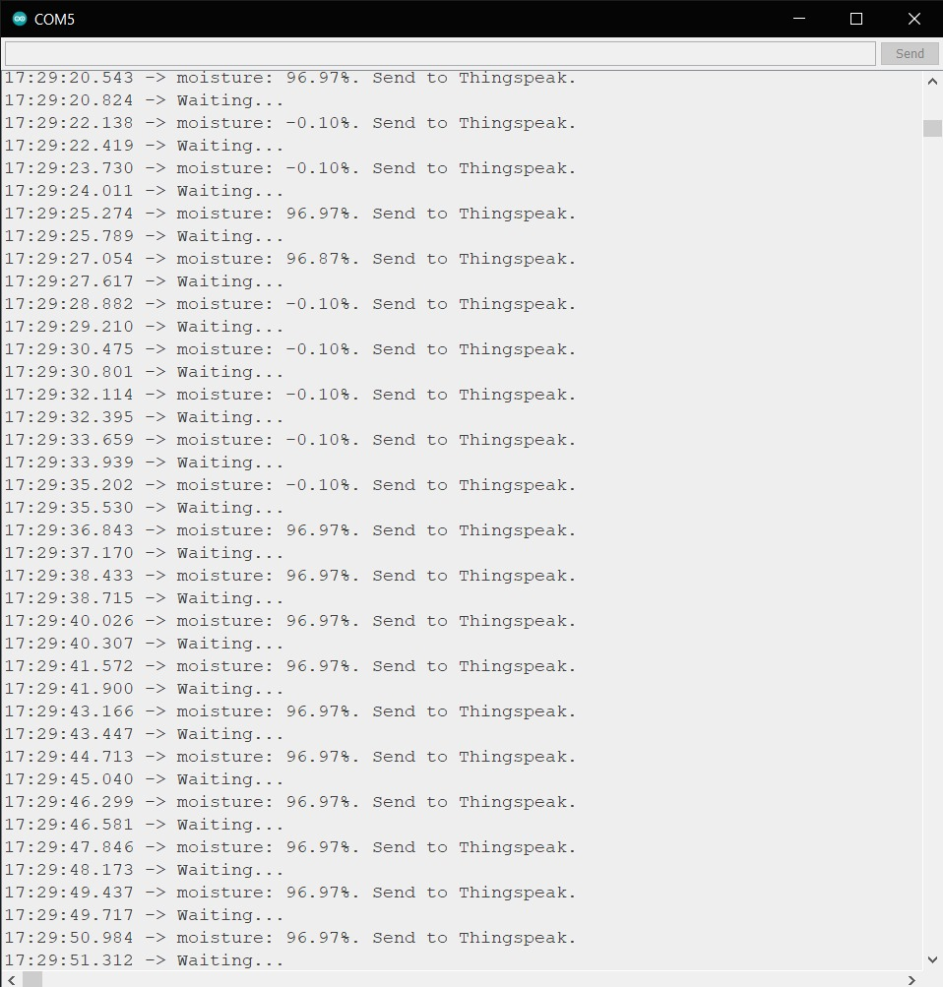
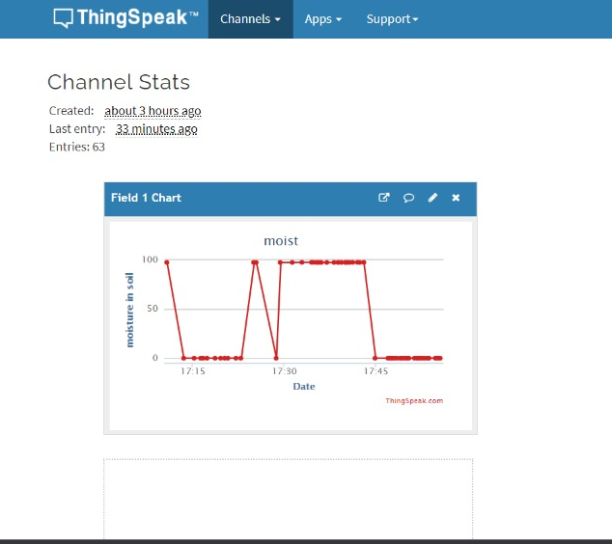

Slide 5
