Slide 1

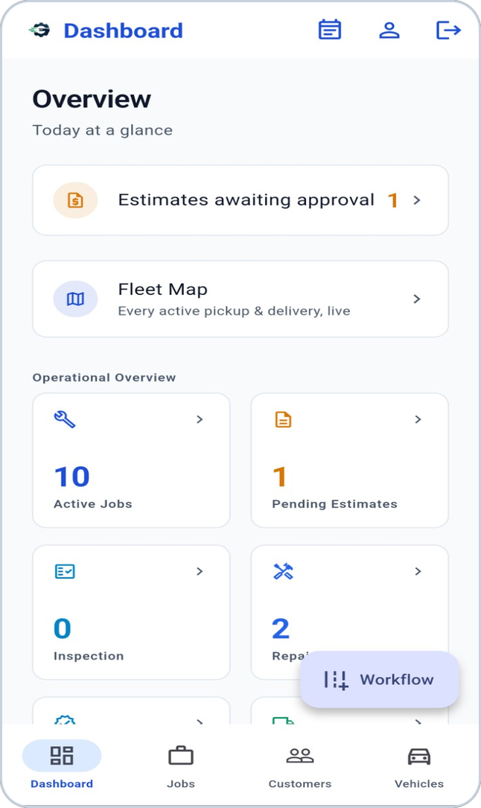
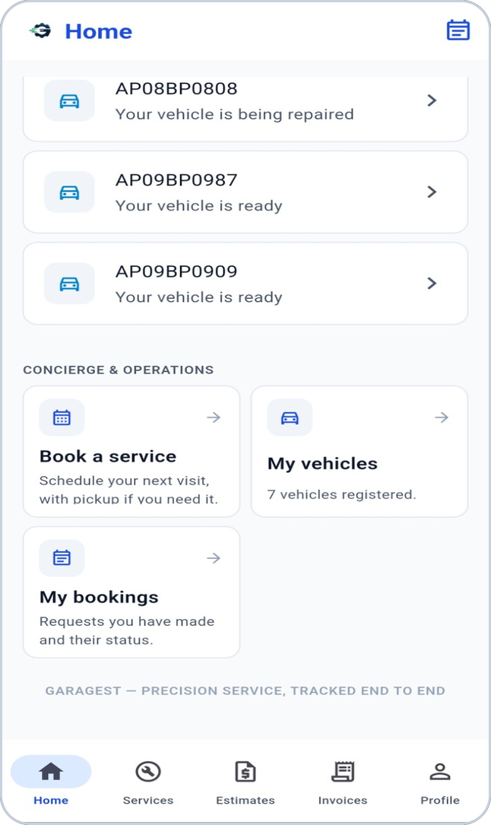
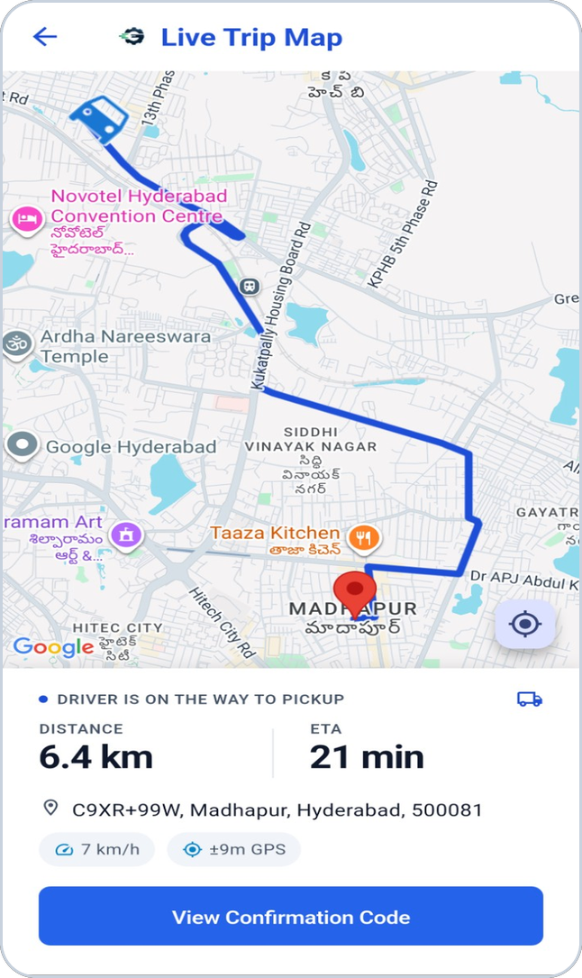
GarageST
Smart Garage Management Platform
Digitizing the complete vehicle service journey.
TVASTRI
Notes:
Cover. Screenshots are real GarageST app screens.

Slide 2








THE STARTING POINT
The garage today
Running a workshop on paper, calls and memory makes the same problems repeat.
Manual job tracking
Scattered customer communication
Paper and checklist dependency
Delayed approvals
Unclear repair status
Communication gaps
Pickup and delivery coordination
Limited service visibility
Tracking operational progress across people, vehicles and approvals becomes difficult.
Notes:
Common operational challenges in manual workshop operations; no statistics are claimed.

Slide 3





ONE CONNECTED PLATFORM
The GarageST vision
Owner
Technician
One vehicle
One job card
Manager
Driver
Service Advisor
Customer
Notes:
One platform, six roles, all connected around the same vehicle and job.

Slide 4
IN ONE SENTENCE
What is GarageST?
A digital operating platform for modern automotive workshops and service centers — from the first booking to the delivered vehicle.
12
journey steps from booking to closure
Customers get visibility and digital approvals
The workshop gets control of every job
Technicians get structured tasks
Drivers get connected pickup and delivery
Owners get one view across the business
6
roles working on the same job
32
workflow events that can notify the right person
Notes:
Counts: 6 roles (owner, manager, service advisor, technician, driver, customer) as personas; 32 notification events; 12 journey steps.

Slide 5










THE COMPLETE LIFECYCLE
End-to-end service journey
1
2
3
4
5
6
Booking
Pickup
Check-in
Inspection
Estimate
Customer approval
7
8
9
10
11
12
Repair
Quality check
Invoice
Payment
Delivery
Job closure
Pickup applies when the customer asks for it; every step is tracked against the same job.
Notes:
Lifecycle as implemented in the job-card workflow and trip/booking features.

Slide 6



THE JOB CARD
One vehicle. One digital journey.
Inspection
Estimate
Repair tasks
Quality check
JOB CARD
the single record for the vehicle’s visit
Invoice & payment
Photos & videos
Notifications
Pickup & delivery trips
Notes:
The Job Card is the central operational record; all activity links to it.

Slide 7


FOR THE VEHICLE OWNER
The customer experience
Book a service
optionally with vehicle pickup
My vehicles & job cards
service visibility in one place
Repair progress
follow the work on your vehicle as it happens
Review & approve estimates
approve or reject digitally
Invoices & payment status
accept the invoice, track payment
Live vehicle journey
follow pickup or delivery on a map
Notifications
important updates reach the phone
Notes:
Customer capabilities confirmed in the customer portal screens, booking, journey and notification features.

Slide 8


DIGITAL INSPECTION
Smart inspection
Vehicle checked in
Inspection checklist
Findings recorded
Photos / videos attached
Inspection completed
Estimate prepared
Structured checklist
Findings per complaint
Evidence that travels with the job
Inspection templates guide the technician through each area.
Each customer complaint is inspected and recorded.
Photos and videos are stored against the job card, with time and location details.
Notes:
Inspection checklist templates, findings and evidence media exist in the product (inspection master, findings, media modules).

Slide 9
TRANSPARENCY BEFORE WORK STARTS
Digital estimate & approval
Garage prepares estimate
Customer reviews items
Approve or reject
Manager confirms
Repair begins
For the customer
For the workshop
Itemised estimate on the phone
Notified when the estimate is ready
Decide digitally — no chasing calls
Managers and the owner are notified of the decision
A manager confirmation gate before repair starts
Approval and repair stay clearly separate steps
Notes:
Customer approves or rejects; repair starts only after the manager confirms (Customer approval vs manager confirmation).

Slide 10
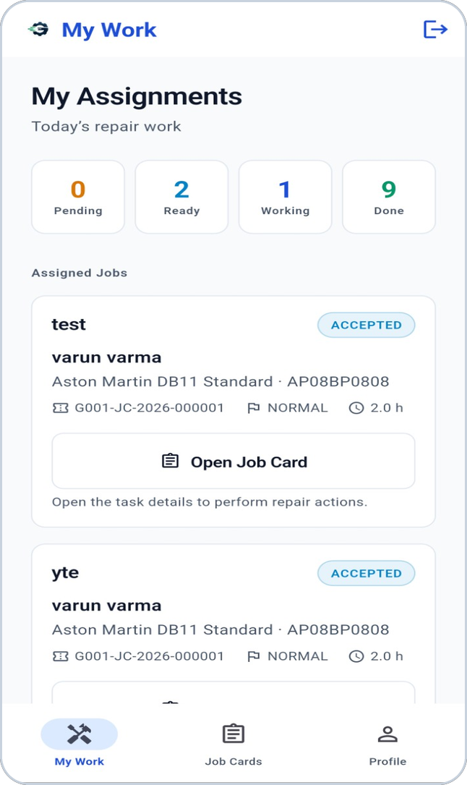
STRUCTURED WORK
Repair management
Job card
Repair pending
Repair in progress
Repair completed
Repair tasks (per technician)
Assigned
Accepted
In progress
Completed
Tasks are assigned to technicians, who accept, start and complete them
The job moves to “repair completed” only when every task is complete
Managers see progress without asking around
Notes:
Job Card state and Repair Task state are separate machines. Screenshot: technician assignments (real app).

Slide 11
AN EXTRA CHECKPOINT
Quality control
Repair completed
Quality check
Pass
Invoice
Fail
Rework: the job returns to repair and the owner, managers and affected technicians are notified.
Quality is verified before the customer is invoiced
Pass or fail is recorded against the job
Managers are told when a check starts, passes or fails
Notes:
QC pass moves the job on; QC fail returns it for rework (tasks reset).

Slide 12

BILLING WORKFLOW
Billing & invoice
Invoice generated
Customer views & accepts
Payment recorded
Vehicle ready for delivery
Invoice from the approved estimate
Customer visibility
Notified at each step
Items match what the customer approved.
Invoices and payment status are visible in the customer app.
Invoice ready · invoice accepted · payment received.
Payment is currently tracked and recorded inside GarageST. An online payment gateway is not part of the current product (see roadmap).
Notes:
No online payment gateway is implemented: payment is recorded in GarageST.

Slide 13
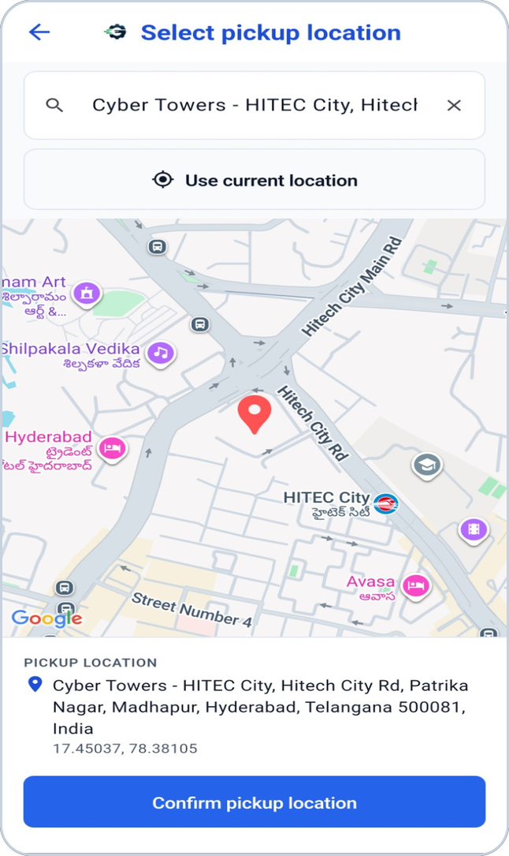
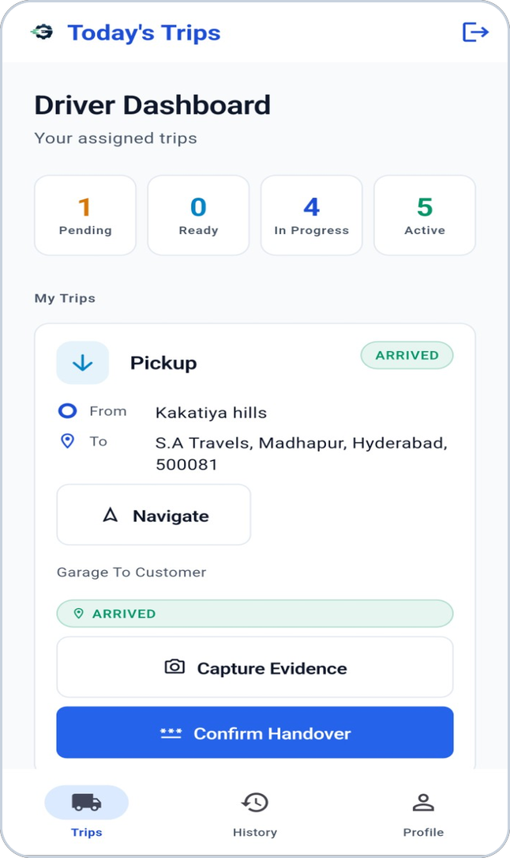
COLLECTION FROM THE CUSTOMER
Vehicle pickup
Pickup request
Garage confirms
Driver assigned
Trip in progress
Handover
Customer chooses the pickup point on a map
The garage confirms and assigns a driver
The driver accepts and starts the trip
Customer and workshop are notified at each stage
Notes:
Pickup request, driver assignment, trip lifecycle and handover. Screenshots: pickup location selection and driver dashboard (real app).

Slide 14

KNOW WHERE THE VEHICLE IS
Live vehicle tracking
Live driver location
the vehicle moves on the map as the driver drives
Route, distance and ETA
shown to the customer on the trip screen
Customer visibility
the customer follows their own vehicle’s trip
Workshop visibility
managers and owners see active trips on a fleet map
Available during active pickup and delivery trips.
Notes:
Real screenshot: Live Trip Map with route, distance and ETA. Driver location streams over STOMP/WebSocket; REST fallback exists.

Slide 15


VERIFIED VEHICLE HANDOVER
Digital handover
Driver arrives
Evidence photos
Customer shows a code
Driver verifies
the customer is notified
condition captured at handover
generated in the customer’s app
handover confirmed in the system
A handover verification code confirms that the vehicle really changed hands — for both pickup and delivery. It is a vehicle-handover check, not a login code.
Notes:
Handover verification code is generated for the customer and verified by the driver; it is not a login OTP.

Slide 16

BACK TO THE CUSTOMER
Delivery management
Ready for delivery
Delivery requested
Driver trip
Handover verified
Vehicle delivered
Job closed
Once payment is recorded the vehicle is marked ready for delivery and the customer is notified
Delivery uses the same driver, live-trip and handover tools as pickup
Completing the verified delivery trip records the delivery and marks the job delivered
The job is then closed by the workshop
Notes:
Ready for delivery -> delivery request/trip -> verified handover -> delivered -> closed.

Slide 17
NEW
Real-time notifications
GarageST proactively notifies users about important workflow events — on the phone’s notification tray, even when the app is not in the foreground.
Bookings
Pickup & trips
Inspection
Estimates
requested · confirmed · rejected · cancelled
driver assigned · started · arrived · handover
started · completed
ready · approved · rejected
Repair
Quality check
Invoice & payment
Delivery & closure
task assigned · started · completed
started · passed · failed
generated · accepted · payment received
ready · delivered · job closed
Delivered through Firebase Cloud Messaging to the user’s Android phone.
Notes:
New feature. 32 events in the matrix; categories derived from the implemented event list.

Slide 18
THE RIGHT MESSAGE TO THE RIGHT PERSON
Notifications by persona
Customer
Owner
Manager / Service Advisor
service updates · estimate ready · invoice · payment · vehicle ready · delivery
important business events: new booking, estimate decisions, repair done, quality-check failure, invoice, payment, delivery, closure
operational updates across bookings, trips, inspection, estimates, repair tasks, QC, invoicing
Technician
Driver
Relevant, not noisy
Each person receives only the events relevant to their role and their own garage. You never hear about your own action.
new repair task assigned · quality-check rework
pickup assigned · customer handover ready
Notes:
Recipients per the implemented resolver; Accountant/Cashier/Inventory manager receive no automatic notifications.

Slide 19






ILLUSTRATIVE
The notification experience
GarageST · now
tap
GarageST opens on the right screen for your role
Validated on a real Android device
Your vehicle is ready for delivery
Your vehicle is ready (JC-…).
Notification appears with sound
Vibrate / silent follows the phone’s mode
Shown in the system tray
Tap opens GarageST and the right screen
History and unread badge work
Vehicle ready & payment received observed
Sound
Vibration per device mode
System tray
Foreground & background
History & unread badge
Deep-link navigation
Illustration drawn for this presentation; wording is the real notification text.
Sound and vibration remain under the user’s Android notification settings.
Notes:
Illustrative drawing using actual notification wording. Physically validated on Android by the product owner.

Slide 20



IN-APP NOTIFICATION CENTER
Notification history
Notifications
Unread indicator
new items stand out; the bell shows the unread count
Payment received
Payment has been received (JC-…).
2 minutes ago
Mark as read
Your vehicle is ready for delivery
tap an item to open it and mark it read
Your vehicle is ready (JC-…).
10 minutes ago
Mark all read
Your invoice is ready
clear the list in one tap
Your invoice is ready for review (JC-…).
1 hour ago
Repair completed
Always available
Repair of your vehicle is complete (JC-…).
history stays in GarageST even if a push was missed
yesterday
Illustration — drawn for this presentation using real notification wording.
Notes:
Illustrative list; the real screen shows title, message, relative time, unread dot, mark read, mark all read.

Slide 21
THE BUSINESS BENEFIT
Communication without chasing
Without it
With GarageST
Calling the customer to approve an estimate
Asking the technician if the job is done
Telling the customer the vehicle is ready
Checking whether payment came in
The estimate-ready notification reaches the customer’s phone
Managers are told when repair or QC changes
The customer hears “vehicle ready” as soon as it is
Owners see payments as they happen
Important workflow events can proactively reach the right user instead of depending entirely on manual calls and messages. Today this is in-app push; other channels are not part of the current product.
Notes:
Push notifications only today; SMS/WhatsApp are not part of the current product.

Slide 22



PROOF OF THE WORK
Media & service evidence
Photos & videos from the job
Time and location details
Reliable uploads
Inspection, before/during/after-service and trip evidence.
Evidence carries capture time and location information.
Media uploads in the background and retries if the network drops.
Private storage
Customer can view
Vehicle trip evidence
Media is kept in a private bucket and opened through short-lived secure links.
Customers can see the media published for their own job.
Pickup and delivery handover photos are kept with the trip.
Notes:
Direct-to-R2 upload, evidence + thumbnail, GPS/time stamping; customers can view job media.

Slide 23
ROLE-BASED EXPERIENCE
A workspace for every role
Customer
Manager / Owner
Driver
Technician
bookings, vehicles, progress
jobs, estimates, fleet
assigned trips
assigned repair work
Notes:
Real screenshots: customer home, manager dashboard, driver dashboard, technician assignments.

Slide 24
OWNER
Benefits for the garage owner
Centralized visibility of every job
Job status and workflow tracking
Staff coordination across roles
Customer transparency builds trust
Billing and payment visibility
Vehicle movement visibility
Notifications for important business events
Notes:
Operational benefits supported by implemented capabilities; no ROI figures claimed.

Slide 25
OPERATIONS
Benefits for managers & service advisors
Job progress at a glance
Customer approvals and estimate status
Repair progress and technician workload
Quality-check results
Billing and delivery coordination
Notified when something needs attention
Notes:
Manager / service advisor capabilities.

Slide 26
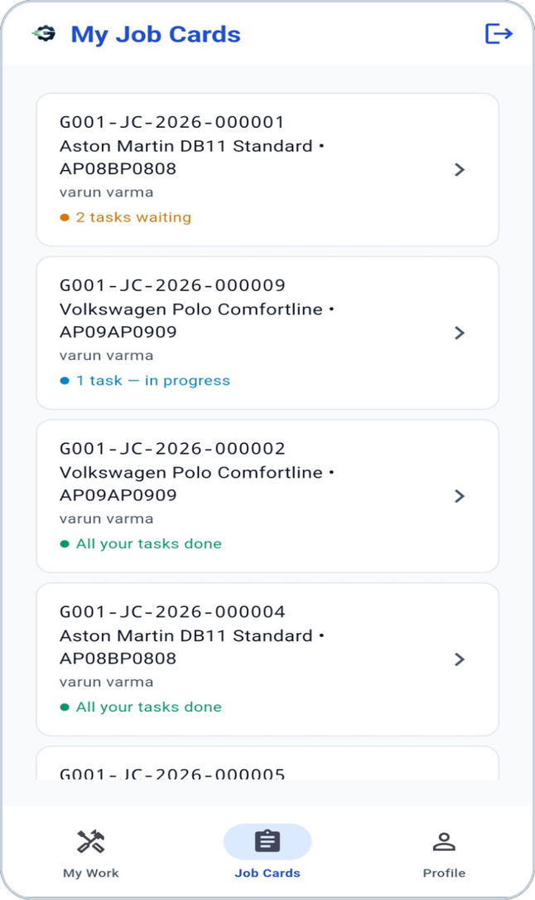
TECHNICIAN
Benefits for technicians
See the repair tasks assigned to you
Task status: accept, start, complete
Job and vehicle context in one place
Clear workflow progression
Quality-check feedback when rework is needed
Notified when a task is assigned
Notes:
Real screenshot: technician job cards.

Slide 27
DRIVER
Benefits for drivers
Assigned pickup and delivery trips
Navigation to the customer or garage
Live trip with route
Evidence photos and verified handover
Pickup and delivery in one workflow
Notified of new assignments
Notes:
Real screenshot: driver dashboard.

Slide 28
CUSTOMER
Benefits for customers
Clear visibility of your vehicle’s service
Digital estimate review and approval
Service progress without calling
Invoice and payment status
Follow your vehicle’s pickup or delivery
Notifications at the important moments
Your job-card history in the app
Notes:
Customer benefits; service history = the customer’s job card list.

Slide 29
GARAGE-LEVEL ISOLATION
Multi-garage operations
Garage A
Garage B
Owner
Its own staff and roles
Its own jobs and trips
Its own notifications
Its own staff and roles
Its own jobs and trips
Its own notifications
An owner can view the garages they belong to.
Staff see only their own garage’s work
A notification for Garage A never reaches Garage B staff
Customers see only their own vehicles and jobs
Advanced branch / franchise management features are not part of the current product.
Notes:
Garage-scoped users and notification isolation are implemented; owners can view more than one garage. Enterprise branch management is roadmap.

Slide 30





TRUST
Security & data control
Authenticated access
Role-based permissions
Garage-level isolation
Customer ownership
Every user signs in; sessions use secure tokens.
People see and do what their role allows.
Each garage’s data stays within that garage.
Customers only reach their own vehicles and jobs.
Secure communication
Controlled media access
Notification ownership
No secrets in the app
The app talks to the platform over secured APIs.
Photos and videos are private and opened with short-lived links.
You can only read and manage your own notifications.
Service credentials stay on the server.
Notes:
High-level, client-safe summary of implemented controls.

Slide 31




BUILT ON PROVEN COMPONENTS
Technology foundation
Flutter
Spring Boot
PostgreSQL
Firebase Cloud Messaging
mobile app
application platform
system of record
push notifications
Cloudflare R2
Render
STOMP / WebSocket
Maps & routing services
media storage
hosting
live trip tracking
maps, routes, geocoding
Notes:
Only technologies confirmed in the current implementation.

Slide 32
THE BIG PICTURE
How everything connects
Customer / Staff
customers · owners · managers · advisors · technicians · drivers
GarageST mobile app
Android
GarageST backend
REST API · live trip
PostgreSQL
business workflow data
Firebase Cloud Messaging
push notifications
Cloudflare R2
photos & videos
Maps & routing
live trip maps and routes
Render
cloud hosting
The backend owns the business rules; PostgreSQL is the source of truth; notifications, media, maps and hosting are supporting services.
Notes:
Simplified architecture. Flutter app, REST API, live trip over WebSocket, PostgreSQL, supporting services.

Slide 33
HONEST STATUS
Current product status
Available today
Not part of today’s product
Booking, job-card workflow and role-based workspaces
Digital inspection, estimate and customer approval
Repair tasks, technician assignment, quality check
Invoicing and payment recording
Pickup and delivery trips, live tracking, verified handover
Photos and videos as service evidence
Push notifications and in-app history (validated on Android)
Garage-level isolation; owners can view their garages
Online payment gateway
iOS push notifications
SMS / WhatsApp / e-mail messaging
Notification preferences and quiet hours
Advanced branch / franchise management
Listed as roadmap candidates on the next slide — not commitments.
Notes:
Status terms: IMPLEMENTED, PHYSICALLY VALIDATED (notifications on Android), NOT IMPLEMENTED / ROADMAP.

Slide 34
DIRECTIONS — NOT COMMITMENTS
Roadmap
Now
In the product today
Next
Candidate next steps
Future
Longer-term options
Complete service journey
Role-based workspaces
Live trips and handover
Push notifications on Android
iOS push notifications
Online payment gateway
Additional communication channels (SMS / WhatsApp / e-mail)
Notification preferences
Directions under consideration, each traceable to a known gap in today’s product; no dates or commitments are implied.
Notes:
No dates. Candidates only; basis: iOS parked, payment gateway deferred in code, messaging channel stub, preferences not built.

Slide 35

WHAT SETS THE PRODUCT APART
Why GarageST
Connected service lifecycle
Role-based workflow
Digital inspection
Approval workflow
Repair task management
Live vehicle movement
Digital handover
Billing visibility
Proactive push notifications
Service evidence
Customer transparency
One connected platform
Notes:
Factual product characteristics only; no superlatives or comparisons.

Slide 36



ADOPTION PATH
Getting a garage onto GarageST
1
Garage setup
2
User roles
3
Service workflow
register the garage; staff join and are approved
owner, managers, advisors, technicians, drivers
the guided job-card workflow
4
Inspection templates
5
Customers & vehicles
6
Staff operations
checklists for technicians
added by staff or by customers
jobs, estimates, repairs, invoices
7
Customer experience
8
Notifications
9
Go-live
customers register in the app
enabled for the garage’s environment
start running real jobs
Notes:
Steps supported by the product: garage registration/join, roles, inspection templates, customers/vehicles, customer app registration, notifications enabled by configuration.

Slide 37

POTENTIAL KPIS — NOT ACHIEVED RESULTS
Measuring success
Job turnaround time
Approval response time
Inspection completion
Repair task completion
Delivery turnaround
Notification delivery & read rate
Customer digital engagement
Operational visibility
These are measures a garage could track with GarageST. They are suggestions, not results achieved by any customer.
Notes:
Potential KPIs, not achieved results. No customer results are claimed.

Slide 38
From vehicle arrival to vehicle delivery —
one connected digital journey.
TVASTRI · GarageST
Notes:
Closing. No contact details were supplied, so none are shown.

