Slide 1

IILM UNIVERSITY, GREATER NOIDA
INTERNSHIP REPORT PRESENTATION
AI Technology, Digital Asset Management
& Retrieval-Augmented Generation (RAG)
Enablement at Nine Triangles Digital Pvt. Ltd.
VARUN
Roll No. 2410031423 | B.Tech CSE, Batch 2024–2028
26 May 2026 – 15 July 2026

Slide 2






ABOUT THE STUDENT
Candidate Profile
Roll Number
2410031423
VARUN
Institute
IILM University, Greater Noida, U.P.
B.Tech — Computer Science & Engineering
Programme
B.Tech CSE, Batch 2024–2028
Internship Domain
AI Technology, DAM & RAG
Duration
26 May 2026 – 15 July 2026 (7 Weeks)
AI Tech, DAM & RAG Internship • VARUN
02

Slide 3


ABOUT THE ORGANIZATION
Nine Triangles Digital Pvt. Ltd.
Nine Triangles Digital Pvt. Ltd. is a boutique digital strategy consulting and integrated-implementation company headquartered in Noida, Uttar Pradesh, founded in 2017 by Krishna Mohan Jha. Within its Technology practice, the organization applies data-driven and machine-learning-aided approaches to help client brands gain an innovative edge.
Founded 2017
Four Practice Areas
Technology Practice
Boutique digital strategy consulting and integrated-implementation company.
Creative, Technology, Media, and Data Analytics.
Applies data-driven, machine-learning-aided approaches for client brands.
AI Tech, DAM & RAG Internship • VARUN
03

Slide 4





INTERNSHIP OVERVIEW
What the Internship Set Out to Achieve
General objectives, aligned with certificate-supported activities.
Understand DAM
Study RAG Principles
Organize Data & Assets
How Digital Asset Management practices organize and govern digital content.
How retrieval and generation stages combine to produce grounded AI responses.
Assist in making digital assets more discoverable and reusable.
Practice Prompt Engineering
Test AI Workflows
Support Knowledge Bases
Hands-on exposure to improving reliability of AI-generated output.
Assist in testing and identifying gaps in expected vs. actual behaviour.
Keep organizational information current and well-structured.
AI Tech, DAM & RAG Internship • VARUN
04

Slide 5
PROBLEM STATEMENT
Structuring Knowledge for Reliable AI
Organizations generate digital assets faster than manual, folder-based systems can organize them — and AI systems built on top of disorganized information inherit the same problem, producing incomplete or ungrounded answers.
The problem area addressed during the internship was two-fold:
01
02
Structuring Knowledge
Connecting to AI Tools
How digital assets and organizational knowledge can be structured and maintained so they form a reliable knowledge base.
How that knowledge base connects to AI/LLM-based tools — through retrieval, prompt engineering, and systematic evaluation — so AI features stay accurate and useful.
AI Tech, DAM & RAG Internship • VARUN
05

Slide 6

DAM is the practice of organizing, tagging, storing, and retrieving an organization's digital content so it can be found and reused efficiently.
01
TECHNICAL DOMAIN
Asset Organization
Digital Asset
Management (DAM)
Documents, creative assets, and structured records grouped into a coherent, searchable structure.
Tagging & Metadata
Consistent metadata, categories, and naming conventions applied to raw digital assets.
Foundation for AI
Well-organized assets become the raw material that reliable, context-aware AI systems depend on.
AI Tech, DAM & RAG Internship • VARUN
06

Slide 7

RAG pairs a Large Language Model with a retrieval mechanism over an organization's own knowledge base, so responses are grounded in accurate, current information.
02
TECHNICAL DOMAIN
Retrieval Layer
Retrieval-Augmented
Generation (RAG)
Searches an indexed knowledge base for the most relevant context to a given query.
Augmented Prompting
Combines retrieved context with the user's query before passing it to the LLM.
Grounded Generation
The model generates responses grounded in retrieved facts, not training data alone.
AI Tech, DAM & RAG Internship • VARUN
07

Slide 8

Prompt engineering is the practice of designing and refining input prompts to improve the accuracy and relevance of LLM output.
03
TECHNICAL DOMAIN
Iterative Drafting
Prompt
Engineering
Prompts drafted and tested against representative queries.
Observe & Refine
Refinement based on the relevance and accuracy of resulting output — an iterate-observe-refine cycle.
Applied During Internship
Hands-on exposure to this cycle was one of the most iterative parts of the internship methodology.
AI Tech, DAM & RAG Internship • VARUN
08

Slide 9

Maintaining a structured, current repository of organizational information that AI systems and employees can draw upon.
04
TECHNICAL DOMAIN
Grouping & Structuring
Knowledge Base
Management
Related content grouped, terminology standardized, duplication removed.
Keeping Content Current
A key challenge is keeping the knowledge base current as underlying assets change.
Supports Retrieval Quality
A well-organized knowledge base directly improves the quality of what RAG retrieves.
AI Tech, DAM & RAG Internship • VARUN
09

Slide 10

Systematic checking of AI-powered features against expected behaviour, relevance, and usability criteria.
05
TECHNICAL DOMAIN
Exercising Workflows
AI Workflow Testing
& Evaluation
AI workflows exercised with varied inputs to surface edge cases and inconsistencies.
Evaluating Output
AI-powered features assessed against usability and performance considerations.
Feedback Loop
Findings feed back into indexing and knowledge-base layers for continuous improvement.
AI Tech, DAM & RAG Internship • VARUN
10

Slide 11


SYSTEM ARCHITECTURE
Generic AI / DAM–RAG Workflow
Technology-agnostic workflow — not a claim of Nine Triangles' proprietary production architecture.
Digital Assets
Documents, media, and structured records
Asset Organization & Knowledge Base
▼
Classifying, tagging, and structuring content
Data Processing & Indexing
▼
Converting content into embeddings / structured indices
Retrieval Layer
▼
Similarity search against the indexed knowledge base
Prompt Construction
▼
Combining retrieved context with the user query
LLM Generation
▼
Producing a response grounded in retrieved context
Evaluation & Validation
▼
Assessing relevance, accuracy, and usefulness
AI Tech, DAM & RAG Internship • VARUN
11

Slide 12
METHODOLOGY
A Seven-Week Learning Journey
A structured, progressively deepening approach across the internship period.
1
WEEK 1–2
2
WEEK 2–3
3
WEEK 3–4
Orientation & Domain Study
Digital Asset Audit & Tagging
Knowledge Base Organization
Introduced to DAM fundamentals and the role of RAG.
Existing content reviewed for completeness and metadata consistency.
Grouping content, standardizing terminology, removing duplication.
4
WEEK 4–5
5
WEEK 5–6
6
FINAL WEEKS
RAG Concept Application
Prompt Engineering & AI Testing
Evaluation & Reporting
Understanding how retrieval and generation interact in practice.
Iterative drafting, testing, and refining of prompts.
Assessing AI features and consolidating findings into this report.
AI Tech, DAM & RAG Internship • VARUN
12

Slide 13
EXPECTED OUTCOMES
Skills & Capabilities Gained
Working understanding of DAM practices and their role in supporting downstream AI systems.
AI workflow testing exposure and familiarity with common failure modes.
Applied understanding of RAG, including the relationship between retrieval and generation quality.
Knowledge-base management practices that keep information usable over time.
Improved data-organization skills — tagging, structuring, and de-duplicating digital content.
Feature evaluation experience — assessing AI features and documenting results professionally.
Hands-on prompt engineering — iterative refinement of prompts against observed output quality.
Professional growth in analytical thinking, collaboration, and technical communication.
AI Tech, DAM & RAG Internship • VARUN
13

Slide 14
CERTIFICATE-SUPPORTED WORK
Key Activities & Objective Mapping
Every activity below is directly attested by the internship completion certificate.
Certificate-Supported Activity | What It Involved
AI Research | Supporting AI technology initiatives and exploratory research
Data Organization | Structuring and tagging digital assets for discoverability
Prompt Engineering | Iterative refinement of prompts for AI-generated output
Testing AI Workflows | Exercising workflows to surface gaps and inconsistencies
Knowledge Base Management | Keeping organizational information current and structured
Evaluating AI-Powered Features | Assessing performance and usability of technology platforms
AI Tech, DAM & RAG Internship • VARUN
14

Slide 15
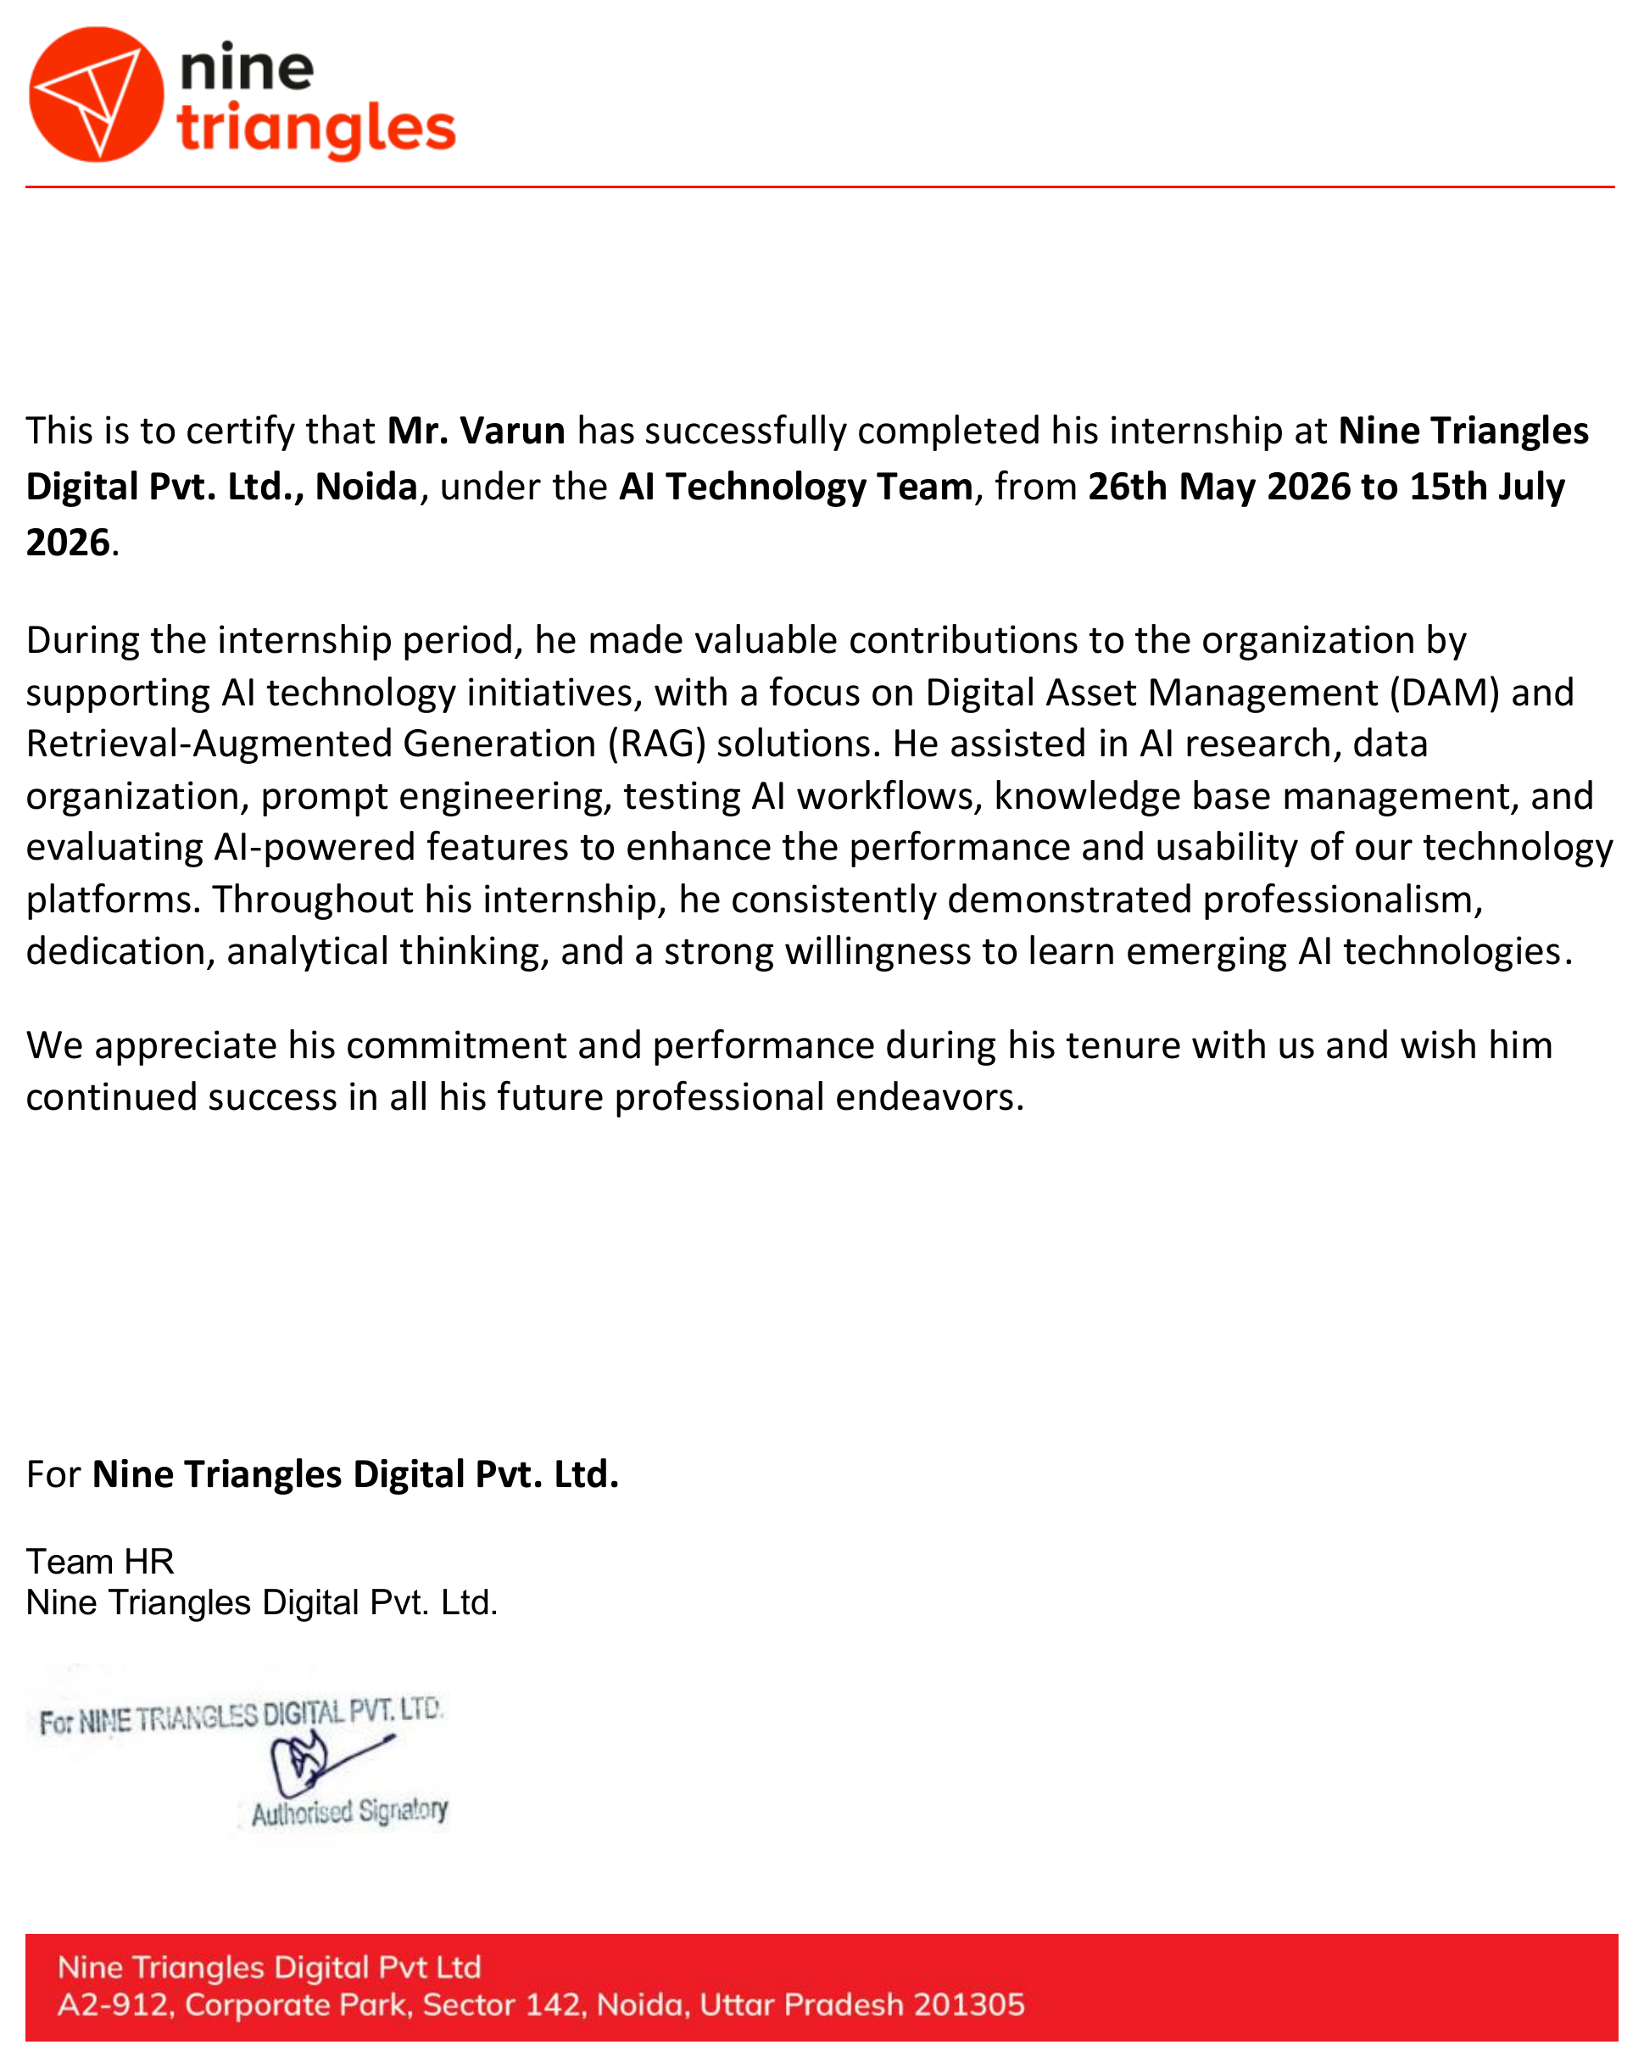



CERTIFICATION
Successfully
Completed
Status
Successfully Completed
Team
AI Technology Team
Duration
26 May 2026 – 15 July 2026
Issued By
Nine Triangles Digital Pvt. Ltd.
AI Tech, DAM & RAG Internship • VARUN
15

Slide 16
WRAPPING UP
Conclusion & References
This internship provided a working, applied understanding of how AI Technology teams organize digital assets, apply Retrieval-Augmented Generation, and evaluate AI-powered features — bridging classroom learning with real professional practice.
SELECT REFERENCES
Lewis, P. et al. (2020). Retrieval-Augmented Generation for Knowledge-Intensive NLP Tasks. NeurIPS 33.
AIIM — Digital Asset Management: Overview and Best Practices. aiim.org
IBM. What is Retrieval-Augmented Generation (RAG)? IBM Think Topics.
Google Cloud. Prompt Engineering Overview.
Nine Triangles Digital Pvt. Ltd. — Offer Letter & Internship Completion Certificate (2026).
IILM University, Greater Noida — Internship Report Format Guidelines, AY 2026–27.
AI Tech, DAM & RAG Internship • VARUN
16

Slide 17
Thank You
AI Technology, DAM & RAG Internship | Nine Triangles Digital Pvt. Ltd.
VARUN
Roll No. 2410031423 | IILM University, Greater Noida

