Slide 1
End-end Connectivity on Phones

Slide 2
Outline
Motivations
Turn on and manage both interfaces
The HTTPUrlConnection library
HTTP download with two interfaces
Challenges Faced
Future work
Screenshots

Slide 3
Motivations
Goal of this study:
Utilize WIFI and 3G network Interfaces concurrently to provide better end to end connectivity to applications.
Why HTTP protocol?
Ability to request data in chunks i.e. byte range.
Recent study shows HTTP protocol dominate today’s data traffic on smartphones.

Slide 4
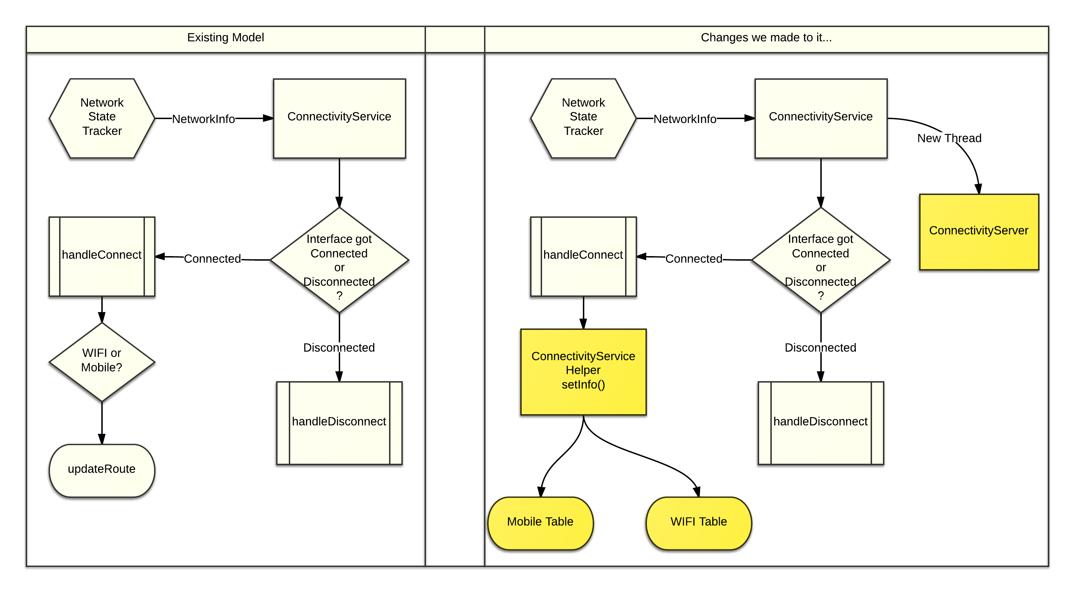
Turn on and manage both interfaces

Slide 5
Http connection handlers in Android
Apache HTTP client
DefaultHttpClient and AndroidHttpClient
HttpURLConnection
General Purpose, and relatively lightweight
Preferred client for Gingerbread and following releases
Implemented inside core java library – libcore

Slide 6
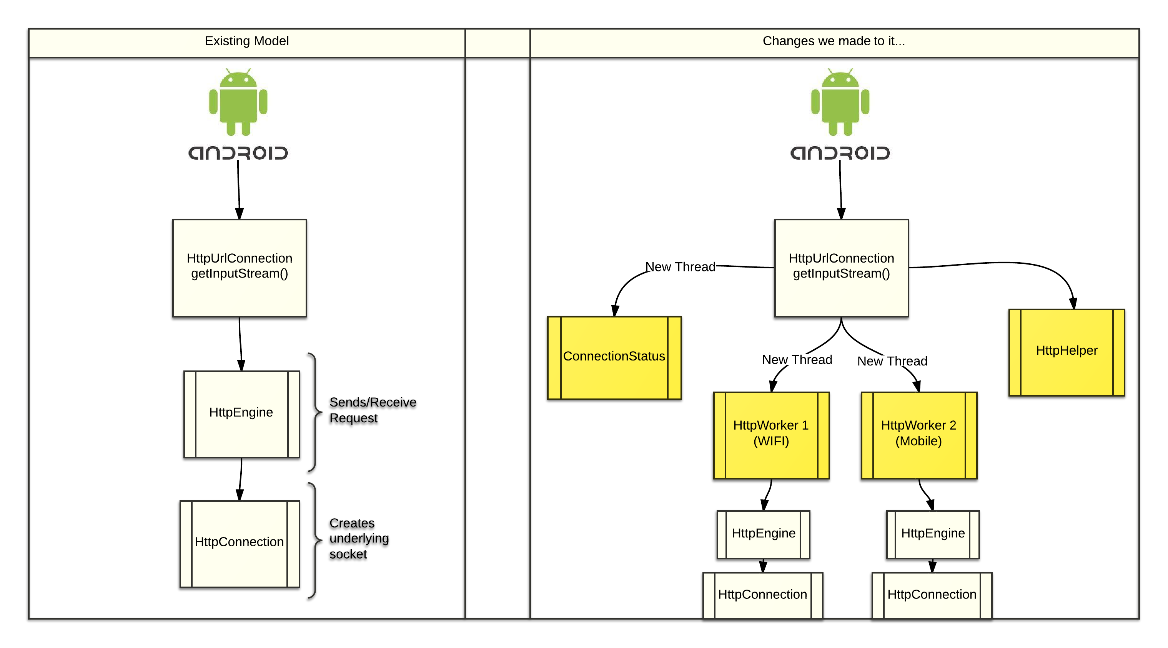
The HttpURLConnection Library

Slide 7
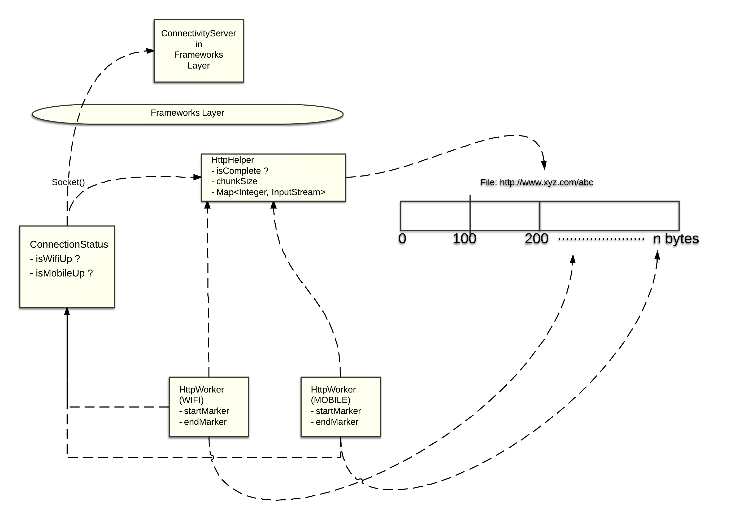
Work Stealing Implementation

Slide 8
Challenges Faced
Setting up 2 kernel routing tables.
Creating Native interface (JNI) for updating routing tables using “ip” and “su” utility.
Understanding HttpUrlConnection library implementation!
Finding an IPC mechanism for communication between JAVA libcore library and Android Frameworks library.
HTTP servers may not always provide the information we want, e.g., content length and content size range, in HTTP response.

Slide 9
Future Work
Finding out “optimal” chunk size or maybe have variable chunk size.
Add download policies to restrict download from an interface depending on factors such as Cost, Latencies etc.

Slide 10
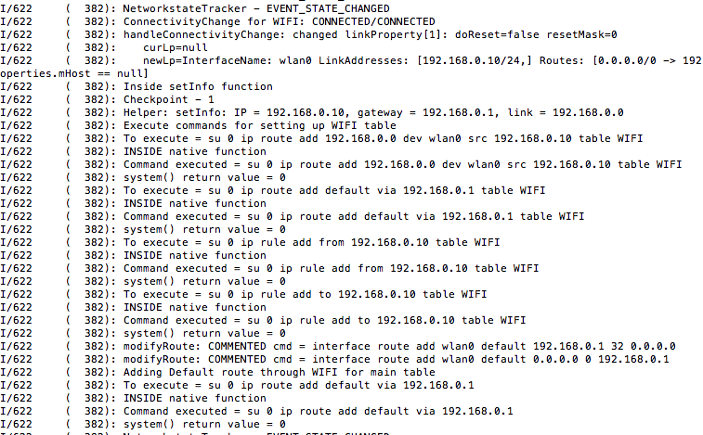
Screenshots

Slide 11
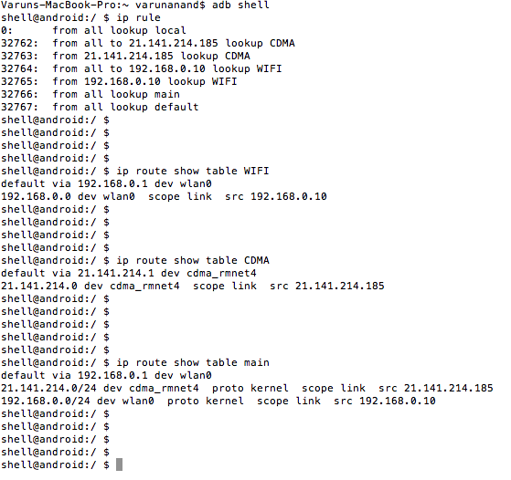

Slide 12
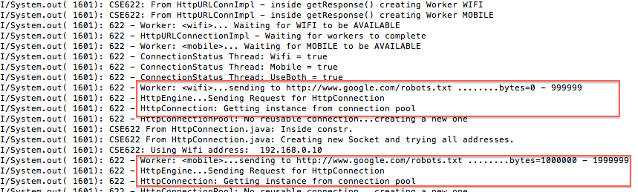

Slide 13

Thank You!

