Slide 1
Agentic AI Hackathon: Building Intelligent Agents with IBM Granite and LangFlow

Slide 2



Name of the team: Fit Score
Details of Team members
TEAM MEMBER NAME | Recent Passport Photo | Email ID | Phone number [WhatsApp]
Satavisa Deka |  | Satavisa.bs23@bmsce.ac.in | 8099261502
Shuchi Sharma |  | Shuchisharma.bs23@bmsce.ac.in | 8073761419
Varun R |  | Varunr.bs23@bmsce.ac.in | 8088812876

Slide 3
Problem statement
The Challenge
Preventive healthcare relies on early identification of lifestyle-related health risks. However, patient lifestyle data such as physical activity, sleep patterns, diet logs, and stress indicators are often underutilized. Manual analysis of such data is not scalable. An intelligent assistive system is needed to analyze lifestyle data and highlight potential preventive health risks.
Lifestyle Data Analysis Agent
An agent that processes physical activity, sleep, diet, and stress-related data into health summaries.
Preventive Risk Detection Agent
An agent that identifies risk patterns associated with lifestyle behaviors using guideline-based references.
Health Advisory Assistant
An agent that provides preventive health insights and lifestyle improvement suggestions
(assistive only).
Outcome
Supports preventive healthcare awareness and promotes healthier lifestyle choices.
Mandatory Tech Stack
Lang Flow using the IBM Granite Model
(Using RAG on preventive healthcare guidelines and wellness frameworks).

Slide 4
Proposed solution
Agentic AI Ecosystem: A specialized system of three autonomous agents that mimic a professional medical team.
Collaborative Logic: The system uses a "Relay Race" architecture where data is cleaned, analyzed against factual databases, and converted into coaching advice through distinct processing stages.

Slide 5
Need of project
In today’s fast-paced lifestyle, health issues are increasingly driven by poor daily habits such as lack of physical activity, irregular sleep, unhealthy diet, and high stress levels. However:
Most people ignore early warning signs of lifestyle-related health risks
Manual monitoring and interpretation of lifestyle data is complex and not scalable
Existing health applications provide generic recommendations, lacking personalization
Preventive healthcare is often overlooked in favor of reactive treatment
Therefore, there is a strong need for:
An intelligent, automated system that continuously analyzes lifestyle behavior
Early identification of preventive health risks before they become serious
Personalized, assistive lifestyle guidance
A scalable solution that promotes preventive healthcare awareness
This project bridges the gap between raw lifestyle data and meaningful preventive health insights using Agentic AI.

Slide 6
End user of project
Sedentary Professionals: Office workers needing to manage stress and activity levels.
Health-Conscious Students: Individuals looking to optimize sleep and nutrition during high-stress periods.
Remote Clinics: Can act as a preliminary screening tool for community health workers.

Slide 7
Technology Used
Langflow platform
Langflow component name – Agent , Chat input , Chat output
IBM Grainte model - for eg – ibm-granite-3-2-8b
IBM Cloud
IBM Watsonx.ai
Watsonx

Slide 8
Novelty and Uniqueness
Agentic AI Architecture:
Uses multiple intelligent agents for lifestyle analysis, risk detection, and health advisory, enabling modular, scalable, and explainable AI workflows.
Preventive-First Approach:
Focuses on early lifestyle risk identification rather than disease diagnosis, promoting long-term health awareness.
Guideline-Backed AI using RAG:
Integrates preventive healthcare guidelines and wellness frameworks through Retrieval-Augmented Generation, ensuring evidence-based and trustworthy insights.
Ethical & Assistive AI Design:
Provides non-diagnostic, supportive lifestyle suggestions, maintaining safety, transparency, and responsible AI principles.
Highly Scalable & Integrable:
Can be easily integrated with wearables, fitness apps, IoT devices, and telehealth platforms.

Slide 9
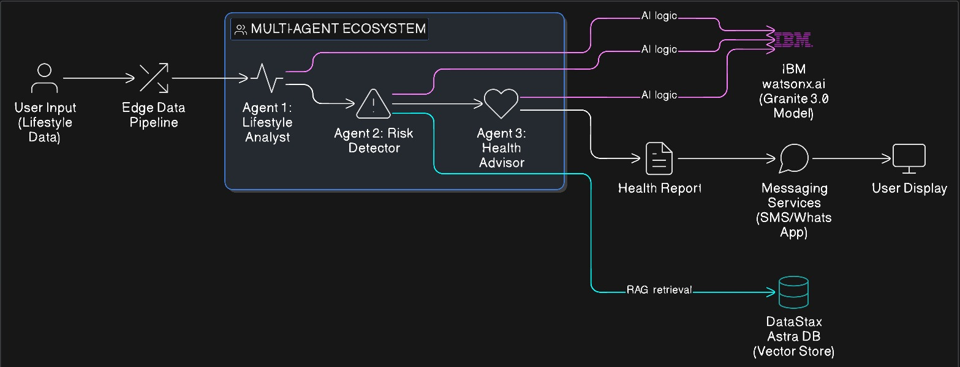
Technical flow diagram - Architecture blueprint

Slide 10
Langflow component Used
Chat Input
Collects user lifestyle data
Acts as the system’s starting point
IBM watsonx AI Agent
Core intelligence powered by IBM Granite
Analyzes data and detects preventive risks
File Component
Stores datasets and health guidelines
Supplies reference data for analysis (RAG)
Chat Output
Displays lifestyle summary and insights
Shows assistive, non-diagnostic suggestions
Prompt Template
Controls AI behavior and response format
Ensures ethical and consistent outputs

Slide 11
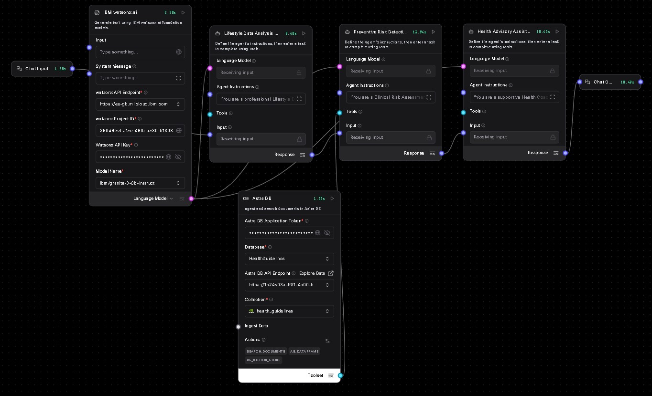
Input Screenshot 1

Slide 12
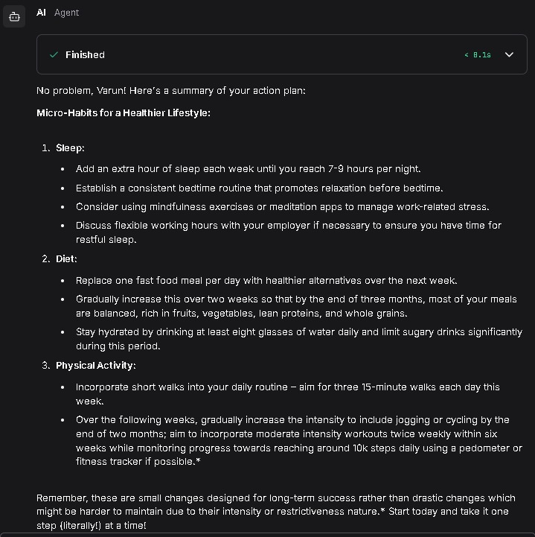
Output Screenshot 1

Slide 13
Future Scope
Direct Wearable Integration: Automatic data syncing from Apple Health, Google Fit, and Oura.
Expanded Knowledge Base: Scaling Astra DB to hold thousands of specialized guidelines for chronic disease management.
Physician Hand-off: A feature to export [RED] risk reports directly to a user's doctor.

Slide 14
Git Hub Link
https://github.com/varun95300/FitScore

Slide 15
References
IBM watsonx.ai documentation
https://www.ibm.com/products/watsonx-code-assistant?utm_content=SRCWW&p1=Search&p4=2373028861817&p5=e&p9=173891984084&gclsrc=aw.ds&gad_source=1&gad_campaignid=22029767454&gclid=Cj0KCQiAp-zLBhDkARIsABcYc6s6tONUla5z49sPmutlBfcn9nohENjT9ZRSOpnDW-dg44L2B4HriekaAmoBEALw_wcB
DataStax Astra DB Vector guides
https://docs.datastax.com/en/astra-db-serverless/get-started/vector-concepts.html
Langflow orchestration tutorials.
https://docs.langflow.org/

Slide 16


